Slide 1



Supporting Mobility Decisions with MapStore
Yanko Godaert

Slide 2
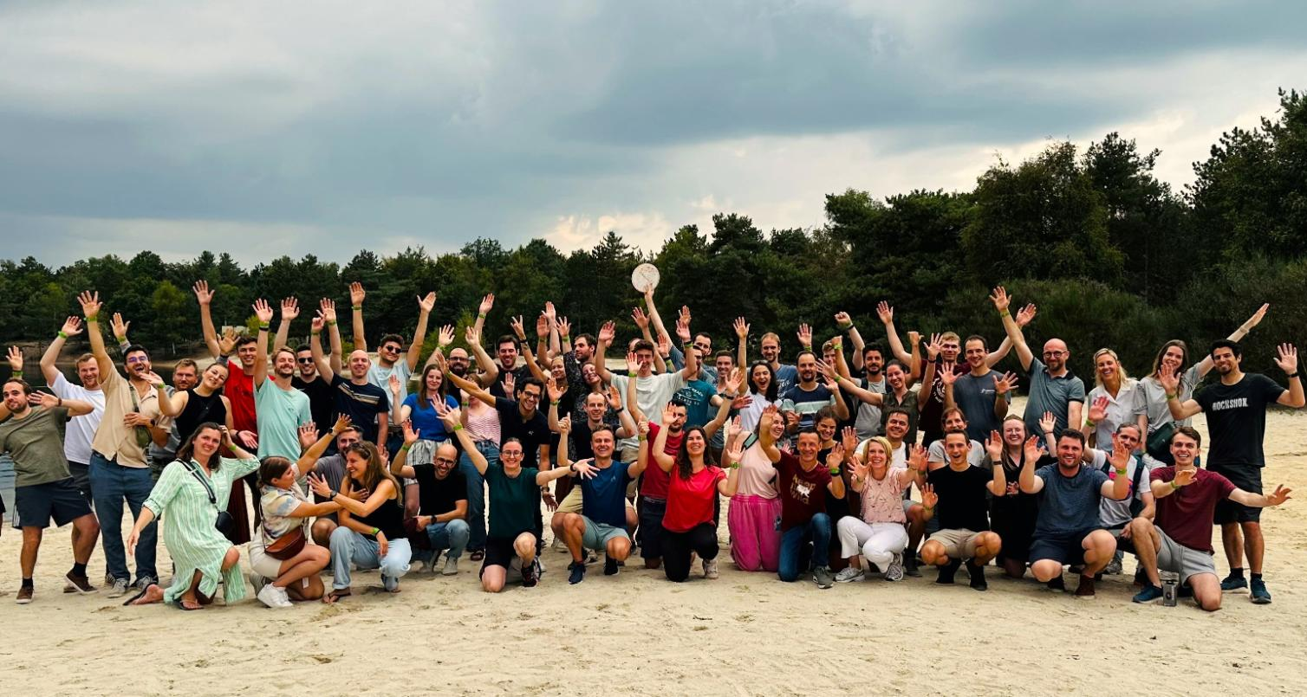



Slide 3
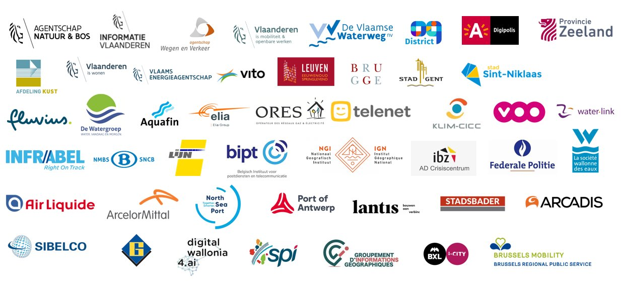
OUR CLIENTS
> 88
Notes:
> 350 !!

Slide 4

What is MapStore?

Slide 5
MapStore
Free & Open Source WebGIS software
GeoSolutions (🤌) product owner MapStore (& GeoNode, GeoServer, GeoNetwork core contributor)
Geoportal for creating, managing and sharing maps, dashboards, geostories
‘out-of-the-box’ lot of default GIS-viewer-functionalities
Advanced functionalities (widgets, timeline, dashboards, geostories, 3D, …)
Adaptive (desktop - mobile)
Highly customizable
Open Source
Extension framework
Downstream projects

Slide 6

MapStore@DMOW

Slide 7


Department of Mobility and Public Works (DMOW)
Governmental institution of Flemish government (Flanders region)
Make Flanders move along
85 000 km roads
1 000 km waterways
4 ports
>> big challenges in safe, smart and sustainable mobility policy making with adequate infrastructure
Highly-location related domain >> benefit from geo-data enabled decision-making
MapStore
GeoServer
GeoNetwork

Slide 8
MapStore@DMOW
4 y setup open-source web-GIS-infra
GIS-viewer: MapStore downstream project
Webservices: GeoServer
Metadata portal: GeoNetwork
Databases: PostgreSQL
Maps, dashboards & geostories for different use cases
Internal
Public
Maps & geostories
Embedded
Support contract GeoSolutions (Italy): feature requests, priority bug fixes & configuration support for MapStore, GeoServer, GeoNetwork
Role Geo Solutions (Belgium)
Not involved with initial setup (other projects)
Manage & support MapStore project
E&E data processing

Slide 9
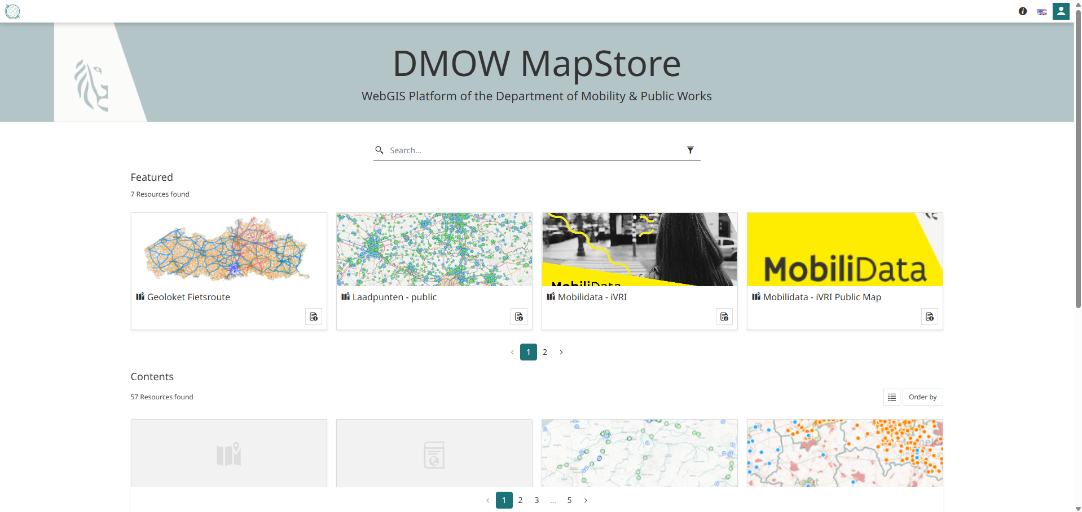
DMOW GIS Viewer

Slide 10
Case: Shared soft mobility
Transport region Antwerp:
Current situation of shared soft mobility (bikes & scooters) ?
Where can we improve? Which areas are underserved?
Processing
harvest all available open GBFS data
aggregate on different levels of administrative boundaries
enrich with number of inhabitants
entire Flanders region
Publish on GeoServer, with multiple styles
Create public MapStore map >> from open data to open data

Slide 11
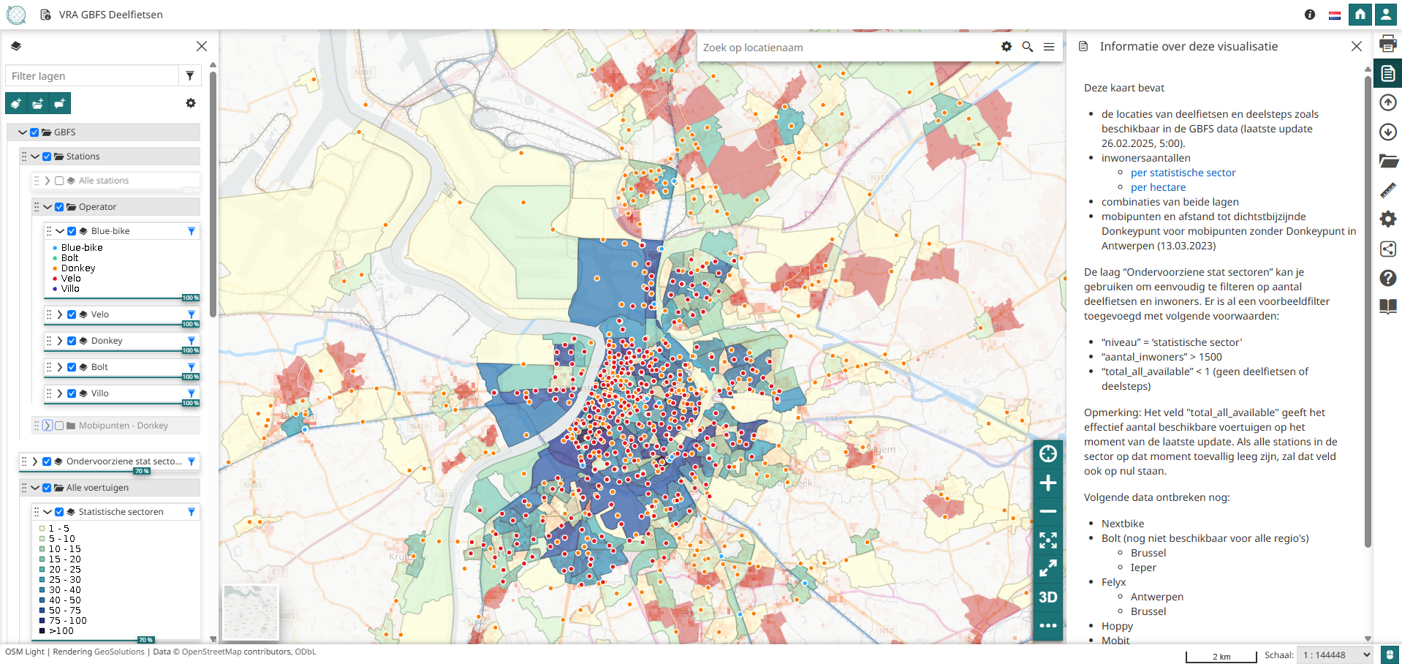
Demo: Shared soft mobility

Slide 12
Case: Intelligent Traffic Lights
Equip existing traffic lights with new smart technology
React smoothly and adaptively to road users at an intersection
Turning green faster or longer based on the actual traffic ahead
Two-way communication (e.g., emergency services)
Current situation
Active: 205
Under construction: 149
Scheduled: 63
MapStore goals
Manage data & status >> WFS transaction editing capability
Communication to citizens
Simplified public map view
Embedded on website

Slide 13
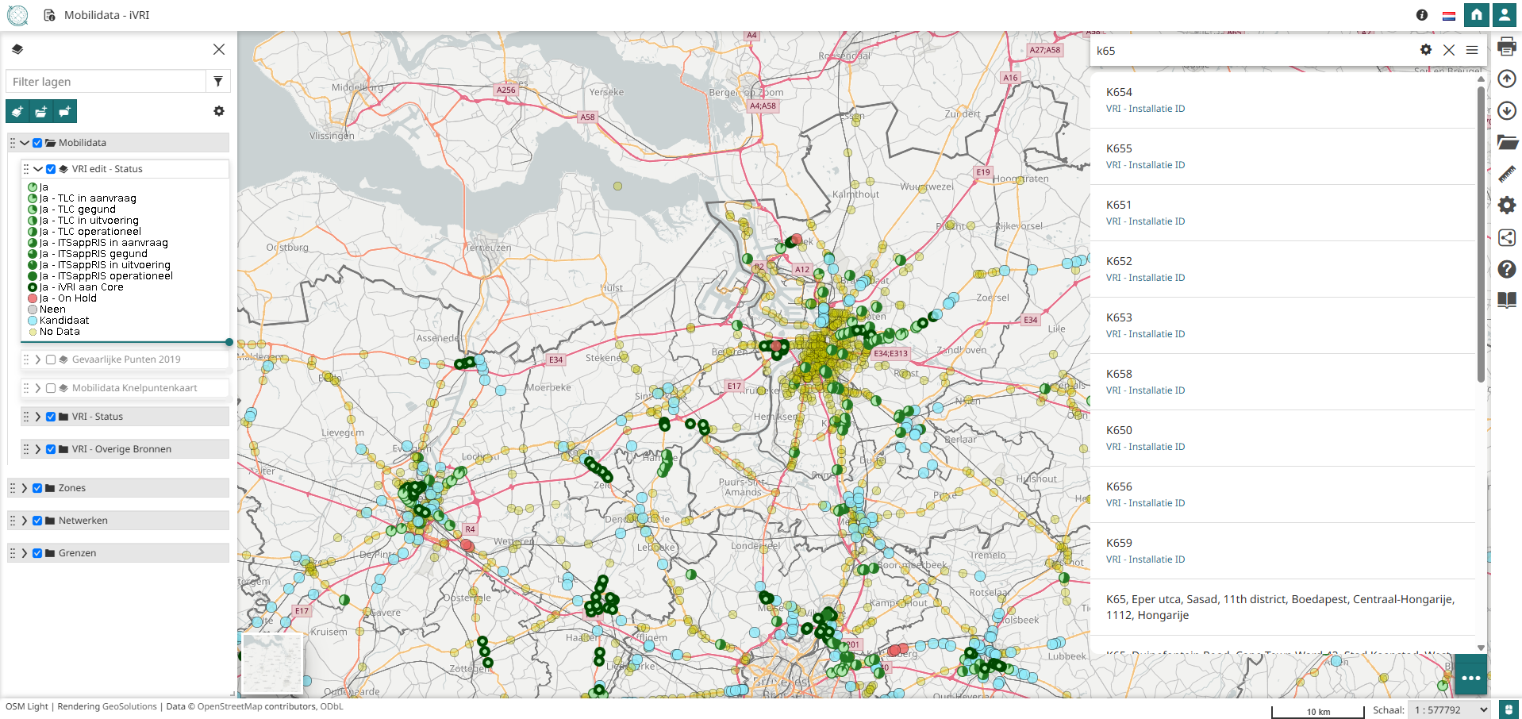
Demo: Intelligent Traffic Lights

Slide 14

Sidenote: Dutch translations
MapStore UI configured in Dutch
On every MapStore update DMOW
Checks & updates Dutch translations
Pushes translations to source code

Slide 15
Sidenote: Authentication
Default internal authentication service
LDAP/AD service
OpenID service
OpenID Connect
Default providers
Google
Keycloak
Custom ACM/IDM provider
https://authenticatie.vlaanderen.be
Login VO/Itsme
User management not in MapStore but external in ACM/IDM
>> generic (experimental) OpenID Connect provider

Slide 16
Case: PhotoViewer extension
Custom MapStore extension >> developed from extension framework
Functionalities
View a picture on a map, linked to attributes in a dataset
Implement routes
Navigation
Animation
Generic >> lot of use cases
Custom street view
Graphs of FCD travel times
Historical aerial photographs >> demo POC

Slide 17
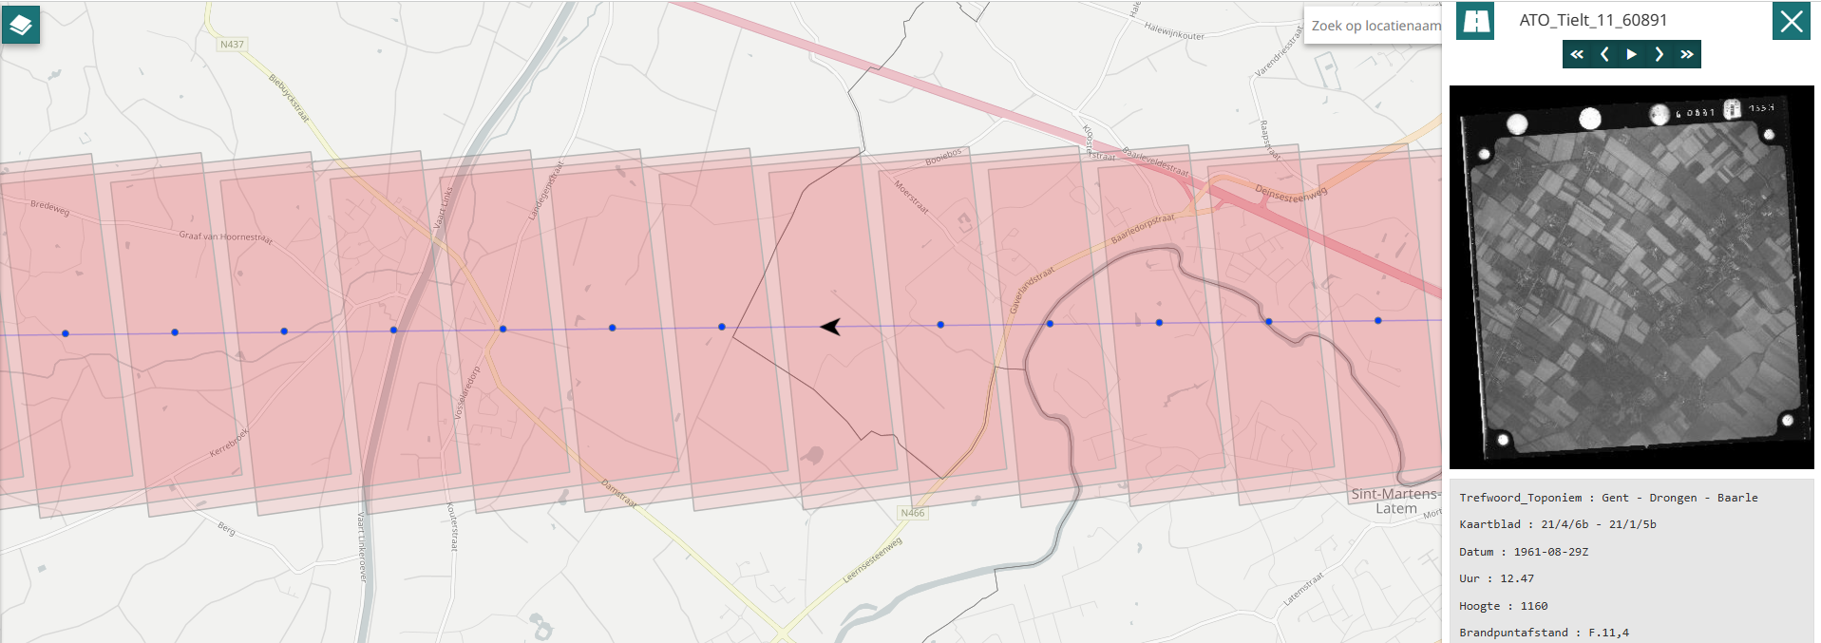
Demo: PhotoViewer extension

Slide 18
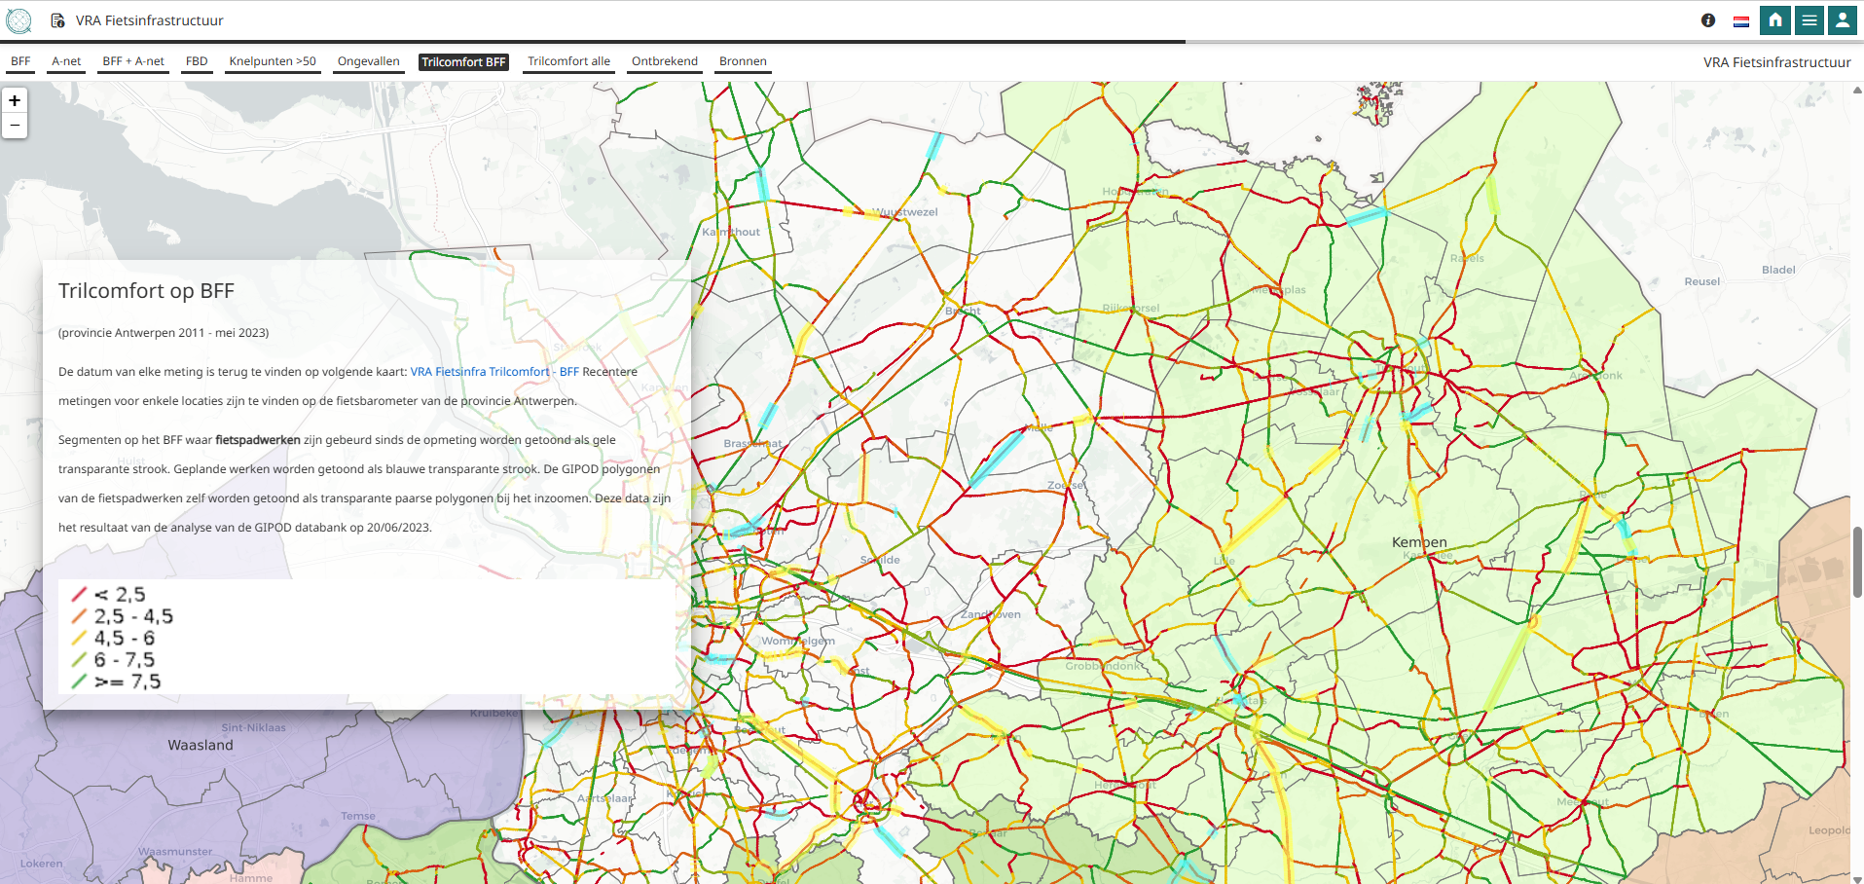
Case: Geostory bicycle infrastructure
Transport region Antwerp
Geostory to integrate a lot of complex location data in different maps into one thematic overview with extra contextual information in a Geostory
Integrated in reports >> publicly shared with citizens

