Slide 1
'brdr’ : Alignment of Geospatial Boundaries
A Python library aligning thematic geometries to reference borders
FOSS4G.be - 25/09/2025
Karel Dieussaert

Slide 2
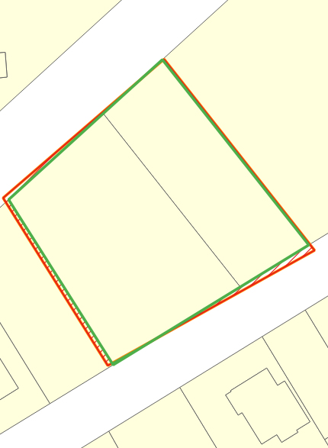
Agenda
'brdr’ : Alignment of Geospatial Boundaries
Why? The origin of the project
What? brdr (& brdrQ)
How? The algorithm
Use cases
FOSS4G.be - 25/09/2025
Karel Dieussaert
https://github.com/OnroerendErfgoed/brdr
https://github.com/OnroerendErfgoed/brdrQ

Slide 3

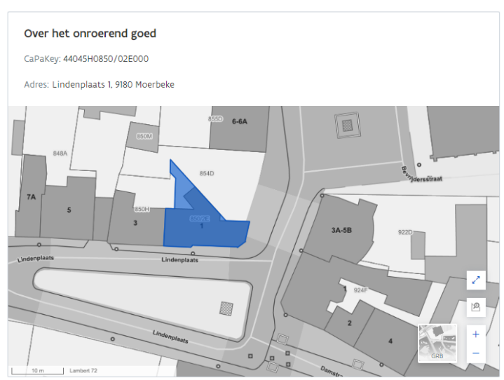

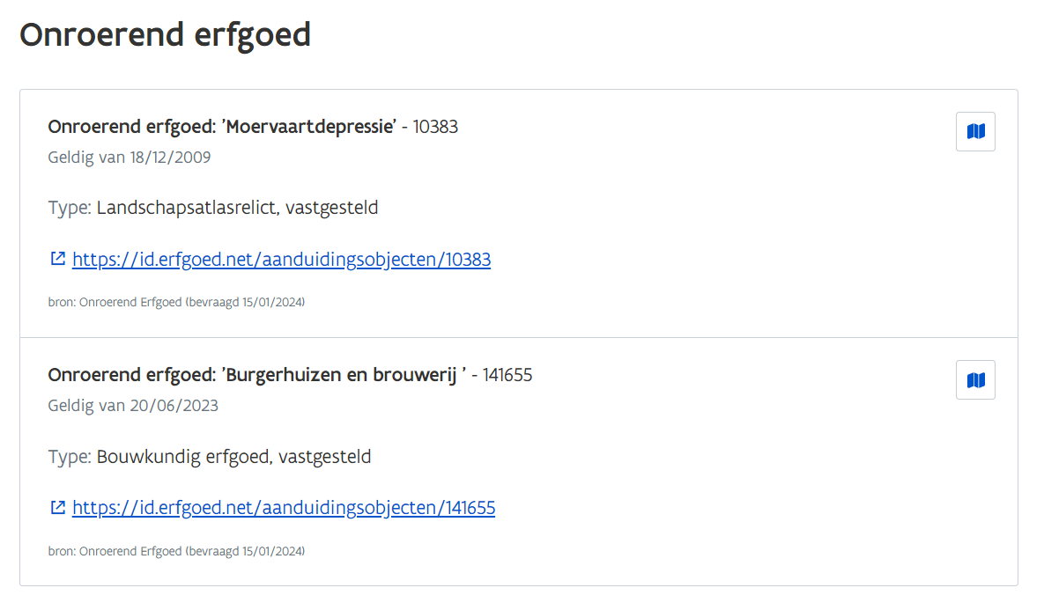
Why?
Source X
…………….
Exchanging spatial information
DATA SOURCES
…………….
Data Utility Company
Where is protected heritage?
Source:
Flemish Heritage Agency
…………….
Exchange of spatial information
Queries based on Geometry
Geodata quality is crucial (!)
Source Z
Data quality enhancement project
(partnership Athumi – Flemish Heritage Agency)

Slide 4
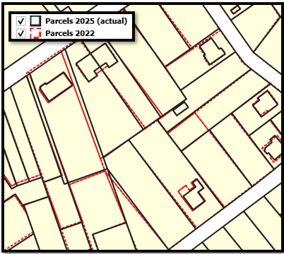
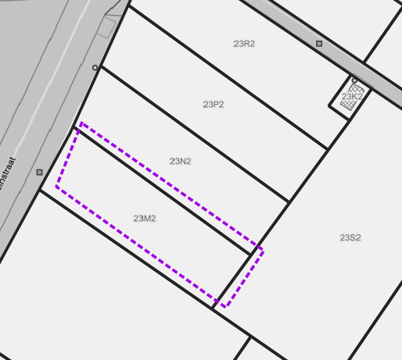
Geodata quality
No actualization =
Misaligned geodata

Slide 5
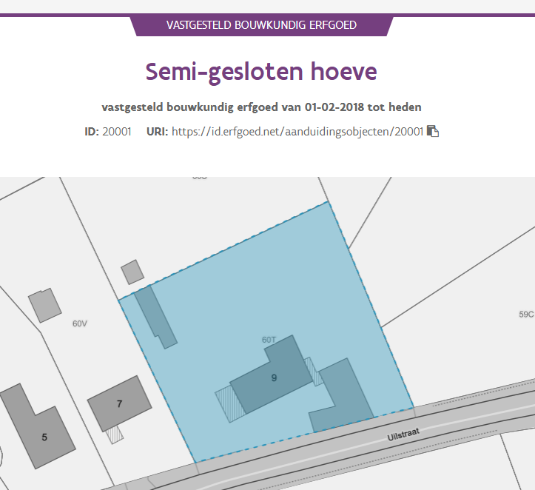
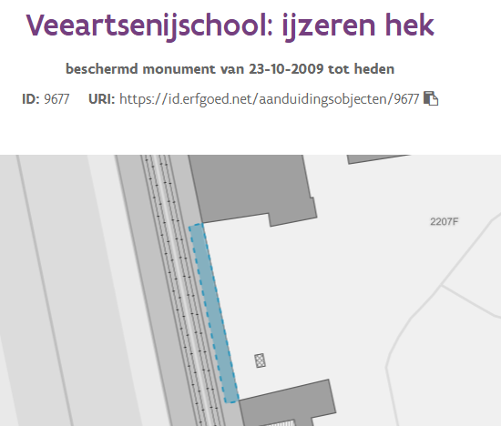
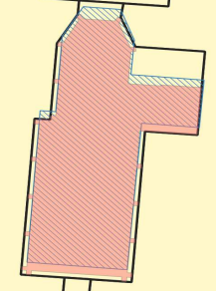
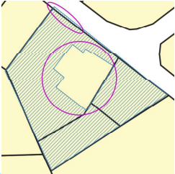
Flanders Heritage geodata
Very diverse
Basic (simple) case:
Contour based on 1 or more parcel
Other cases:
Contour based on other references (buildings, artwork,…)
Contour with donuts (‘inner holes’)
Contour covering ‘part of parcel’
Narrow structures (f.e hedges, facades,…)
Contour on Public Domain (no-reference)
➔ Generic solution for Geometry Alignment: ‘brdr’

Slide 6

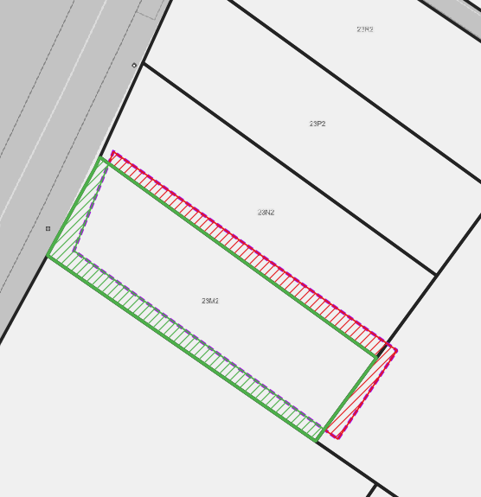
What is brdr?
Python package (available on PyPi & Github)
Open-source (MIT-license)
Goal:
Re-aligning (multi-)polygons to reference borders
Ensures consistency and quality in boundary datasets
Generic:
Not tied to a region or business
Algorithm (calculation) separated from GUI/applications
Integration webservice Flanders Heritage
‘brdr’ python package
QGIS plugin (brdrQ)
‘align’-algorithm
Proof-of-concept ArcGIS pro
Proof-of-concept FME
Integration backend
…
https://github.com/OnroerendErfgoed/brdr

Slide 7

‘brdr’ principles
BRDR
ALGORITHM
INPUT DATA(SET)
ALIGNED DATA(SET): PREDICTION(S) & DIFFERENCES
Intentionality:
intentional deviations can be retained
Conservation of shape:
re-use geometry of reference borders

Slide 8
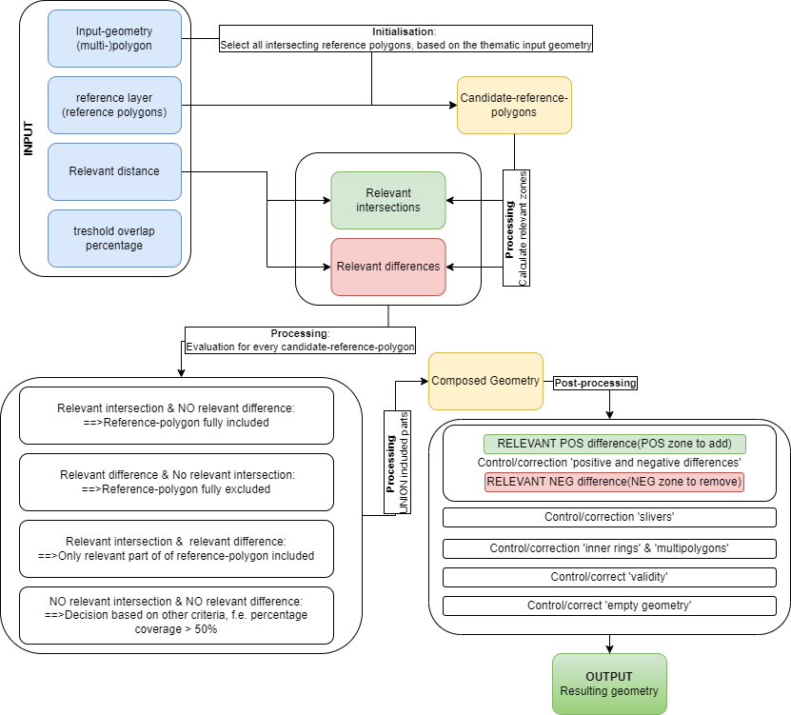
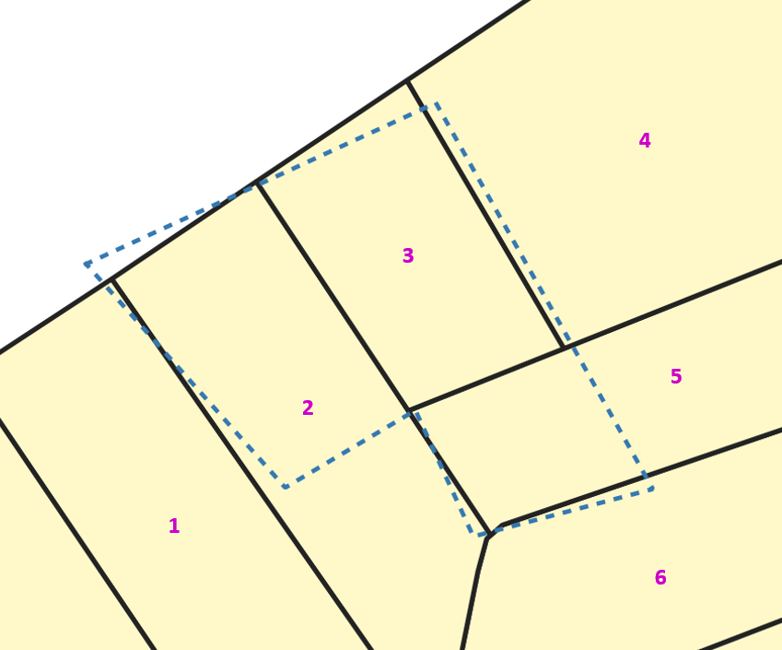
Alignment-algorithm (‘brdr’)
RELEVANCE =
...important, relevant (in a specific context). In short, relevant refers to a substantive contribution: a contribution that "matters"...
“Relevant distance”:
Distance used to determine which zones are included or excluded in the resulting geometry.
~Maximum distance that the resulting geometry may change.
Article (dutch): https://doi.org/10.55465/SXCW6218

Slide 9
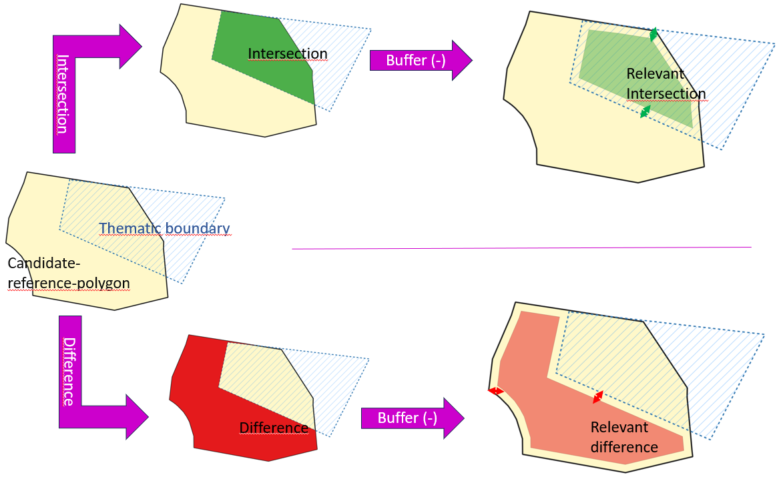
Alignment-algorithm (‘brdr’)
“Relevant zones”: Relevant intersection & relevant differences
-Relevant distance/2
-Relevant distance/2
Article (dutch): https://doi.org/10.55465/SXCW6218

Slide 10
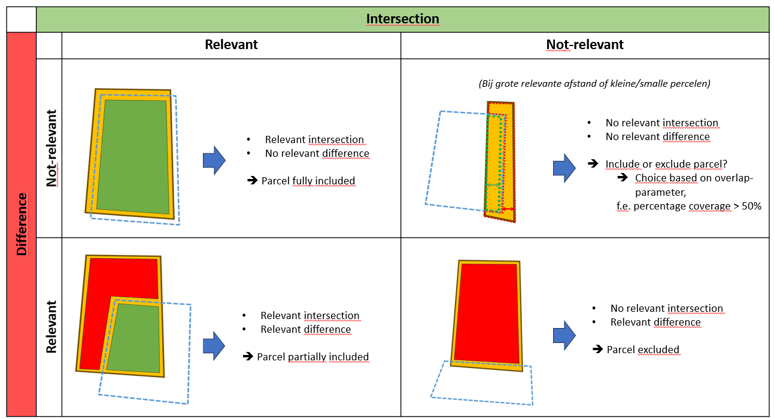
Alignment-algorithm (‘brdr’)
“Relevant intersections & relevant differences”
Artikel: https://doi.org/10.55465/SXCW6218

Slide 11
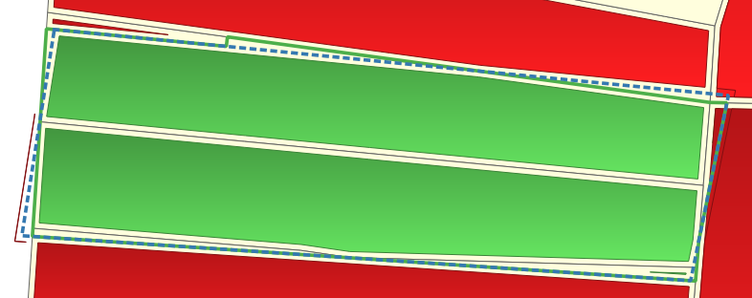
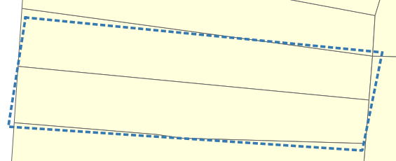
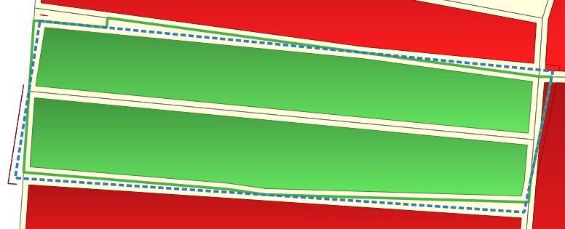
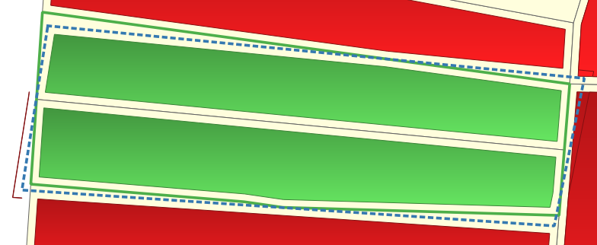
Alignment-algorithm (‘brdr’)
Relevant distance
0,6 m
Relevant distance
0,8 m
Relevant distance = data/business dependent
Dataset history
Geometry source
Accuracy
Object detail level
…
Relevant distance
(>) 1,0 m

Slide 12
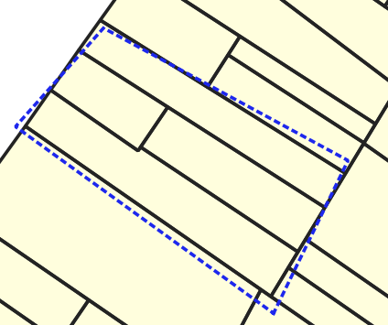
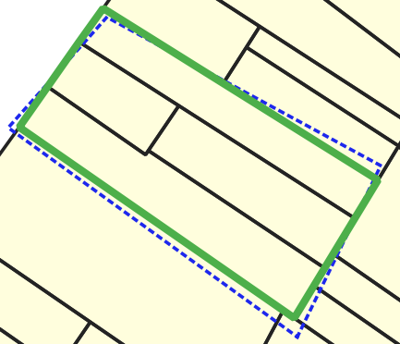
Alignment-algorithm (‘brdr’)
“How to determine this ‘relevant distance’?”
➔’brdr’ tries all !
PREDICTION
@ 4.8m

Slide 13
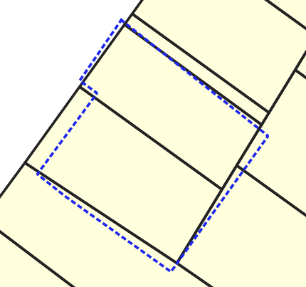
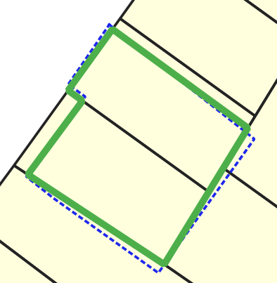
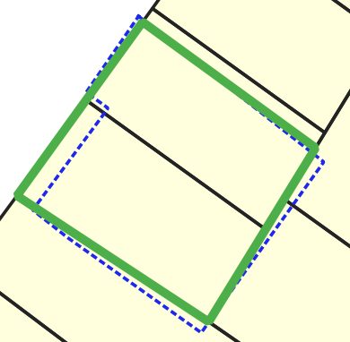
Alignment-algorithm (‘brdr’)
PREDICTION 1
@ 2.8m
PREDICTION 2
@4.4m

Slide 14
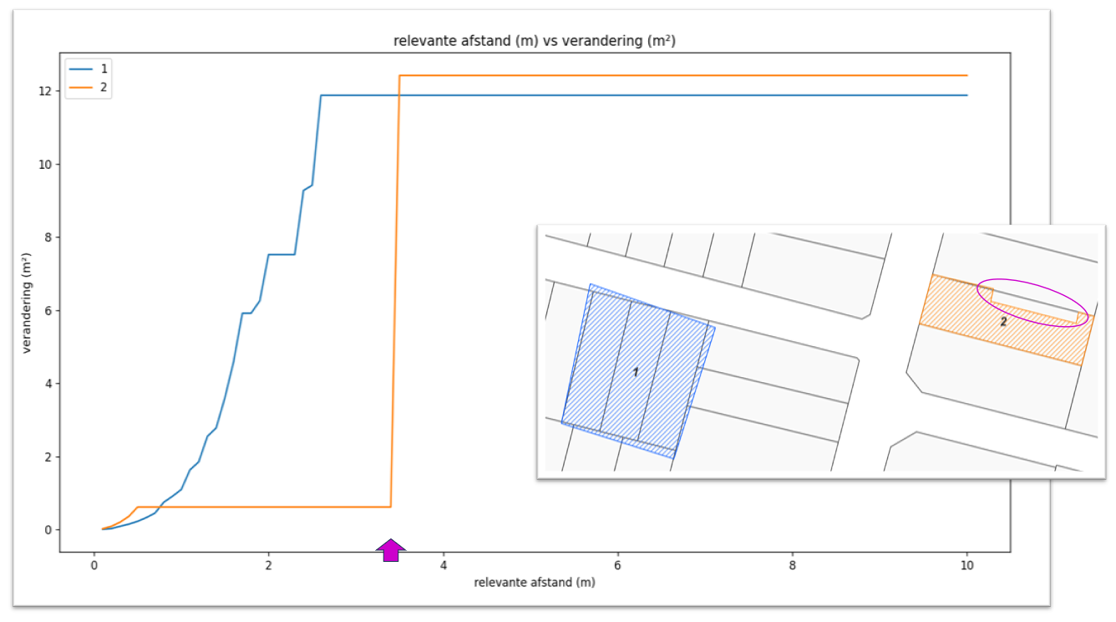
Predictions
Prediction 2
Prediction 1
Executing the algorithm with a series of ‘relevant distances’:
0,0.1, 0.2, …1...1.9,2
Prediction-score
Change measurement (m²) = Difference in area between input and resulting geometry
→CHANGE (m²)→
PREDICTIONS= ‘Stable’ results
Prediction 1
PREDICTION SCORE=
Length of stability
→RELEVANT DISTANCE(m)→

Slide 15
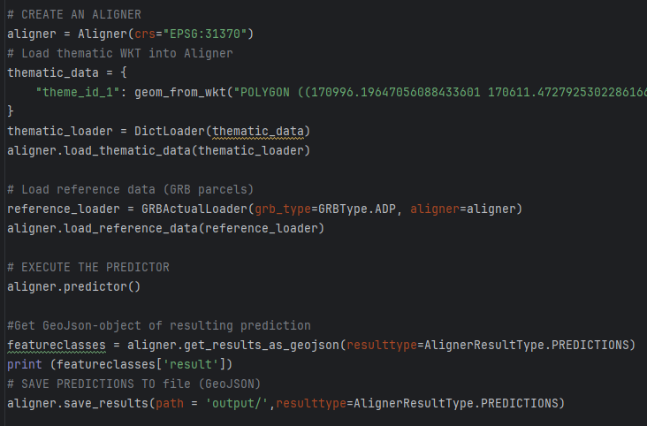
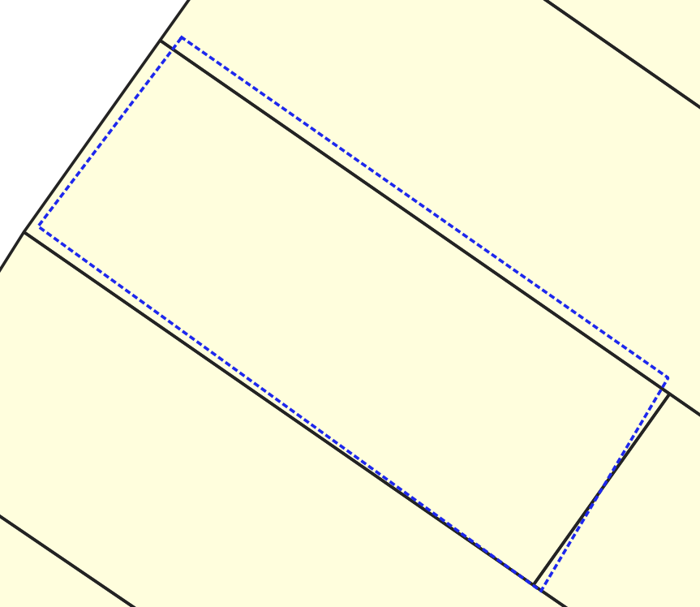
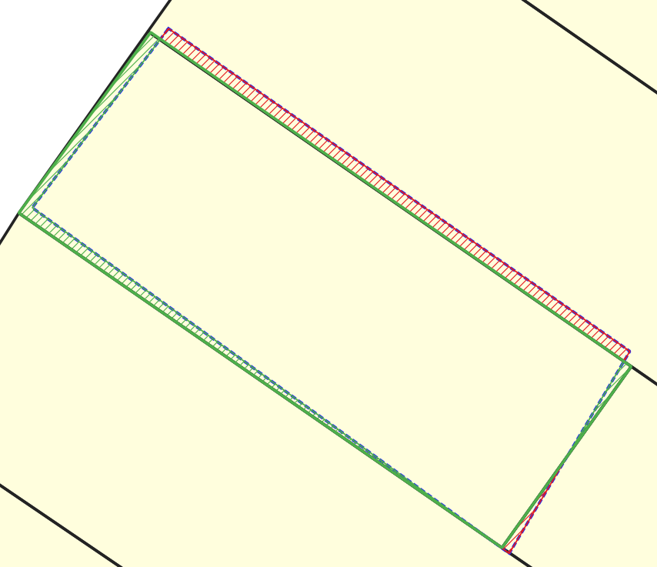
Basic Example (Code ‘brdr’ v0.14.0)
PREDICTION
@1.2m

Slide 16
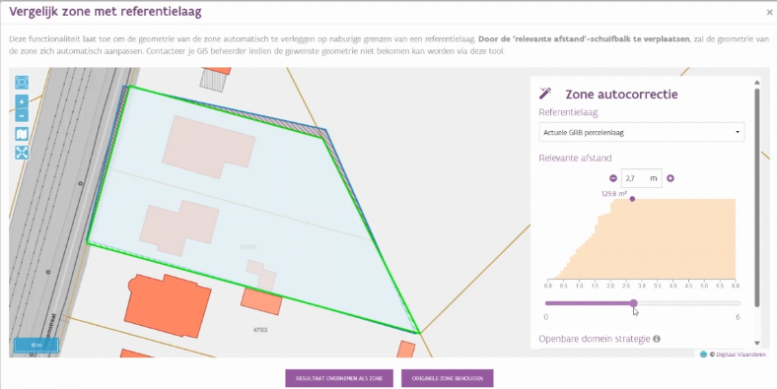
‘brdr’ for geodata-management Use cases
Implementation in business-processes, workflows and tooling (f.e brdrQ)
Bulk geodata-alignment
Feature-by-feature alignment: Predictions
Geodata-lifecycle-support: Automatic actualizations to newer version of reference-data
Alignment after reprojection :
f.e. Lambert72 -> Lambert2008
Data cleaning:
sliver-cleanup and validity
Version management:
Visualize differences between versions of geodata
Research & Data-Analysis:
Investigate the pattern in deviation and change between thematic and reference boundaries
…

Slide 17
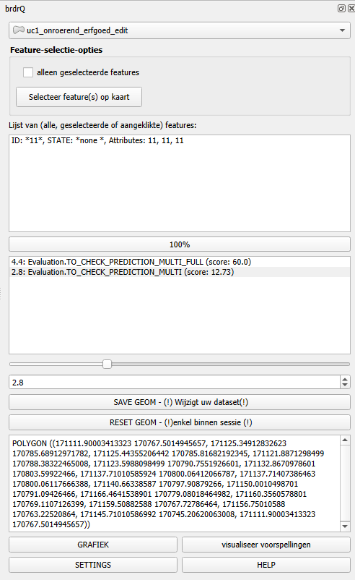
What is brdrQ?
1. Select Layer
Plugin for QGIS
UI to assist in aligning features
Uses ‘brdr’ for processing
Tools:
Bulk alignment
Feature-to-feature alignment (predictions)
Settings: preferences, strategies,…
Installation:
see instructions on https://github.com/OnroerendErfgoed/brdrQ
2. Select Feature
3. Select Prediction
4. Save/Reset
https://github.com/OnroerendErfgoed/brdrQ

Slide 18
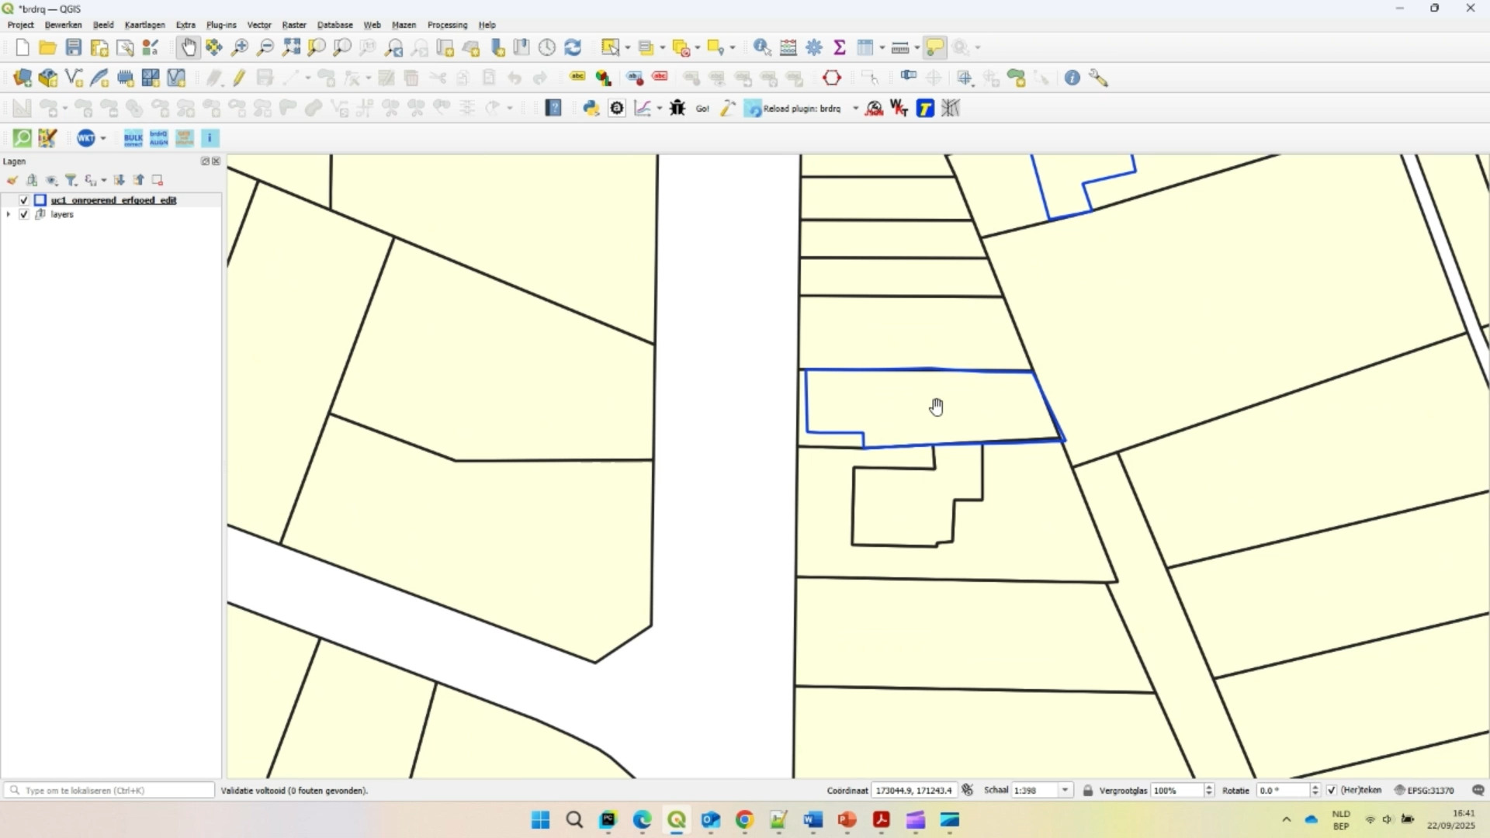
brdrQ

Slide 19
Future
brdr
Optimization of ‘brdr’ code base
Improvements based on user feedback
Documentation
Towards v 1.0.0
Enhancement: support for non-polygons
brdrQ
Improvements based on user feedback
Documentation
Towards v 1.0.0

Slide 20
Thanks! Questions?
Want to try?
Python package ‘brdr’: https://github.com/OnroerendErfgoed/brdr
QGIS – plugin brdrQ: https://github.com/OnroerendErfgoed/brdrQ
Project page (dutch): https://docs.athumi.eu/vip/help/grenzen-verleggen
Project report (dutch) : https://doi.org/10.55465/SXCW6218
Bugs?
Brdr - bug? → https://github.com/OnroerendErfgoed/brdr/issues
BrdrQ – bug?→https://github.com/OnroerendErfgoed/brdrQ/issues
Idea?→ discussion forum: https://github.com/OnroerendErfgoed/brdr/discussions/
Ideas/Improvement/Discussion
discussion forum: https://github.com/OnroerendErfgoed/brdr/discussions/
E-mail: <karel.dieussaert@vlaanderen.be><Karel.dieussaert@geosolutions.be >

