Slide 1
Service Analysis with Openrouteservice
Amandine Holemans

Slide 3
Agenda
Description of the project
Description of the tools
Openroadservice
QGIS and plugin
Dynamic temporal control
Step by step
Conclusion

Slide 4
1. Project

Slide 5
Analysis of Emergency service locations
In collaboration with SPI (Liège)
Purpose: Analyse the optimal configuration for the location of emergency services
Use of the Qgis project: Analyse, present and convince
Challenges:
Different types of required response time
Different types of possible scenario to present
Presentation made by nonuser of Qgis
Presentation:
Use of fictive data
Could be applied to different types of services

Slide 6
2. Tools

Slide 7
Openroadservice

Slide 8

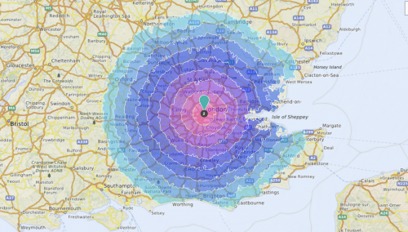
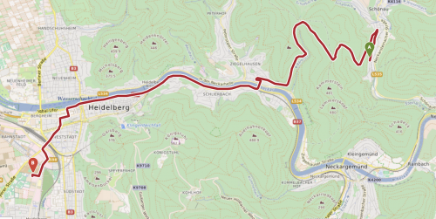
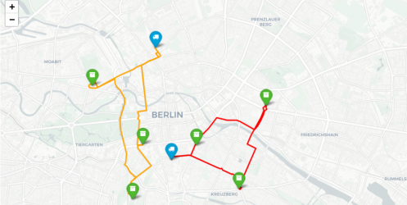
Openroadservice (ORS)
Description
A web API providing access to road network data and routing capabilities.
Powered by OSM data
Delivers road information and metadata
Supports route calculation and spatial queries
Based on open standards for easy integration (REST / OGC)
Enables smarter mobility
Source: https://openrouteservice.org/services/

Slide 9
Openroad Service (ORS)
Types of services
Isochrones
Direction
Optimization
Time-distance Matrix
Geocoding
Poi
Elevation
…
Source: https://openrouteservice.org/services/

Slide 10
Qgis and plugin

Slide 11

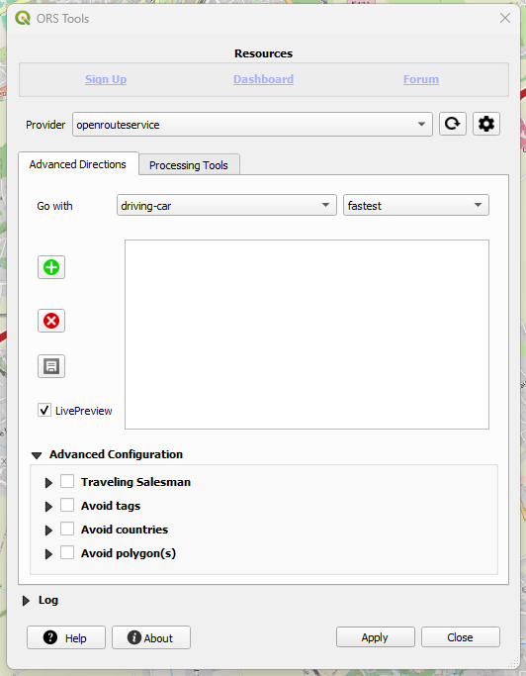
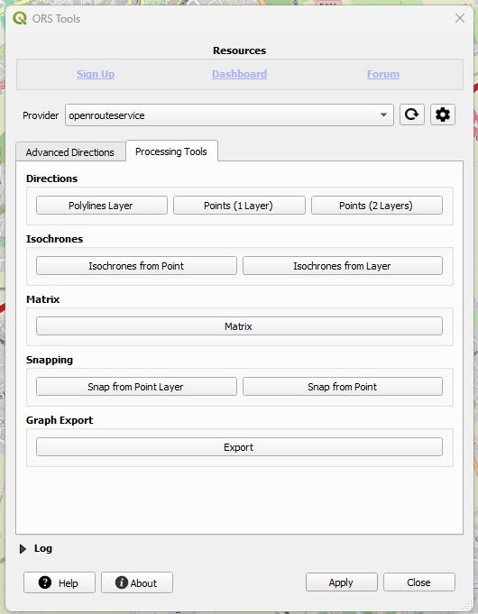
QGIS and ORS plugin
Easy to use, no API knowledge needed
Integrates all ORS tools
Free sign up required
Quotas by minutes and by days linked to the user (can be upgraded)
Main Endpoints | Total Quota Left | Quota per Minute
Directions | 2000 | 40
Export | 100 | 5
Isochrones | 500 | 20
Matrix | 500 | 40
Snap | 2000 | 100
https://account.heigit.org/manage/key

Slide 12
Dynamic temporal control

Slide 13
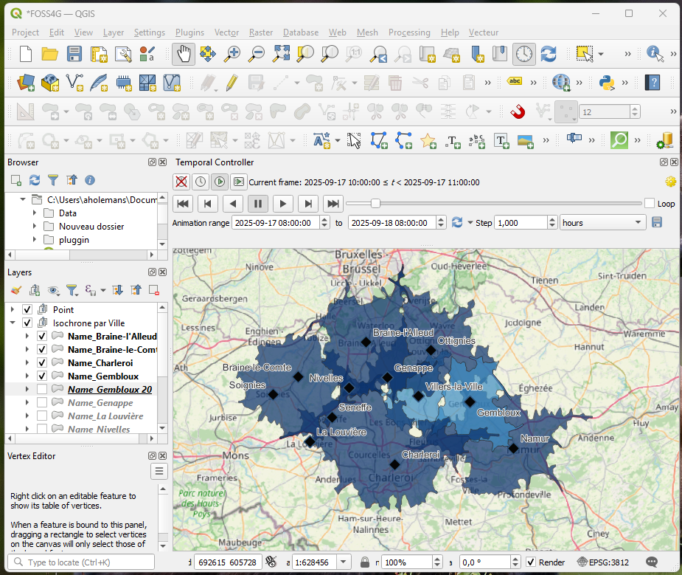
Presentation of the tool
Enable displaying layers according to a configured time range
Steps to configure:
Set the time range by layer (in the properties: by attribute or manually)
Enable temporal controller
Choose the time mode (fixed or animated)
Launch the animation (if selected)
Can export images
Notes:
Ajouter GIFF d’une animation si le temps

Slide 14
Specific use of this tool within this project
Should be used for evolution in time
Here used to present different scenario
Allow non-QGIS user to present different scenario quickly (no need to play with layers)
Switch a set of layer on and off automatically
Why not only use PDF ? Allow the user to improvise a scenario by activating other layers during the presentation if needed

Slide 15
3. Step by step

Slide 16
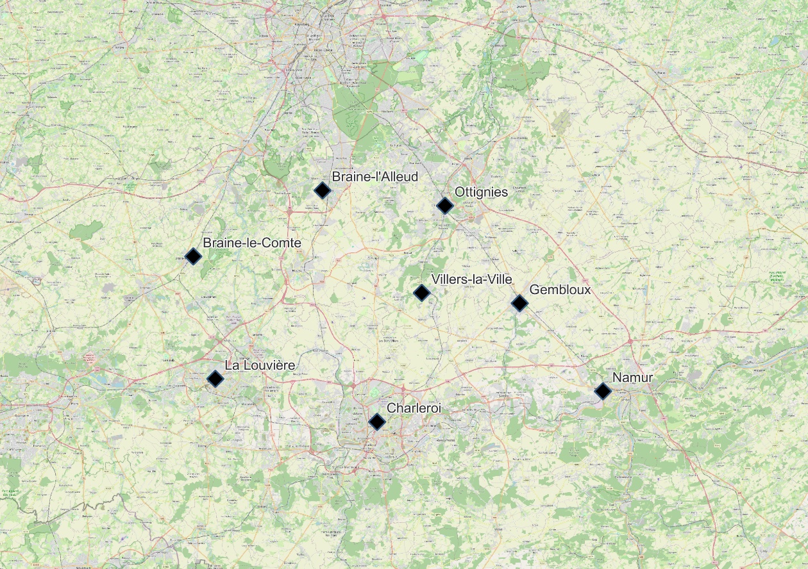
Step by step
Creation of the point layer for service centers

Slide 17
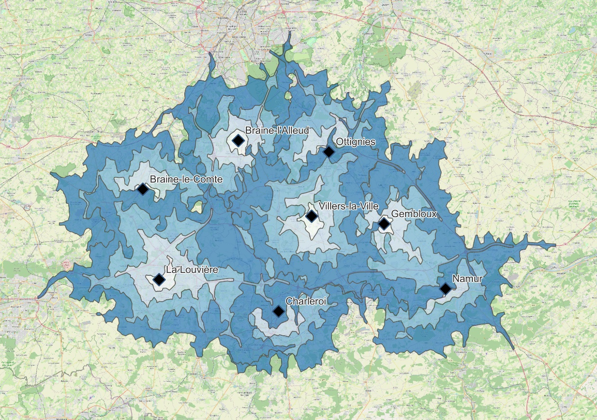
Step by step
Creation of the point layer for service centers
Creation of the isochrones (with ORS Plugin)

Slide 18
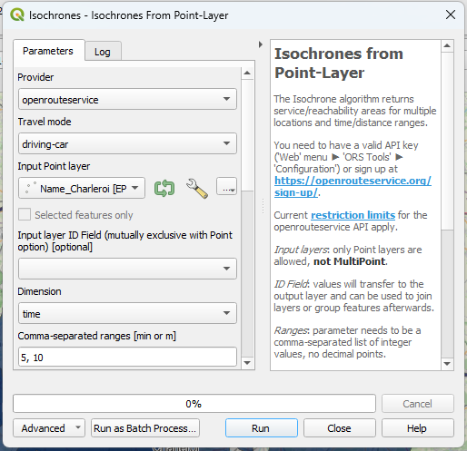
Creation of the isochrones
Parameters:
Isochrones from layer
Travel mode: Driving by car
Input point layer: Service centers
Input layer ID: Name
Dimension: Time
Ranges: 5, 10, 15, 20 min
(always better to avoid more time ranges at this step)
Location type: Start

Slide 19
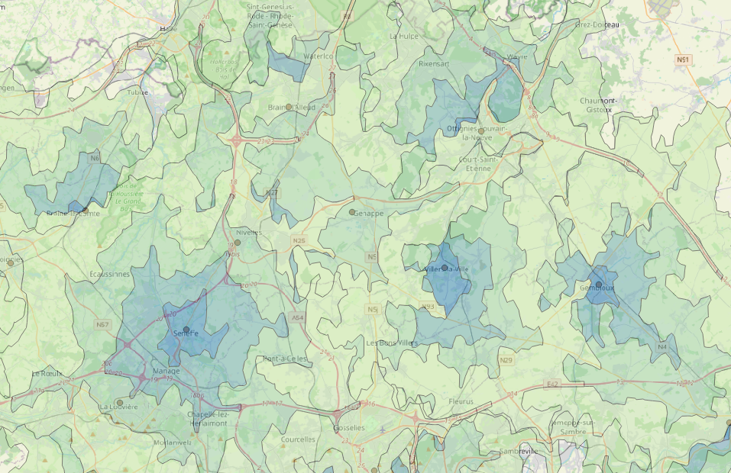
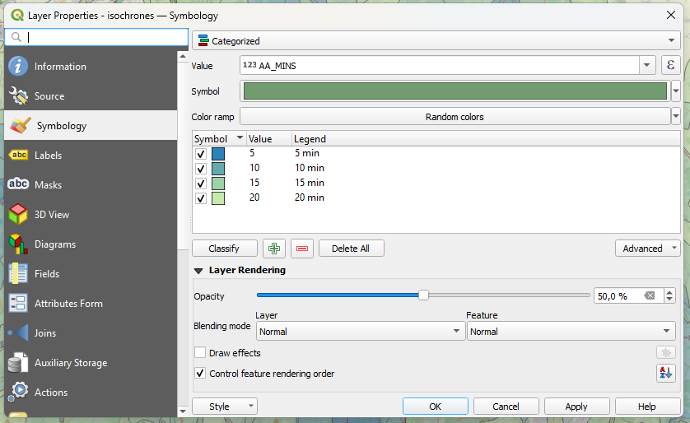
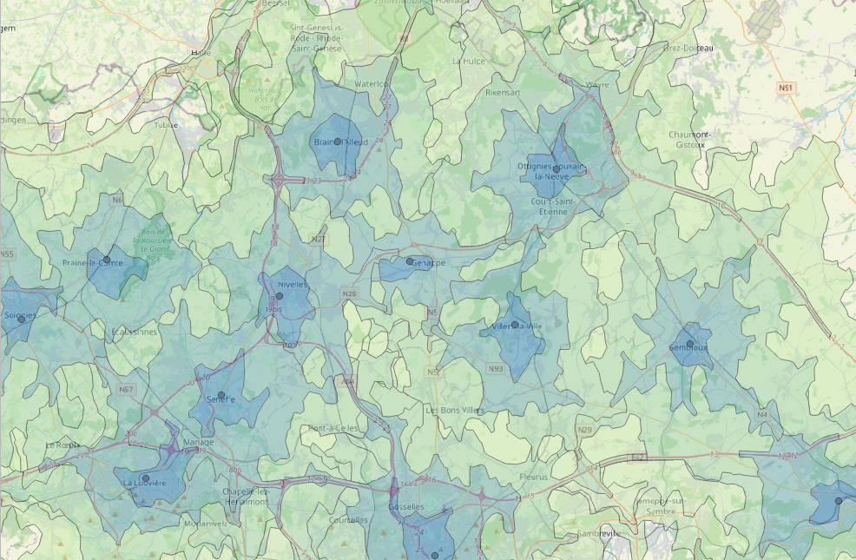
Good to know
Isochrones generated by ORS plugin are not ordered correctly
To display the smallest isochrones on top
→ Use the « Control feature rendering order » of the symbology panel

Slide 20
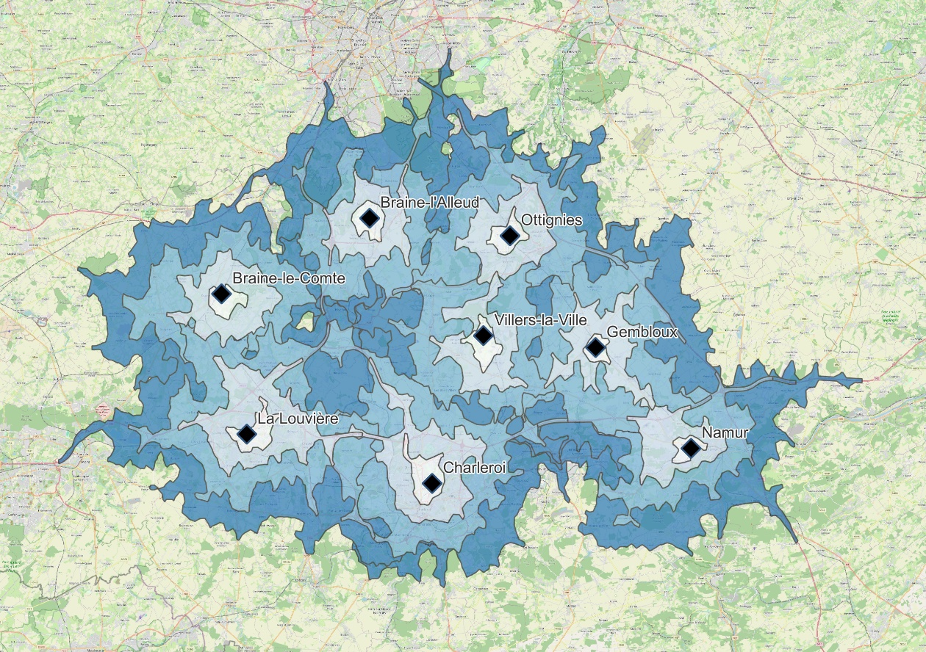
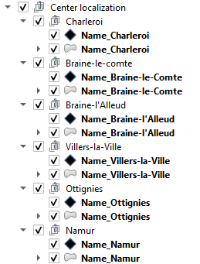
Step by step
Creation of the point layer for service centers
Creation of the isochrones (with ORS Plugin)
Split by center localization (Tool split vector layer) → One center : one layer

Slide 21
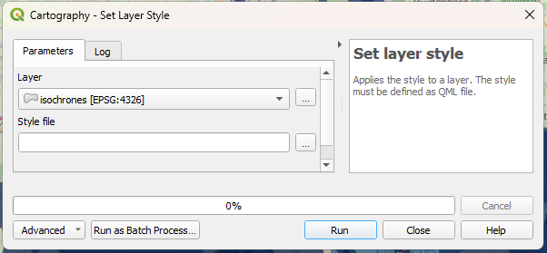
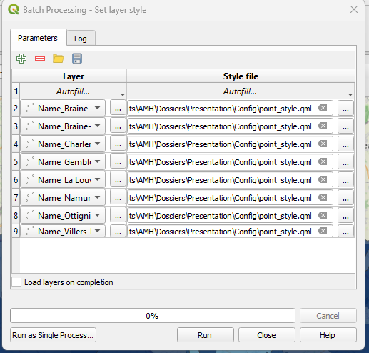
Good to know
Set layer style – Batch processing:
For the temporal control, need to split data by layer
To quickly change the style of all layers
Save a template of the style (.qml)
Tool: « Set layer style »
Batch processing option to apply the style to all layer at a time

Slide 22
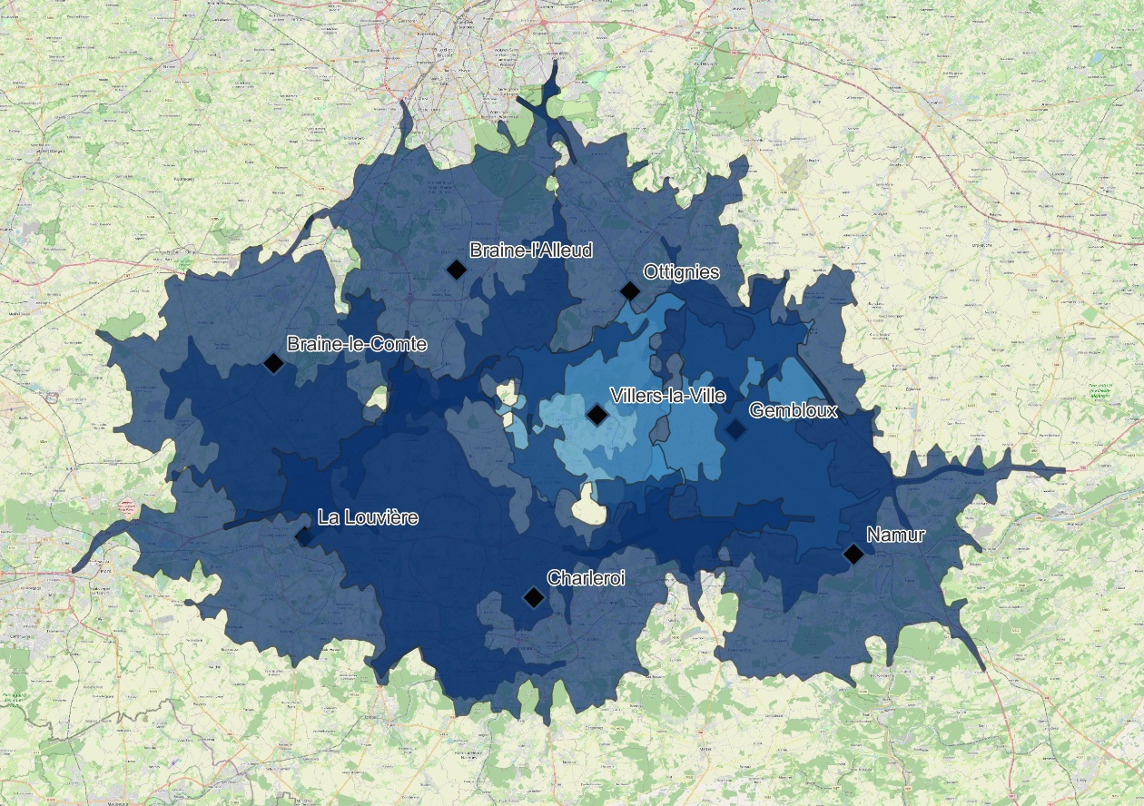
Step by step
Creation of the point layer for service centers
Creation of the isochrones (with ORS Plugin)
Split by center localization (Tool split vector layer) → One center : one layer
Choice of the time range by center (according to the center type)
Establishment of the temporal propriety

Slide 23
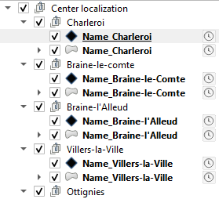
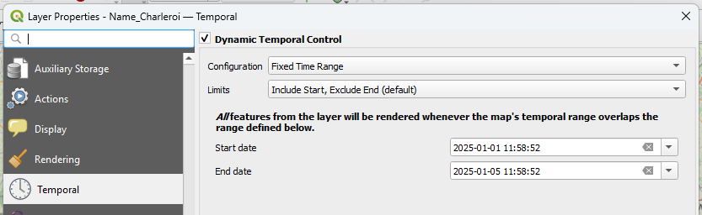
Apply scenario to temporal control
 | 01-janv | 02-janv | 03-janv | 04-janv | 05-janv
 | Scenario 1 | Scenario 2 | Scenario 3 | Scenario 4 | Scenario 5
Braine l'Alleud | x | x | x | x | x
Braine-le-Comte | 0 | x | x | x | x
Charleroi | x | x | x | x | x
Gembloux 20 | 0 | 0 | x | 0 | 0
Gembloux 15 | 0 | 0 | 0 | x | x
La Louvière | x | 0 | 0 | 0 | 0
Namur | x | x | x | x | x
Ottignies | x | x | x | x | x
Villers-la-Ville | 0 | 0 | 0 | 0 | x
Scenario fixed previously in a table
To use the temporal tool here
→ one day : one scenario
Set in the properties (can be set with attribute)

Slide 24
Step by step
Creation of the point layer for service centers
Creation of the isochrones (with ORS Plugin)
Split by center localization (Tool split vector layer) → One center : one layer
Establishment of the temporal propriety
Choice of the time range by center (according to the center type)
Configuration of the temporal dynamic control

Slide 25
4. Conclusion

Slide 26
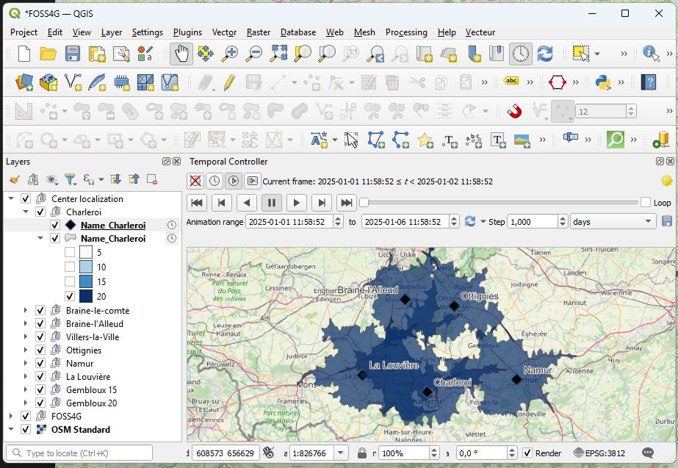
Conclusion
Use of QGIS and ORS
Easy to create – No API knowledge needed
Qgis project created: decision-making tool
Offers a customisable presentation → Ability to switch between scenario during the discussion and create new ones
Qgis project final output for the presentation

Slide 27
Any questions?

