Slide 1



THEME:
IMPLEMENTATION OF A DIGITALIZED INFORMATION SYSTEM FOR THE PROJECT “FINANCIAL INCLUSION OF MEMBERS OF VILLAGE SAVINGS AND CREDIT ASSOCIATIONS (AVEC) IN THE NAWA REGION
LAUNCH OF ACTIVITIES
Presented by:

Slide 2

Introduction
Financial inclusion, as a key driver of economic and social development, plays a crucial role in empowering vulnerable populations and growing local economies. In Côte d'Ivoire, rural populations, particularly women, have long faced difficulties accessing formal financial services, hampering their opportunities for economic growth and their participation in financial life. To address this challenge, the Ivorian government launched the National Financial Inclusion Strategy (SNIF 2019-2024), aimed at facilitating access to formal financial products and services for vulnerable populations. This study will aim to map all Village Savings Loan Associations (VSLAs) in the NAWA region.
In the following, we will present the methodological approach adopted, the digital mapping, the challenges encountered, and some recommendations.

Slide 3

Approach Methodology
Recruitment and Training of Agents: Selection of interviewers based on their experience and knowledge of the study area.
Organization of Data Collection: Distribution of work among sub-prefectures, collection method using CAPI (Computer Assisted Personal Interviewing) software called Kobotoolbox, and management of access constraints.
Data Collection Process: Collection period, logistical challenges (access to camps), and adaptation to new unlisted VSLAs.

Slide 4
Presentation of Digital Mapping (Webmapping)
Presentation of Digital Mapping (Webmapping): The objective of the online mapping is to visualize the distribution of AVECs and financial institutions in the Nawa region.
Data layers: Location of AVECs, financial institutions, and sub-prefectures. Using PostgreSQL and PostGIS.
Interactive Features:
Dynamic tooltips for each data point.
Advanced filtering by financial service type and sub-prefecture.
Spatial analysis with tools such as isochrones to measure accessibility.
Allons à la carte en ligne / Let's go to the online map

Slide 5
Some results obtained
Sub-prefecture | Number of WITH | Total number of members | Total number of women | Total number of men | Total amount of savings collected | Total loan amount | Number of banks | Number of microfinances | Number of AVECs with an account in a financial institution
OUPOYO | 96 | 2 820 | 2 219 | 601 | 316 388 800 | 200 514 020 | 0 | 0 | 25
GNAMANGUI | 179 | 5 285 | 3 434 | 1 851 | 739 491 290 | 614 995 950 | 0 | 0 | 22
MEAGUI | 209 | 8 750 | 6 369 | 2 381 | 642 950 870 | 485 075 315 | 4 | 4 | 50
TOTAL | 484 | 16 855 | 12 022 | 4 833 | 1 698 830 960 | 1 300 585 285 | 4 | 4 | 97
Analysis of results
Distribution of AVECs by sub-prefecture: Méagui is distinguished by a high concentration of AVEC and strong savings.
Geographic disparities: Méagui /Gnanmangui and Oupoyo, with less served peripheral areas.
Impact of accessibility: Isochronous analysis reveals that AVECs in Méagui benefit from better access to financial services, unlike those in Gnanmangui and Oupoyo.

Slide 6
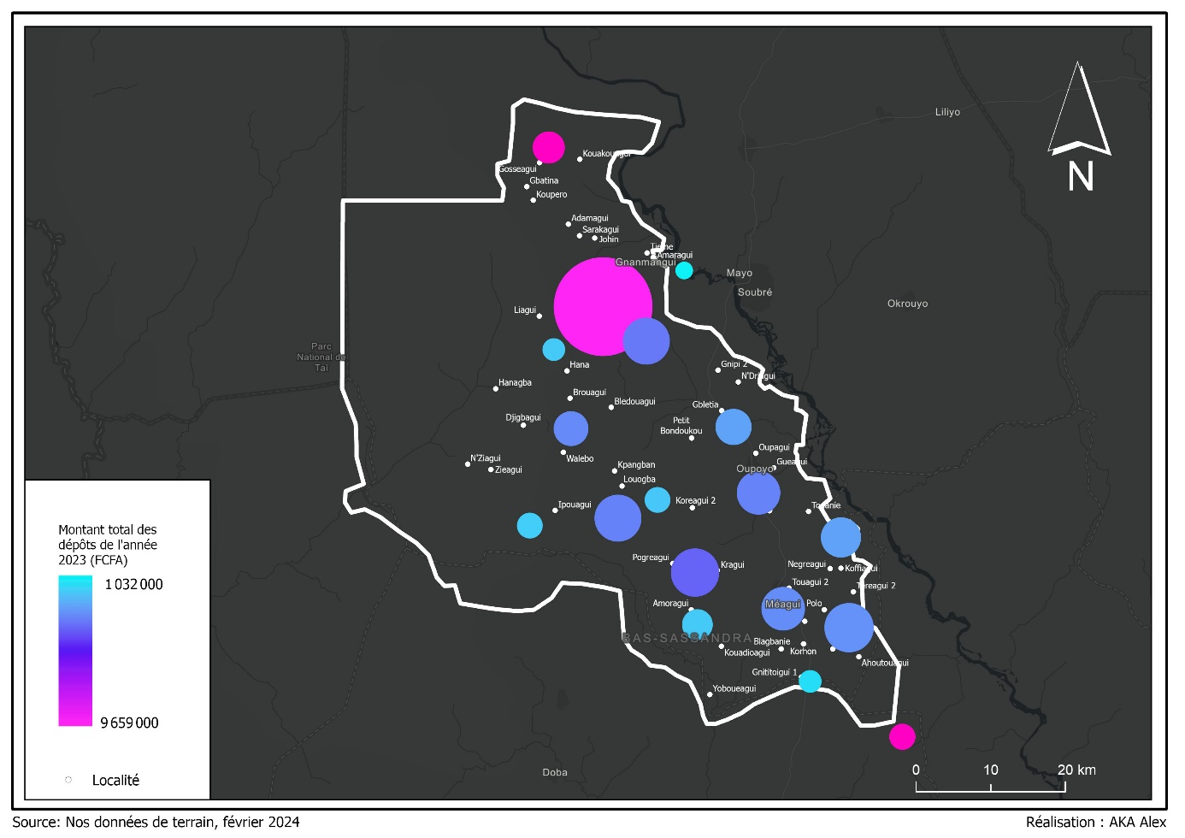
Some results obtained

Slide 7
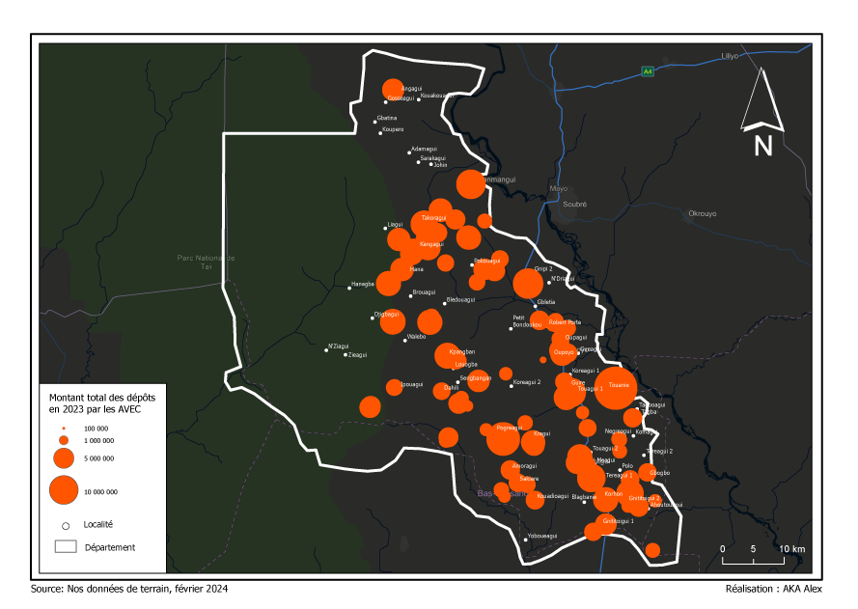
Some results obtained

Slide 8
Difficulties encountered
Discovering new WITH: Lack of updating of initial databases, making data collection time longer.
Adaptation to new data: Late integration of ECAM AVECs.
Accessibility of camps: Isolated areas and poor road infrastructure.

Slide 9
Recommendations
Regular updating of databases: To integrate new unlisted AVECs.
Improving access to remote areas: Use of solutions such as mobile agencies and other services
Strengthening AVECs in peripheral areas: Training and support for better fund management and easier access to financial services.

Slide 10
Method : Lightweight integration via iframe or dedicated HTML page
Add a link to the menu (for example: "Mapping WITH" or "Webmapping").
This link will redirect to a page embedding the map as an iframe or via an HTML file hosted in a subfolder on the server.
The web mapping project has been optimized for smooth navigation and compatibility with current web standards (HTML5, responsive design).
Steps to follow to integrate the map into the APIF website
Map hosting
Export the mapping project in web format (HTML + JS + data).
Upload this folder to the APIF server, in a directory similar to: https://apif.finances.gouv.ci/carto/avec/
Create a new Joomla article (or a new custom page)
In the Joomla administration:
Go to Content > Articles > Add a new article.
Title: Map of AVECs in Ivory Coast.
In the content, insert an iframe or script redirecting to the map:

Slide 11
Publish the article.
Create a dedicated menu in the navigation bar.
Go to Menus > Main Menu (or the one displayed at the top).
Click New.
Menu title: Webmapping AVEC or Cartography AVEC.
Menu type: Link to an article.
Select the previously created article.
Save and publish.
It can also be placed in the "PROJECTS" or "PUBLICATIONS > Statistics" menu, depending on APIF's wishes.
Display Verification
Test the display on:
Computer
Tablet
Smartphone
Ensure the map is responsive (adapts to the screen size). If not, adjust the <iframe> dimensions or switch to a redirect to a full-width page.
Security and Performance
Ensure that the hosted files are HTTPS-enabled.
Add an .htaccess file if necessary to control access to sensitive resources.
Optionally, minify JS/CSS files to speed up loading.
Advantages:
Quick and easy integration without modifying the existing site structure
No advanced server configuration required
Fast and responsive map loading
Easy maintenance (updates by simply replacing files)

Slide 12
Presentation by :
Olivier Cauphy ABON’GO
CEO
ANGEL TECHNONOLOGY (ANGETEC)
Côte d’Ivoire: (+225) 0709007076 / 0140222525
Belgique: (+32) 0498400583
o.abongo@angeltechnology,ci
www.angeltechnology.ci
Thank you

