Slide 1

bePelias: un géocodeur local basé sur BeStAddress
Vandy Berten – Smals Research – 25-09-2025

Slide 2







Smals – ICT for Society
Support for e-government
Knowhow
Development
www.smals.be
Staffing
Infrastructure

Slide 3
Geocoding: concept
Geocoding = (1) Address standardization + (2) Geolocation
Geocoder = API (Application Programming Interface)
“Av. Fonsny 20, 1060 Bruxelles”
(1) Address standardization:
Data quality:
Standardization
Deduplication
Matching
Auto-completion (type-ahead)
…
{“street” : “Avenue Fonsny”,
“housenbr”: “20”,
“zipcode” : “1060”,
“city” : “Saint-Gilles”,
“country” : “Belgique”,
“location”: [50.8358,4.3361]}
(2) Geolocation:
Visualization
Controls
Spatial (GIS) analytics
…
Or polygon
Notes:
Note: we exclude POI search from our definition (exm: « Smals, Brussels »)

Slide 4
Geocoding: concept
Address standardization = Mapping
Geolocation = « side effect »/bonus
“Av. Fonsny 20, 1060 Bruxelles”
Street | Number | Zipcode | Locality | Location
… | … | … | … | …
Avenue Fonsny | 20 | 1060 | Saint-Gilles | 50.8358, 4.3361
Avenue Fonsny | 22 | 1060 | Saint-Gilles | 50.8359, 4.3358
… | … | … | … | …
{“street” : “Avenue Fonsny”,
“housenbr”: “20”,
“zipcode” : “1060”,
“city” : “Saint-Gilles”,
“country” : “Belgique”,
“location”: [50.8358,4.3361]}

Slide 5






Tools
Cloud commercial providers:
Here we go
Bing maps
Google maps
TomTom
Sometimes free in specific conditions
Mainly 2 open-source/open-data solutions:
OpenStreetMap/Nominatim
Photon (OSM + ElasticSearch)
On-premise possible for a specific region

Slide 6

BeSt Addresses
BeSt Addresses: BOSA project providing an authentic source for Belgian addresses
Gathering regional authentic sources: UrbiS, Adressenregister (ex CRAB), ICAR
Each address has a (stable) id which should be used in other applications
Can be used either through file download (public) or via API (public/eGov)
https://bosa.belgium.be/fr/services/best-address-services

Slide 7


Our constraints
We needed a geocoding API:
Local/on-premise
Based on BeSt Address (SPF BOSA)
Not written from scratch
Accepting large volumes
Three options so far:
PhacochR (Obs. de la santé et du Social BXL + ULB/IGEAT) 🡪 Not an API (a batch R library)
BOSA API 🡪 Until recently, no fuzziness at all
Pelias + BeSt 🡪 Outdated/poor data, low robustness

Slide 8
Pelias
Open source: https://github.com/pelias/docker (projects > belgium)
Data-source problems (in 2023):
Based on OpenAddresses.io version of BestAddress CSV files (https://batch.openaddresses.io/), but due to some incompatibility, not updated since Feb 2021
Pelias still uses an old OpenAddresses dataflow, deprecated mid-2021
Poor data: partial best Id, no translation, no box numbers…
Robustness problem:
If structured version doesn’t work, sometimes unstructured version does (and vice-versa)
If none works, some simple transformations often allow matching:
{“postalcode”: 1160, “locality”: “Auderghem”} 🡪 {“postalcode”: 1160}
Cleansing text, removing parenthesis in street, non-digits in housenumber…

Slide 9

bePelias
BestAddress csv files
{'street' : '...', 'postalcode': '…'}
Match?
yes
Standardize
no
‘addr’: ’…’
Check+Match?
yes
Transform:
Regex (street, nbr)
Skip city name
Skip housenumber
no
Based on a new dataflow from BestAddress, by-passing OpenAddresses.io
“Match?”= “is a building”. If no transformer gives a building match 🡪keep the best one
If coords = 0,0 🡪 call interpolation engine

Slide 10
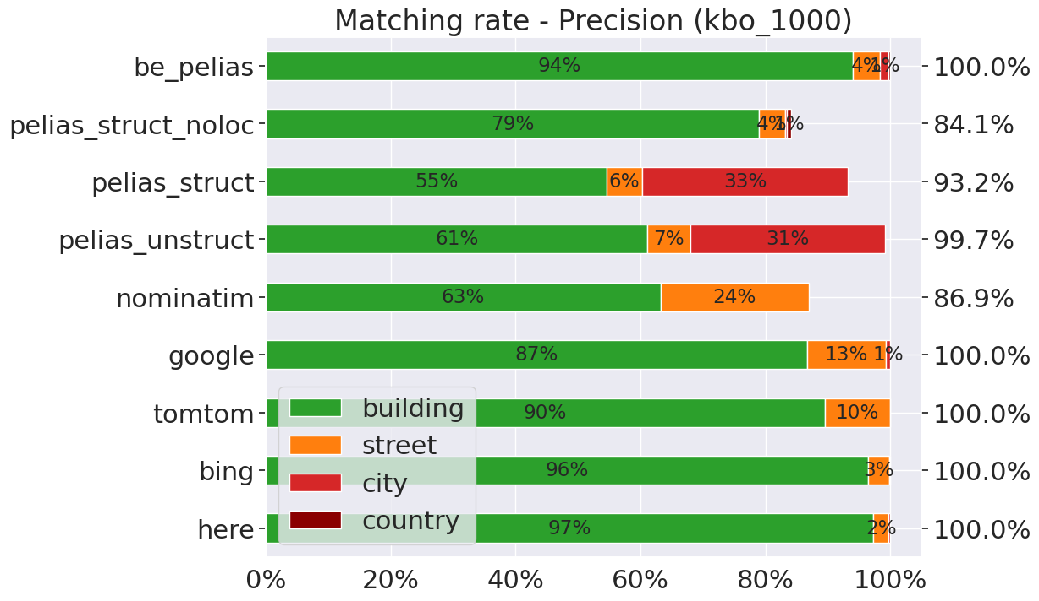
bePelias: Matching rate
OS/on-prem

Slide 11
Performances
Giving an answer does not make this answer to be correct!
Ideal situation: testing against a reference address list. But:
Building such a list is complex!
List will be (intrinsically) biased
🡪 We propose a methodology based on a “majority vote”

Slide 12


Methodology
Collect a (not too clean) address dataset 🡪 1 000 addresses from KBO
Send this dataset to several coders 🡪 here, bing, nominatim, google…
Use median point for each address as reference, with some conditions:
Enough (precise) matches 🡪 957 with ≥ 3/7 “building” matches
Enough answers close to median 🡪 932 with ≥ 3/7 within 100 m
Compute misc. stats about « distance to median point »

Slide 13
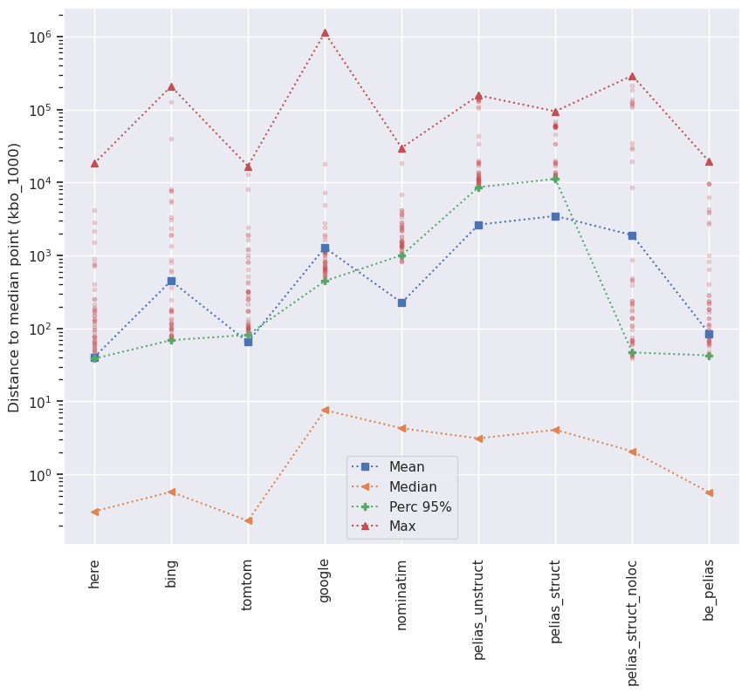
Distance to median point
OS/on-prem
The lower the better!
! No stats if no building level results
🡪 « bad » geocoders are even worse
Notes:
Pelias : souvent city-level
Nominatim: souvent street-level (! Pas de stats calculées quand pas de résultat)

Slide 14
Deployment
Available on https://github.com/SmalsResearch/bePelias/
Docker + Python + FastAPI
Deploy :
./scripts/build.sh # Build pelias & bepelias docker images (~30 minutes)
./scripts/feed.sh # Prepare files from Bosa and load them (~1h30)
./scripts/run.sh # Run Pelias and bePelias API (with default parameters)
Many variants (one region, update data, two-machines build…)
Live (test) instance available on request
Unstructured mode available

Slide 15
Call
https://[host:IP]/REST/bepelias/v1/geocode? streetName=Avenue+Fonsny&houseNumber=20&postCode=1060&postName=Saint-Gilles
{ items: [{
bestId: "https://databrussels.be/id/address/219307/7",
street: {name: {fr: "Avenue Fonsny", nl: "Fonsnylaan"},
id: "https://databrussels.be/id/streetname/4921/2"},
municipality: {name: {fr: "Saint-Gilles", nl: "Sint-Gillis"},
code: "21013",
id: "https://databrussels.be/id/municipality/21013/14"},
postalInfo: {name: {fr: "Saint-Gilles", nl: "Sint-Gillis"},
postalCode: "1060"},
housenumber: "20",
status: "current",
coordinates: {lat: 50.83583, lon: 4.33845},
precision: "address"}],
total: 1,
callType: "struct",
inAddr: {address: "Avenue Fonsny, 20",
locality: "",
postalcode: "1060"},
peliasCallCount: 3,
transformers: "clean;no_city",
self: "..." }

Slide 16
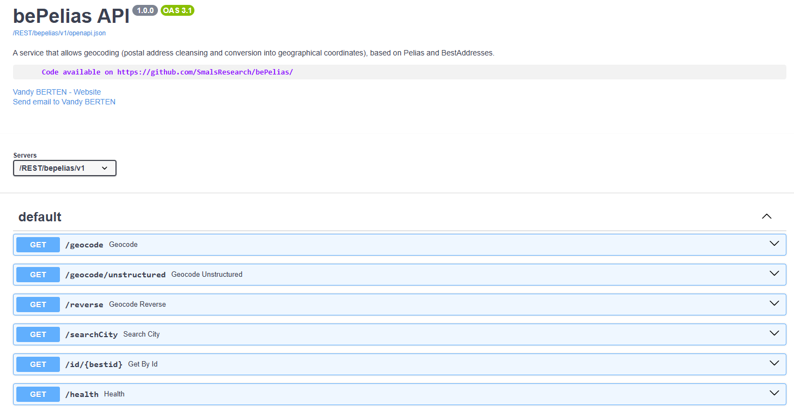
OpenAPI

Slide 17
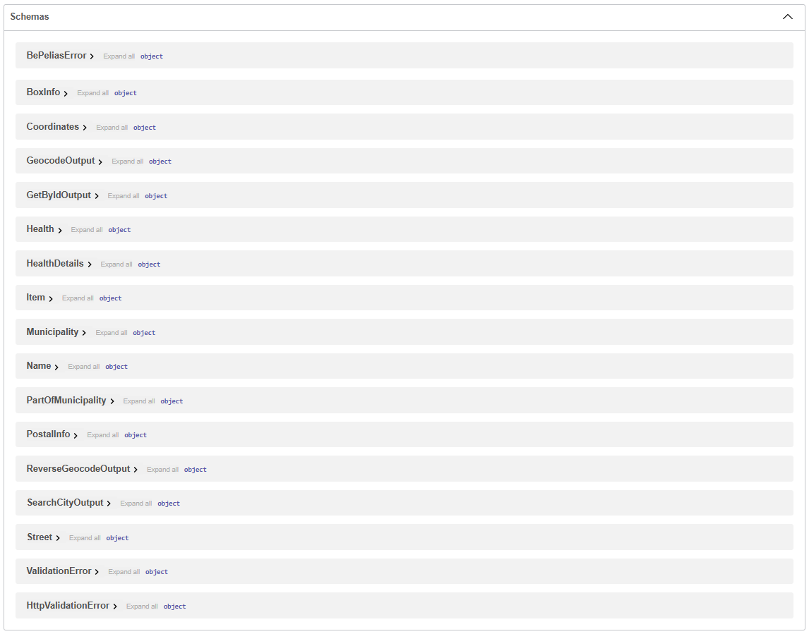
OpenAPI

Slide 18
Conclusions
bePelias: on-premise geocoder (REST API) based on BeSt Address (Belgium)
Simple deployment
Similar performance as main cloud actors
Only for addresses (not for « Smals, Saint-Gilles » or « Resto à Ixelles »)
Special thanks to « Crisis Centrum » (M. Ducobu, G. Kruwialis) for their input

Slide 19
Vandy BERTEN vandy.berten@smals.be https://www.smalsresearch.be/author/berten/

Slide 20
Challenge 1: parsing
{“street” : “Av. Fonsny”,
“housenbr”: “20”,
“zipcode” : “1060”,
“city” : “Bruxelles”}
“Av. Fonsny 20, 1060 Bruxelles” 🡺
Very complex problem looking very simple!
Not always « Avenue Fonsny 20, 1060 Saint-Gilles »
« 1600/2 Chée de Wavre, 1160 Bruxelles »: easy for a human, not for a computer
Box information : “10 A”:
“housenumber”: “10 A”,
or “housenumber”: “10”, “box”: ”A” (10/A, 10 bt A, 10 apt A…)
Addresses often contain extra/useless info:
Smals, Avenue Fonsny…
Avenue Fonsny 20 (Saint-Gilles), 1060 Bruxelles
« Sonnez ‘Tartempion’ », « Au dessus de la poste »…
Notes:
Cannot trust parsed input! {“street” : “Av. Fonsny 20”, “housenbr”: “”, “city”: “1060 Bruxelles”…}

Slide 21
Challenge 2: matching
Levenshtein distance
Streetname
Square Albert 1er
Boulevard du Roi Albert II
…
Rue Van Bemmel
Rue David Van Bever
Rue Ferdinand Elbers
Ketelberg
9
Bd Albert 2
16
3
Rue Van Bever
6
10
Rue Elbers
5
Zipcode | Locality
1160 | Auderghem
1000 | Bruxelles
1160 Bruxelles
Many quasi-homonyms ; exm in BRU: Lapins vs Lupins vs Lutins, Augustins vs Augustines,
Savoir vs Lavoir, Cologne vs Pologne
Notes:
Verger vs Berger, Filleul vs Tilleul, Loyauté vs Royauté, sambre vs Cambre (>50 with only dist=1 in BRU) Présence prénoms, abréviations (Av, Blvd, …), qualificatif (roi, colonel…), noms de sous-communes/lieux dits…

