Slide 1

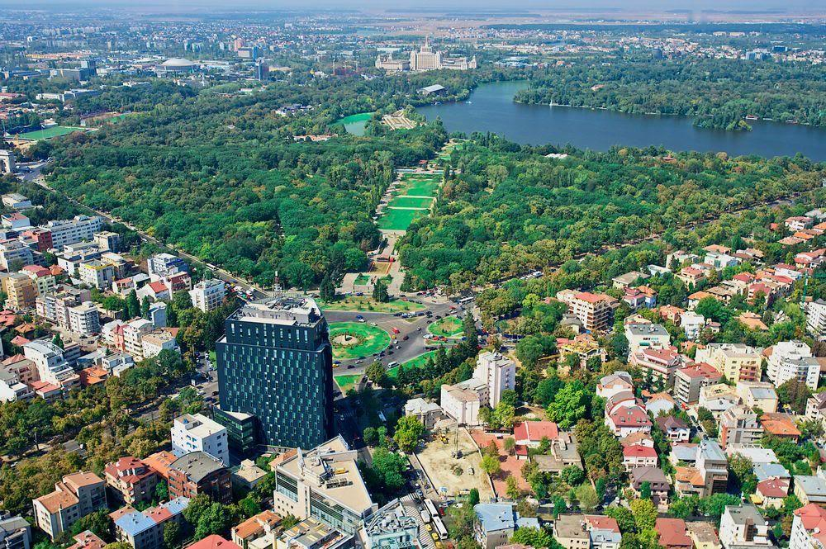

Assemblée générale 2019
www.osgeo.org
Open Source Geospatial Foundation
Image: https://commons.wikimedia.org/wiki/File:Bucuresti_de_sus.jpg
Notes:
Image: https://commons.wikimedia.org/wiki/File:Bucuresti_de_sus.jpg

Slide 2
Empower everyone with open source geospatial
OSGeo est une fondation à but non lucratif
Elle fournit du soutien financier, organisationnel et légal aux projets
Diffuser et promouvoir
Promouvoir l’adoption des technologies géospatiales open source
Partenariats pour une approche ouverte des standards, des données et de l’enseignement
L’OSGeo est conduit par des volontaires
  Communauté mondiale de passionnés
Notes:
We are a not for profit foundation under IRS code 503(c)4 organized under Social Welfare advocacy

Slide 3
Open Geospatial
Travailler avec nos partenaires
  Open Source: Une approche collaborative du développement logiciel
  Open Data: Information librement disponible
  Open Standards: Empêcher les verrous logiciels
  Open Education: Supprimer les barrières à l’apprentissage et l’enseignement
  Open Science: Partager données et logiciels pour une recherche responsable

Slide 4


















Nos soutiens à l’échelle mondiale
Notes:
TODO: Update sponsors list

Slide 5
OSGeo Status Overview
Open, free membership:
425 elected charter members > C’est ouvert ! Venez !
developers, activists, advocates, distribution by year, region and country http://bl.ocks.org/jsanz/raw/779f9b9954b92461fa50/ (see animated gif) Thanks to Jorge Sanz for the graphics
914 ^{21/9/2019} members on website
33790^{1/8/2019} OSGeo mailman server unique subscribers
Source: M Neteler's monthly cronjob
Notes:
3 mins: Helena - Vice - President, OSGeo - OSGeo status overview (formal requirement)

Slide 6
OSGeo in 2019 - Conferences
Upcoming events
20+ Regional FOSS4G conferences and meetings
FOSS4G 2020 CALGARY ~ August 24th, 2020 - Calgary, Alberta, Canada
FOSS4G 2019 Niigata ~ September 13th, 2019 - Niigata city, Japan
FOSS4G UK 2019 ~ September 18th, 2019 - Edinburgh, UK
State of the Map 2019 ~ September 21st, 2019 - Heidelberg, Germany
FOSS4G SotM Oceania 2019 ~ November 12th, 2019 - Wellington, New Zealand
State of the Map Africa 2019 ~ November 22nd, 2019 - Grand-Bassam, Ivory Coast
FOSSGIS 2020 - March 2020 Freiburg, Germany
Bolsena Codesprint 2019 ~ June 24th, 2019
FOSS4G NL 2019 at Delft University ~ June 20th, 2019
Jornadas SIG Libre 2019 ~ May 29th, 2019
OSGeo Community Sprint 2019 ~ May 14th, 2019
FOSS4G-NA 2019 ~ April 14th, 2019
3rd Irish OSGeo Symposium 2019 ~ April 11th, 2019
FOSS4G-Ar 2019 ~ April 9th, 2019
FOSSGIS 2019 ~ March 13th, 2019
International QGIS User Conference ~ March 4th, 2019
FOSS4G-IT 2019 ~ February 20th, 2019
FOSDEM 2019 ~ February 2nd, 2019
FedGeoDay 2019 ~ January 31st, 2019

Slide 7

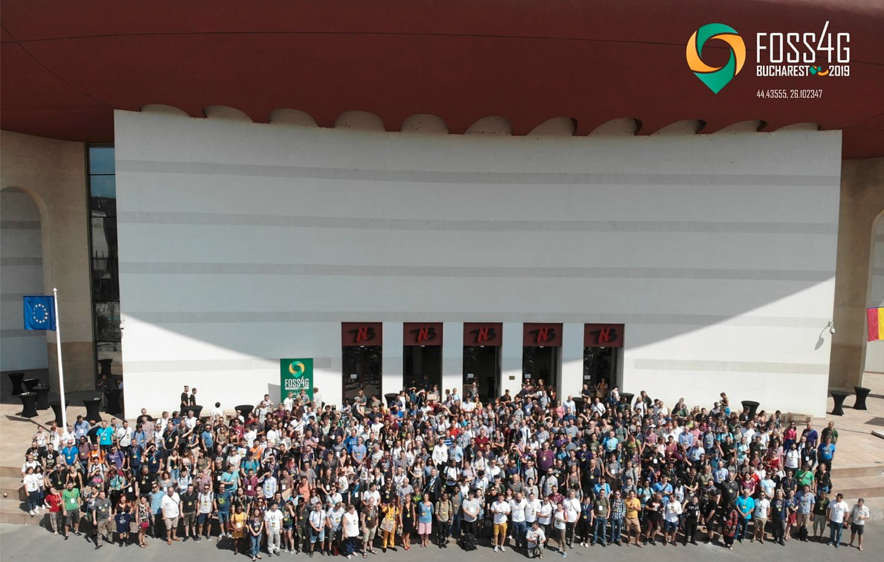

Slide 8
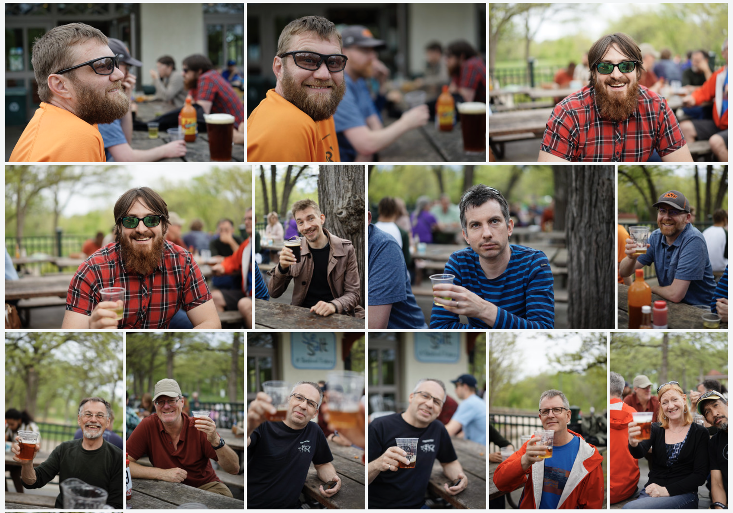
Community Sprint in Minneapolis
Photos CCbyA Jody Garnett

Slide 9
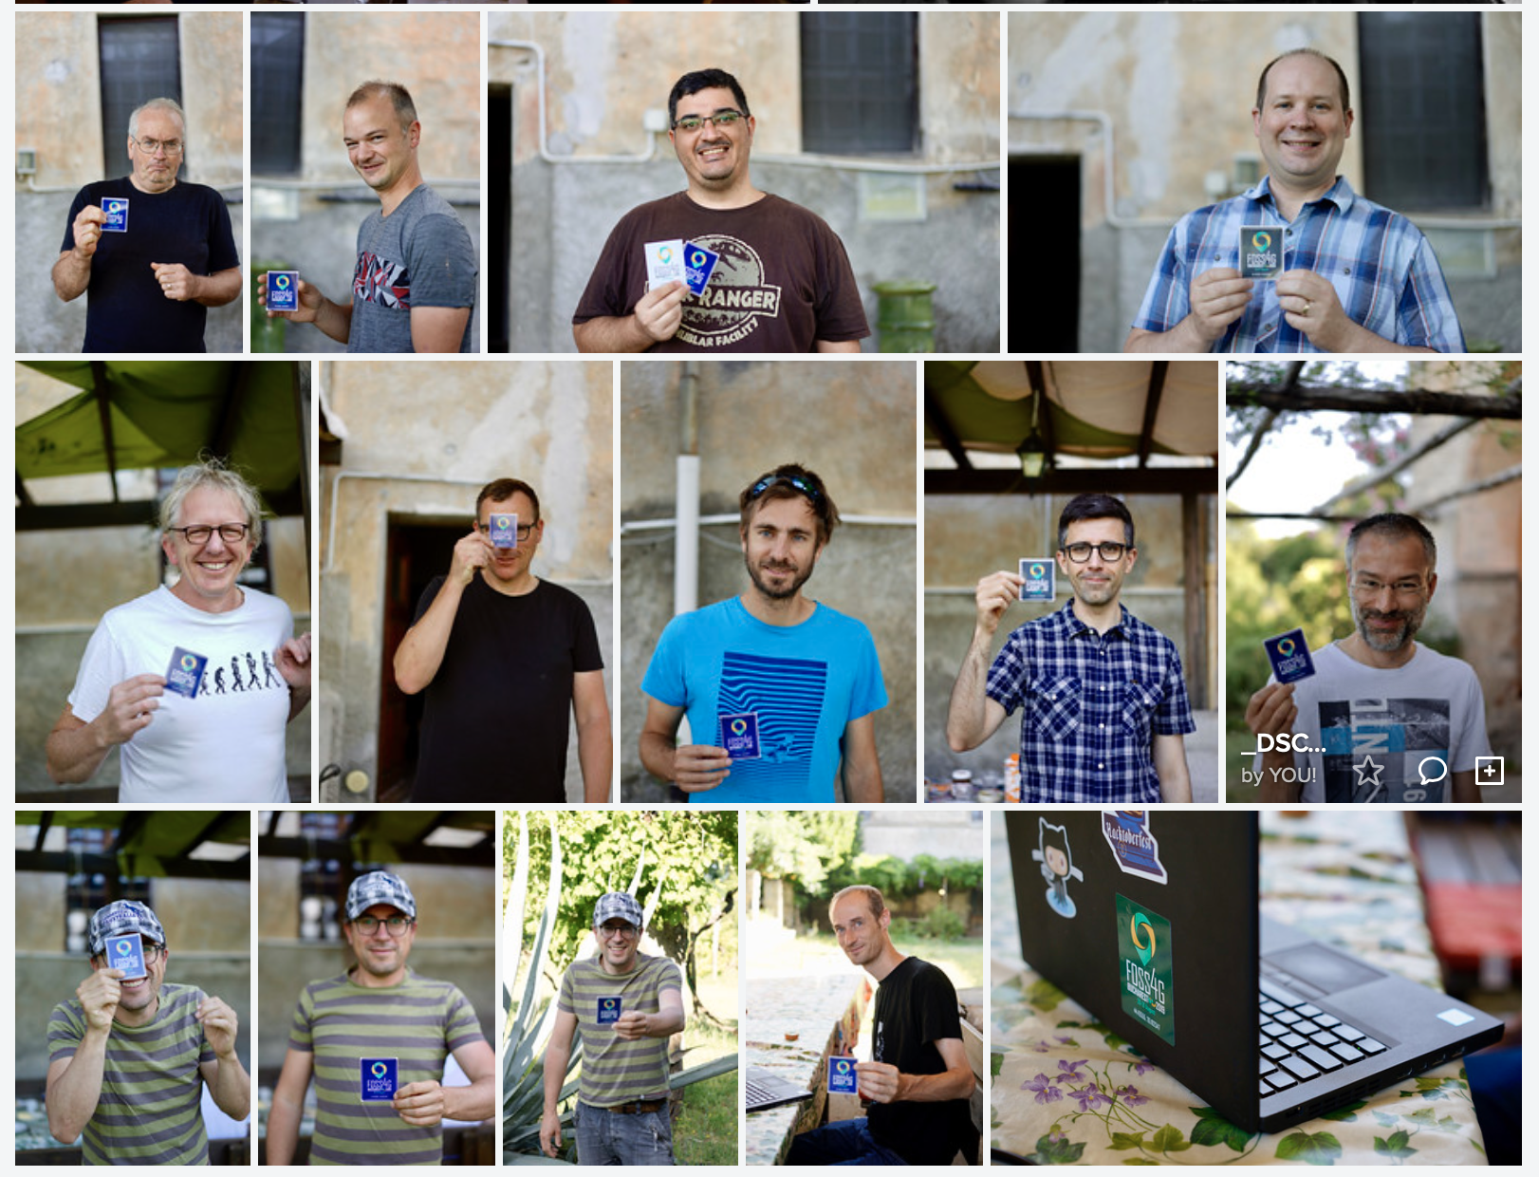
Bolsena Code Sprint
Photos CCbyA Jody Garnett

Slide 10
OSGeo Committees
United Nations
GeoForAll
Marketing
Incubation
Conference
Open GeoScience
System Administration

Slide 11

OSGeo Projects
Each OSGeo project operates as a committee in our foundation represented in our AGM by their project officer.
Notes:
Project Reports (15 mins - yes for everyone)
Project Report (15 min):
Single slide deck, two slides each for a status update, collect status report on discuss and summary in AGM
Several projects have full talks accepted about the project update - we can ask the same person to provide 2-3 slide summary here

Slide 12

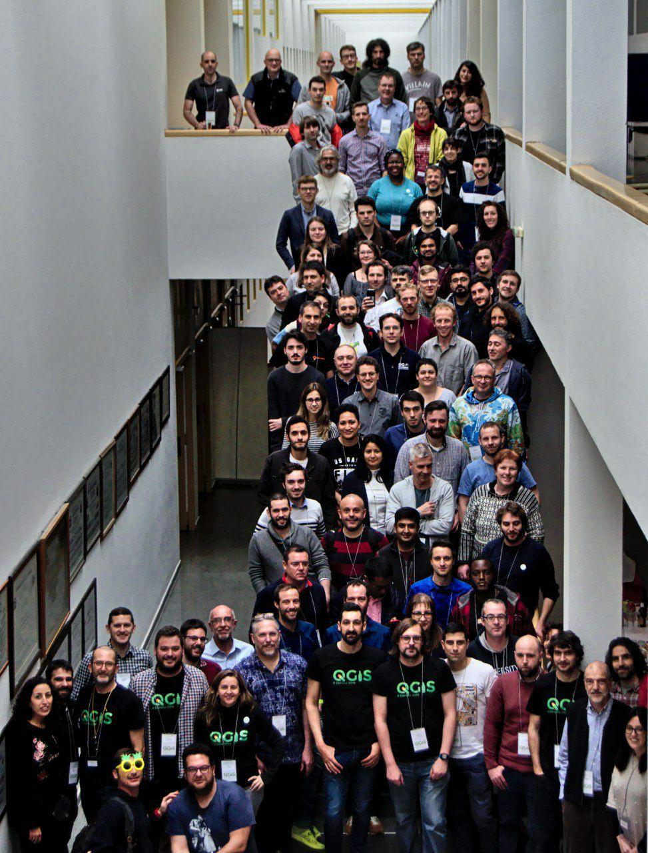
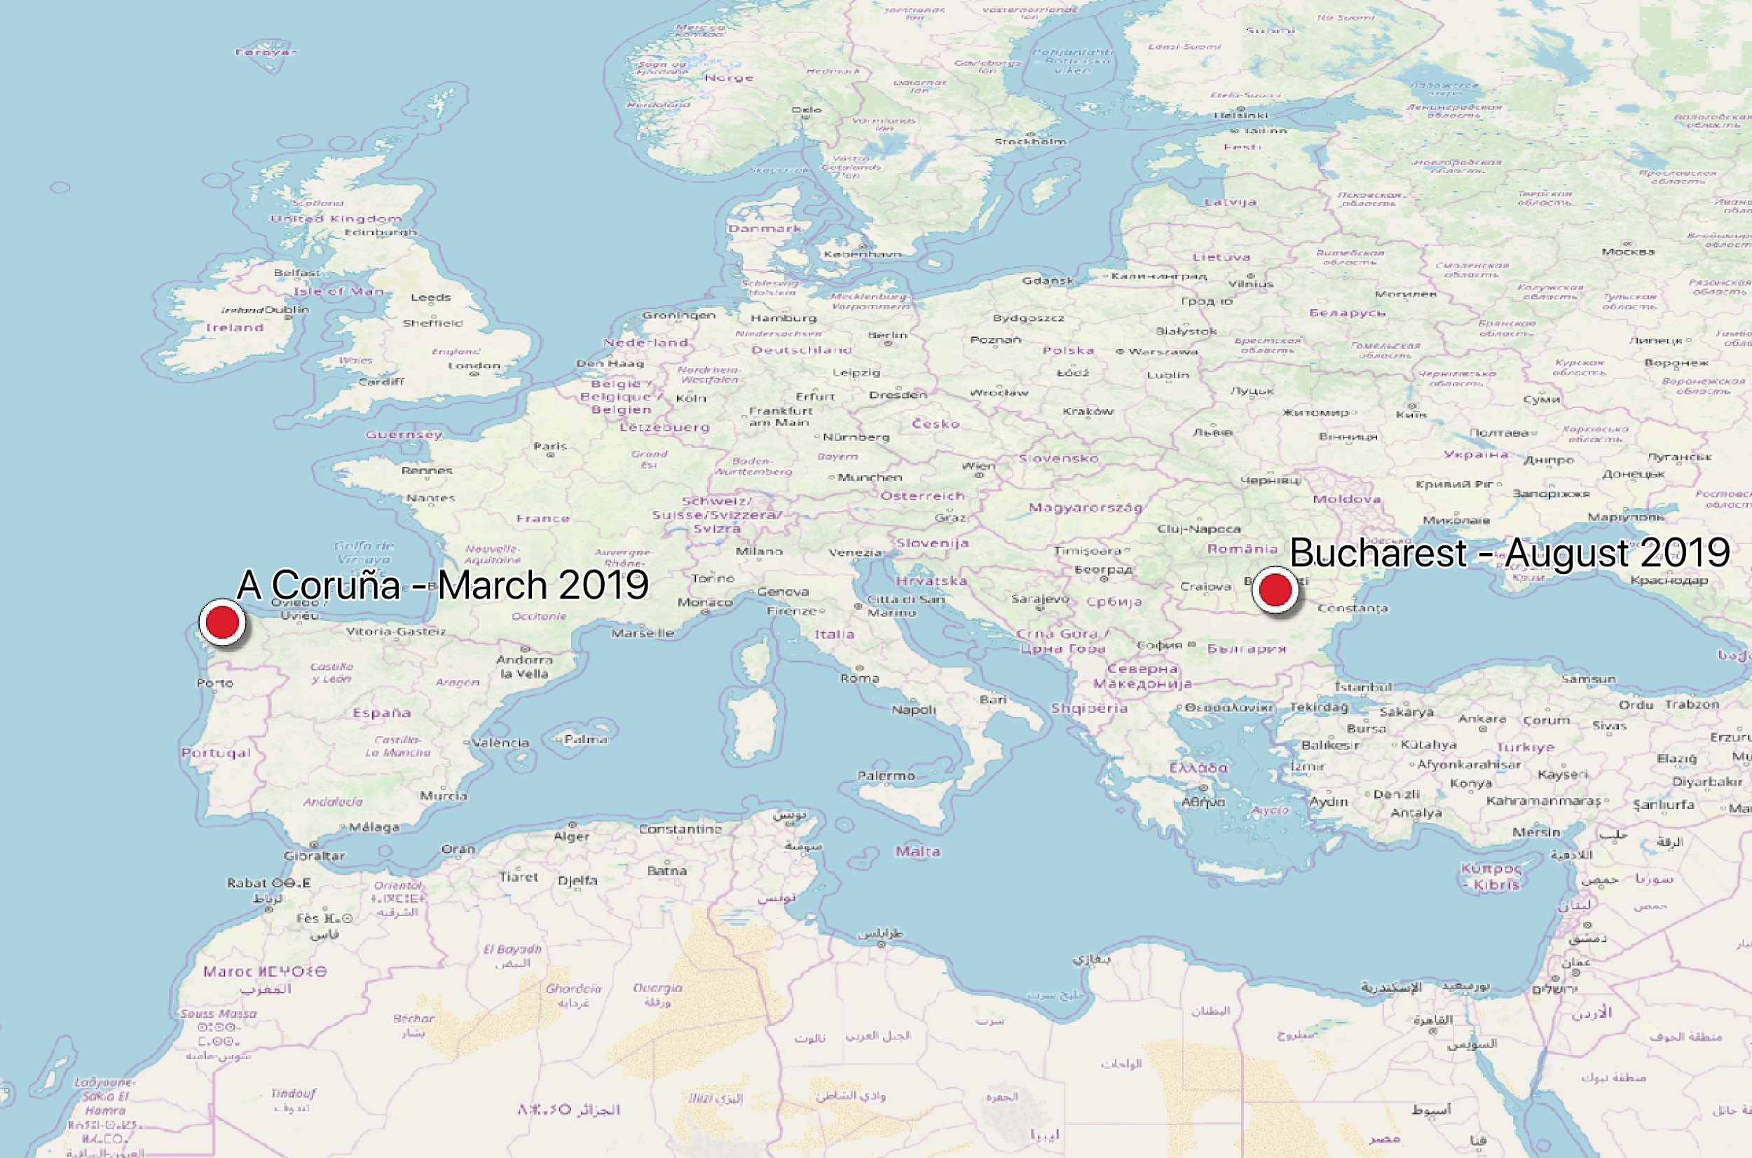

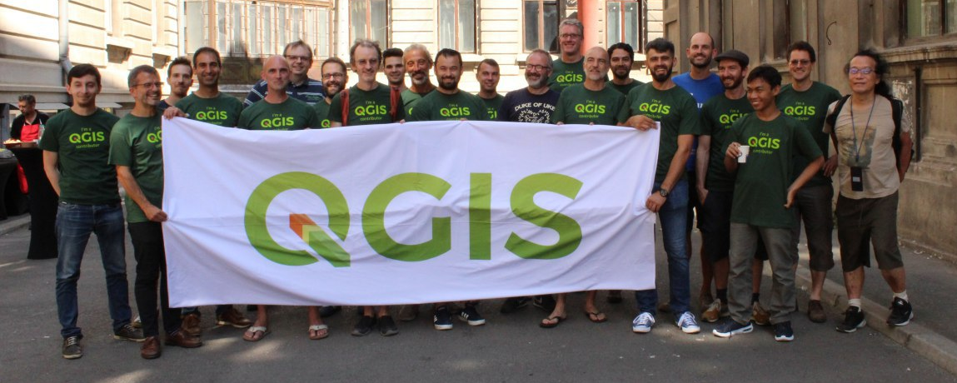

2 x QGIS Conference and Contributor meetings
October 2018
Approx 60k BUGFIX FUNDING FOR DEVS
7.5k DOC FUNDING
2 x Major Releases
February 2019
1 GSOC STUDENT
20k GRANT FUNDING FOR DEVS
PROJ6 SUPPORT
GDAL 3 SUPPORT
Notes:
Providing a reporting template used for prior conferences:
key accomplishments
releases
infrastructure or process changes
community health and happiness
areas for improvements
these are challenges faced by the project
opportunities to help
anything for members to help with?
requests and communication
any formal request from the board, marketing or other committees?
did you make a budget request for 2018? How did it go ...
external correspondence? letter of recommendation for a GSOC student? code donation? etc…
outlook for 2019
any roadmap items to share with our members?
let the board know if there is anything to plan for in 2019
Example: https://github.com/geotools/geotools/wiki/GeoTools-Annual-Report-2017

Slide 13











gvSIG
GeoServer
GeoNode
ORFEO ToolBox
OpenLayers
GeoNetwork

Slide 14

OSGeo Incubating
OSGeo Incubating projects are working with the Incubator Committee to become an official OSGeo project..
Notes:
Project Reports (15 mins)
Project Report (15 min): Single slide deck, two slides each for a status update, collect status report on discuss and summary in AGM
Several projects have full talks accepted about the project update - we can ask the same person to provide 2-3 slide summary here

Slide 15



PROJ (formerly PROJ.4)
Notes:
Providing a reporting template used for prior conferences:
key accomplishments
releases
infrastructure or process changes
community health and happiness
areas for improvements
these are challenges faced by the project
opportunities to help
anything for members to help with?
requests and communication
any formal request from the board, marketing or other committees?
did you make a budget request for 2018? How did it go ...
external correspondence? letter of recommendation for a GSOC student? code donation? etc…
outlook for 2019
any roadmap items to share with our members?
let the board know if there is anything to plan for in 2019
Example: https://github.com/geotools/geotools/wiki/GeoTools-Annual-Report-2017

Slide 16
Local Chapter Updates
Regional / language outreach promoting our vision for open source!
Chapters operates at arms length, often incorporated as a “non-profit” in their respective country to better engage with local advocacy.

Slide 17

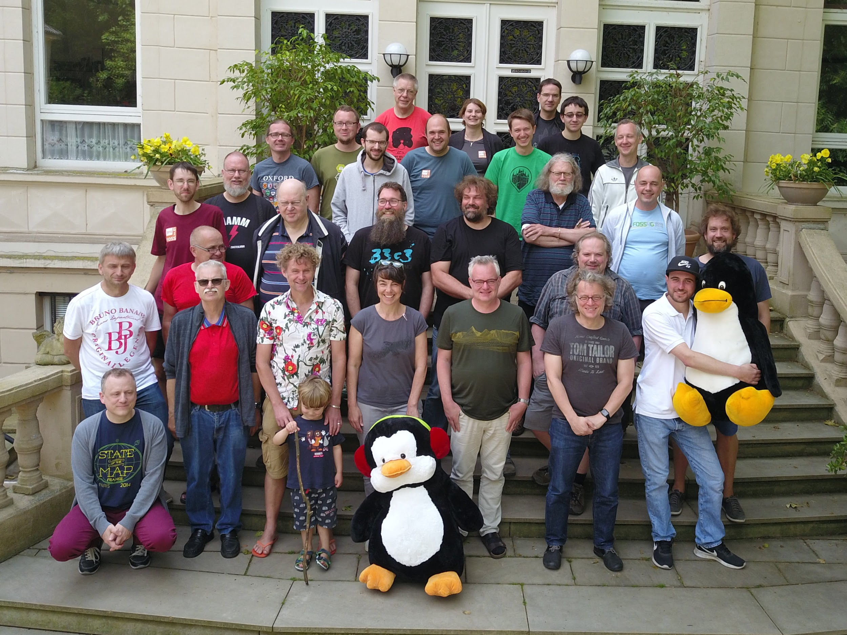
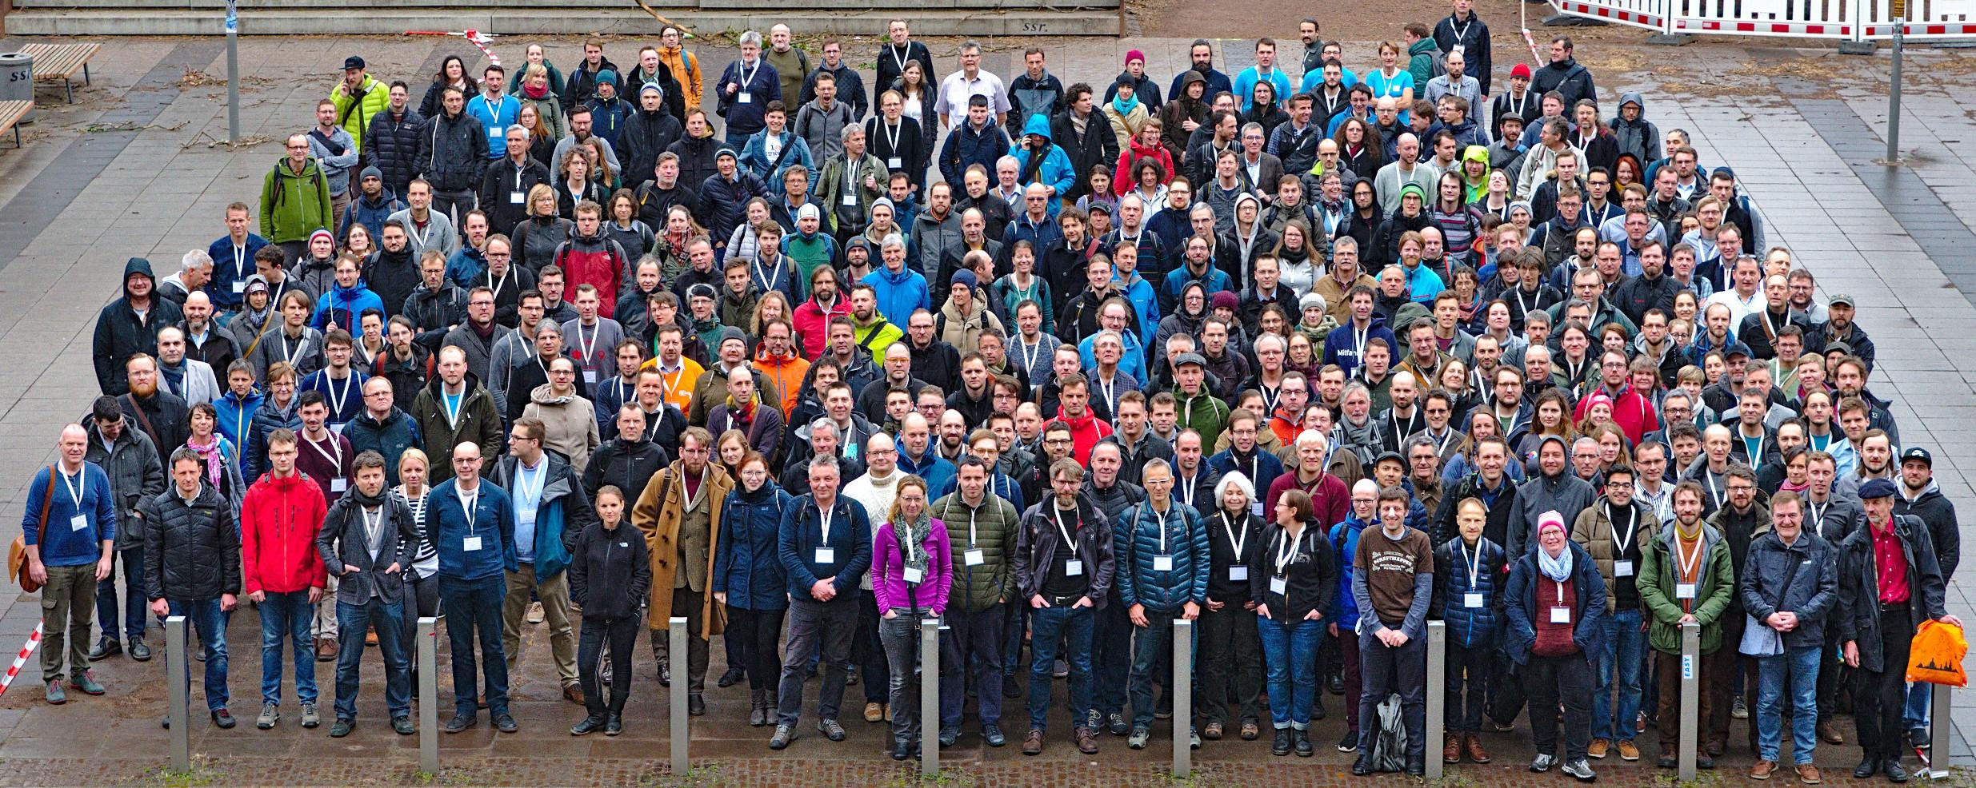
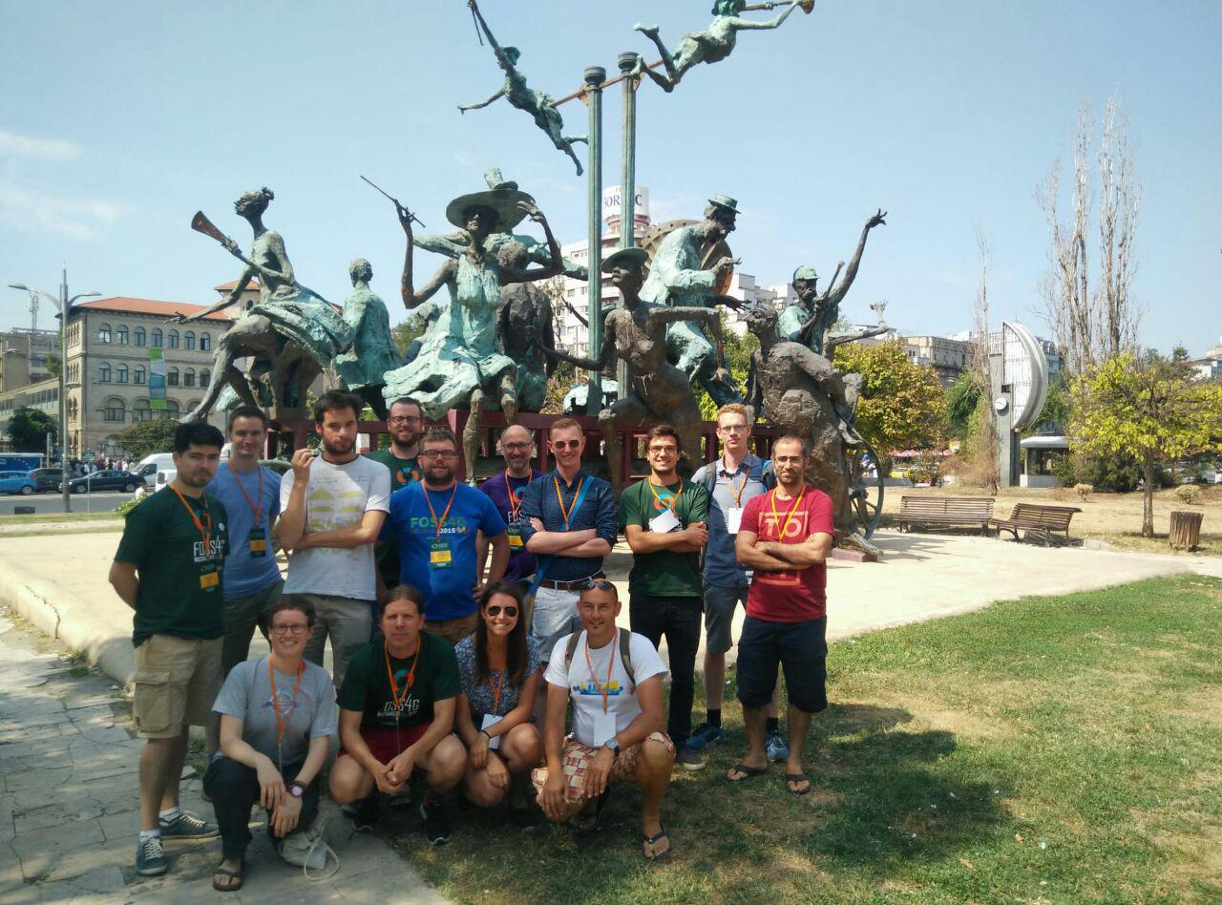



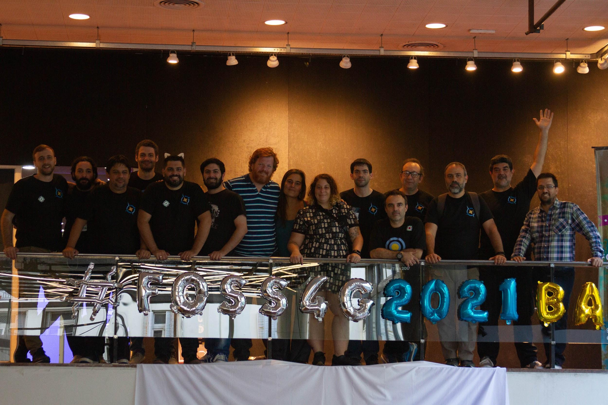


ﾲ
Poland
Portugal
Geoinquiet@s Argentina
California
California
Africa
Finland
Québec

Slide 18


OSGeo-fr
New board
QGIS fr user days Dec. 2018 http://conf.qgis.osgeo.fr/
Events:
  Capitole du Libre Nov. 2018
  Paris OpenSource Summit Dec. 2018
  GeoDatadays Jun. 2019
  Festival International de Géographie 19
FOSS4G-fr 2020 ?
Projects :
  new status
  SAC

Slide 19
OSGeo Initiatives
OSGeo Initiatives form to change down specific opportunities, gathering together interested parties.
We ask initiatives that we support to provide a AGM status update.
Notes:
Committee Reports (15 mins)

Slide 20



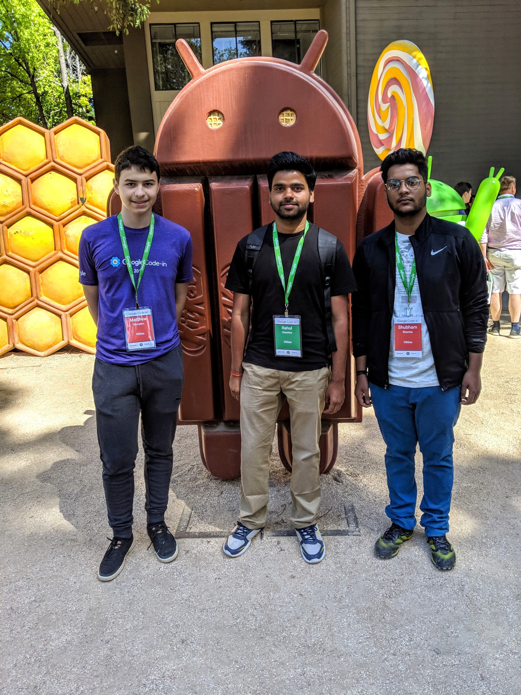

Slide 21
Venez participer à la communauté
Photo by Javi Lorbada on Unsplash
Welcome to open geospatial
C’est gratuit
...mais hautement addictif
Notes:
Photo by Javi Lorbada on Unsplash (https://unsplash.com/photos/nkLfKiCf3EQ )

