Slide 1

ZOO-Project version 1.3.0
Fenoy G., Raghavan V., Bozon N.

Slide 2


Layout
- WPS introduction
- ZOO-Project presentation
- ZOO-Project 2012 status
- ZOO-Project as a SDI engine

Slide 3

Qu'est-ce que le WPS ?
Le standard Web Processing Service défini la manière de s'informer à propos puis d'appeler des services SIG à travers internet.
WPS specifies a mean for a client to request the execution of a spatial calculation from a service.
WPS intends to automate geoprocessing by employing geospatial semantics in a service-oriented architecture (SOA).
Open Geospatial Consortium interoperability standards since 2005

Slide 4

Pourquoi utiliser le WPS ?
Le Web Processing Service vous permet de déployer et d'orchestrer des services SIG avancés coté serveur.
Le WPS peut se connecter à différents types de moteurs cartographiques et autres bases de données spatiales, offrant ainsi la possibilité de gérer des infrastructure de données spatiales complexes.
Le WPS est un manière générique et standardisé d'utiliser les SIG dans le nuage.
Le WPS permet aux logiciels de l'OSGeo d'être utilisé les uns avec autres.

Slide 5

WPS implementation since 2009
ZOO-Project is a WPS (Web Processing Service) compliant server-side platform based on OGC's WPS 1.0.0
ZOO-Project is open source software released under MIT/X-11 license since 2009.
ZOO-Project is designed to create and chain web processing services easily, using FOSS4G libs or existing code.
ZOO-Project is based on a C Kernel (ZOO Kernel) able to load dynamic libraries and to orchestrate Web services coded in six different programming languages.
1

Slide 6
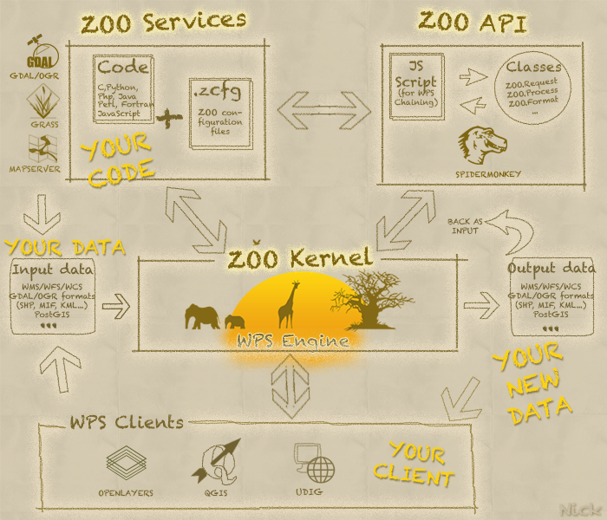
Vue d'ensemble du ZOO-Project

Slide 7



Principales fonctionnalités
- Support GDAL depuis 2009
(Programmes GDAL et OGR disponible sous la forme de services)
- Support MapServer depuis 2011
(le ZOO-Kernel permet de diffuser automatiquement le résultat
de l'exécution d'un service grâce aux protocoles WMS/WFS/WCS)
- Support GRASS GIS depuis 2012
(Utilisation possible de modules GRASS GIS comme ZOO-Services
en ayant recours ou non au projet GRASS-Bridge)
svn checkout http://svn.zoo-project.org/svn/trunk zoo

Slide 8
ZOO-Project new features (1)
ZOO-Project Python API
- SERVICE_SUCCEEDED
- SERVICE_FAILED
- UPDATE STATUS
ZOO-Project JavaScript API
- SERVICE_SUCCEEDED
- SERVICE_FAILED
- UPDATE STATUS
Building and interacting with WPS Services becomes even more easier.

Slide 9
ZOO-Project new features (2)
ZOO-Project translation function
zoo._("My String")
Internal mechanism to translate chains of characters
from Python or Javascript
Allows to use WPS Services in several natural languages directly

Slide 10

ZOO-Project new features (3)
ZOO-Project on Win32 (ZOO4W BuildKit)
Compilation buildkit for installing FOSS4G on Windows platform
- ZOO-Project
- Mapserver
- GDAL/OGR
- Shapely
- PostGreSQL
- PgRouting
THE POWER OF WPS AND
FOSS4G ALSO ON WINDOWS

Slide 11

ZOO-Project as a SDI Engine
ZOO-Project is used as the engine of the MapMint software.
MapMint is a commercial open source stack dedicated to deploy complete spatial data infrastructure.
ZOO-Project
+
MapServer
+
GDAL
+
OpenLayers

Slide 12
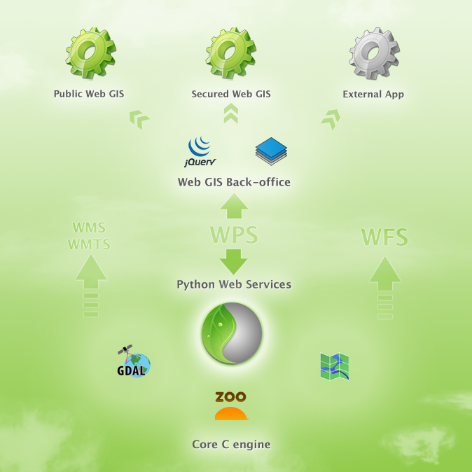
100% geospatial SaaS
WPS + WMS + WFS + WMTS
Everything is a Service
- GIS data access
- GDAL/OGR functions
- MapServer configuration
- OpenLayers configuration
- HTML5 output maps creation

Slide 13
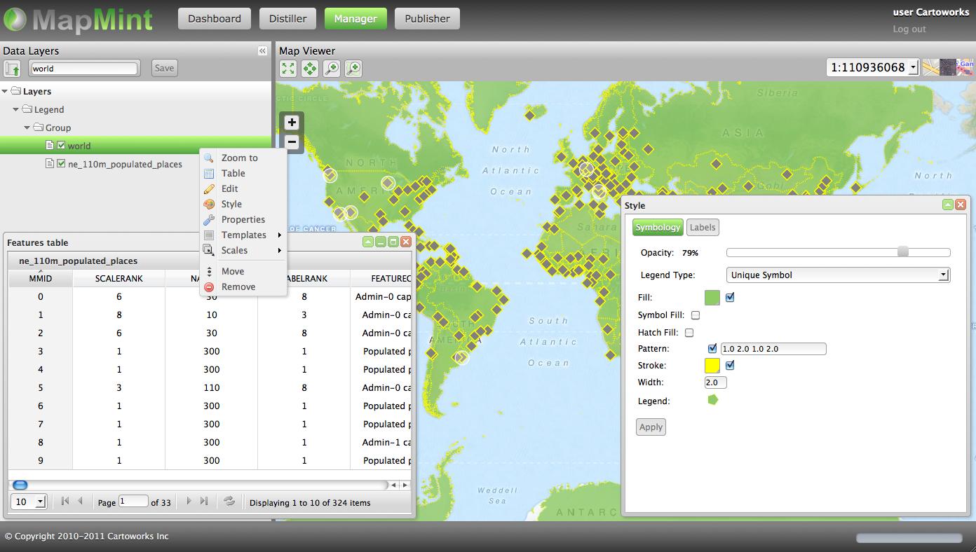
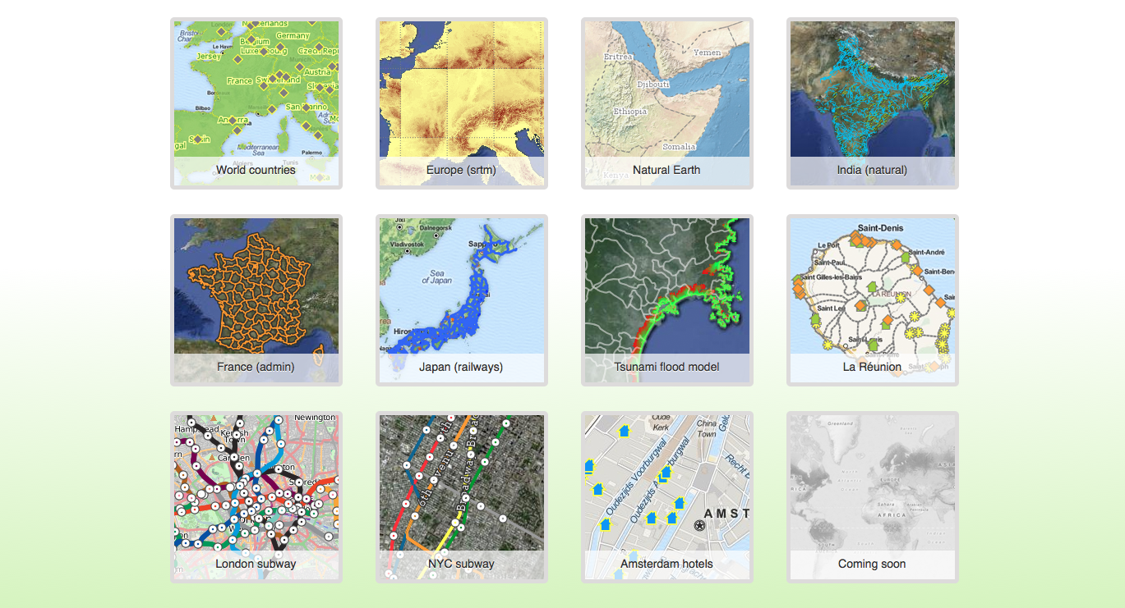
The web maps generator
- 50+ GIS formats
- PostGIS databases
- Full MapServer editor
- Full OpenLayers editor
- HTML5 layouts
- CSS3 themes
- Web mobile output

Slide 14

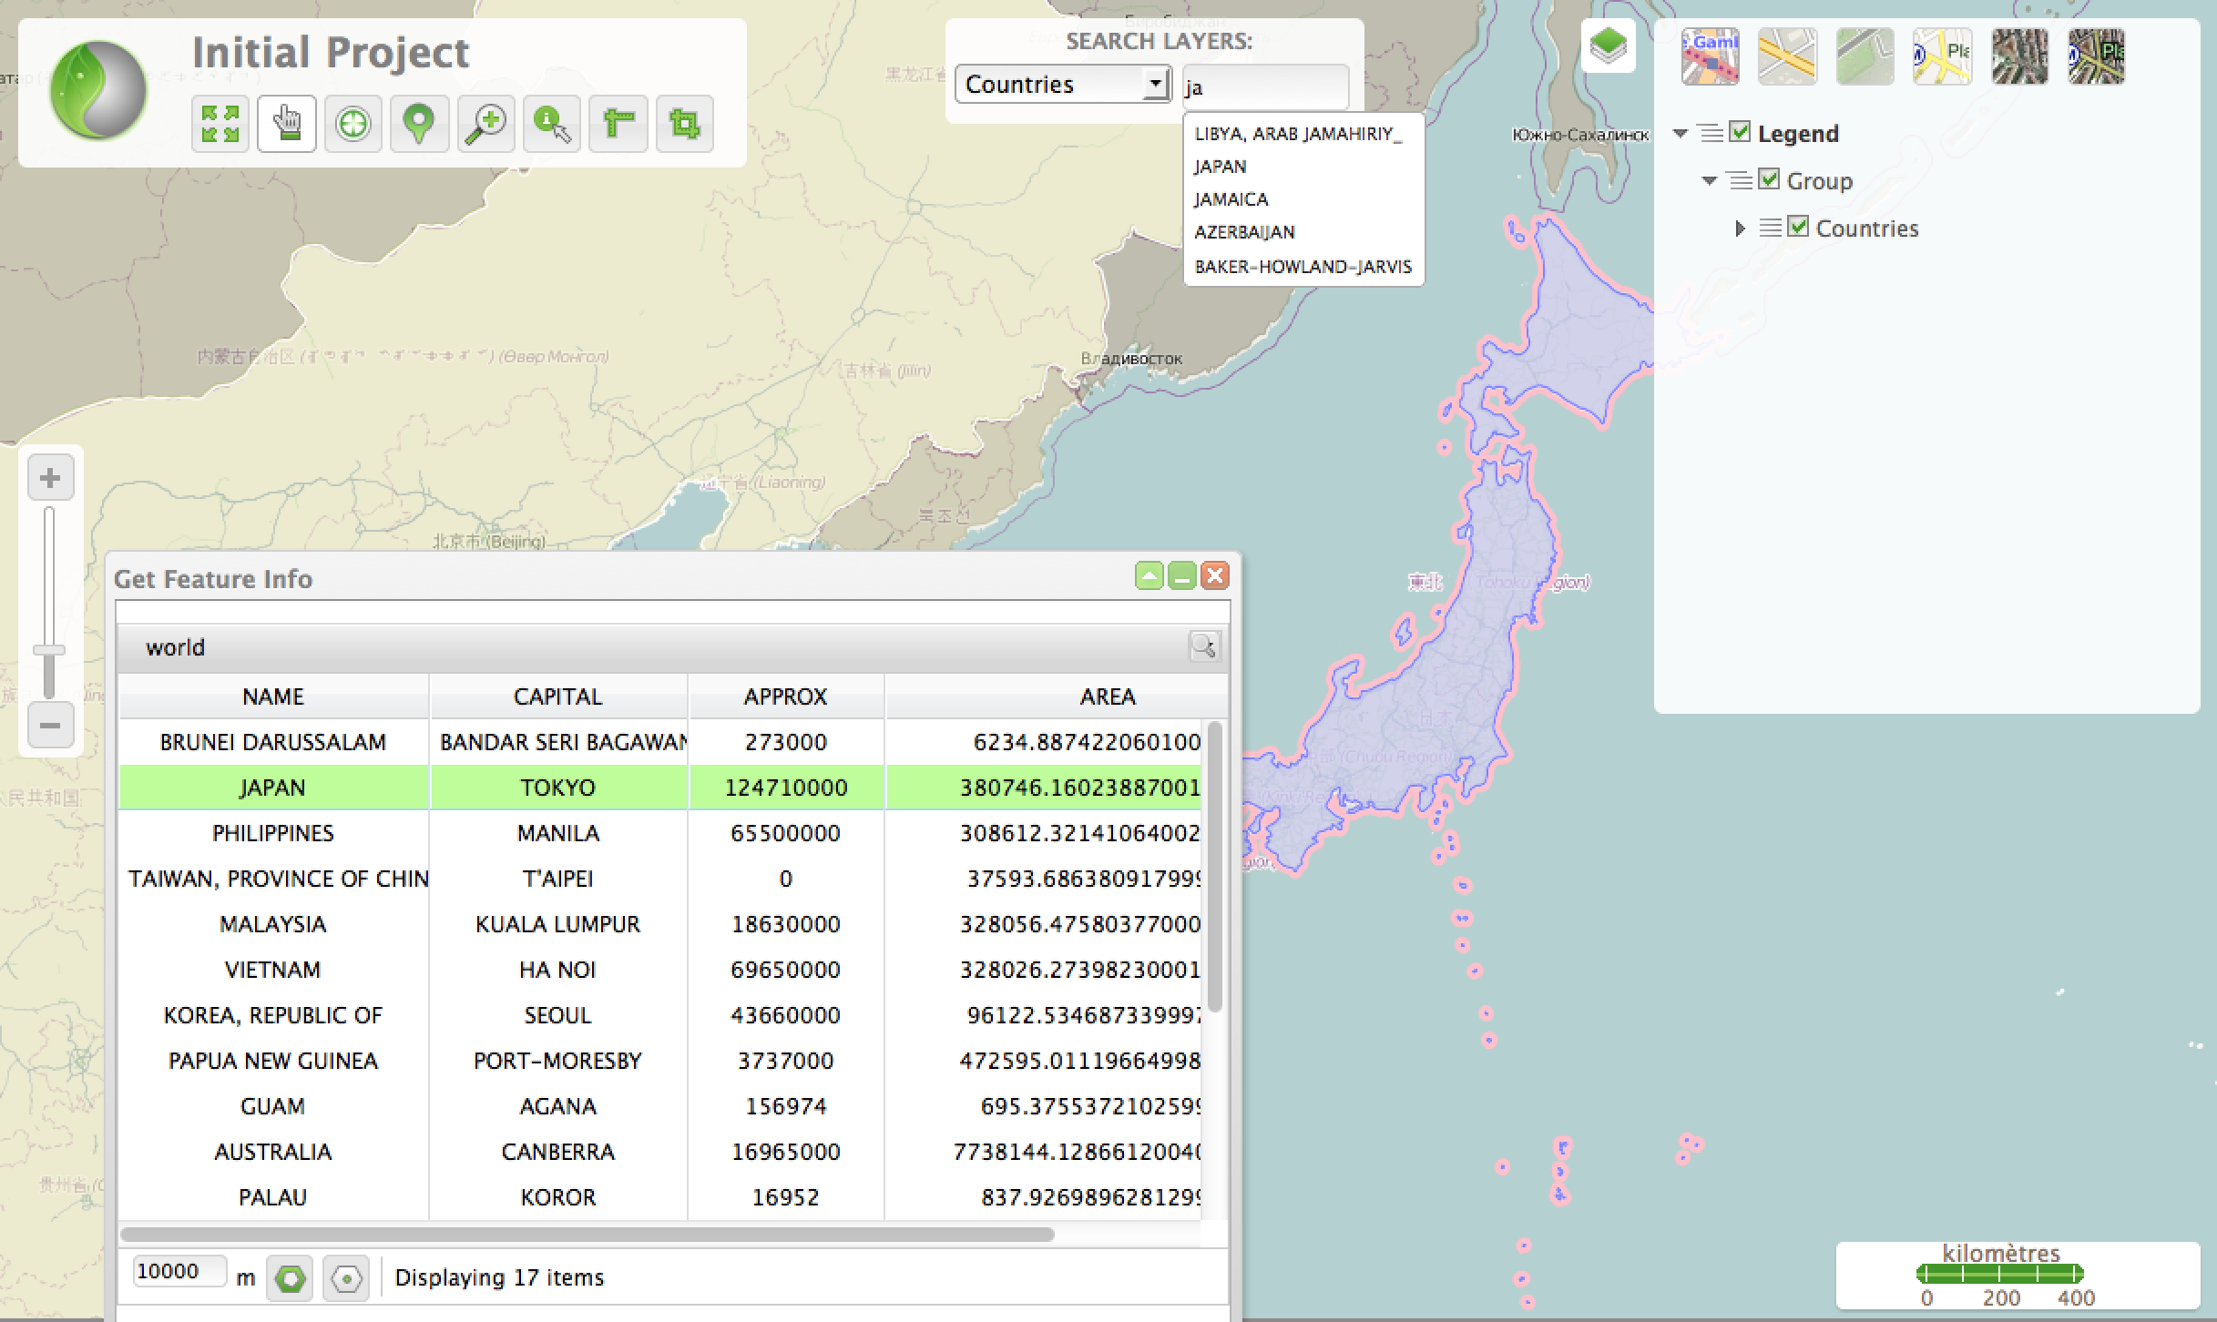
Advanced features
- Windows and Trees
- Search engine (WFS)
- Editing (WFS-T)
- Thematic mapping MapServer
- Spatial analysis (GDAL)
- Routing (PgRouting)
- Raster analysis (GDAL)
- GeoReferencer (GDAL)

Slide 15
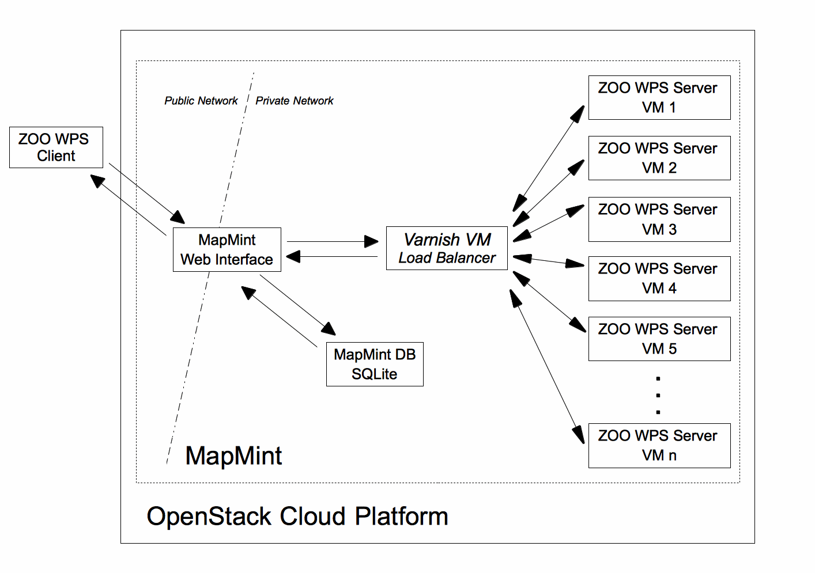

MapMint in the Cloud (Paas4G !!)
GeoSpatial Cloud
OpenStack + MapMint
Multiple ZOO-Kernel for one MapMint instance
Scaling and fault-tolerant functions according to the number of WPS requests

Slide 16
Conclusion
ZOO-Project is an extensible WPS compliant engine
GDAL, MapServer, GRASS and other OSGeo software can all be run together on the Web, using ZOO-Project and its standard WPS requests
MapMint is a commercial open source platform which is fully built on WPS and OSGeo stack.
MapMint developement leads to several contributions to open source projects
The Geospatial cloud is being built using WPS.

Slide 17

Thank you !
http://zoo-project.org
http://mapmint.com

