Slide 1
Datum Transformations in Qgis @GeoDev #5
Anja Vrecko
anja.vrecko@sinergise.com

Slide 2
Scope
Datum transformations
Some theory
How I approached it in Qgis
Out of scope
Coordinate systems in general
How to chose a right projection for my purpose
V datums

Slide 3
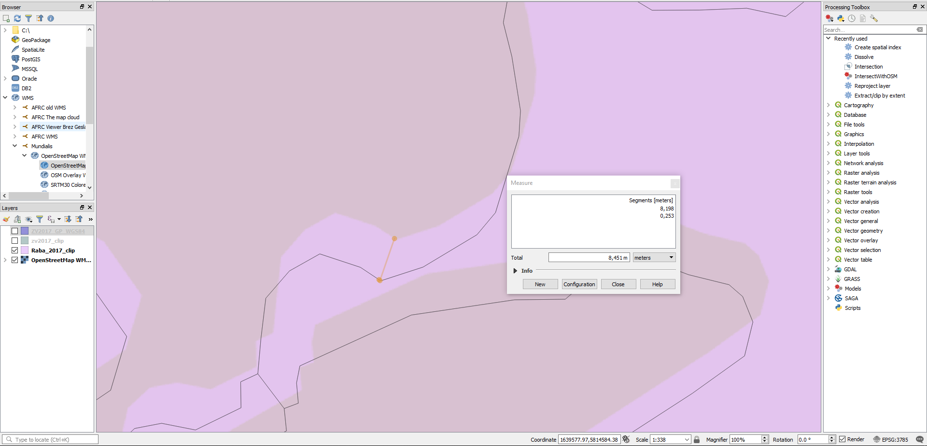
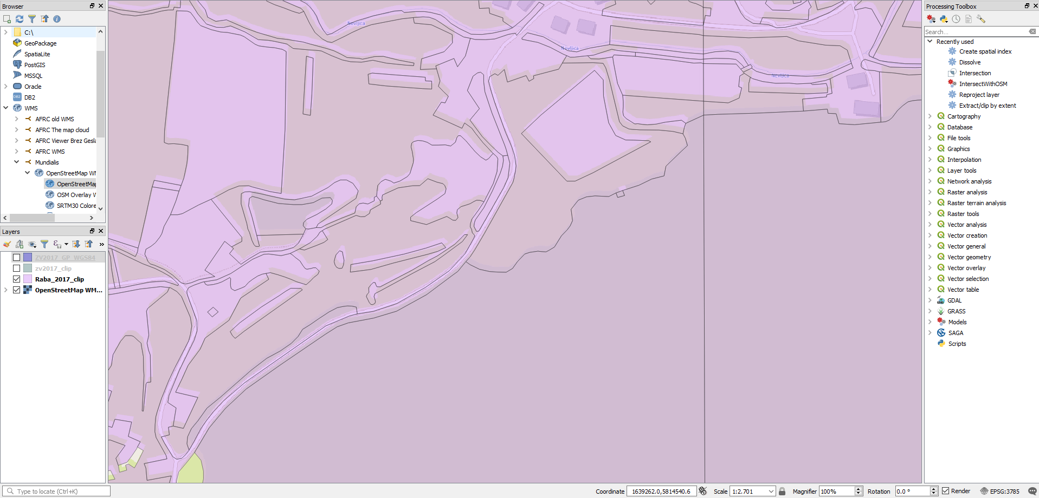
Problem

Slide 4
Problem

Slide 5
Problem
Approx. 8 m mismatch between RABA and Open Street Map (map is shown in EPSG:3785) – can 8 m discrepancy be a consequence of less accurate set of transformation parameters?
RABA has no coordinate reference system (CRS) specified but it was assumed it is in „old“ Slovenian reference coordinate system
Some kind of transformation was happening but it was not clear what parameters are being used

Slide 6
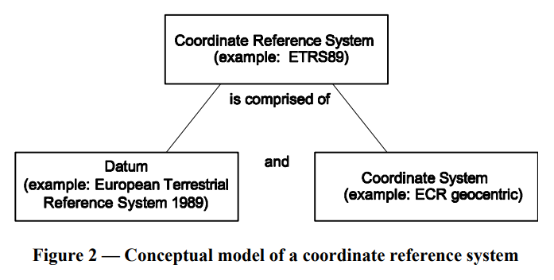
What I knew:
GURS provides transformation parameters per region or for the whole country. Accuracy for the whole country is cca 1,25 m.
http://www.e-prostor.gov.si/zbirke-prostorskih-podatkov/drzavni-koordinatni-sistem/horizontalni-drzavni-koordinatni-sistem-d96tm/#tab6-1026
Common problems with transformations:
Axis order
„coordinate frame“ rotation vs „position vector“ rotation
Differences between:
Earth vs ellipsoid vs projection surface
Projection vs datum transformation
Ellipsoid vs datum

Slide 7
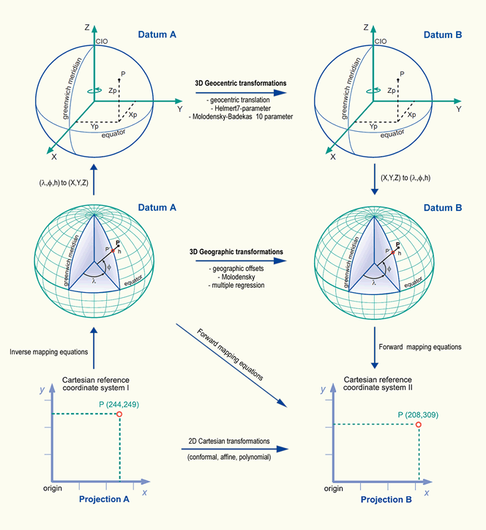
Datum Transformations - Big Picture

Slide 8
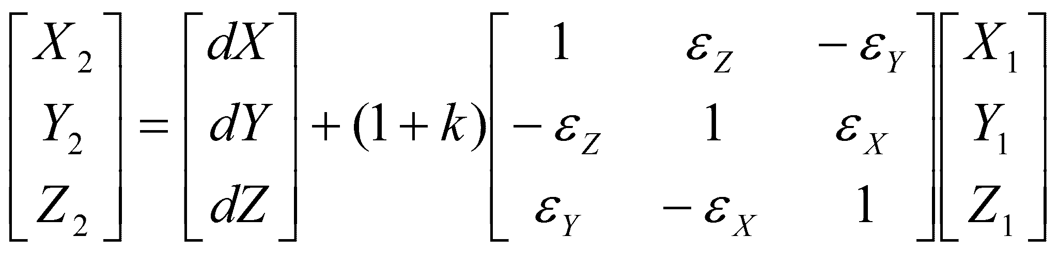
Transformation models
7- parameters Helmert‘s similarity transformation
Bursa-Wolf = Helmert‘s but with simplified rotation matrix:
Molodensky-Badekas= Bursa-Wolf but rotation is around centroid
abridging Molodenski = simplified version, where we model 3 translations only
Sources: https://www.researchgate.net/publication/228757515_A_NOTE_ON_THE_BURSA-WOLF_AND_MOLODENSKY-BADEKAS_TRANSFORMATIONS, http://elte.prompt.hu/sites/default/files/tananyagok/MapGridsAndDatums/ch04s02.html

Slide 9
But transformation between 2 ellipsoids seems deterministic ...
Datum
Where do the transformation parameters come from?

Slide 10
What I didn‘t know:
How all the theory is implemented (in Qgis)
CRSs have „default“ transformations (TOWGS84)
How to control transformations in Qgis

Slide 11
Tools
PROJ
C:\Program Files\QGIS 3.0\share\proj;
EPSG
# Slovenia 1996<4882> +proj=geocent +ellps=GRS80 +units=m +no_defs <>
# Slovenia 1996<4765> +proj=longlat +ellps=GRS80 +towgs84=0,0,0,0,0,0,0 +no_defs <>
# MGI / Slovenia Grid (deprecated)<2170> +proj=tmerc +lat_0=0 +lon_0=15 +k=0.9999 +x_0=500000 +y_0=0 +datum=hermannskogel +units=m +no_defs <>
# MGI / Slovene National Grid (deprecated)<3787> +proj=tmerc +lat_0=0 +lon_0=15 +k=0.9999 +x_0=500000 +y_0=-5000000 +datum=hermannskogel +units=m +no_defs <>
# Slovenia 1996 / Slovene National Grid<3794> +proj=tmerc +lat_0=0 +lon_0=15 +k=0.9999 +x_0=500000 +y_0=-5000000 +ellps=GRS80 +towgs84=0,0,0,0,0,0,0 +units=m +no_defs <>
# MGI 1901 / Slovenia Grid<3911> +proj=tmerc +lat_0=0 +lon_0=15 +k=0.9999 +x_0=500000 +y_0=0 +ellps=bessel +towgs84=682,-203,480,0,0,0,0 +units=m +no_defs <>
# MGI 1901 / Slovene National Grid<3912> +proj=tmerc +lat_0=0 +lon_0=15 +k=0.9999 +x_0=500000 +y_0=-5000000 +ellps=bessel +towgs84=682,-203,480,0,0,0,0 +units=m +no_defs <>
ESRI
# MGI / Slovenia Grid<2170> +proj=tmerc +lat_0=0 +lon_0=15 +k=0.999900 +x_0=500000 +y_0=0 +ellps=bessel +units=m +no_defs no_defs <>
GDAL
3912,"MGI 1901 / Slovene National Grid",9001,3906,19845,9807,1,0,4498,8801,0,9102,8802,15,9102,8805,0.9999,9201,8806,500000,9001,8807,-5000000,9001,,,,,,,,,,,,,
Gdal datum:
6765,Slovenia Geodetic Datum 1996,geodetic,"Densification of ETRS89, based on ITRS89 at epoch 1995.55.",1996-01-01,7019,8901,1212,"Geodetic survey, topographic mapping.",,Surveying and Mapping Authority of Slovenia,OGP,"2008/04/04",,0,"D_Slovenia_Geodetic_Datum_1996"
.prj (= WKT representation of CRS, WKT2 is coming but not yet supported in Qgis)

Slide 12
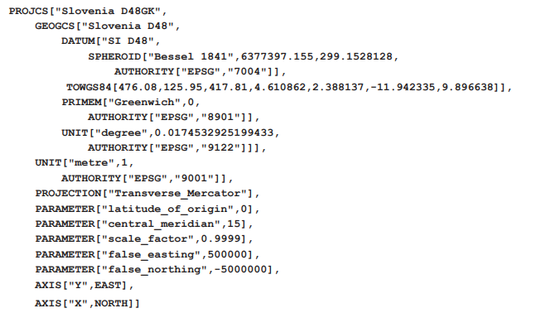
WKT representation:

Slide 13
Back to the example:
Old“ Slovenian coordiante reference system: D48/GK ... EPSG 3912
Transformations:
EPSG:3962: TOWGS84 [682.0, -203.0, 480.0, 0.0, 0.0, 0.0, 0.0]
EPSG:3915: TOWGS84 [426.9, 142.6, 460.1, 4.91, 4.49, -12.42, 17.1]
EPSG:3917: TOWGS84 [ 409.545, 72.164, 486.872, -3.085957, -5.46911, 11.020289, 17.919665] = offical GURS‘s parameters for the whole country
„New“ Slovenian coordiante reference system: D96/TM ... EPSG 3794
Recomended user defined CRS with:
TOWGS84[476.08,125.95,417.81,4.610862,2.388137,-11.942335,9.896638]
Check out: https://epsg.io/
Source: Sandi Berk, Danijel Boldin: Slovenian coordinate reference systems in GIS environment, http://www.geodetski-vestnik.com/61/1/gv61-1_berk.pdf

Slide 14
In Qgis show:
1) How to assign CRS to the layer
2) How to get a list of avalaible transformation parameters sets
3.1) Set custom CRS
3.2) Change .prj file
4) Reproject data and save it

Slide 15
*In Python:
Coordiante transformations in Python:
pyproj (uses proj.4)
osgeo (uses gdal)
How to define your own parameters:
https://publicwiki.deltares.nl/display/OET/Python+convert+coordinates

Slide 16
Recommendations:
Control datum transformation
Do not hide important settings
In Qgis the safest option is to define your own CRS (as opposed to tweaking towgs84 parameter)
If possible compare results with:
Results of higher accuracy transformation (for Slovenia you can use 3tra http://www.e-prostor.gov.si/zbirke-prostorskih-podatkov/drzavni-koordinatni-sistem/transformacija-v-novi-koordinatni-sistem/#tab2-1177)
OSM proved quite reliable (but check if accuracy is good enough for you)
Use the same parameters for all data sets (you can not do this if you do not know how data was transformed)

Slide 17
Thank you!

