Slide 1

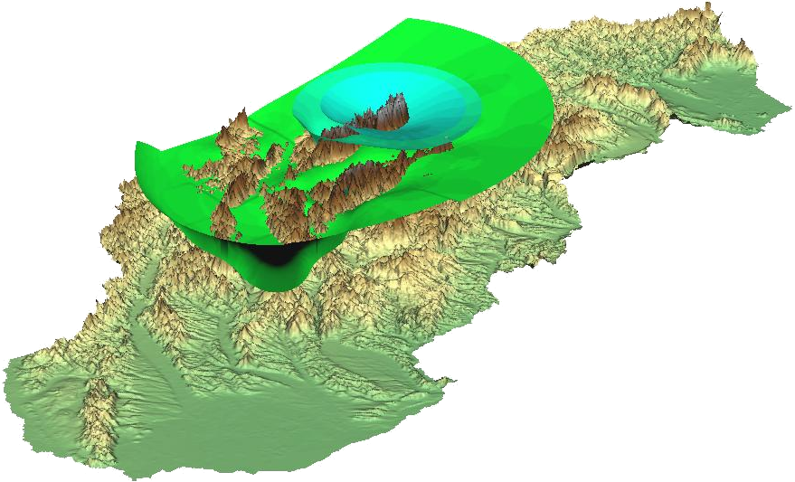
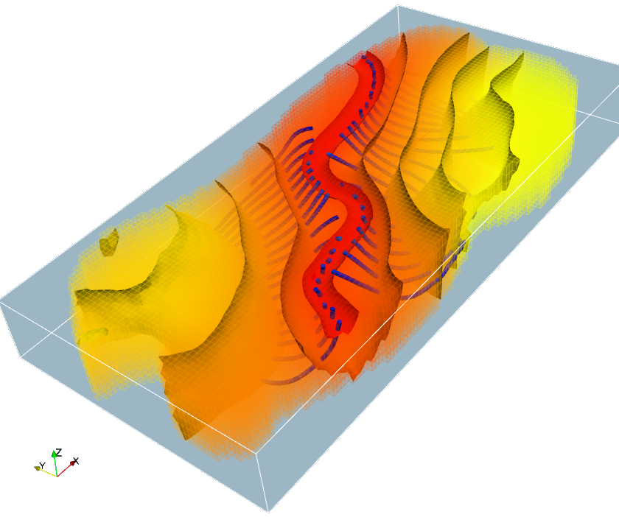
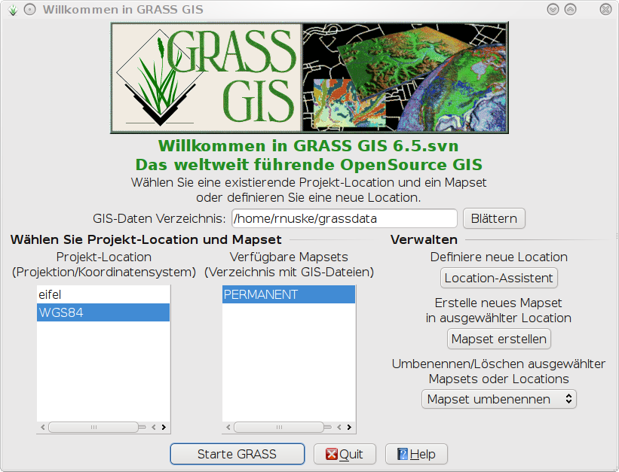
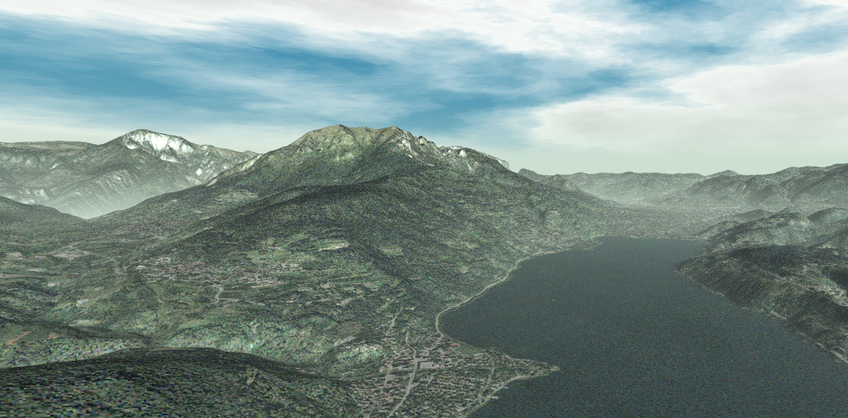
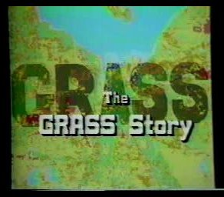

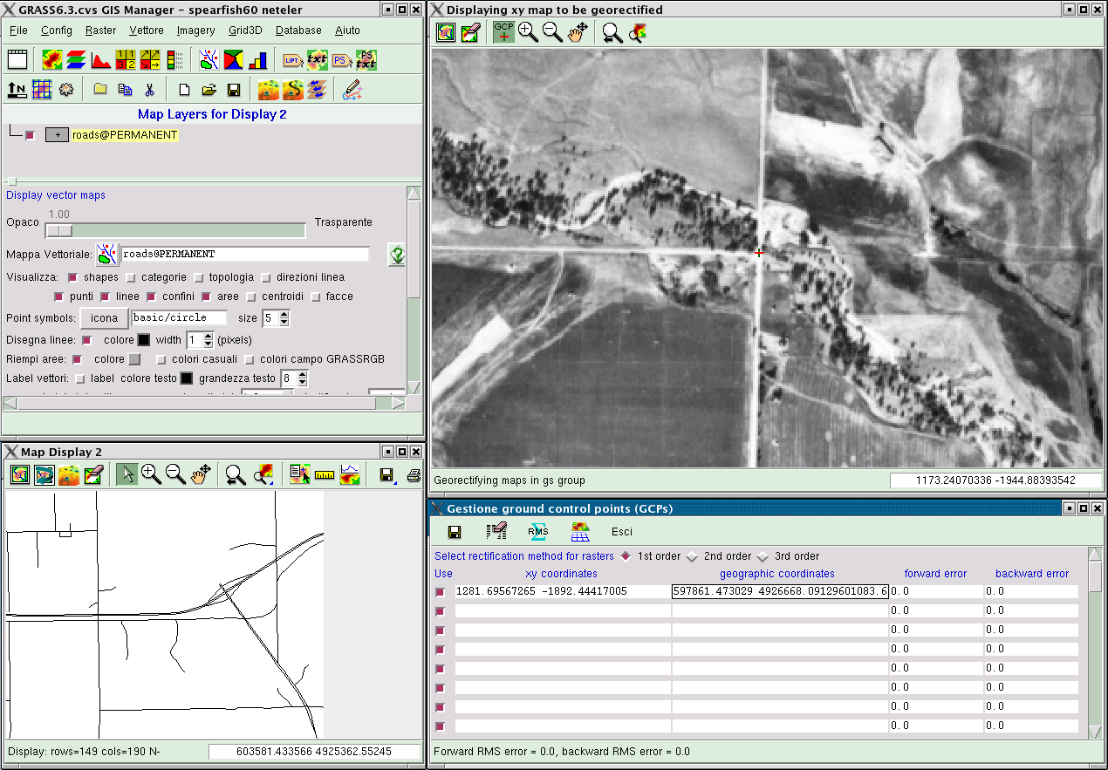
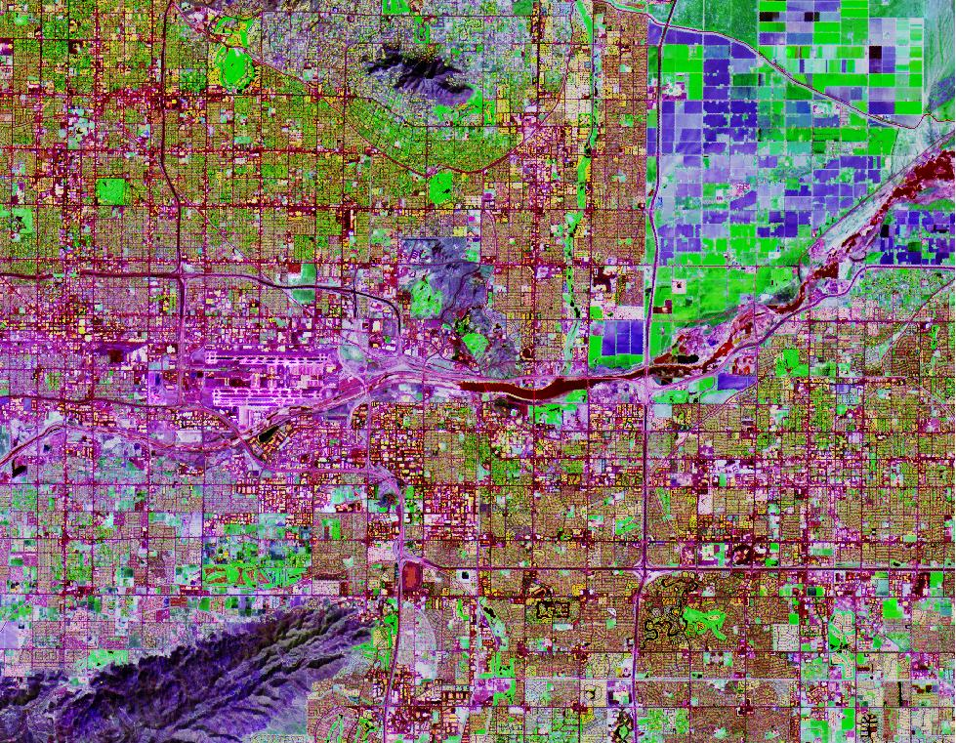
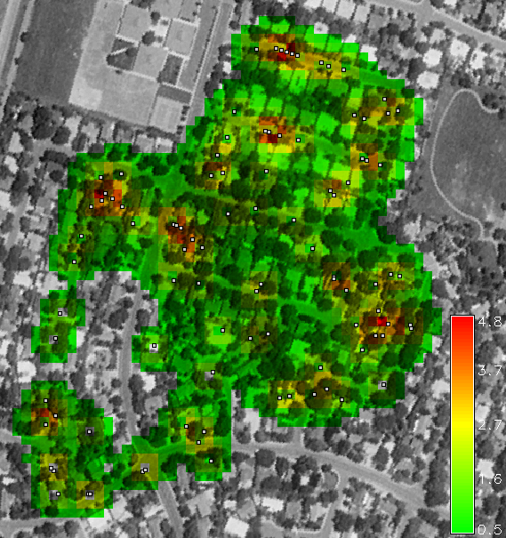
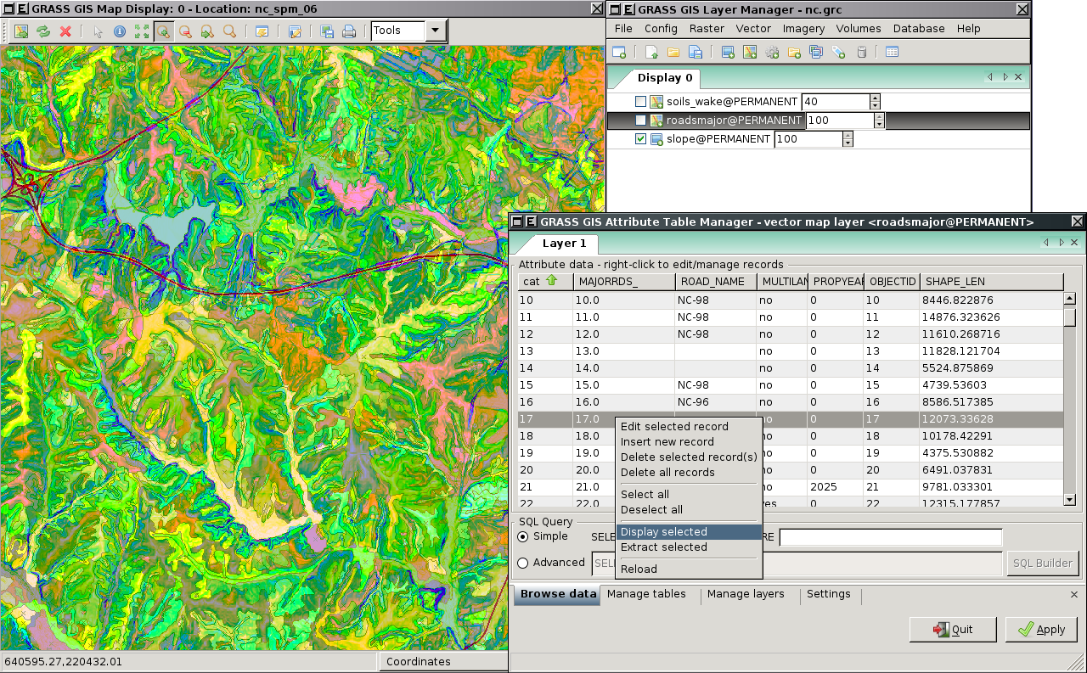

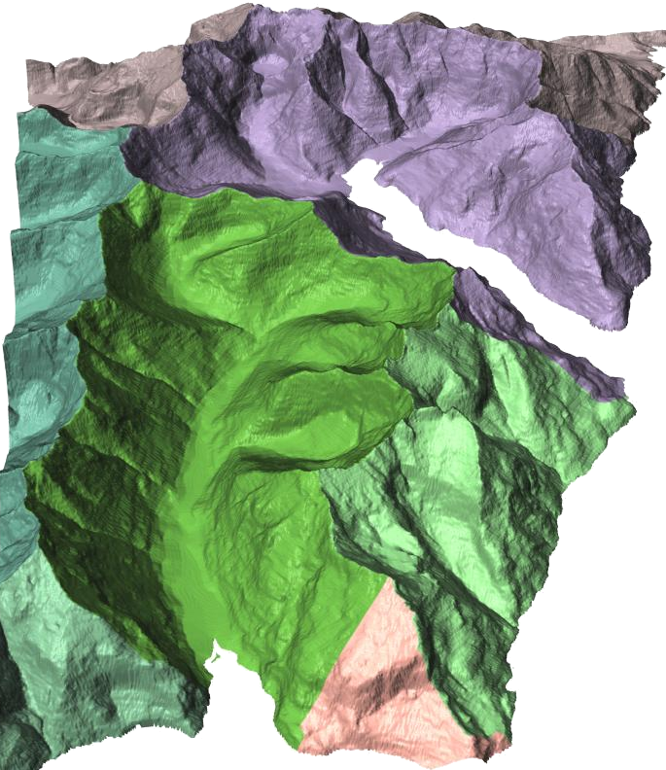
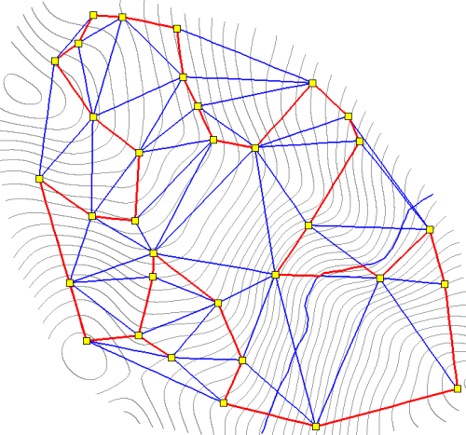
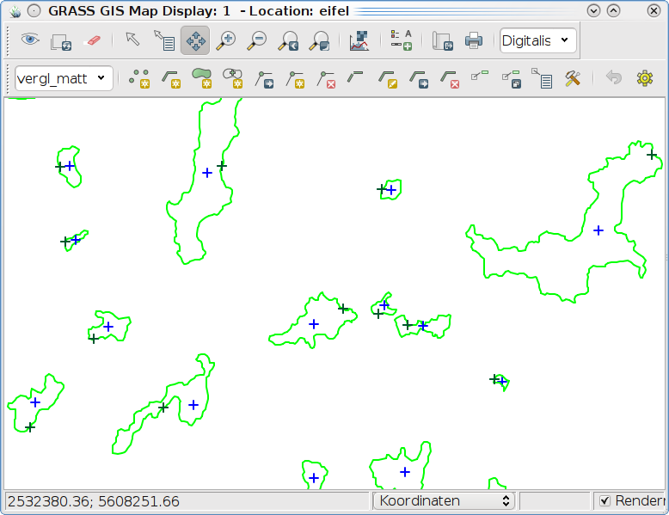
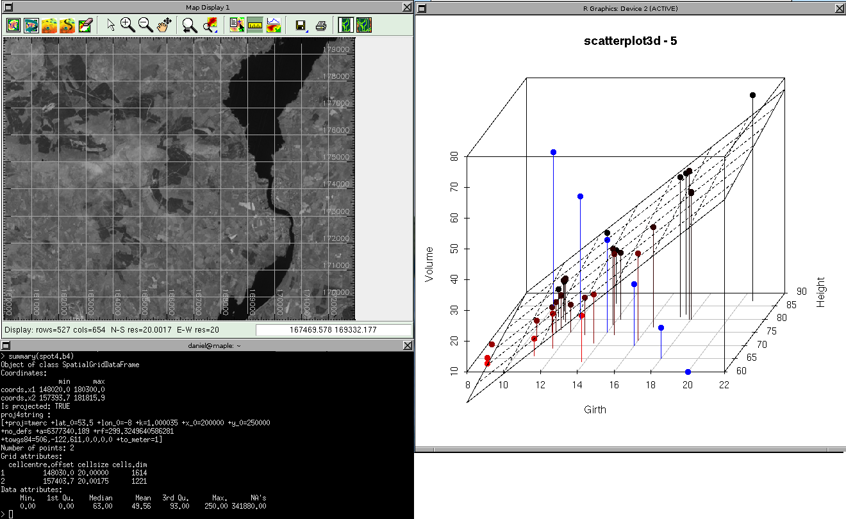
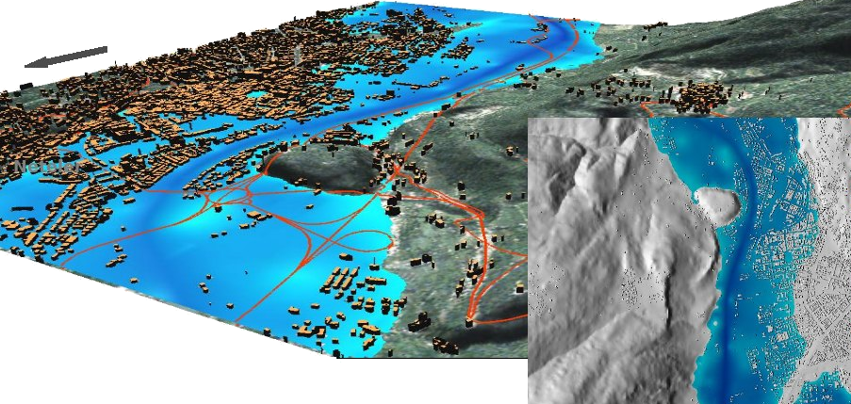



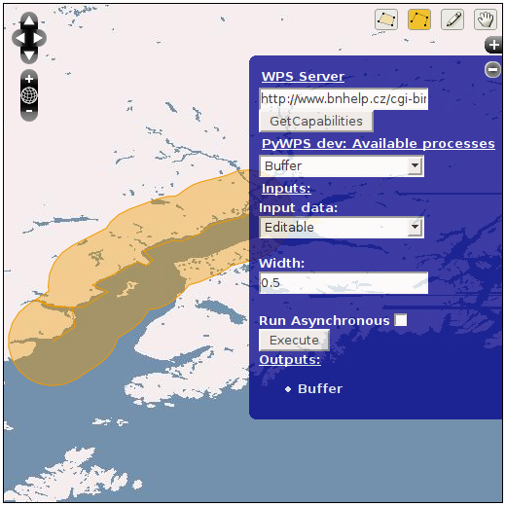
GRASS GIS
The World Leading Free Software GIS
What is GRASS?
GRASS (Geographic Resources Analysis Support System) is the most comprehensive open source GIS. GRASS is a hybrid, modular geoinformation system with raster-and vector functions. GRASS is available under the GNU General Public License and is a freely available software. The system provides raster and vector data, topological functions,
3D-Data
GRASS is able to process both three-dimensional vector and raster data. For instance, this can be used for modeling ground water as well as for precipitation modeling.
Photo-realistic landscapes can be generated from digital terrain models and satellite imagery in conjunction with Pov-Ray.
3D Raster and Voxel processing, image processing, spatial modelling, visualization capabilities, map production and the import and export of various GIS data formats. As a portable software it runs on the common operating systems: (Linux, Mac OS X, Windows) with a graphical user interface, and optionally a command line interface.
Distribution of Percipitation in der Slovakia (H.Mitasova)
Ground water modelling (S. Gebbert)
History of GRASS GIS
GRASS was first developed in 1982 by the U.S. Army Corps of Engineers. The fact that the development has been funded by tax money, led to the free utility of the program.
GRASS 4.0 was the first version released on the Internet in the 1990s. In 1997 the GRASS Development Team was founded at Baylor University (Texas), and version 4.2 was released in November of that year. Since 1999, GRASS is released under the GPL. The development is now coordinated from Europe (now Fondazione E. Mach, Italy; formerly by the Department of Geography, University of Hanover, Germany). Since February 2008 GRASS is an official OSGeo project. Currently GRASS is nearing release of version 6.4.
(M. Neteler)
Remote Sensing
GRASS has a plethora of methods for processing remotely sensed data. In addition, to radiometric and geometric corrections, GRASS has extensive image classification, image enhancement, segmentation, change detection and Principal Component Analysis capabilities.
Raster / Vector Processing
GRASS has evolved into a powerful and complete GIS. Traditionally, GRASS was particularly strong in the field of raster and image processing and of comparable to ArcInfo.
Georektifizierung mit dem Tcl/Tk GUI (M. Neteler)
Hauptkomponentenanalyse mit Asterdaten (M.Barton)
Analysing WLAN-Strength
(D. Beaudette)
GRASS and
GRASS seamlessly links with R using the spgrass6 interface, which facilitates statistical analysis of geographical data in R, the 'lingua franca' of statisticians.
Processing attribute data with the WXPython GUI
Besides traditional methods such as cluster analysis and kriging it is also possible to analyse point patterns, habitats and telemetry data with R. Simple statistical summaries and other regionalizations such as kNN method can be carried out within R. It is equally possible to harness the visualisation capabilities of R.
Analysing watersheds
Editieren von Vektordaten mit dem WXPython-GUI
Shortest route to collect data logger in mountainious terrain
(D. Beaudette)
GRASS and Database Management Systems
To manage your attribute data in GRASS you can choose from the most popular database management systems. At present, drivers for PostgreSQL, MySQL available, Sqlite, and the DBF format are supported. In contrast to the full relational database managment systems, the DBF driver has only limited capabilities.
Überflutung von Trento (M. Neteler)
Web Processing Services & Web GIS
For some time there are different ways to use GRASS as a Web Processing Service. For examples PyWPS, WPS Server and the PHP project called ZOO. In GRASS 7 an XML document containing the WPS process description issued automatically if the module is called with the parameter "--wps-process-description. In addition, GRASS data can be easily integrated into UMN Mapserver applications.
Further Information:
Homepage: http://grass.osgeo.org/
Wiki: http://grass.osgeo.org/wiki
Download: http://grass.osgeo.org/download
Internationale Mailing List: http://grass.osgeo.org/community/support.php
Design by Robert Nuske & Daniel McInerney

