Slide 1
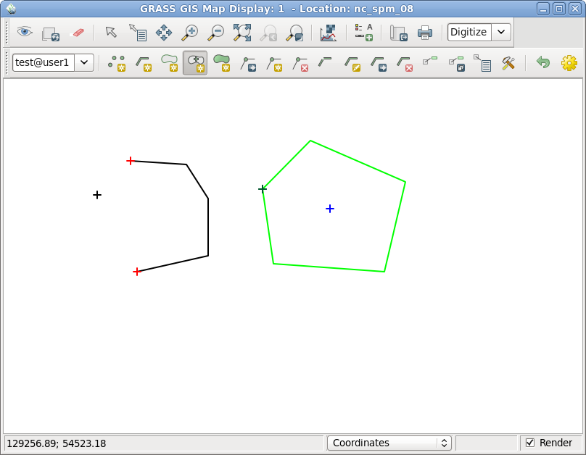
Basic vector topological elements in GRASS GIS 7
line
centroid
boundary
point

