Slide 1
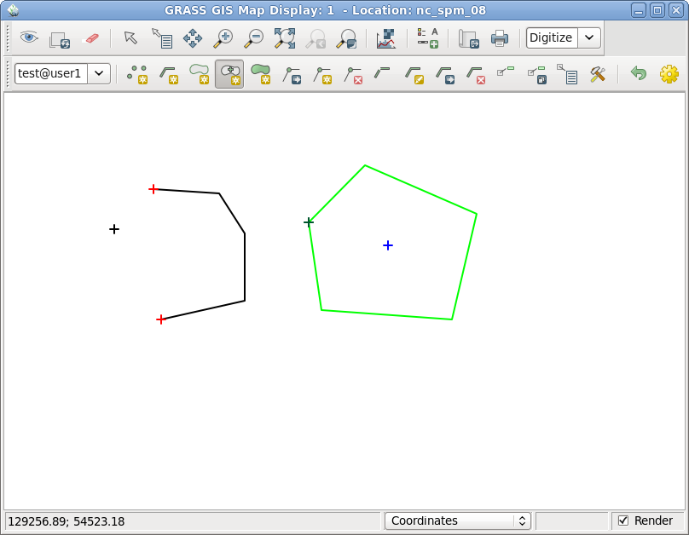
Basic vector geometry types in GRASS GIS 7
line
centroid
boundary
point

