Slide 1
Real-time Collaborative Editing System
徐直前 黄子昂 吴永基 金朔苇

Slide 2
Part I – CRDT Algorithm

Slide 3
Review: The Problem of Synchronization
Original State
Alice:
We wanted cars, instead we got characters.
Bob:
We wanted cars, instead we got characters.

Slide 4
Review: The Problem of Synchronization
Original State
Alice:
We wanted cars, instead we got 140 characters.
insert(“140 ”, 30)
insert(“flying”, 9)
Bob:
We wanted flying cars, instead we got characters.

Slide 5
Review: The Problem of Synchronization
Scenario 1: Alice‘s OP arrives first
Alice:
We wanted flying cars, instead we got 140 characters.
Bob:
We wanted flying cars, instead we got 140 characters.

Slide 6
Review: The Problem of Synchronization
Oops!
Scenario 2: Bob‘s OP arrives first
Alice:
We wanted flying cars, instead we got 140 characters.
Bob:
We wanted flying cars, instead 140 we got characters.

Slide 7
Solution: Commute + Idempotent
Rule 1:
Commutativity
Rule 2:
Idempotence

Slide 8
Solution: Commute + Idempotent
Rule 1:
Commutativity
If every operation could commute with every other operation, the clients would converge to the same state regardless of which messages arrived where first.

Slide 9

Solution: Commute + Idempotent
Rule 2:
Idempotence
$$f\left(f\left(x\right)\right)=f(x)$$
Apply the operation twice gets the same result as applying it once

Slide 10
Solution: Commute + Idempotent
Rule 2:
Idempotence
Problem Solved:
If the operation the client sent got duplicated. (UDP instead of TCP)
Two clients do the same operation at the same time.
Duplicated operation becomes a nop.

Slide 11
CRDT
A data structure which can be replicated across multiple computers in a network, where the replicas can be updated independently and concurrently without coordination between the replicas, and where it is always mathematically possible to resolve inconsistencies which might result.

Slide 12
Introduction: The Example of a Bag

Slide 13

Introduction: The Example of a Bag
Imagine Alice, Bob and Oscar are operating on a common bag.
Alice
Bob
Oscar

Slide 14
Introduction: The Example of a Bag
Imagine Alice, Bob and Oscar are operating on a common bag.
Alice
Bob
Remove(🍎)
Remove(🍎)
Oscar
Add(🍎)

Slide 15
Introduction: The Example of a Bag
Local operation first, then remote operations.
Remove(🍎)
Remove(🍎)
Alice
Add(🍎)
Add(🍎)
Bob
Remove(🍎)
Remove(🍎)
Oscar

Slide 16
Introduction: The Example of a Bag
Local operation first, then remote operations.
Alice and Bob:
Depend on receiving add first or remove first
?
?
Alice
Bob
Receives two remove operations
Oscar

Slide 17
Introduction: The Example of a Bag
Receives remove first
Receives add first

Slide 18
Solution
Though the two apples are the same, they are all apples.
We assign a globally unique identifier to differentiate them

Slide 19
Introduction: The Example of a Bag
Imagine Alice, Bob and Oscar are operating on a common bag.
Remove(🍎1)
Remove(🍎1)
Alice
Add(🍎2)
Add(🍎2)
Bob
Remove(🍎1)
Remove(🍎1)
1
2
Oscar

Slide 20
Introduction: The Example of a Bag
Problem solved!
2
2
Alice
Bob
2
Oscar

Slide 21
Inspiration
A text document is an ordered bag of characters!
Generate unique ID for characters.
Sort order of those ID => Sequence of the document

Slide 22
ID for Characters
S u p r m a c y
1 2 3 4 5 6 7 8
Insert the missing “e”
S u p r e m a c y
1 2 3 4 4.5 5 6 7 8
We create a new ID(4.5) for the character “e”

Slide 23
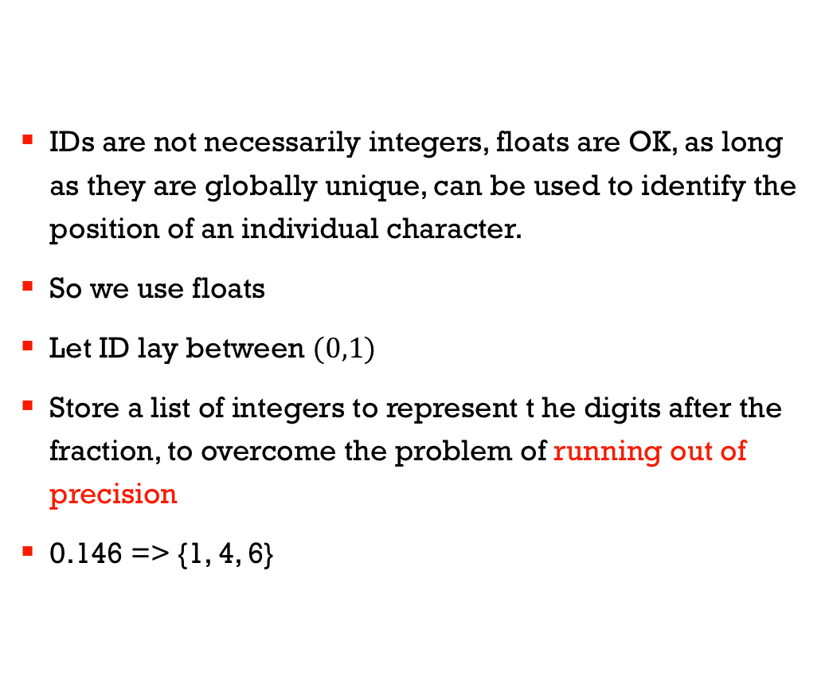
Notes
IDs are not necessarily integers, floats are OK, as long as they are globally unique, can be used to identify the position of an individual character.
So we use floats
Let ID lay between $(0,1)$
Store a list of integers to represent t he digits after the fraction, to overcome the problem of running out of precision
0.146 => {1, 4, 6}

Slide 24
Problems?
Two clients generating the same ID at the same time (e.g. insert a character at the same position concurrently)
One client generating an ID that was already generated (e.g. delete a character and reinsert it)

Slide 25
Solution
Tag the digit of the character with a client ID that generate it!

Slide 26
Solution
Tag the digit of the character with a client ID that generate it!
P
e
r
a
d
a
s
t
r
a
{(1, Alice)}
{(2, Alice)}
{(3, Alice)}
{(4, Alice)}
{(5, Alice)}
{(6, Alice)}
{(7, Alice)}
{(8, Alice)}
{(9, Alice)}
{(10, Alice)}
{(11, Alice)}
{(12, Alice)}

Slide 27
Solution
Bob inserts “aspera”
P
e
r
a
s
p
e
r
a
a
d
a
s
t
r
a
{(1, Alice)}
{(2, Alice)}
{(3, Alice)}
{(4, Alice)}
{(4,Alice),(1,Bob)}
{(4,Alice),(2,Bob)}
{(4,Alice),(3,Bob)}
{(4,Alice),(4,Bob)}
{(4,Alice),(5,Bob)}
{(4,Alice),(6,Bob)}
{(4,Alice),(7,Bob)}
{(5, Alice)}
{(6, Alice)}
{(7, Alice)}
{(8, Alice)}
{(9, Alice)}
{(10, Alice)}
{(11, Alice)}
{(12, Alice)}

Slide 28
Data Structure
Position identifier: a tuple (position, clock), the clock is the Lamport clock at the client
Position: a list of identifiers
Identifier: a tuple of (digit, client id) to represent a single digit in a position
The digit can be in any base, normally we use 256

Slide 29
Operations
Insert: Sent character to insert + position identifier
Delete: Sent the position identifier

Slide 30
Operations
Remote change: insertion
Get index of the preceding character in the CRDT
Insert character in the CRDT
Create a local change inserting a character at that index
Remote change: deletion
Get the index of a character with the same position identifier in the CRDT
Delete that character in the CRDT
Create a local change deleting a character at that index
Local change: insertion at position n
Find the n th and (n+1) th character in the CRDT
Create a position identifier between character n and n + 1 and insert character in the CRDT
Send out a remote insert change for that character
Local change: deletion at position n
Find the nth character in the CRDT
Delete that character in the CRDT
Send out a remote delete change for that character

Slide 31
Part II – Overview

Slide 32
Features
Implemented CRDT
Access Control & Permission Management
Markdown Syntax & Live Preview

Slide 33
Permission Management
Only admin (the first user to login) can modify permissions.
Admin use \{user}\ command to specify a region that can be edited by the specific user (guest).
Guests cannot use that command to modify other guests’ permission.
The demo version only supports a single guest editing at a time, but easy to extend.

Slide 34
Part II – Architecture

Slide 35
server
服务器负责转发和确认各用户的id信息，并且保留一个副本
admin
转发给包括admin在内的所有客户端
本地检查权限，发出修改
收到修改，同步更新crdt和editor
guest1
guest2
guest3

Slide 36
server
只有带有Admin的id的权限控制标记是有效的
拥有完全修改权限
admin
客户端接收到以后，更新各自的权限表，根据权限表，可以判断自己是否有权限来修改
不具有修改用户权限的能力
guest1
guest2
guest3

Slide 37
Part IV – 可改进的部分

Slide 38
难点与未来目标
更友好的用户界面
代码高亮
为用户分配不同标识符（颜色）
多样化渲染
富文本
图片与视频
文档隔离与用户身份
账号管理
多文档
实现完善的用户权限管理
管理员分配
客户分组

Slide 39
Part V - Demo
111.231.146.48:4000
111.231.146.48:4004

Slide 40
Thanks!

