Slide 1
Unikernel
Monitor
Based on Rumprun Unikernel
冉礼豪 管修贤 胡煜霄 戈惊宇
报告：任正行

Slide 2
Implementation
Motivation
Design
Future

Slide 3
1
Motivation

Slide 4
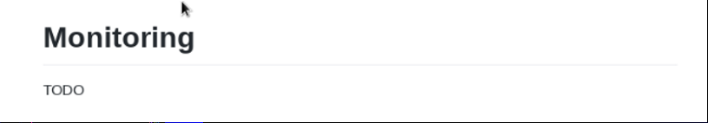
1
Unikernel is good but very unreliable
The major obstacle to developing an unikernel is debugging.
We lose control !
Notes:
无论何时，对应用的监控和日志收集都是必要的。

Slide 5
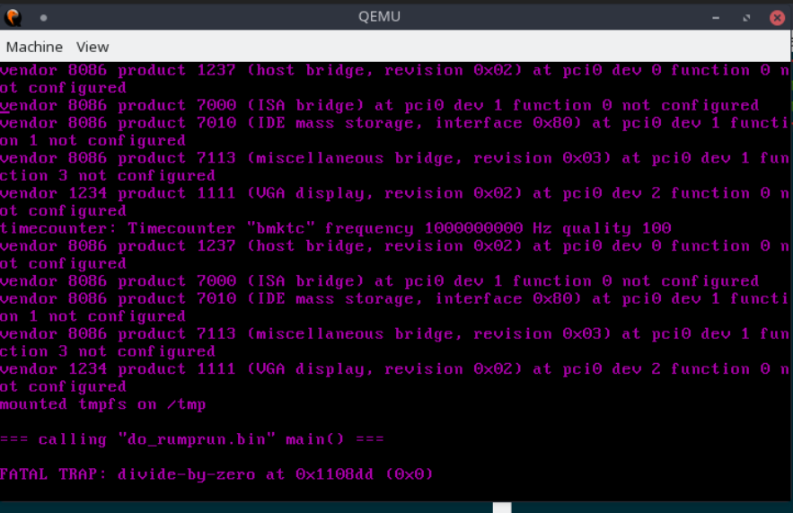

Slide 6
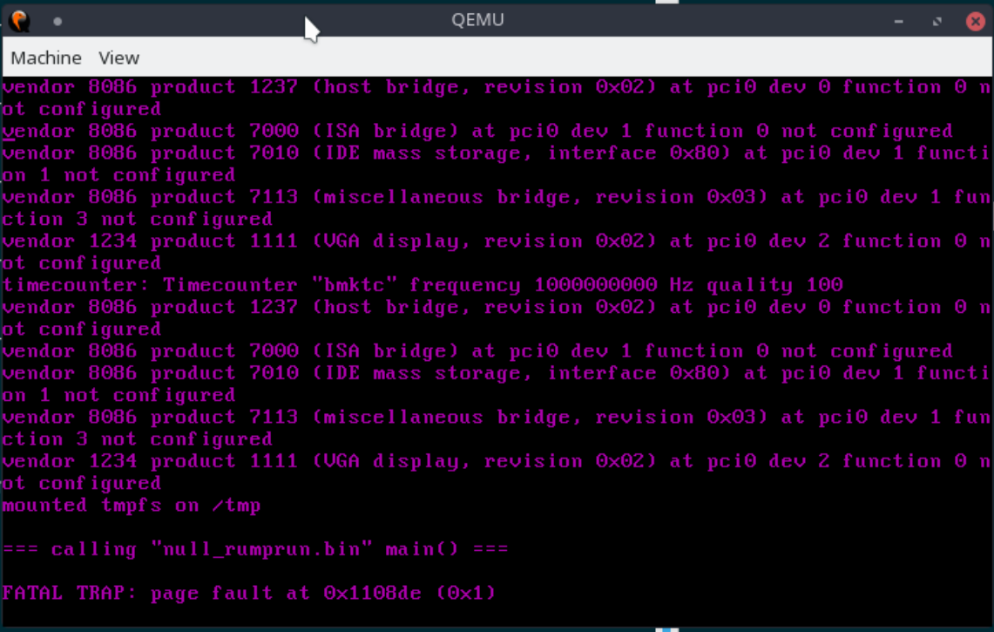

Slide 7
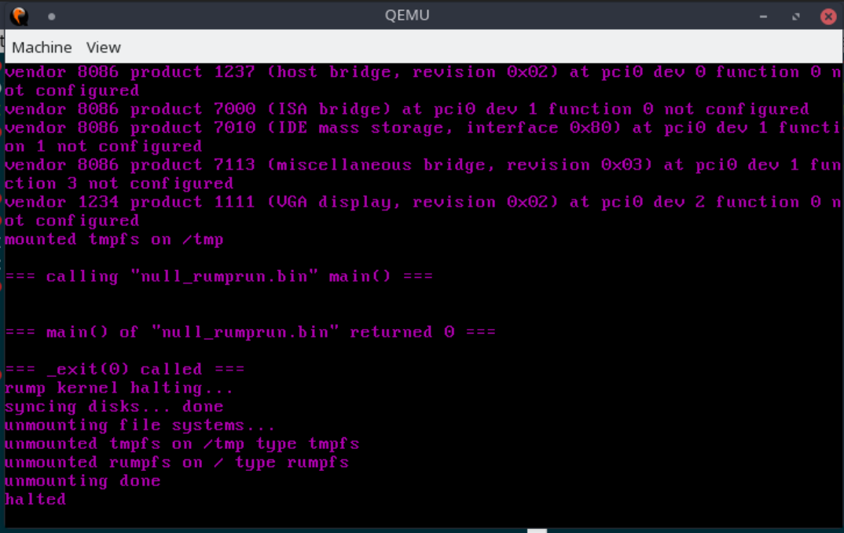

Notes:
在这种情况下，程序一旦出问题，维护代价都会非常大，甚至是基本无法维护的。

Slide 8
3
How to solve
Serial I/O
Print it on virtual VGA?
Network
Write in a file?
Virtual Socket.
Notes:
VGA: 有的时候没有。串口：资源有限，复用困难。File：FS的问题。

Slide 9
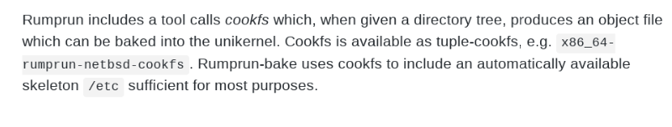

Slide 10
2
Design

Slide 11
Tap/Tun
Service/Client mode
Packet Format

Slide 12
1
Tap/Tun
Tun/tap interfaces are a feature offered by Linux (and probably by other UNIX-like
operating systems) that can do userspace networking, that is, allow userspace programs
to see raw network traffic (at the ethernet or IP level) and do whatever they like with it.
software-only interfaces
The interface can be transient

Slide 13
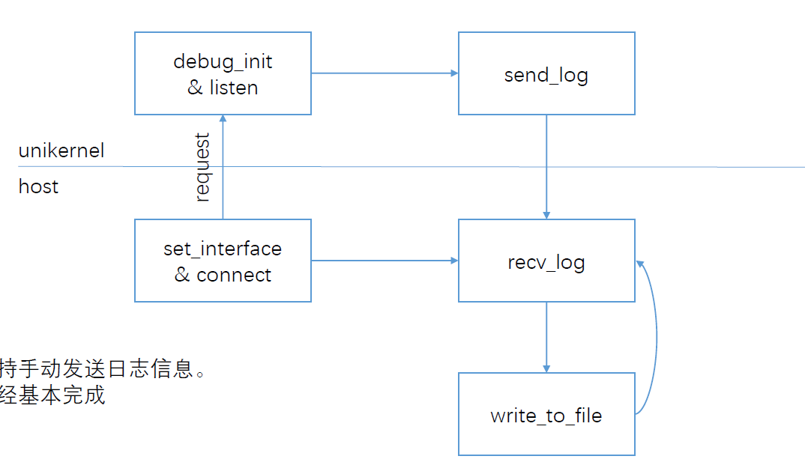
2
Service/Client mode

Slide 14
3
Packet
date
type
detail

Slide 15
4
Show Results

Slide 16
3
Implementation

Slide 17
1
Tun/Tap
You can think of a tun/tap interface as a regular network interface that, when the kernel decides that the moment has come to send data "on the wire", instead sends data to some userspace program that is attached to the interface
/dev/net/tun
Ioctl()

Slide 18
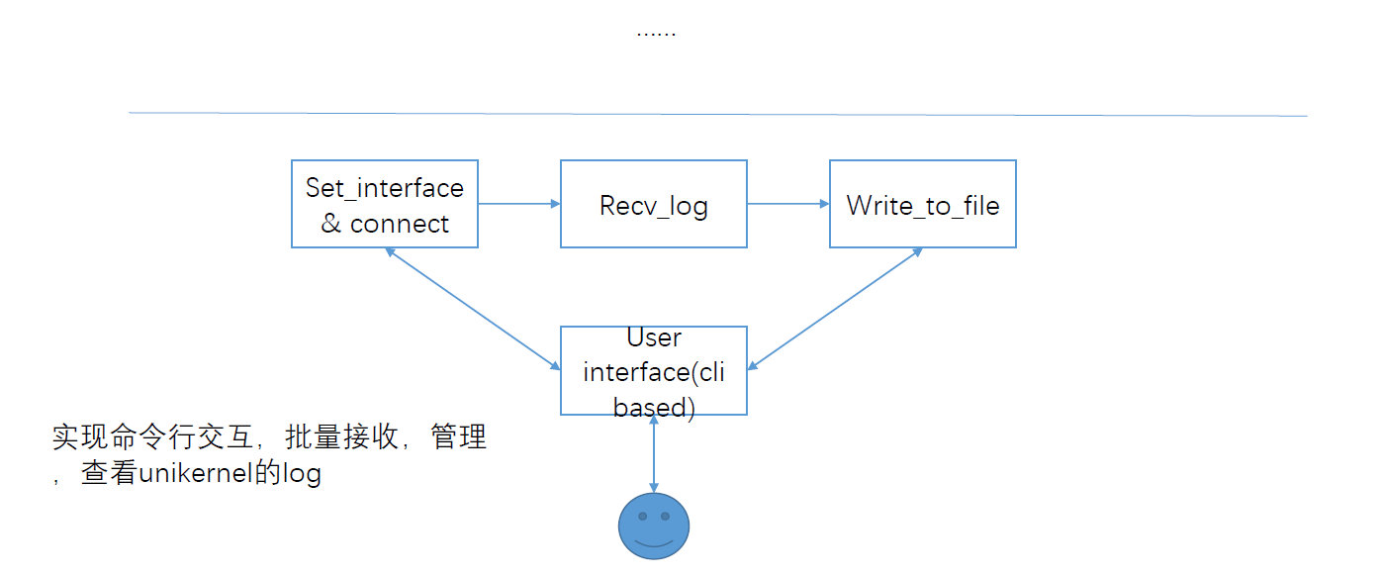
2
Interface

Slide 19
3
Evaluation
Practicality
1
2
Scenes to be used.
UMonitor
Extensibility.
4
3
Robustness

Slide 20
4
Future
PPT模板下载：www.1ppt.com/moban/ 行业PPT模板：www.1ppt.com/hangye/
节日PPT模板：www.1ppt.com/jieri/ PPT素材下载：www.1ppt.com/sucai/
PPT背景图片：www.1ppt.com/beijing/ PPT图表下载：www.1ppt.com/tubiao/
优秀PPT下载：www.1ppt.com/xiazai/ PPT教程： www.1ppt.com/powerpoint/
Word教程： www.1ppt.com/word/ Excel教程：www.1ppt.com/excel/
资料下载：www.1ppt.com/ziliao/ PPT课件下载：www.1ppt.com/kejian/
范文下载：www.1ppt.com/fanwen/ 试卷下载：www.1ppt.com/shiti/
教案下载：www.1ppt.com/jiaoan/
字体下载：www.1ppt.com/ziti/

Slide 21
1
All kinds of Unikernel
Clive, Clickos, OSv, IncludeOs….
Benefit from Taptun

Slide 22
2
Interactive Monitor

Slide 23
3
Pre-compiling
Make it easier for the developer to get debug info.

Slide 24
THANK
YOU

