Slide 1
[ERASURE CODE ON CEPH]
MID TERM REPORT

Slide 2





Centralized System V.S. Distributed system
 

Slide 3

Distributed storage
Hadoop
Ceph
 

Slide 4

CAP
CONSISTENCY

AVAILABILTY
PARTITION
TOLERANCE


 

Slide 5

[ERSURE CODE]
n
1
0
0
0
0
D1
0
1
0
0
0
D2
D1
0
0
1
0
0
D3
D2
=
0
0
0
1
0
*
D4
n + m
D3
0
0
0
0
1
D5
D4
C1
B11
B12
B13
B14
B15
D5
C2
B21
B22
B23
B24
B25
C3
B31
B32
B33
B34
B35

Slide 6


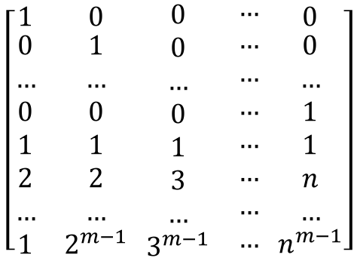


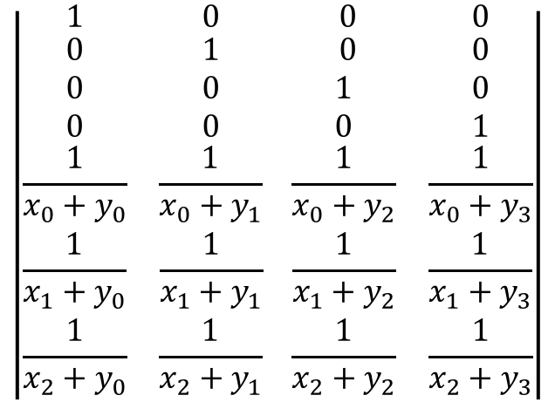

CRS
$$\left|\begin{matrix}1 & 0 \\ \begin{aligned}0 \\ 0 \\ 0 \\ \frac{1}{x_{0}+y_{0}} \\ \frac{1}{x_{1}+y_{0}} \\ \frac{1}{x_{2}+y_{0}} \\ \end{aligned} & \begin{aligned}1 \\ 0 \\ 0 \\ \frac{1}{x_{0}+y_{1}} \\ \frac{1}{x_{1}+y_{1}} \\ \frac{1}{x_{2}+y_{1}} \\ \end{aligned}\end{matrix} \begin{matrix} 0 & 0 \\ \begin{aligned} 0 \\ 1 \\ 0 \\ \frac{1}{x_{0}+y_{2}} \\ \frac{1}{x_{1}+y_{2}} \\ \frac{1}{x_{2}+y_{2}} \\ \end{aligned} & \begin{aligned}0 \\ 0 \\ 1 \\ \frac{1}{x_{0}+y_{3}} \\ \frac{1}{x_{1}+y_{3}} \\ \frac{1}{x_{2}+y_{3}} \\ \end{aligned}\end{matrix}\right|$$
$$\left[\begin{matrix}1 & 0 \\ \begin{aligned}0 \\ … \\ 0 \\ 1 \\ 2 \\ … \\ 1\end{aligned} & \begin{aligned}1 \\ … \\ 0 \\ 1 \\ 2 \\ … \\ 2^{m−1}\end{aligned}\end{matrix} \begin{matrix}\begin{aligned}0 \\ 0 \\ … \\ 0 \\ 1 \\ 3 \\ … \\ 3^{m−1}\end{aligned} & \begin{aligned}… \\ … \\ … \\ … \\ … \\ … \\ … \\ …\end{aligned}\end{matrix} \begin{matrix}0 \\ \begin{aligned}0 \\ … \\ 1 \\ 1 \\ n \\ … \\ n^{m−1}\end{aligned}\end{matrix}\right]$$
$$\left|\begin{aligned}d_{0} \\ d_{1} \\ … \\ d_{3} \\ c_{0} \\ c_{2} \\ … \\ c_{2}\end{aligned}\right|$$
$$\left|\begin{aligned}d_{0} \\ d_{1} \\ d_{2} \\ d_{3} \\ c_{0} \\ c_{1} \\ c_{2}\end{aligned}\right|$$
$$\left|\begin{aligned}d_{0} \\ d_{1} \\ d_{2} \\ d_{3} \\ \end{aligned}\right|$$
$$\left|\begin{aligned}d_{0} \\ d_{1} \\ … \\ d_{3} \\ \end{aligned}\right|$$
=
=
 

Slide 7
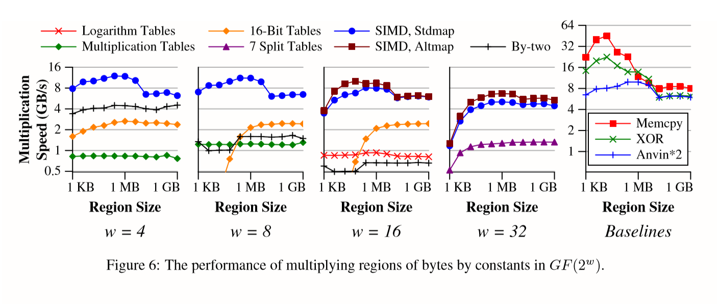

SIMD
byte | f | e | d | c | b | a | 9 | 8 | 7 | 6 | 5 | 4 | 3 | 2 | 1 | 0
table1 | 0b | 0c | 05 | 02 | 04 | 03 | 0a | 0d | 06 | 01 | 08 | 0f | 09 | 0e | 07 | 00
byte | f | e | d | c | b | a | 9 | 8 | 7 | 6 | 5 | 4 | 3 | 2 | 1 | 0
table1 | 2d | 2a | 23 | 24 | 31 | 36 | 3f | 38 | 15 | 12 | 1b | 1c | 09 | 0e | 07 | 00
table2 | ea | 9a | 0a | 7a | 37 | 47 | d7 | a7 | 4d | 3d | ad | dd | 90 | e0 | 70 | 00
 

Slide 8

Full stripe writes

⬄
Reconstruct Writes
Read-modify writes
⇩
 

Slide 9


environment



 

Slide 10

Case：FACEBOOK
5 file blocks
5 file blocks
4 RS parity blocks
X1
X2
X3
X4
X5
X6
X7
X8
X9
X10
P1
P2
P3
X4
S1
S2
Local parity block
Local parity block
S3
implied parity block
 

Slide 11

Case：Microsoft
y2
X0
X1
X2
y0
y1
y2
y2
Py
Px
 

Slide 12
innovation point

EFFICIENCY
Notes:
Improve availability
Accelerate computation
Reducing computational complexity of coding

Slide 13
Next Step（posssibly）?


Slide 14
THANK YOU
FOR LISTENING
Reporter : ZHW
Members: CYK,BC,LS,ZMZ
Time:4.19

