Slide 1
Implementing an OS for Raspberry Pi 3 in Rust
刘云飞 李维晟 汪若辰 余磊

Slide 2
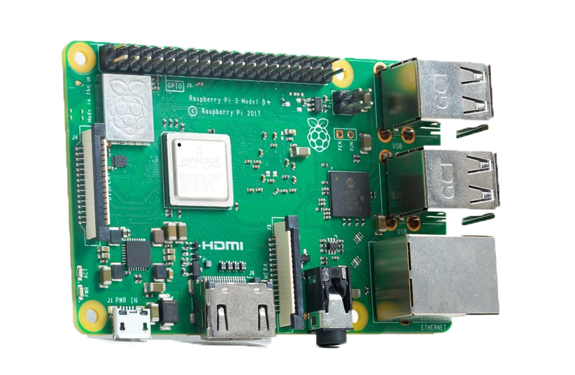

调研

Slide 3
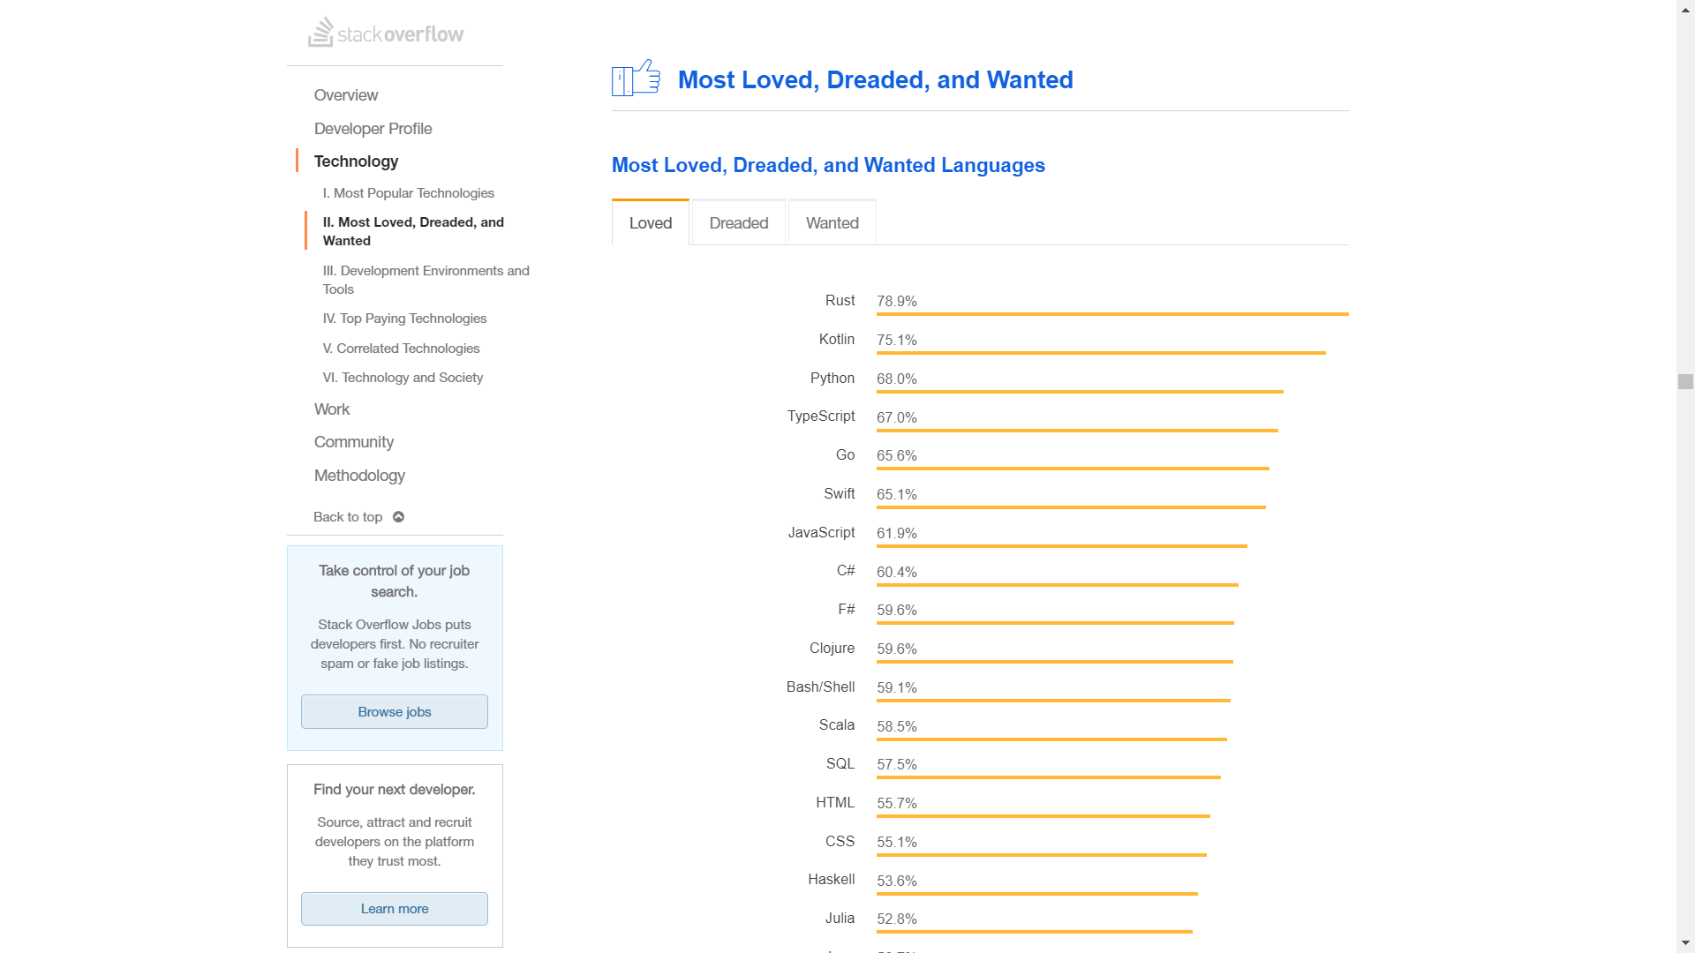

Slide 4
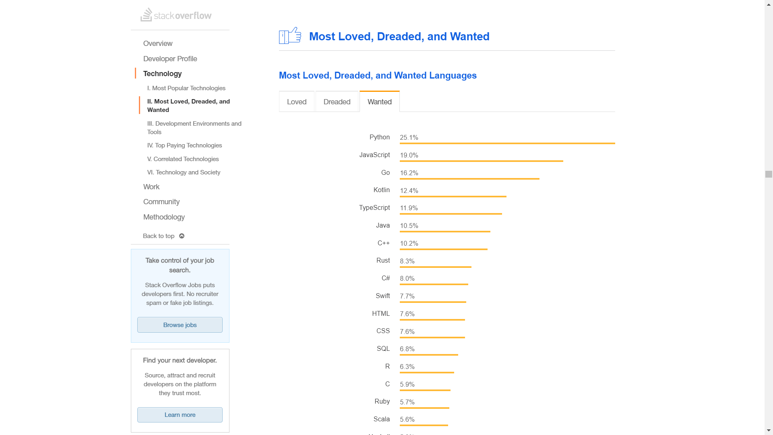

Slide 5


Orbital

Slide 6
可行性

Slide 7
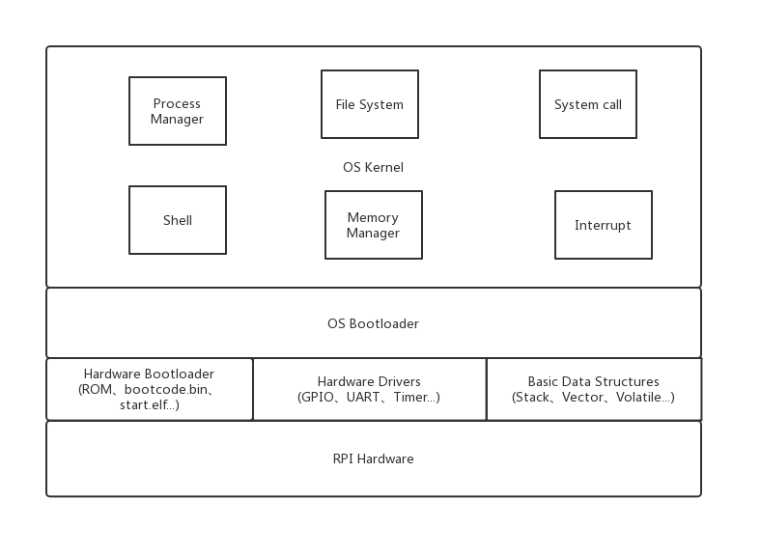

Slide 8
Planning
CS140e
Further …

Slide 9
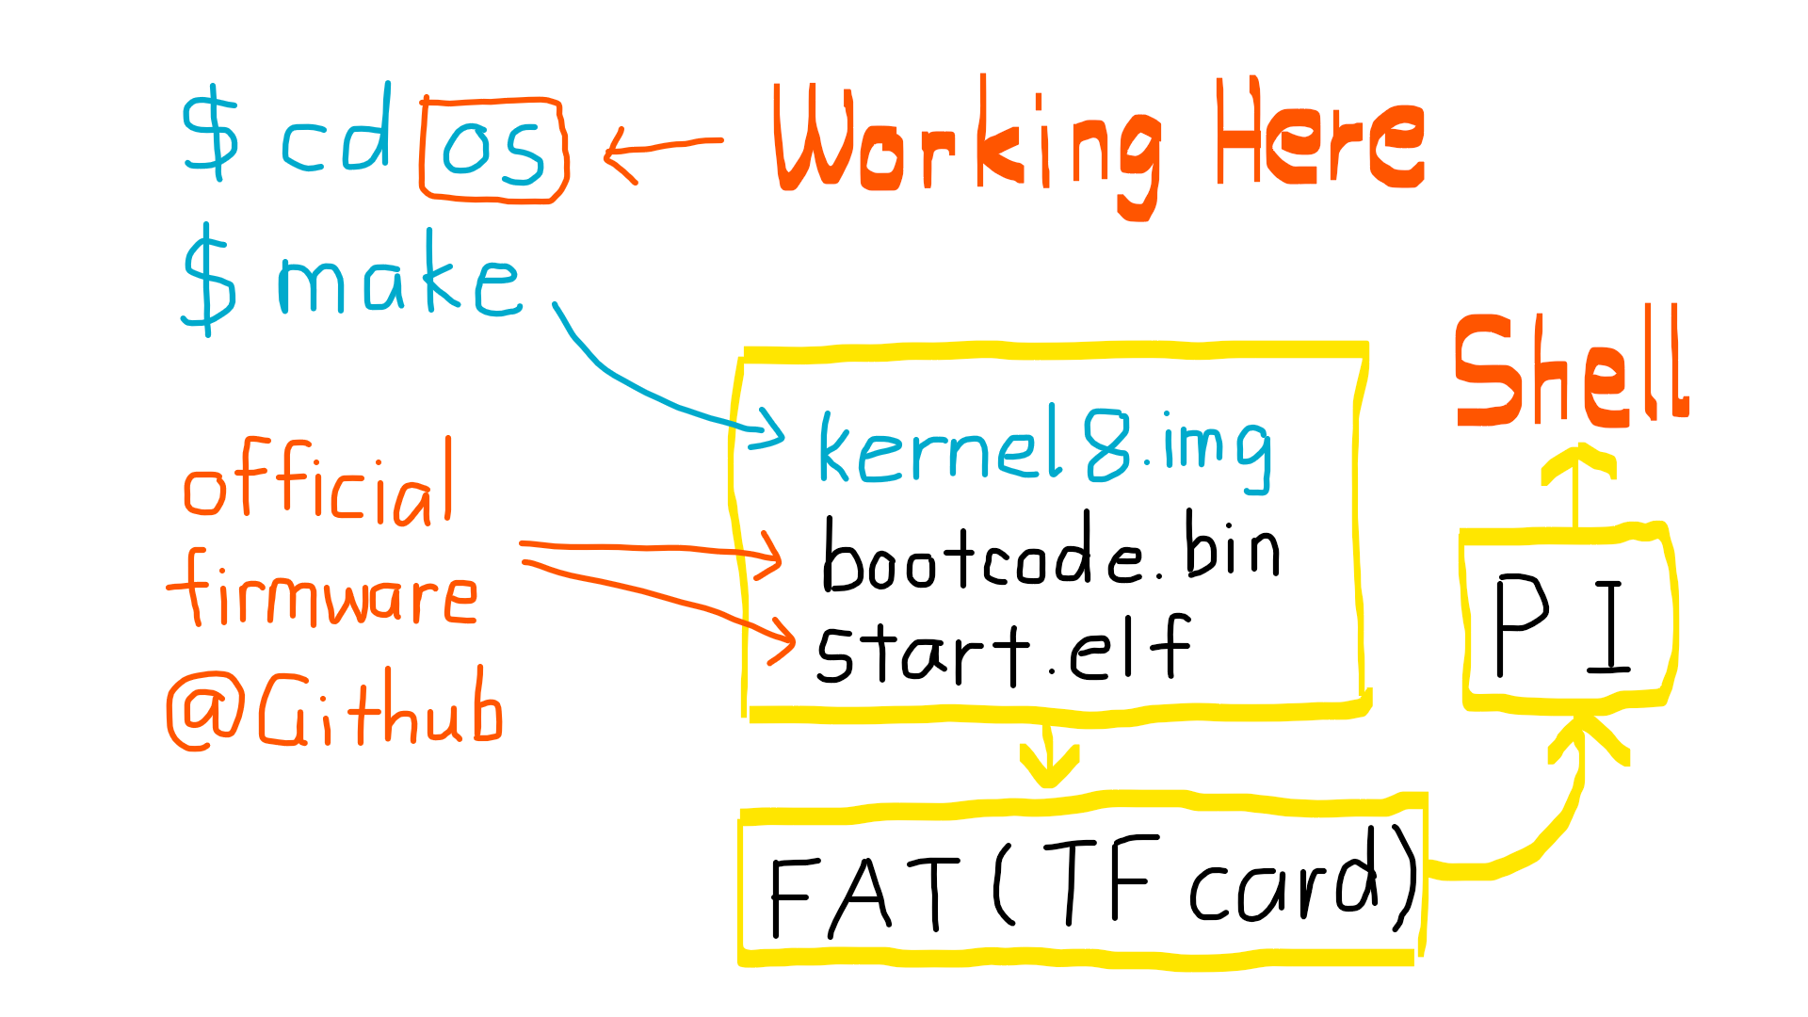

Slide 10
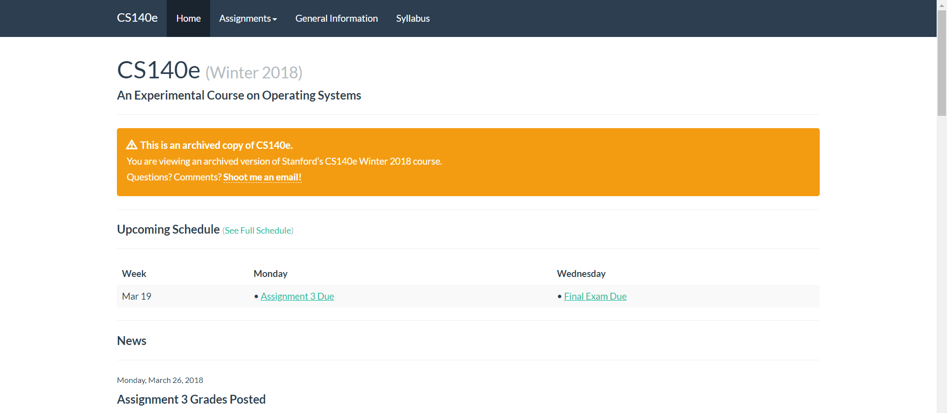
CS140e @ https://cs140e.sergio.bz/

Slide 11
What had we done?
Assignment 0: Blinky
Assignment 1: Shell
Assignment 2: File System
Assignment 3: Spawn
Further …

Slide 12
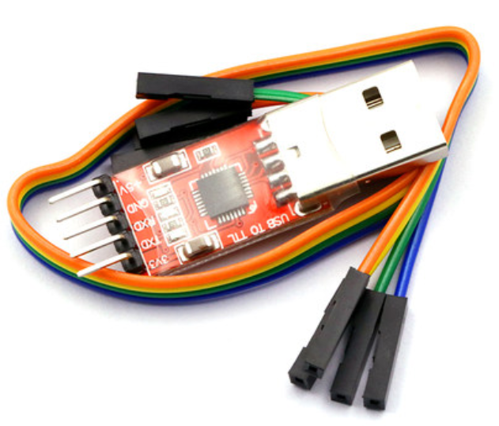
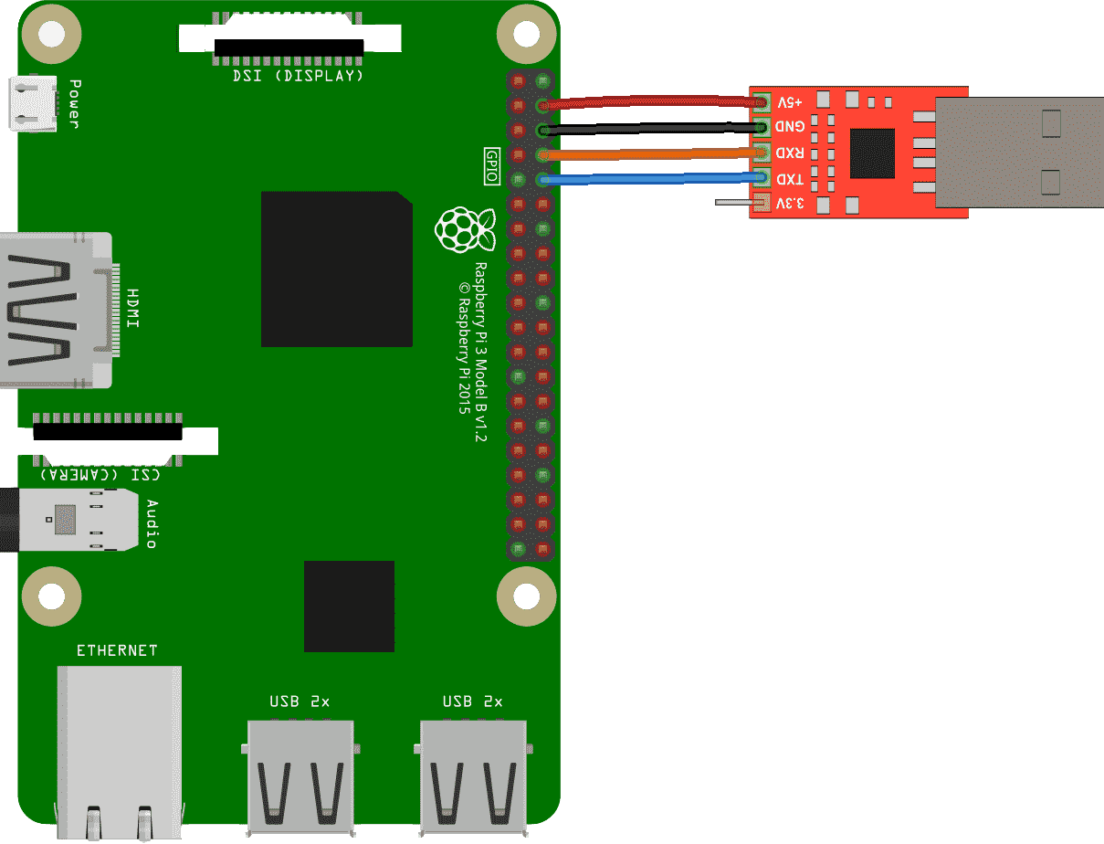
Assignment 0: Blinky
Use USB TTL adapter to communicate with Raspberry Pi.

Slide 13
$ sudo screen /dev/ttyUSB0 115200

Slide 14

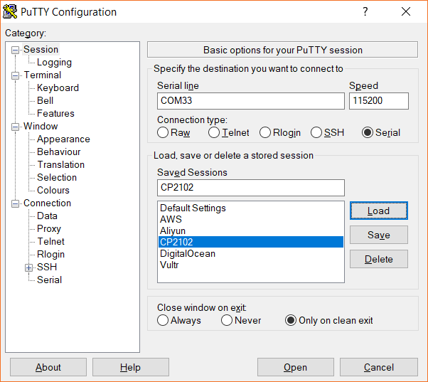
putty.exe COMXX 115200bps

Slide 15
Assignment 1: Shell
StackVec
volatile
xmodem
ttywrite
Timer
GPIO
UART
Shell

Slide 16
Implementing an OS for Raspberry Pi 3 in Rust
Thank You!
刘云飞 李维晟 汪若辰 余磊

