Slide 1
Getting into Data Science with OSHA
Rebecca Bilbro
Bala Venkatesan
Data innovation DC
March 4, 2015
* The views presented here are our own and do not represent the views of the Occupational Safety and Health Administration, U.S. Department of Labor, or any other U.S. government agency.

Slide 2
OSH Act of 1970
Originally required employers to report workplace fatalities and catastrophes (three or more hospitalizations) to OSHA.
As of Jan 1, 2015, employers also required to report serious injuries (amputations, losses of an eye), any employee hospitalizations.
New data will help draw a more comprehensive, real-time map of the landscape of serious and fatal workplace injuries and illnesses.

Slide 3
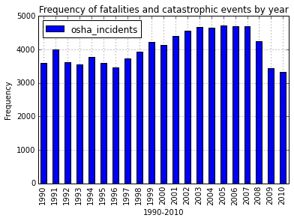
Asking questions with data
What can the first few decades of data captured tell us about workplace hazards?
What’s hidden inside the plateau?

Slide 4
Getting into data science
Georgetown Data Analytics Certificate Program
Python experimentation: BeautifulSoup, Pandas, NumPy, Pearson, MatPlotLib, iPython Notebook
Hypothesis-generation: exploring relationships between OSHA dataset and
seasonality
industry (SIC) codes
unemployment rate
geography

Slide 5
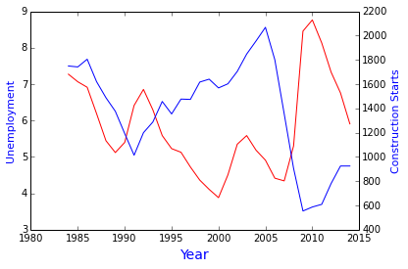
Preliminary findings

Slide 6
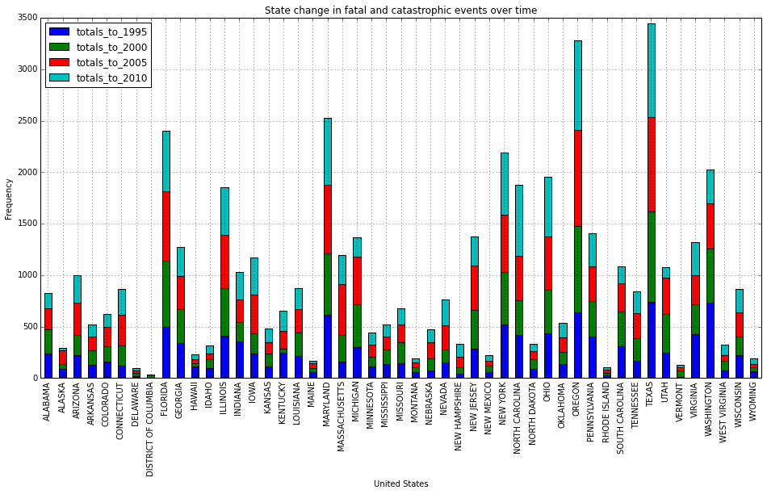
Preliminary findings

Slide 7
Preliminary findings
Employment rates and workplace fatalities are inversely correlated, particularly in the construction sector.
For 1990-2010: increase in fatalities in states just north of Mason-Dixon line correlated with a matching decline in states just south.
Outliers (California, Texas, Oregon, Florida, Maryland) – due merely to larger populations, or something else?

Slide 8
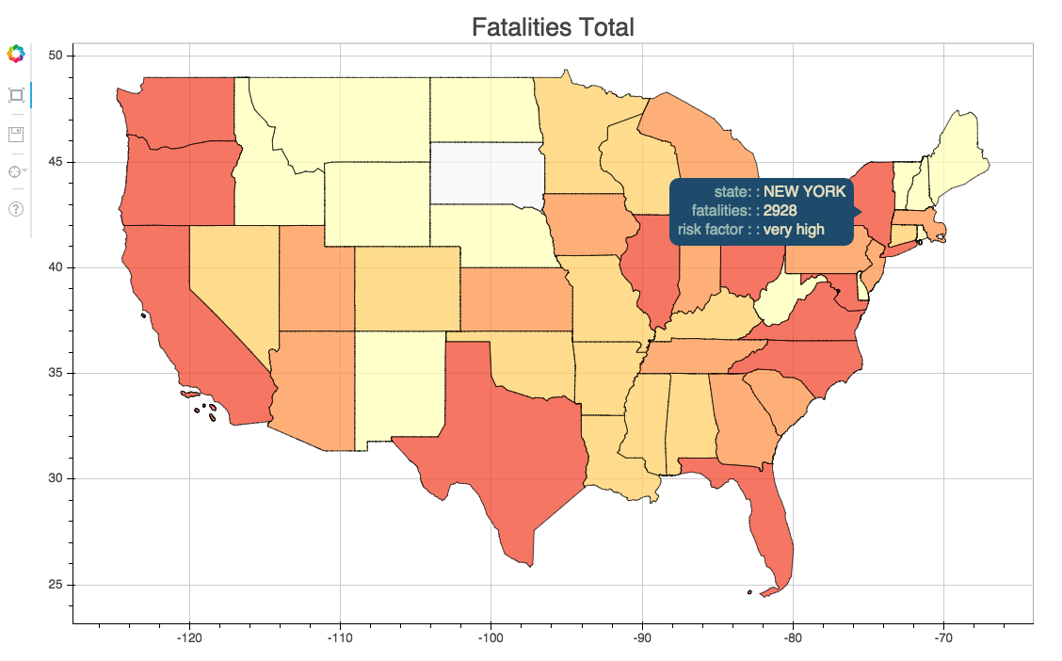
Geographic dispersion of workplace fatalities and catastrophes

Slide 9
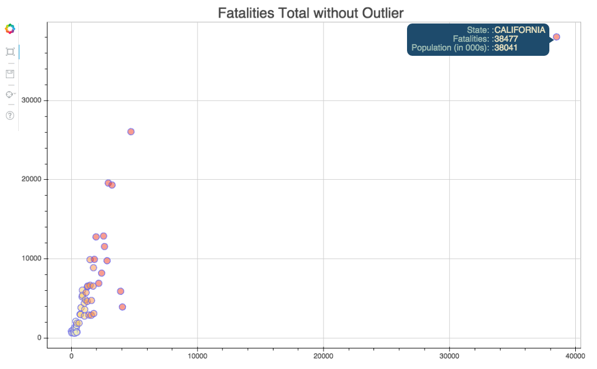
Geographic dispersion of workplace fatalities and catastrophes

Slide 10
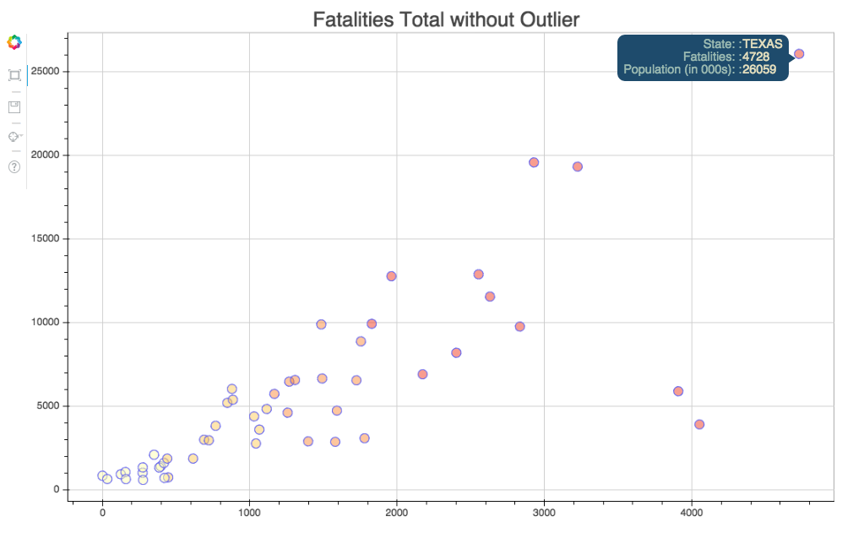
Geographic dispersion of workplace fatalities and catastrophes

Slide 11
What does this visualization tell us?
Some outliers go away when we control for population size (esp. by employee population, by industry sector) but some do not.
Interesting case of California vs. Texas – difference in labor laws, politics, workers’ compensation policies.
What will the new reporting data tell us?

Slide 12
Join us in exploring OSHA’s datasets!
GitHub
Python ingestion and Bokeh heat map code:
github.com/OSHADataDoor/FatalityMapper
Original Georgetown Univ. data analytics capstone project:
github.com/Colonials/capstone
Questions? Find us on LinkedIn!
Rebecca Bilbro
Bala Venkatesan

