Slide 1
Getting into Data Science with OSHA
Rebecca Bilbro
Bala Venkatesan
Data innovation DC
March 4, 2015
* The views presented here are our own and do not represent the views of the Occupational Safety and Health Administration, U.S. Department of Labor, or any other U.S. government agency.

Slide 2
OSH Act of 1970
Originally required employers to report workplace fatalities and catastrophes (three or more hospitalizations) to OSHA.
As of Jan 1, 2015, employers also required to report serious injuries (amputations, losses of an eye), any employee hospitalizations.
New data will help draw a more comprehensive, real-time map of the landscape of serious and fatal workplace injuries and illnesses.

Slide 3
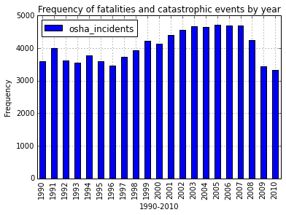
Asking questions with data
What can the first few decades of data captured tell us about workplace hazards?
What’s hidden inside the plateau?

Slide 4
Getting into data science
Georgetown Data Analytics Certificate Program – Cohort 2
Challenges of getting into data science
What you need to get started:
Some programming
Some statistics
A visual eye
Persistence!

Slide 5
Getting into data science
Python experimentation: BeautifulSoup, Requests, Pandas, NumPy, PearsonR, MatPlotLib, iPython Notebook, Bokeh
Teamwork: GitHub
Hypothesis-testing with OSHA data and:
seasonality
industry (SIC) codes
unemployment rates
geography

Slide 6
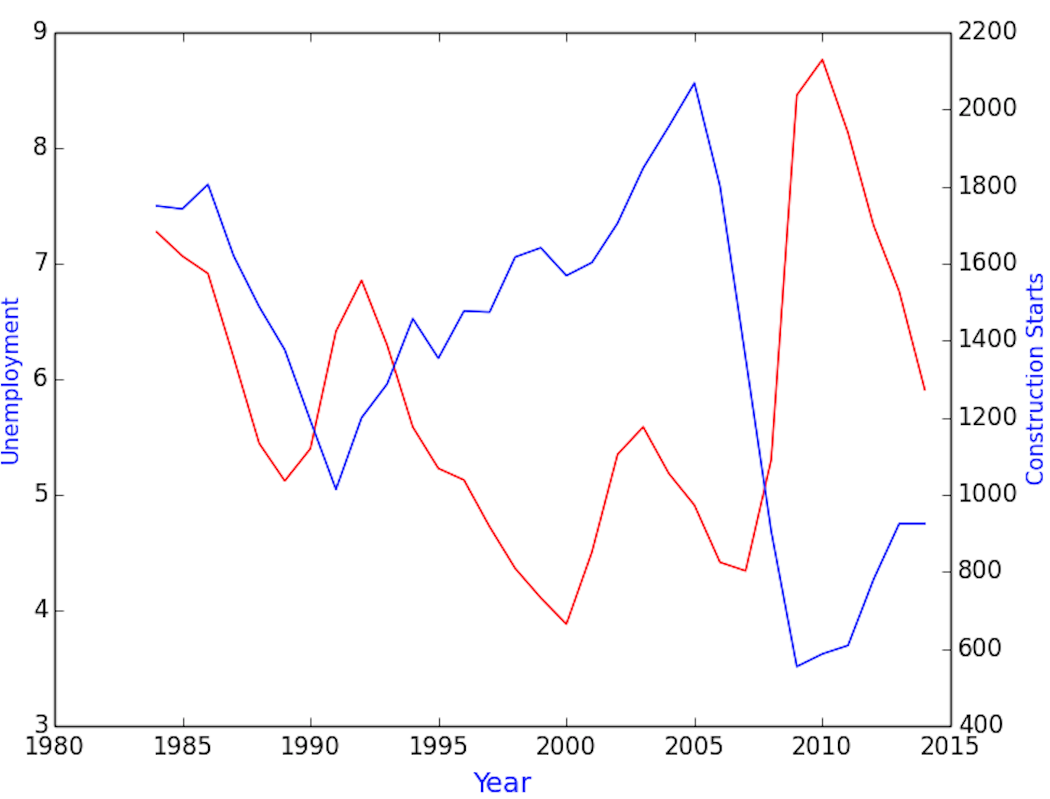
Preliminary findings
There’s an inverse correlation between unemployment and construction activity.

Slide 7
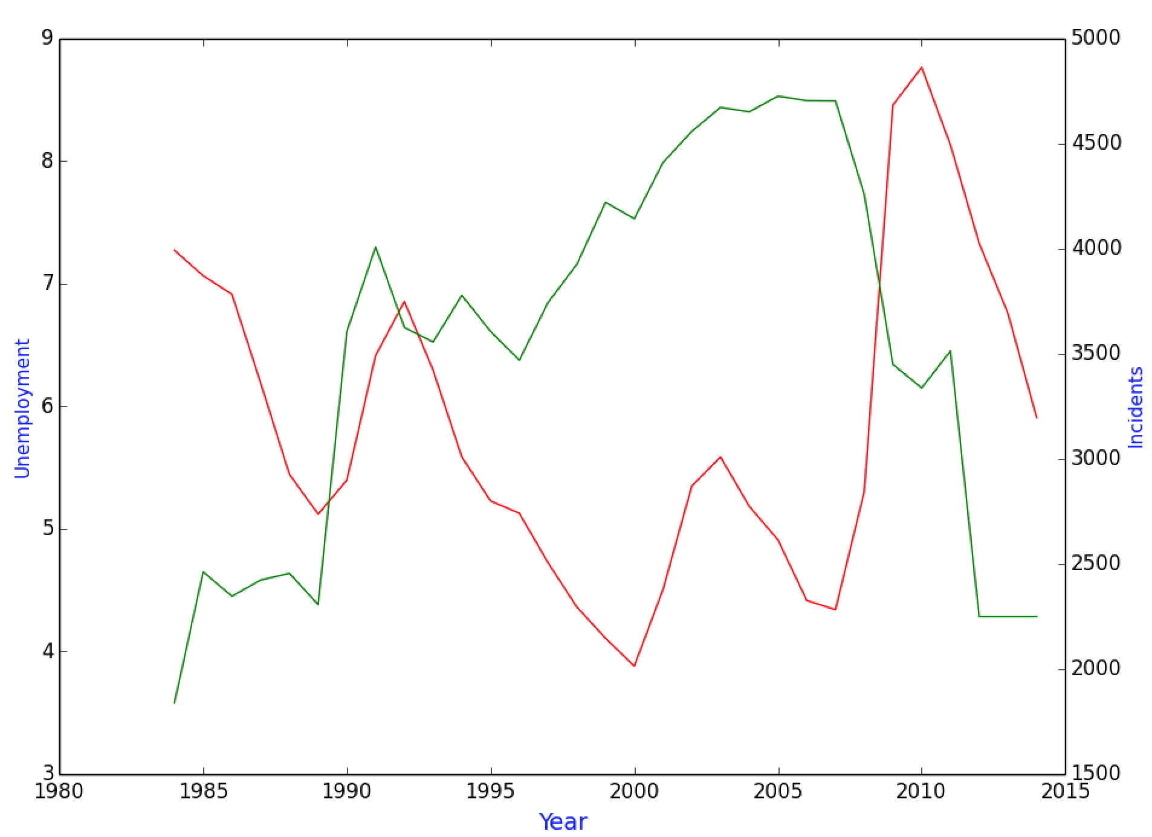
Preliminary findings
There’s also an inverse correlation between unemployment and workplace fatalities/catastrophes.

Slide 8
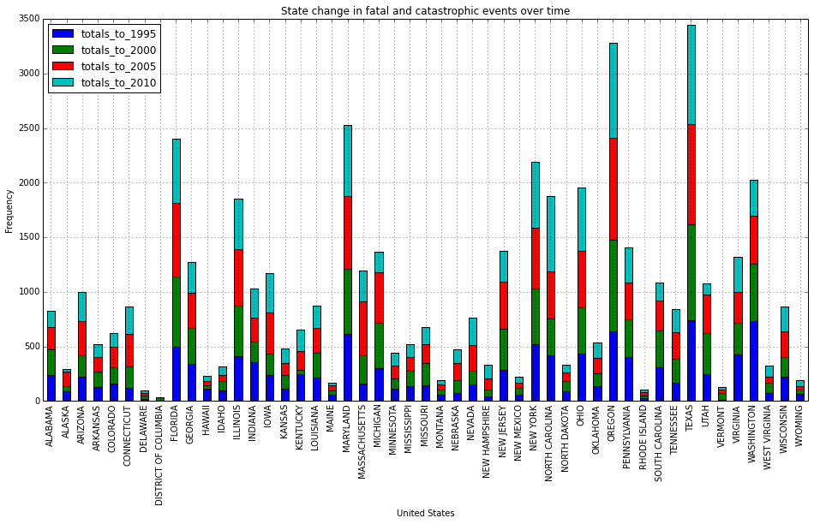
Preliminary findings
From 1990-2010: northward shift in fatalities across Mason-Dixon line?

Slide 9
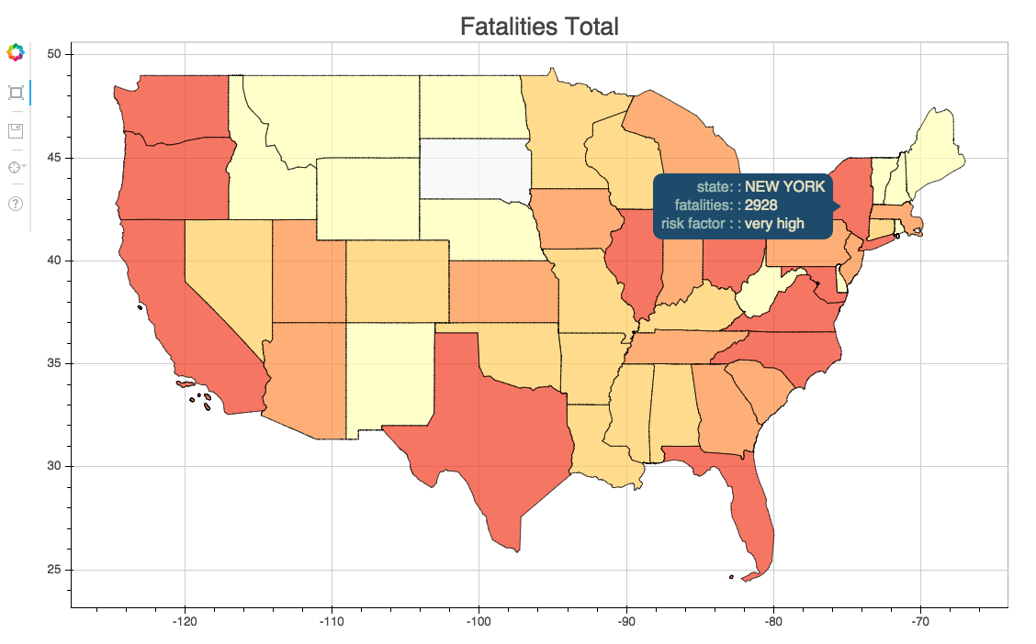
Geographic dispersion of workplace fatalities and catastrophes
There are several outliers: California, Texas, Oregon, Florida, Maryland.
Is this due to population size, or something else?

Slide 10
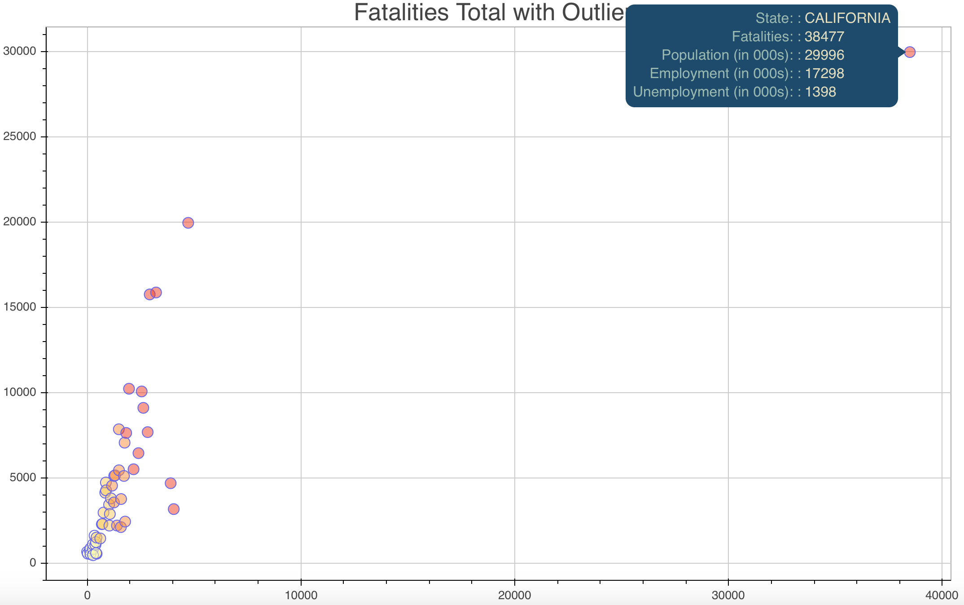
Geographic dispersion of workplace fatalities and catastrophes
Is California overrepresented in the fatalities/catastrophes reported to OSHA?
Remains an outlier even after correcting for worker population.

Slide 11
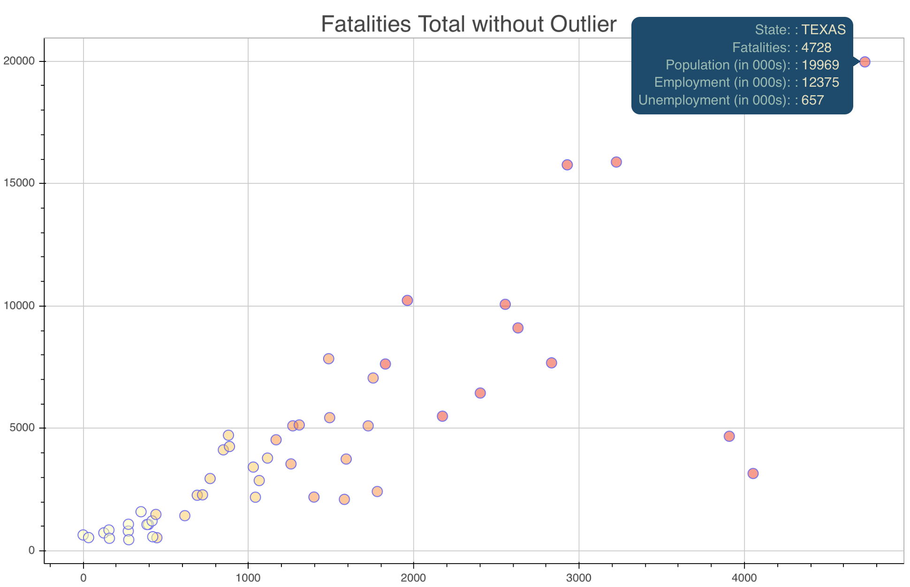
Geographic dispersion of workplace fatalities and catastrophes
When we exclude the California data, Texas begins to stand out.
Difference in labor laws, politics, workers’ comp.
Underreporting? Could check by comparing to BLS fatality data.

Slide 12
What’s next?
Time-series animations: Deeper study of geographic migration in fatal and catastrophic workplace events over time.
Predictive analytics: Can we predict future incidents?
A LOT more data: What will we learn from the new reporting data (not just fatalities/catastrophes but all serious work-related injuries, illnesses, and hospitalizations)?

Slide 13
Join us in exploring OSHA’s datasets!
GitHub
Python ingestion and Bokeh heat map code:
github.com/OSHADataDoor
Original Georgetown U. data analytics capstone project:
github.com/Colonials/capstone
Questions? Find us on LinkedIn!
Rebecca Bilbro
Bala Venkatesan

