Slide 2
Summer 2026 AI Research Experience (AIRE) Program Introduction and What to Expect Karen Tomko, Emily Fairchild Ohio Supercomputer Center aire-info@osc.edu

Slide 3
SOME THANKS
National Science Foundation Awards #2320952, #2320953, #2320954 provide the funds for this program and partially support the OH-SCIPE team
OSC and OH-TECH staff: Jerran Leber, Tammi Hysell, Jen Forsberg, Betsy Kordes, Alan Chalker, Lexi Biasi, Andrea Gibson, Leya Varghese, Shannon Duffy, OH-TECH Desktop support
All of you for participating as our awardees and mentors

Slide 4
TODAY’S AGENDA
9:30-10:00 - Arrive / Check in
10:00-10:20 - Welcome and Introductions
10:20-10:40 - What to Expect during your Research Experience
10:40-12:00 - Research Project Overviews (10 minutes each)
12:00-1:00 - Group Photo, then Lunch
1:00-1:30 – Research Project Overviews, HPC account setup check
1:30 – 2:00 – Travel and checking for Data Center Tour
2:00-4:00 - Data Center Tour

Slide 5
Terminology
AIRE- AI Research Experience
CIP- Cyberinfrastructure Professionals
HPC- High Performance Computing
AI Fellow – Faculty or staff with stipend to collaborate on an AI Research Project

Slide 6
OH-SCIPE PROJECT OVERVIEW
Official Title: Interdisciplinary Research Support Community For Artificial Intelligence And Data Sciences
Project Goal:
Address shortage of Cyberinfrastructure (CI) Professionals with AI Expertise
Approach:
Hire, mentor, and train a new cohort of CI Professionals (ML Engineers and Facilitators) for Ohio
Engage with researchers to address their AI challenges
Encourage the next generation of AI and CI workers
National Science Foundation funded initiative between Case Western Reserve University, Ohio Supercomputer Center and University of Cincinnati, Awards #2320952, #2320953, #2320954
The awards are thorough the NSF SCIPE program; we refer to this project as OH-SCIPE.

Slide 7
AI RESEARCH EXPERIENCES FOR OHIO UNDERGRADUATES
The annual summer AI Research Experience (AIRE) program provides an opportunity for postsecondary students in Ohio to work on AI-focused research projects with university teams for nine weeks during the summer.
Participants are placed with research teams at Case Western Reserve University, The Ohio State University, or the University of Cincinnati.
The program offers the chance to explore education and career paths in the emerging cyberinfrastructure field.
The OH-SCIPE team provides training and guidance on AI and high performance computing technologies, as well as support on software and computer systems needed for the research projects.
Notes:
Check article for Charles for additional things

Slide 8
Overview of AIRE
The aim of AIRE, managed by the OH-SCIPE project, is to increase awareness of the work of Cyberinfrastructure Professionals (CIP), individuals who provide IT support to university researchers, with a growing focus on supporting AI. The AIRE program can help undergraduates explore potential education and career paths in this emerging field.
Our goal is to better inform the next generation of professionals and help them develop the skills needed in this changing world. Our hope is that when we connect students from a variety of institutions with leaders of their field in AI and ML, we can help the students understand how these new technologies are applicable in many fields.

Slide 9
Congratulations!
AIRE Awardees:
Daniel Jung, “AI-Driven High-Throughput Platform for Polymer Structure–Property Relationships” with Sanmukh Kuppannagari, CWRU
Brody Green, “Non-ergodic correlation models of sequential earthquake ground motions” with Kuanshi Zhong, UC
Dylan Winger, “Artificial intelligence for analysis of wildlife imagery” with Joe Johnson, UC
Avyukth Rangarajan, “Fairness Evaluation of Vision-Language Models for Autonomous Driving” with Sumon Biswas, CWRU
Garfield Lawrence, “Learning Generalizable Manipulation Policies via Vision-Language-Action (VLA) Models” with Yu Yin, CWRU
Maxwell Lyman, “Near Real-Time PET Image Synthesis from Histo-Image Using Deep Learning” with Jing Tang, UC
Alexander Gose, “Multi-Modal and Multi-Agent AI Crisis Response Testbed” with Nathan Elrod, UC
Landry Lies, “Workflow or it didn’t happen: Reproducibility in AI research for science” with Matthew Thompson & Elizabeth Campolongo, OSU
AI Fellow:
Andrew Merwin, BWU, “Building models to assist in the identification of singing insects in an urban park system”,with Sanmukh Kuppannagari, CWRU
Tomi Fayomi, Franklin University, Rajiv's project, Exploring AI-Driven Cyberinfrastructure for Science
Isaac Wilson, Columbus State Community College, Elizabeth and Matt's project, "Pixels to Paragraphs: Giving Vision Models a Voice"
Jaser Hamad, Cuyahoga Community College, Sanmukh's project, AI-Driven Polymer Aging Prediction and Classification System
Oleksandr Vykliuk, Cuyahoga Community College, Weicong's project, Anomaly Detection in HPC System Logs
Malak Sulaiman, Cuyahoga Community College, Mohsen's project, Adaptive Speech Processing via Reinforcement Learning
Filip Stopyra, Cuyahoga Community College, Weicong's project, Fake-Image Detection with Forte
Tomi Fayomi, Franklin University, Rajiv's project, Exploring AI-Driven Cyberinfrastructure for Science
Isaac Wilson, Columbus State Community College, Elizabeth and Matt's project, "Pixels to Paragraphs: Giving Vision Models a Voice"
Jaser Hamad, Cuyahoga Community College, Sanmukh's project, AI-Driven Polymer Aging Prediction and Classification System
Oleksandr Vykliuk, Cuyahoga Community College, Weicong's project, Anomaly Detection in HPC System Logs
Malak Sulaiman, Cuyahoga Community College, Mohsen's project, Adaptive Speech Processing via Reinforcement Learning
Filip Stopyra, Cuyahoga Community College, Weicong's project, Fake-Image Detection with Forte
Notes:
We had about 94 applicants from 14 schools (2 R1, 4 private, 7 community colleges)

Slide 10
What to Expect
To meet new people
Learn new things about: AI, High-Performance Computing, Python …
Learn more about the research process
Work hard
Have some failure
Achieve something unexpected
To be treated with kindness and respect

Slide 11
What is expected of you
Show up for trainings and weekly meetings
Work 36-38 hours per week – with place and times coordinated with your science mentors
Ask questions and give us feedback
Let someone know of any issues that come up
Use AI and other existing solutions or resources thoughtfully with guidance from your mentors
Be kind and respectful to each other and to everyone on the project

Slide 12
Schedule
Week 1-2 (May 19-27) – In-person kickoff event, followed by virtual training: Python, Linux, HPC basics
Weeks 2-8 (May 26-July 10) – Carry out project, meet regularly with science mentors, join CIP office hours
Week 9 (July 13-17) – Project wrap-up, deliverables to science mentor, prepare presentations
July 20 – Virtual Wrap-up event with project presentations

Slide 13
Training Schedule and Topics
5/20 (W) |  | 5/21 (Th) |  | 5/22 (F) |  | 5/26 (Tu) |  | 5/27 (W)
10am | 2pm | 10am | 2pm | 10am | 2pm | 10am | 2pm | 9:30am | 2pm
Intro to HPC | Intro to Linux CLI | Version Control w/ Git | Python environments w/ conda/uv | Jupyter and kernels | Python OOP | Data Science w/ Pandas | Intro to ML, Sci-kit Learn | PyTorch | PyTorch cont.

Slide 14
CIP Weekly Office Hours
Weekly meeting for technical questions, training follow-up and project updates (required)
Every Monday at 1pm-2pm
Cyberinfrastructure professionals are here to support you and your project!
The best outcome is that you bring technical issues to discuss and actively engage with each other and the CIPs
You can also reach out to CIPs outside of office hours (Slack, email)

Slide 15

Slack Channel
Use the QR code here to join the slack space for our project, it's titled SCIPE (scipeworkspace.slack.com)
We've created a channel, #aire-2026, for AIRE 2026 communications
Post and answer questions on all things related to #aire-2026
Reach out via email (aire-info@osc.edu) for anything you don’t want to broadcast

Slide 17
Project Overviews
AIRE Projects:
“AI-Driven High-Throughput Platform for Polymer Structure–Property Relationships” with Sanmukh Kuppannagari, CWRU
“Non-ergodic correlation models of sequential earthquake ground motions” with Kuanshi Zhong, UC
“Artificial intelligence for analysis of wildlife imagery” with Joe Johnson, UC
“Fairness Evaluation of Vision-Language Models for Autonomous Driving” with Sumon Biswas, CWRU
“Learning Generalizable Manipulation Policies via Vision-Language-Action (VLA) Models” with Yu Yin, CWRU
“Near Real-Time PET Image Synthesis from Histo-Image Using Deep Learning” with Jing Tang, UC
“Multi-Modal and Multi-Agent AI Crisis Response Testbed” with Nathan Elrod, UC
“Workflow or it didn’t happen: Reproducibility in AI research for science” with Matthew Thompson & Elizabeth Campolongo, OSU
AI Fellow Project:
Andrew Merwin, BWU, “Building models to assist in the identification of singing insects in an urban park system”,with Sanmukh Kuppannagari, CWRU
Tomi Fayomi, Franklin University, Rajiv's project, Exploring AI-Driven Cyberinfrastructure for Science
Isaac Wilson, Columbus State Community College, Elizabeth and Matt's project, "Pixels to Paragraphs: Giving Vision Models a Voice"
Jaser Hamad, Cuyahoga Community College, Sanmukh's project, AI-Driven Polymer Aging Prediction and Classification System
Oleksandr Vykliuk, Cuyahoga Community College, Weicong's project, Anomaly Detection in HPC System Logs
Malak Sulaiman, Cuyahoga Community College, Mohsen's project, Adaptive Speech Processing via Reinforcement Learning
Filip Stopyra, Cuyahoga Community College, Weicong's project, Fake-Image Detection with Forte
Tomi Fayomi, Franklin University, Rajiv's project, Exploring AI-Driven Cyberinfrastructure for Science
Isaac Wilson, Columbus State Community College, Elizabeth and Matt's project, "Pixels to Paragraphs: Giving Vision Models a Voice"
Jaser Hamad, Cuyahoga Community College, Sanmukh's project, AI-Driven Polymer Aging Prediction and Classification System
Oleksandr Vykliuk, Cuyahoga Community College, Weicong's project, Anomaly Detection in HPC System Logs
Malak Sulaiman, Cuyahoga Community College, Mohsen's project, Adaptive Speech Processing via Reinforcement Learning
Filip Stopyra, Cuyahoga Community College, Weicong's project, Fake-Image Detection with Forte

Slide 18
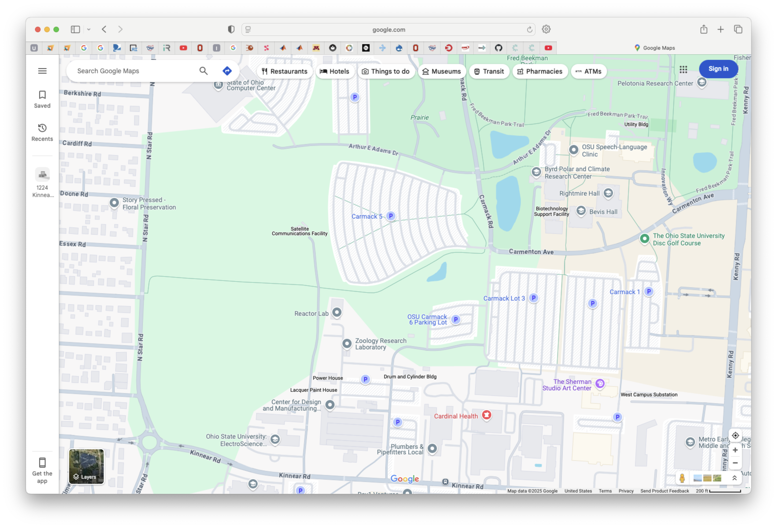

DATACENTER TOUR (A.K.A SOCC TOUR)
Drivers
See suggested route in this map
You will need to get buzzed into the parking lot
Riders
Do you have a ride to the datacenter?
Everyone
Did you bring a government issued ID?
Please limit what you take into the SOCC.
Remember - No photos until we are in OSC’s suite with the computers.
SOCC
OSC
Notes:
Do you have a government ID (drivers license, passport), Have you signed up to carpool with someone?

