Slide 1
OSL640: INTRODUCTION TO OPEN SOURCE SYSTEMS Week2: lesson 1 Unix & Linux file management concepts managing directories
Photos and icons used in this slide show are licensed under CC BY-SA

Slide 2
Lesson 1 topics
Unix / Linux File Management Concepts
Purpose of Directories
Directory Pathnames / Tree Diagrams
Filename Rules
Managing Directories
Creating / Viewing Contents of / Manipulating / Removing Directories: mkdir –p, rmdir, rm -r –i, ls -l -d –R , tree, cp –R, mv
Demonstration
Homework
Perform Tutorial 2: Unix / Linux File Management (Investigation 1) Perform LINUX PRACTICE QUESTIONS (1 – 8)

Slide 3
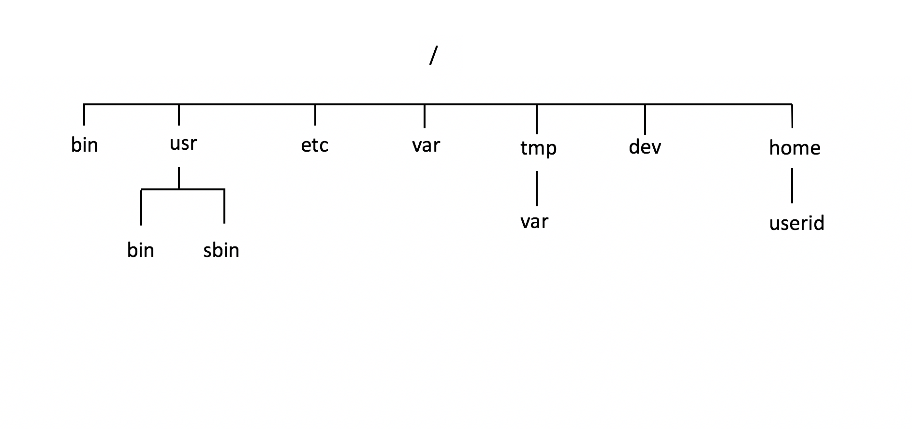
Linux File Management Concepts
Purpose of Unix / Linux Directories
To better organize files (eg. text, images, documents, spreadsheets, programs) within your Matrix account, they should be stored in directories.
To further organize many files, directories may contain sub-directories.
Learning how to issue Linux commands for navigating and manipulating directory and files within the the Linux filesystem are essential skills for Linux users and Linux system administrators (i.e. sysadmins).

Slide 4
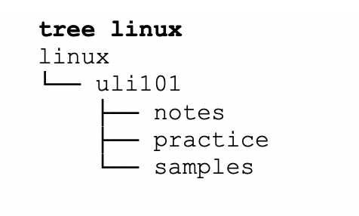
Linux File Management Concepts
Purpose of Unix / Linux Directories The Unix/Linux file system is hierarchical, like other operating systems such as Windows, Mac OSX, etc. In Unix / Linux (as opposed to MS Windows), there are no drive letters such as C:, or D:
All files and directories appear under a single ancestor directory called the "root directory".
In the Linux (Unix) OS, the "root directory" / is the starting directory, and other "child directories", "grandchild directories", etc. can be created as required. The hierarchical structure resembles an "upside-down tree". There is actually a command called tree that displays a "directory tree diagram"!

Slide 5

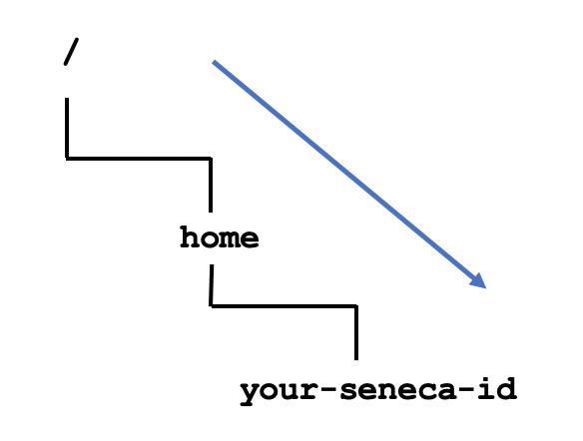
Linux File Management Concepts
Directory Pathnames
A pathname is used to specify the location of a file within the file system.
A pathname points to a file system location by following the directory tree hierarchy expressed in a string of characters in which path components, separated by a delimiting character, represent each directory.
The delimiting character is most commonly the slash character ("/").
Reference: https://en.wikipedia.org/wiki/Path_(computing)
Example:
/home/your-seneca-id

Slide 6
Linux File Management Concepts
Common Unix / Linux Directories
Below are several common Unix / Linux Directories and their purpose:
Directory Pathame | Purpose
/ | Root directory (ancestor to all directories)
/home | Used to store users’ home directories
/home/username | A specific User's Home Directory
/bin , /usr/bin | Common system binaries (commands)
/usr/sbin | Common utilities for system administration
/etc | System administration files (eg. passwd)
/var | Dynamic files (log and mail files)
/tmp , /var/tmp | Temporary files for programs
/dev | Device driver files (terminals, printers, etc.)

Slide 7
Linux File Management Concepts
Directory File Naming Rules
Before learning to create directories, it is important to understand what represents an appropriate directory filename. Here are some rules:
Unix / Linux File Naming Rules
Unix/Linux characters are case sensitive (e.g. always use lowercase letters)
Adopt a consistent directory naming scheme (this will help you to better navigate within your directory structure)
Make your directory names meaningful (short but descriptive)
Avoid using spaces for directory names (consider periods, hyphens, and underscores instead)
Avoid non-alphanumeric characters, as they may have a special meaning to the system that will make your work more difficult when changing to directories, etc.

Slide 8
Managing Directories
Managing Directories
Below are some common Unix / Linux commands to manage Directories:
Directory Pathame | Purpose
mkdir -p | Creates a directory. The -p option creates parent directories then directory pathnames specified.
rmdir | Removes empty directories.
rm -r -i | Removes files, but when used with -r option, will remove non-empty directories and their contents. The -i option is used to prompt user to confirm deletion of directory contents
ls -l -d –R , tree | List directory contents. Useful to verify if directory was created. The -d option lists the directory itself (not contents) The -R option displays directories and subdirectory contents. The tree command displays diagram of directory structure.
cp -R | Copies directory and its contents (recursive) to a different directory
mv | Moves directory and its contents to a different directory

Slide 9

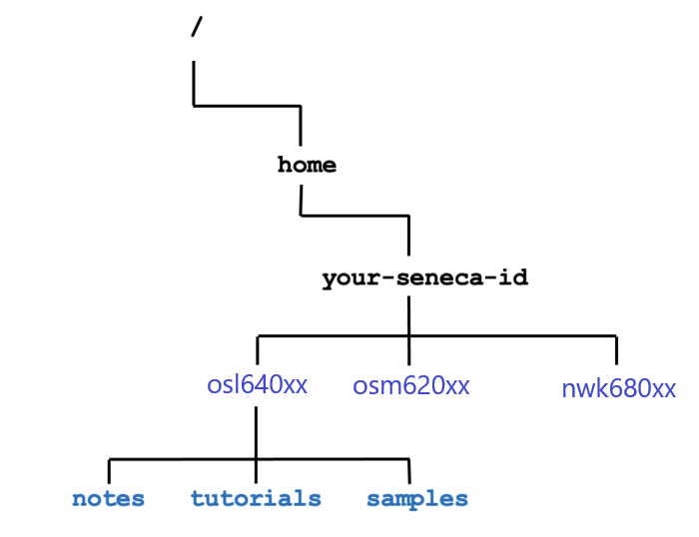
Managing Directories
Managing Directories Demonstration
Your instructor will demonstrate how to manage directories by issuing Unix / Linux commands:
Create directory structure as shown in diagram to the right
View / Verify created directories
Copy directories
Move directories
Remove empty directories
Remove non-empty directories

Slide 10

Managing Directories
Determine Type of File
When issuing the ls command to view directory contents of viewing a directory, the –l option can be used to help determine it file type.
ls -l
drwxr-xr-x 2 murray.saul users 6 Jan 11 09:42 documents
-rw-r--r-- 1 murray.saul users 0 Jan 11 09:42 file.txt
crw-rw-rw- 1 root root 1, 3 Dec 2 07:25 /dev/null
The first character on the left of the output indicates the type of file:
d: directory file
-: regular file
b or c: device file

Slide 11

Managing Directories
Hidden Files
A file is hidden if its name starts with a period “.” This can hide both regular files and directory files.
Why make files hidden?
To clean up directories
To hide backups
To protect important files from accidental deletion
If you issued the ls command without arguments, hidden files do NOT appear.
The ls command with the -a option will show all files including hidden and non-hidden. Current and Parent directories ( . and ..) are displayed
The ls command with the -A option will show all files including hidden and non-hidden. Current and Parent directories ( . and ..) are NOT displayed

Slide 12
Hands-on Time / HOMEWORK
Getting Practice
Perform the online tutorial Tutorial 2: Unix / Linux File Management (ctrl-click to open link):
INVESTIGATION 1: MANAGING DIRECTORIES
LINUX PRACTICE QUESTIONS (Questions 1 – 8)

Slide 13
OSL640: Introduction to open source systems Week2: lesson 2 managing text files: USING Text editors to create & edit a text file managing text file content
Photos and icons used in this slide show are licensed under CC BY-SA

Slide 14
Lesson 2 topics
Creating Text Files
Purpose of a Text Editor
Using the nano Text Editor / Demonstration
Using the vi Text Editor / Demonstration
Managing / Manipulating Text Files
Linux Commands: touch, cat, more/less, cp, mv, rm, diff, file, find
Demonstration
Homework
Perform Tutorial 2: Unix / Linux File Management (Investigation 2) Perform LINUX PRACTICE QUESTIONS (9 – 16)

Slide 15
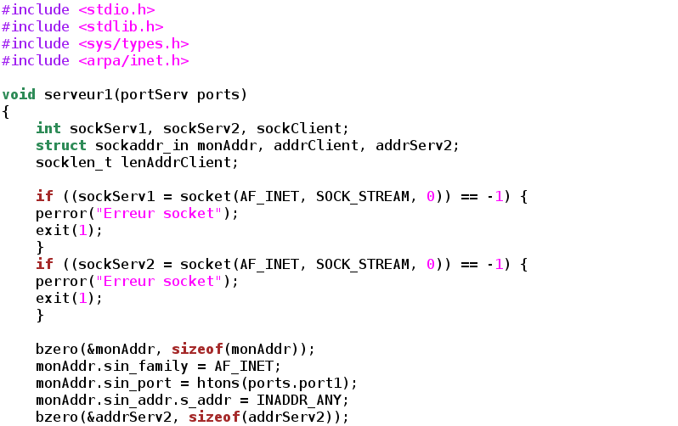
Creating Text Files
Text Editors
A Text Editor allows users to create, modify and save editing changes of text files.
Although programming students can use graphical IDE's to code and compile programs, students can create source code using a text editor and compile their source code in their Matrix account to generate executable programs.

Slide 16
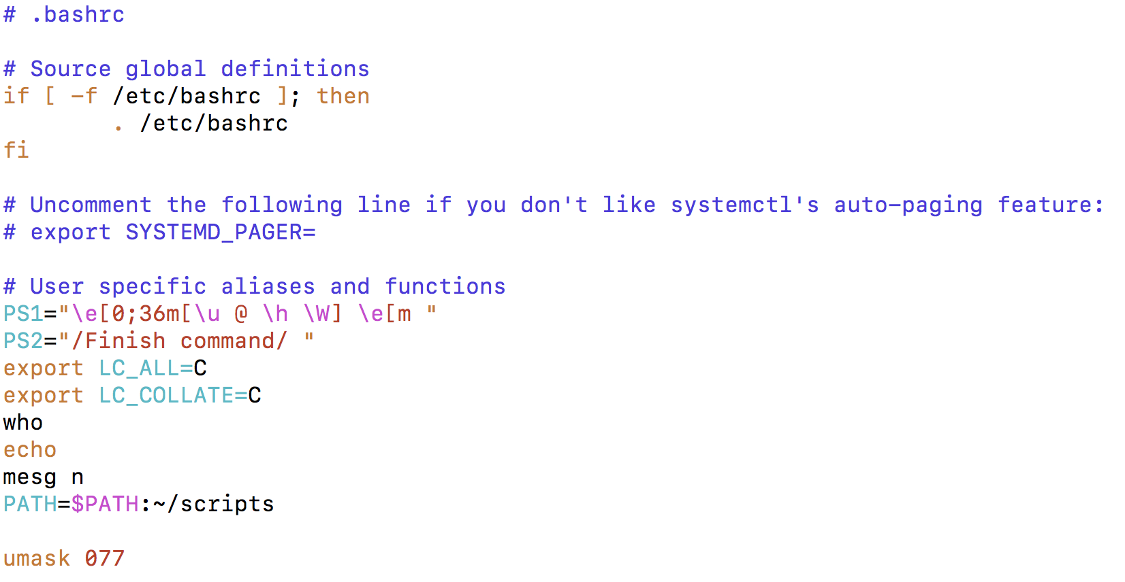
Creating Text Files
Text Editors
Networking and Tech Support students use a text editor to edit configuration files.
Throughout their program, students will become familiar with the process of installing, configuring, and running network services on their Linux servers.
Text editors are an important tools to help setup but also "tweak" or make periodic changes in networking services configuration.

Slide 17
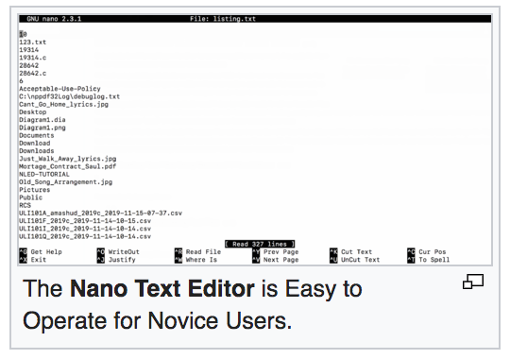
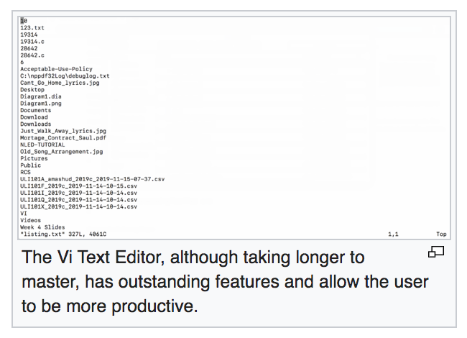
Creating Text Files
Text Editors
Regardless of the IT stream that they are in, it is useful for students to expose themselves to different text editors and then use one that they feel most comfortable working with.
The two most readily-available command line text editors in Linux are nano and vi.

Slide 18
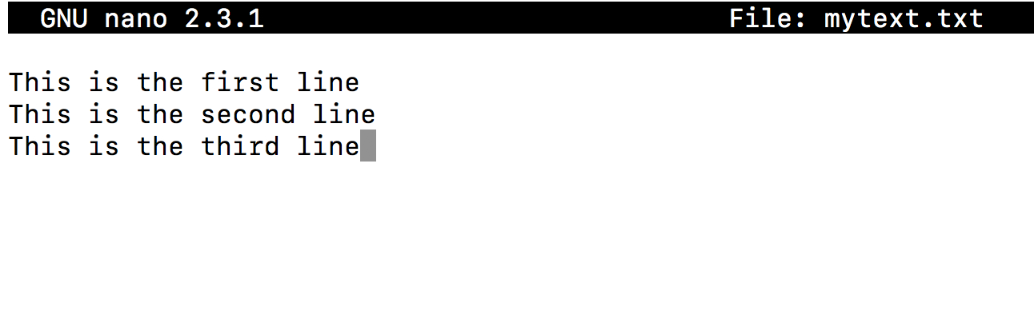
Creating Text Files
Nano Text Editor
The nano text editor is considered to be an easiy-to-use text editor. When using the nano text editor, you are placed in INPUT mode, to enter text immediately.
Nano editing commands typically consist of the ^ symbol which represents the <ctrl> key followed by a character NOTE: There is no undo command in Nano!
The table on the right list a few Nano commands and their purpose. Refer to week 2 notes for a nano reference sheet. NOTE: In the Nano reference sheet, the letter M represents the <esc> key
Key Combination | Purpose
<ctrl><space> , <esc><space> | Move forward / backward one word
<ctrl>a , <ctrl>e | Move to beginning / end of line
<ctrl>k | Cut line
<esc>6 | Copy Line
<ctrl>u | Paste Cut / Copied Text
<ctrl>g | Display help screen
<ctrl>x | Save and exit editing session

Slide 19
Managing Directories
Instructor Demonstration
Your instructor will demonstrate how to create and edit a text file using the nano text editor.

Slide 20
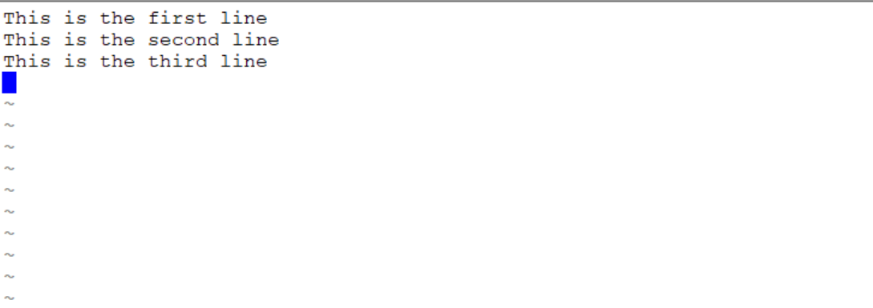
Creating Text Files
vi Text Editor
The vi (vim) text editor (although taking longer to learn) has outstanding features to increase coding productivity..
The major different between nano and vi is that vi starts in COMMAND LINE mode. You need to issue letter commands to perform text editing or press colon “: ” to enter last line mode to issue more complex commands.
To make it easier to learn how to use this text editor, an online tutorial was created (two decades ago) to provide you "hands-on" experience in command editing techniques.
To run this tutorial, issue the following command in Matrix: /home/murray.saul/vi-tutorial
You can refer to your week 2 notes for a vi command reference sheet.
Key Combination | Purpose
i | Enter INSERT mode
<esc> | Return to COMMAND mode
B , W | Move forward / backward one word
0 , $ | Move to beginning / end of line
dd | Cut line
yy | Copy Line
p , P | Paste below / above line
:help | Display help screen
:x | Save and exit editing session

Slide 21
Managing Directories
Instructor Demonstration
Your instructor will demonstrate how to create and edit a text file using the vi text editor.

Slide 22

Managing text files
Purpose It is essential for students in this course not only to create text files but also to learn how to manage text files.
Students need to learn how to create empty files, copy files for backup purposes, move or rename incorrectly spelled filenames, edit files as well as view text file contents without the danger of editing or corrupting those files.
Students also need to learn how to remove files, check for differences between a couple of files as well as obtain information regarding the status of a file and information regarding the file’s content.

Slide 23
Managing text files
Text File Management Commands
Here are common text file management commands:
Linux Command | Purpose
touch | Create empty file(s) / Updates Existing File's Date/Time Stamp
cat | Display text file's contents without editing (small files)
more , less | Display / Navigate within large text files without editing
head , tail | View lines at top/bottom of file
grep | Display lines in file that match a pattern
cp | Copy text file(s)
mv | Move / Rename text files
rm | Remove text file(s)
diff | Displays differences between 2 files

Slide 24
Managing text files
Text File Management Commands
Here are some additional text file management commands:
Linux Command | Purpose
sort | Display contents of file in sorted order
uniq | Display identical adjacent lines only once
file | Gives info about the contents of the file (e.g. file with no extension)
find | To find files matching specified characteristics: find . -name "file*” lists pathname of any filenames beginning with "file", from the current directory and any subdirectories find . -size +50k lists pathname of any files larger than 50 kb, from the current directory and any subdirectories find . -mmin -5 lists files modified less than 5 minutes ago

Slide 25
Managing Directories
Managing Manipulating Text Files
Your instructor will demonstrate how to manage / manipulate text files
Create empty files
View small and large text files
Sort files
Display matched pattern file content
Remove duplicate lines
Compare files for differences
Obtain file information / List file pathnames

Slide 26
Hands-on Time / HOMEWORK
Getting Practice
Perform the online tutorial Tutorial 2: Unix / Linux File Management (ctrl-click to open link):
INVESTIGATION 2: MANAGING TEXT FILES
LINUX PRACTICE QUESTIONS (Questions 9 – 16)

