Slide 1
OSL640: INTRODUCTION TO OPEN SOURCE SYSTEMS Week 3: Lesson 1 Advanced File Management
Photos and icons used in this slide show are licensed under CC BY-SA

Slide 2
Lesson 1 topics
File Pathname Types
Absolute File Pathnames
Relative File Pathnames
Relative-to-home File Pathnames
Demonstration
Perform Week 3 Tutorial
Investigation 1
Review Questions (Questions 1 – 8)

Slide 3

FILE PATHNAME TYPES
Purpose of File Pathnames
As previously mentioned, a pathname is a fully-specified location of a unique filename within a file system. The concept of a pathname relates to every operating system including: Unix, Linux, MS-DOS, MS-Windows, Apple-Macintosh, etc.
Last week, we used a pathname from our home directory to create and manipulate directories and text files. There are different types of pathnames that we can use to access a directory or text file.
For Example: /home/userid/uli101/cars.txt (absolute pathname) samples/cars.txt (relative pathname) ~/cars.txt (relative-to-home pathname)
These types of file pathnames can make it more efficient (i.e. less keystrokes for users to type) when issuing Unix and Linux commands.

Slide 4
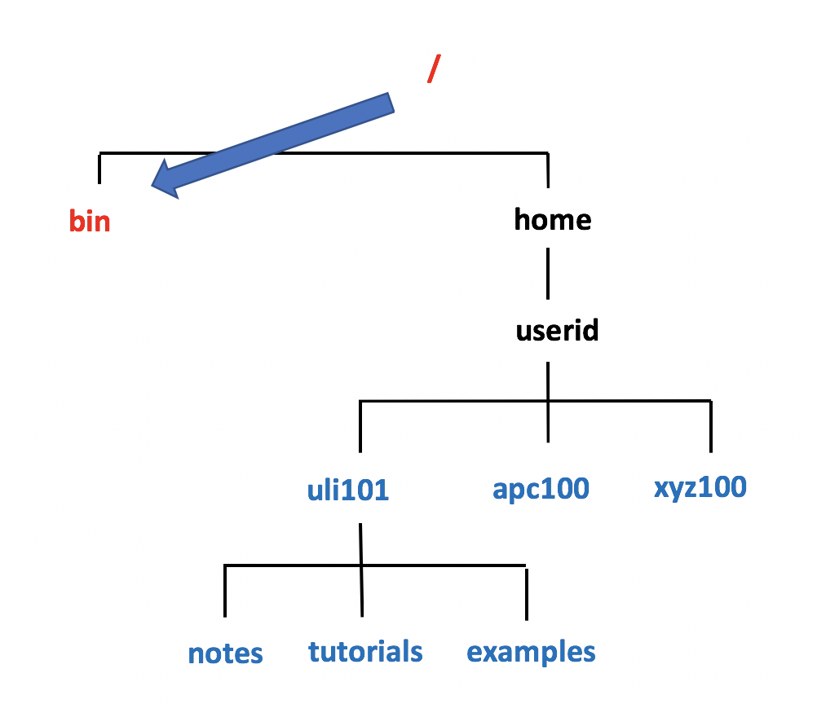
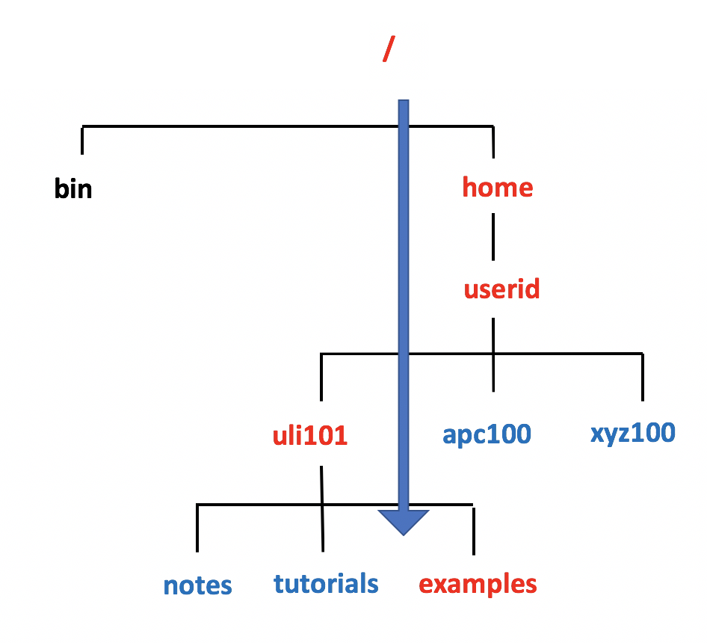
FILE PATHNAME TYPES
Absolute Pathnames
An absolute pathname is a path to a file or directory always beginning from the root directory (i.e. / ).
This type of pathname is referred to as absolute because the pathname always begins ABSOLUTELY from the root directory regardless of your current directory location.
In other words, this type of pathname requires that you always provide the FULL pathname starting with the root directory.
Remember the Rhyme: “If it is ABSOLUTE, it begins with ROOT!”

Slide 5
FILE PATHNAME TYPES
Absolute Pathnames
Advantages of using Absolute Pathnames:
Useful if you do NOT know your current directory location
Helps you to understand the FULL layout of pathname
Examples: /bin /home/userid/uli101/examples

Slide 6
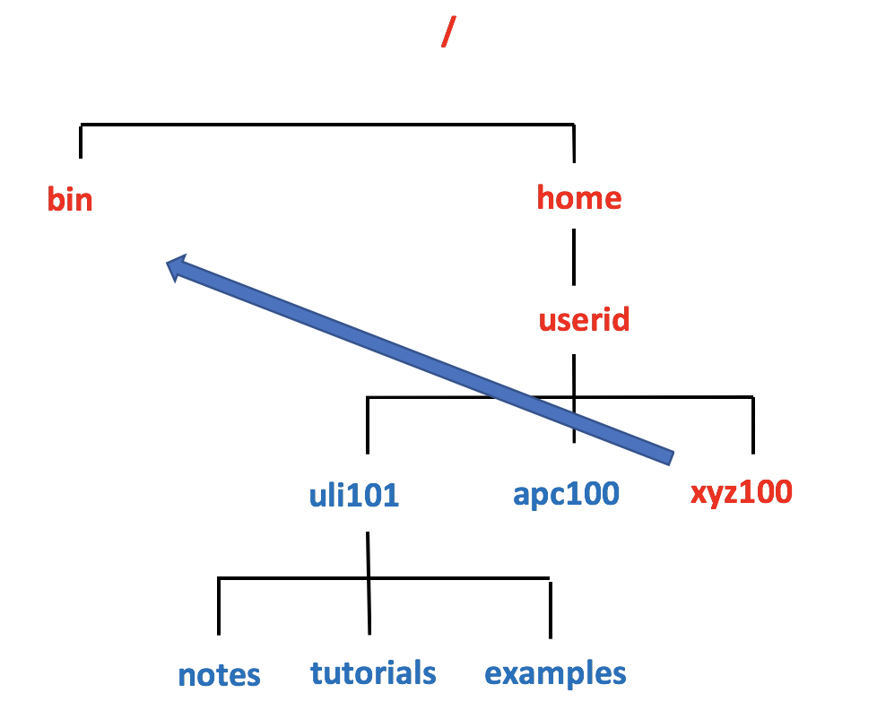
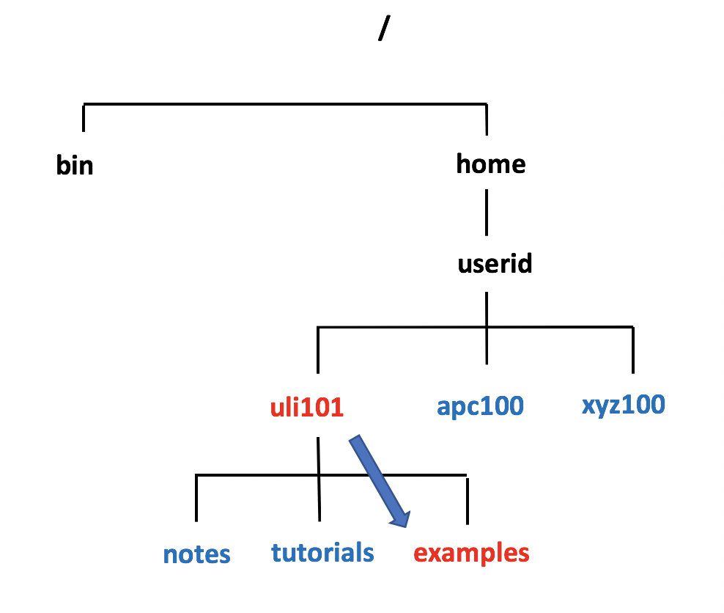
FILE PATHNAME TYPES
Relative Pathnames
A relative pathname is a path to a file or directory that begins from your current directory.
This is called a relative pathname because it is used to locate a specific file RELATIVE to your current directory.
NOTE: In order to use relative pathnames, it is absolutely necessary that you know the location of your current directory!

Slide 7
FILE PATHNAME TYPES
Relative Pathnames
Relative Pathname Symbols:
. A period "." represents the current directory .. Two periods ".." represents the parent directory (i.e. one directory level up)
Advantages of using Relative Pathnames:
Possibly a shorter pathname (less typing)
Examples: ../../../bin examples ./examples

Slide 8
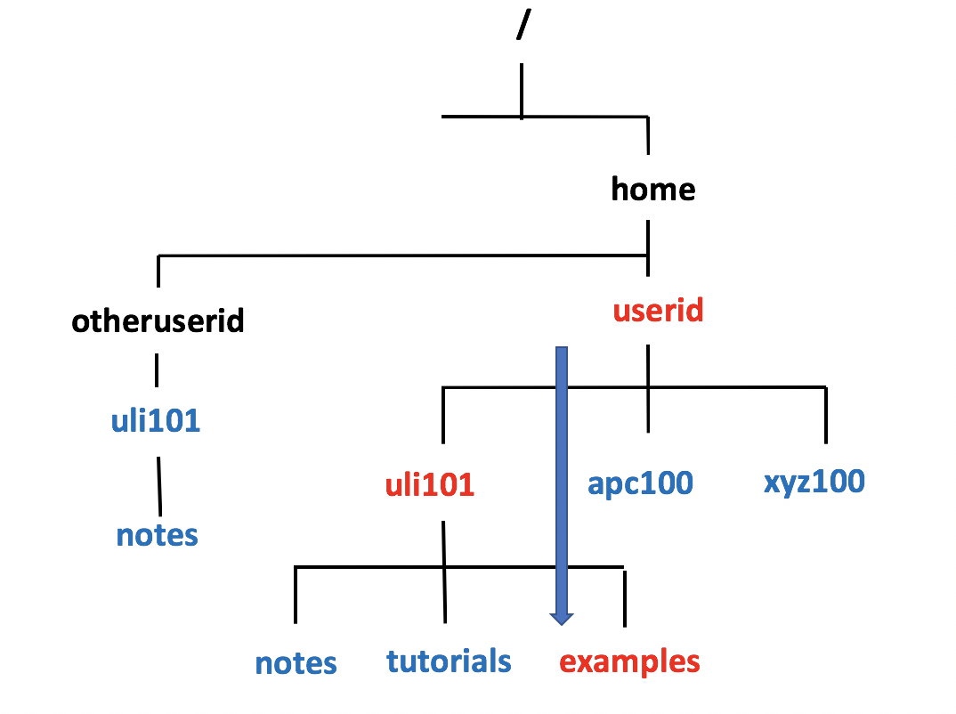
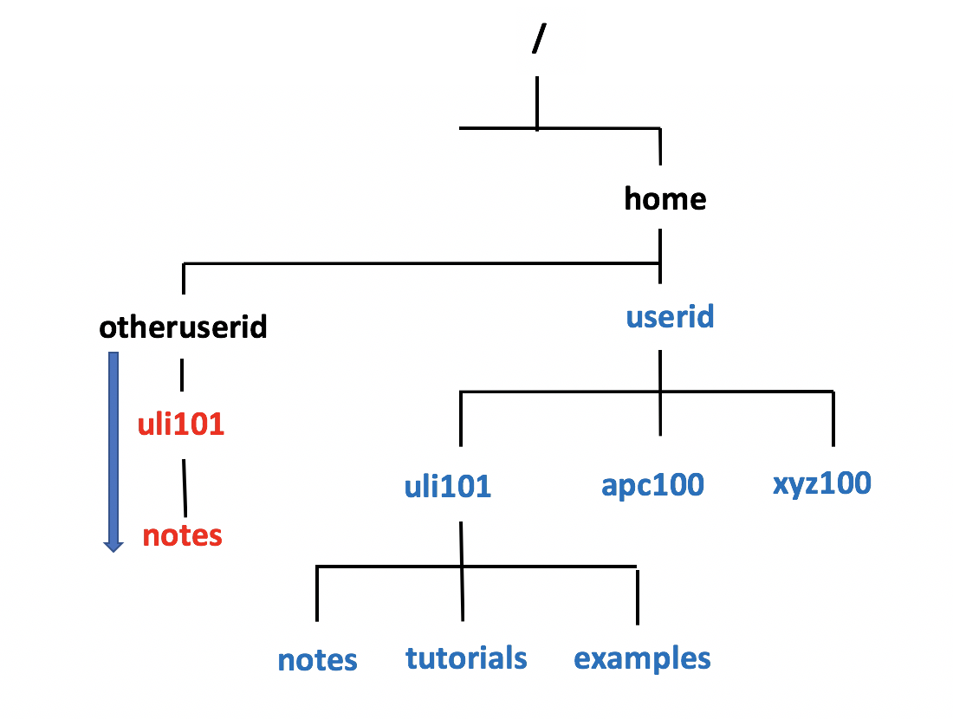
FILE PATHNAME TYPES
Relative-to-home Pathnames
A relative-to-home pathname begins with the tilde character ( i.e. ~) to represent the current user’s home directory.
The tilde character ~ stores the path of the current user’s home directory ( i.e. ~ = /home/current-user-id ).
Advantages of using Relative-to-Home Pathnames:
Possibly a shorter pathname (less typing)
You can place a username IMMEDIATELY after the tilde character to represent another user’s home directory (for example: ~jane = /home/jane)
Examples: ~/uli101/examples ~/uli101/notes ~murray.saul/uli101/notes

Slide 9

FILE PATHNAME TYPES
Instructor Demonstration
Your instructor will now demonstrate how to issue Unix / Linux commands using absolute, relative and relative-to-home pathnames for directory / file management:
Creating / Removing Directories
Moving Files / Directories
Copying Files / Directories
Listing Directory Contents
Removing Regular Files

Slide 10
Hands-on Time / HOMEWORK
Getting Practice
Perform online Tutorial3: Advanced File Management / Quoting Special Characters (ctrl-click to open link):
INVESTIGATION 1: ABSOLUTE / RELATIVE / RELATIVE-TO-HOME PATHNAMES
LINUX PRACTICE QUESTIONS (Questions 1 – 8)

Slide 11
OSL640: INTRODUCTION TO OPEN SOURCE SYSTEMS Week 3: Lesson 2 filename expansion quoting special characters
Photos and icons used in this slide show are licensed under CC BY-SA

Slide 12
Lesson 1 topics
File Name Expansion
Purpose
Special characters for Filename Expansion: * , ? , [ ] , [! ]
Demonstration
Quoting Special Characters
Purpose
Backslash \ , Single Quotes ‘’, Double Quotes “”
Demonstration
Perform Week 3 Tutorial
INVESTIGATIONS 2 and 3
LINUX PRACTICE QUESTIONS (Questions 9 – 13)
Complete Assignment 1 (remaining parts 3, 4, 5 and 6)

Slide 13
Filename expansion
Filename Expansion
This command displayed below is inefficient: it requires a LOT of typing and requires that the user know all the filenames within the current directory. ls a.txt b.txt c.txt 1.txt 2.txt 3.txt abc.txt work.txt a.txt b.txt c.txt 1.txt 2.txt 3.txt abc.txt work.txt
Filename expansion is the use of special characters to allow the shell to match files that share the same characteristics to help save the user save time when issuing Unix / Linux file management commands.
You can use a special character to indicate to the Bash shell to match all files that end with the extension ".txt":
ls *.txt a.txt b.txt c.txt 1.txt 2.txt 3.txt abc.txt work.txt

Slide 14
Filename expansion
Common File Expansion Symbols
Below are the most common Filename Expansion symbols:
Filename Expansion Symbol | Purpose
* | Asterisk (*) to represent 0 or more characters
? | Question mark (?) to represent exactly one character (any character)
[ ] | Square brackets ([ ]) to represent and match for the character enclosed within the square brackets. It represents ONLY ONE character: it's like a Question Mark (?) but with conditions or restrictions
[! ] | Square brackets containing an exclamation mark immediately after the open square bracket ([! ]) to represent and match and OPPOSITE character for the character enclosed within the square brackets.

Slide 15
Filename expansion
How Does File Expansion Work? (Process of “Globbing”)
File Globbing is a feature provided by the UNIX/Linux shell to represent multiple filenames by using special characters called wildcards with a single file name. A wildcard is essentially a symbol which may be used to substitute for one or more characters. Therefore, we can use wildcards for generating the appropriate combination of file names as per our requirement. Reference: https://www.linuxnix.com/10-file-globbing-examples-linux-unix/

Slide 16
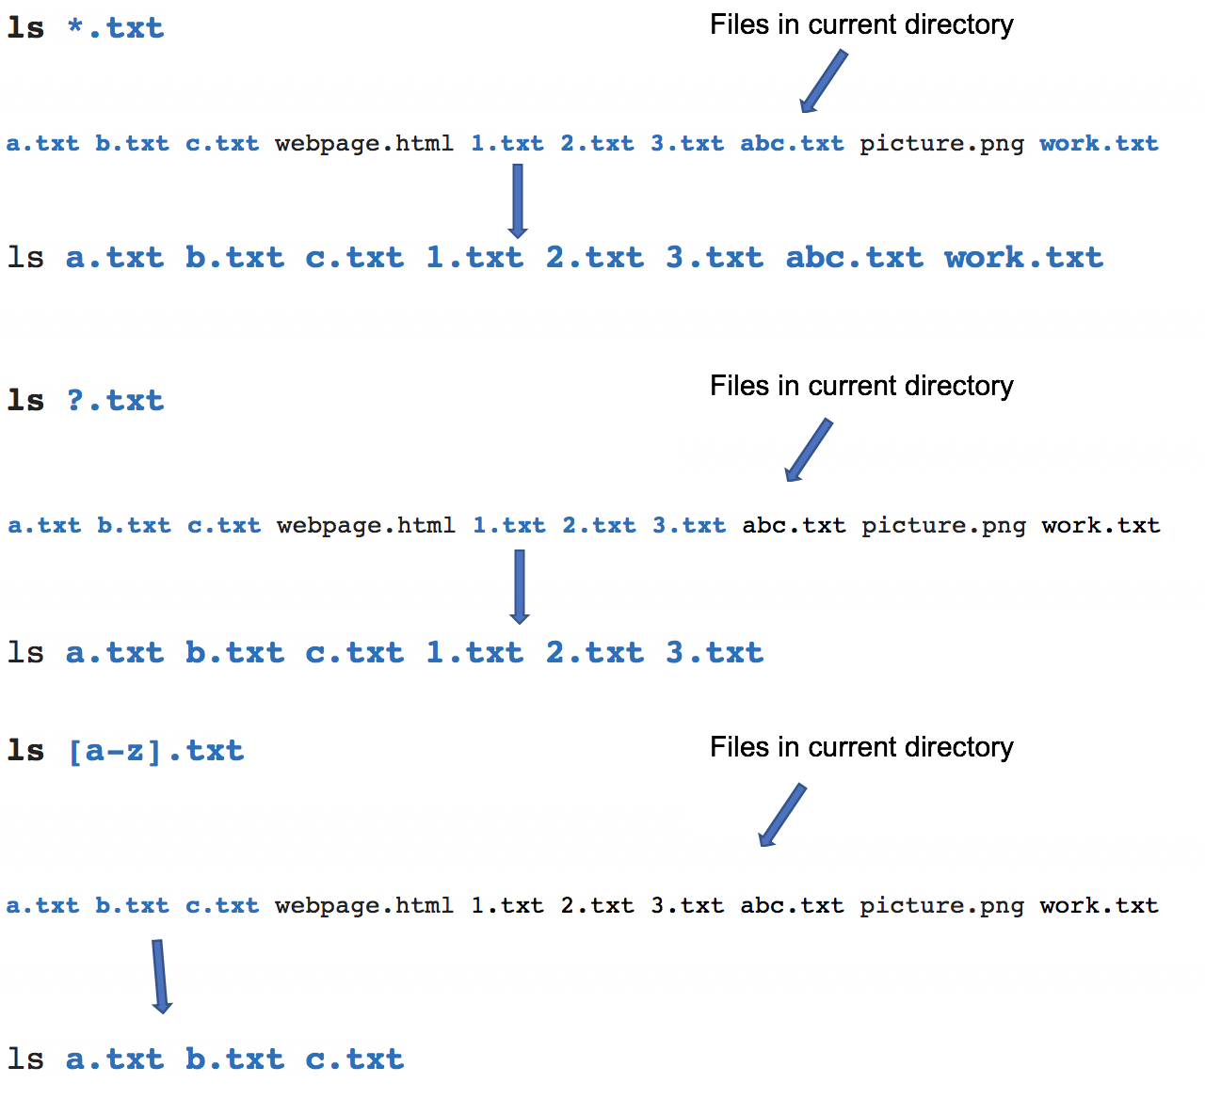
Filename expansion
How Does this Work? (Globbing)
As shown in the diagram on the right, when the ls command is issued with a filename expansion symbol (like *), the Bash shell searches for all files in the current directory that match files that end with the extension ".txt”.
The shell replaces *.txt with all the files that end with the extension .txt in the current directory and runs that command.
You do not see that happen in the shell… it is a process that occurs "behind the scenes”. Instead, you only see the results of the command.

Slide 17
Filename expansion
Instructor Demonstration
Your instructor will now demonstrate how to issue Unix / Linux commands using various filename expansion symbols for file management:
Creating / Removing Directories
Moving Files / Directories
Copying Files / Directories
Listing Directory Contents
Removing Regular Files

Slide 18

Quoting special characters
Quoting Special Characters
As discussed in the above section, there are some special characters that the shell uses to perform an operation; for example, the filename expansion symbols: *, ?, [ ] or [! ]
There is a method to instruct the Linux shell to ignore that special character and use only as regular text.
There are 3 methods to make those special characters act like text characters (referred to "quoting" special characters). These methods are displayed in the next slide.

Slide 19
Quoting special characters
Quoting Special Characters (Methods) The most common filename expansion symbols are displayed below:
Quoting Method | Example
Place the character \ before a special character (works for ALL special characters) | echo \*
Contain Special character within single quotes ‘ ’ (work for ALL special characters) | echo '* hello *'
Contain special characters within double-quotes “ ” NOTE: Double quotes works for most special characters, but not all special characters (such as $variable-name - variables are discussed later in this course) | echo "* hello *"

Slide 20
Quoting special characters
Instructor Demonstration
Your instructor will now demonstrate how to issue Unix / Linux commands quoting special characters, their uses and their consequences:
Displaying Text
Creating / Removing Directories
Listing Directory Contents
Removing Regular Files

Slide 21
Hands-on Time / HOMEWORK
Getting Practice
To get practice to help perform assignment #1, perform the online tutorial Tutorial3: Unix / Linux File Management (ctrl-click to open link):
INVESTIGATION 2: FILENAME EXPANSION
INVESTIGATION 3: QUOTING SPECIAL CHARACTERS
LINUX PRACTICE QUESTIONS (Questions 9 – 13)

