Slide 1
OSL640: INTRODUCTION TO OPEN SOURCE SYSTEMS Week 5: Lesson 1 Additional Linux commands redirection symbols /dev/null FILE , the here document
Photos and icons used in this slide show are licensed under CC BY-SA

Slide 2
Lesson 1 topics
Redirection – Part 1
Additional Commands (tr, cut, wc)
Concepts:
Standard Input, Standard Output, Standard Error
Redirection Symbols: (<, >, >>, 2>, 2>>)
Additional Redirection Concepts:
/dev/null File, The Here Document
Perform Week 5 Tutorial
Investigation 1
Review Questions (Questions 1 – 4)

Slide 3
Additional file Manipulation Commands
Additional Text File Manipulation Commands
Here are some additional commands to manipulate content of text files. Refer to the table below for additional text file manipulation commands:
Command | Description
tr | Used to translate characters to different characters. eg. tr ‘a-z’ ‘A-Z’ < filename
cut | Used to extract fields and characters from records. The option -c option is used to cut by a character or a range of characters. The -f option indicates the field number or field range to display (this may require using the -d option to indicate the field separator (delimiter) which is tab by default). eg. cut –c1-5 filename , cut –d”:” –f2 filename
wc | Displays various counts of the contents of a file. The –l option displays the number of lines, the –w option displays the number of words, and the –c option displays the number of characters. eg. wc filename , wc –l filename , wc –w filename

Slide 4

Additional file Manipulation Commands
Instructor Demonstration
Your instructor will now demonstrate using the following Linux commands:
tr
cut
wc

Slide 5

redirection
Redirection can be defined as changing the way from where commands read input to where commands sends output. You can redirect input and output of a command.
For redirection, meta characters are used.
Redirection can be into a file (shell meta characters are angle brackets '<', '>’) or a program ( shell meta characters are pipesymbol '|’).
Reference: https://www.javatpoint.com/linux-input-output-redirection

Slide 6

redirection
Standard input (stdin) is a term which describes from where a command receives input.
The meta character “<” will redirect stdin into a command.
This would only apply to Unix/Linux commands that can accept stdin like cat, more, less, sort, grep, uniq, head, tail, tr, cut, and wc.
Examples: tr 'a-z' 'A-Z' < words.txt cat < abc.txt sort < xyz.txt

Slide 7


redirection
Standard output (stdout) describes where a command sends its output.
The meta character “>” will redirect stdout to a file either creating a new file if it doesn’t exist or overwriting the content of an existing file.
The meta characters “>>” will redirect stdout to a file either creating a new file if it doesn’t exist or adding stdout to the bottom to the existing file’s contents.
Examples: ls -l ls -l > detailed-listing.txt ls /bin >> output.txt

Slide 8


redirection
Standard Error (stderr) describes where a command sends its error messages.
The meta characters “2>” will redirect stderr to a file either creating a new file if it doesn’t exist or overwriting the content of an existing file.
The meta characters “2>>” will redirect stderr to a file either creating a new file if it doesn’t exist or adding stdout to the bottom to the existing file’s contents.
Examples: PWD PWD 2> error-message.txt PWD 2 >> error-messages.txt PWD 2> /dev/null

Slide 9

redirection
The /dev/null file (sometimes called the bit bucket or black hole) is a special system file that discards stdout or stderr.
This is useful to “throw-away” unwanted command output or errors.
Examples: LS 2> /dev/null ls > /dev/null find / -name "tempfile" 2> /dev/null

Slide 10
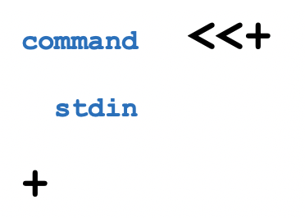
redirection
The Here Document allows stdin to be redirected into a command within the command-line.
The meta characters “<<+” will redirect stdin into the command. The + symbol is used to identify the beginning and ending of the stdin.
You can use ANY symbol or series of characters to mark stdin as long as that symbols or characters are IDENTICAL and the ending symbol or characters are on a separate line with only that symbol or characters.
Example:
cat <<+ Line 1 Line 2 Line 3 +

Slide 11
redirection
Instructor Demonstration
Your instructor will now demonstrate redirection:
Standard Input
Standard Output
Standard Error
Both Standard Output and Standard Error
Both Standard Input and Standard Output
Redirecting to /dev/null
The Here Document

Slide 12
redirection
Getting Practice
To get practice perform Week 5 Tutorial:
INVESTIGATION 1: BASICS OF REDIRECTION
LINUX PRACTICE QUESTIONS (Questions 1 – 4)

Slide 13
ULI101: Introduction to Unix / Linux and the Internet Week 5: Lesson 2 PIPELINE COMMANDS MULTIPLE / MULTILINE COMMANDS
Photos and icons used in this slide show are licensed under CC BY-SA

Slide 14
Lesson 2 topics
Redirection – Part 2
Purpose of Pipeline Commands
Linux Pipeline Command Syntax: |
tee Command
Multiple / Multi-Line Commands
Multiple Linux Commands using Semicolon ”;” and Grouping: ( )
Issuing Large Linux Commands over Multiple Lines
Perform Week 5 Tutorial
Investigations 2 and 3
Review Questions (Questions 5 – 12)
Work on Assignment 2 (Section 3: Redirection & Pipes)

Slide 15
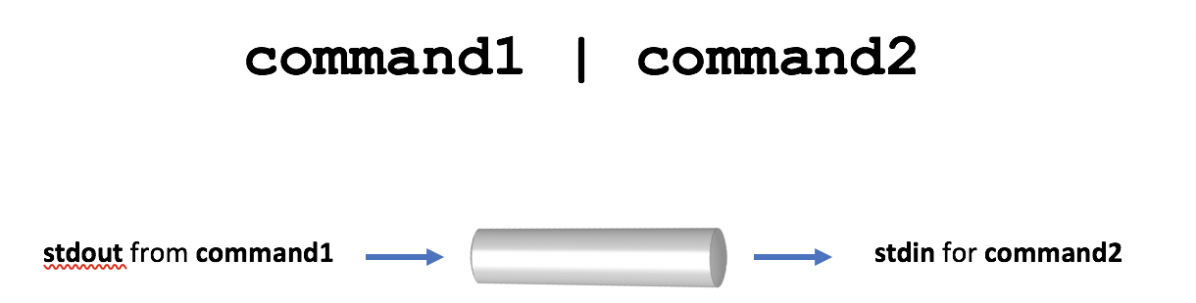
Pipeline commands
Pipeline Commands use a meta symbol “|” (called a pipe) to allow a command’s standard output to be redirected into the standard input of other commands WITHOUT having to use temporary files.
Therefore, a few simple commands can be combined to form a more powerful pipeline command.
Examples: ls -al | more ls | sort -r ls | sort | more ls -l | cut -d" " -f2 | tr 'a-z' ‘A-Z" ls | grep Linux | head -5 head -7 filename | tail -2

Slide 16
Pipeline commands
Filters
Commands to the right of the pipe symbol are referred to as filters.
They are referred to as filters since those commands are used to modify the stdout of the previous command.
Many commands can be "piped" together, but these commands (filters) must be chained in a specific order, depending on what you wish to accomplish.

Slide 17
Pipeline commands
Instructor Demonstration
Your instructor will now demonstrate how to issue Pipeline Commands:

Slide 18
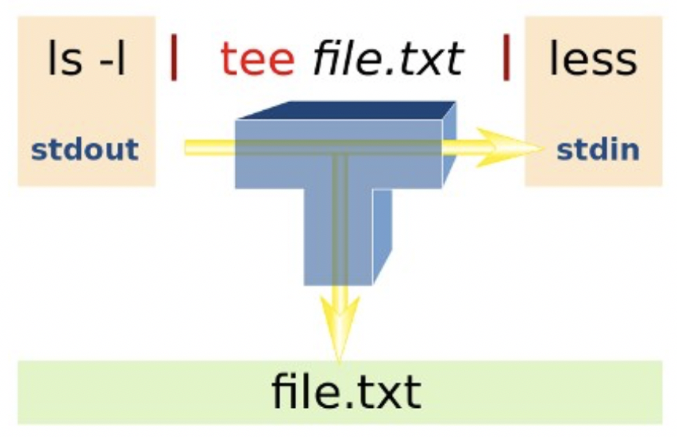
Pipeline commands
The tee utility can be used to split the flow of standard output between a text file and the terminal screen.
The tee option -a can be used to add content to the bottom of an existing file as opposed to overwriting the file's previous contents.
The reason for the name "tee" is that the splitting of the flow of information resembles a capital T.
Examples: ls | tee unsorted.txt | sort ls | grep Linux | tee matched.txt | more ls | head -5 | tee -a listing.txt

Slide 19
Pipeline commands
Instructor Demonstration
Your instructor will now demonstrate how to use the tee command within a Pipeline Command.

Slide 20
Multiple / multi-line commands
There are ways that multiple commands can be run within a single command line.
You can separate commands by using the semi-colon character “;”.
Example: sleep 5; ls
Multiple commands can also be grouped by using parentheses to force commands to be run together (for example, to redirect stdout to a file)
Example: (echo "Who is logged in:"; who) > whoson (Note: all command output is sent to a file)
command1;command2;command3

Slide 21
Multiple / multi-line commands
Commands may also be spread-out over multiple lines, making it easier (for humans) to interpret a long command. You can add a backslash quoting symbol "\" at the end of a line. The \ symbol “quotes-out” the meaning of the ENTER key as text (i.e. new-line) as instead of running the command.
Example: echo "This will be split over multiple \ lines. Note that the shell will realize \ that a pipe requires another command, so \ it will automatically go to the next line” \ | tr '[a-z]' '[A-Z]’
command1 | \ command2 | \ command3

Slide 22
Multiple / multi-line commands
Instructor Demonstration
Your instructor will now demonstrate how to issue Multiple Commands / Multi-Line Linux Commands:
Multiple Linux Commands using semicolon “;”
Multiple Linux Commands using Grouping ( )
Mult-Line Linux Commands using Backslash \

Slide 23
Pipeline commands Multiple / multi-line commands
Getting Practice
To get practice perform the online tutorial Tutorial 5 (ctrl-click to open link):
INVESTIGATION 2: REDIRECTION USING PIPES
INVESTIGATION 3: ISSUING MULTIPLE UNIX/LINUX COMMANDS
LINUX PRACTICE QUESTIONS (Questions 6 – 12)

