Slide 1
OSL640: INTRODUCTION TO OPEN SOURCE SYSTEMS Week 8: lesson 1 Linking files
Photos and icons used in this slide show are licensed under CC BY-SA

Slide 2
Lesson 1 topics
Linking Files
i-nodes
Hard Links / Demonstration
Symbolic Links / Demonstration
Perform Week 8 Tutorial
Investigation 1
Review Questions (Questions 1 – 2)
Perform Assignment 2
Section 4: Linking Files and Directories

Slide 3

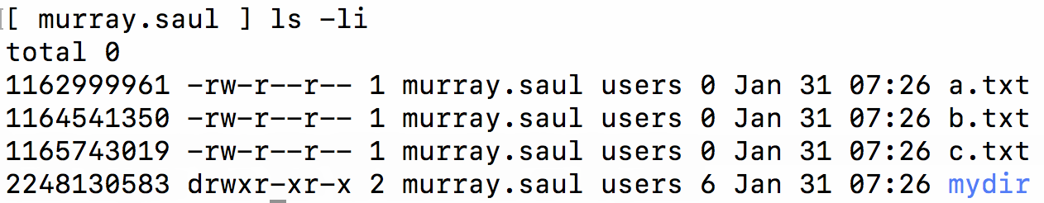
Linking files
inode (index) Number of a File:
The i-node number is like a ”finger-print” which is unique for each file on the Unix / Linux file system.
The i-node is an index (data structure) that provides information about the file such as if the file is a directory or regular file, etc.
Referring to the diagram below, issuing the ls command using the -i option displays the i-node number for each file. You can see that each file has its own unique i-node number in the file system.

Slide 4
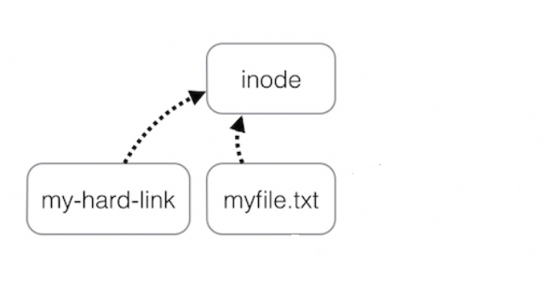
Linking files
Hard Links A Hard link is a reference to the same index on a file system. It does this by creating a file that shares the same i-node number with the other file.
An advantage of using hard links is that if one hard link remains (even if original file has been removed), the data in that hard-linked file is NOT lost. Also, any change to each file will be reflected in any hard-linked file which is useful for backups.
Limitations of hard links are that they take-up extra space, you cannot hard link directories. Also, you cannot hard link files from other Unix/Linux servers (since the i-node number may already be used by the other Unix/Linux server).

Slide 5
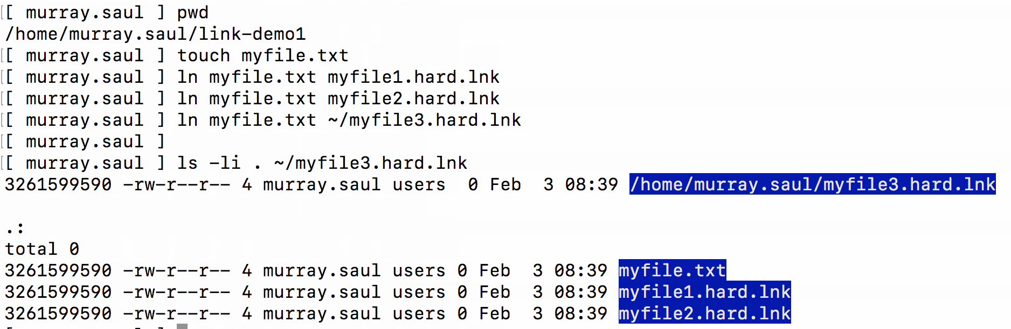
Linking files
Hard Links Examples:
touch myfile.txt ln myfile.txt myfile1.hard.lnk ln myfile.txt myfile2.hard.lnk ln myfile.txt ~/backups/myfile.hard.lnk ls –li myfile*

Slide 6

Linking files
Instructor Demonstration
Your instructor will now demonstrate how to create Hard Links.

Slide 7
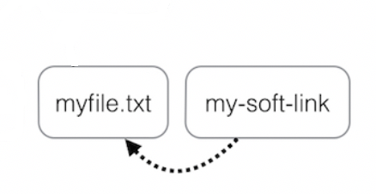
Linking files
Symbolic Links
A Symbolic Link is an indirect pointer to a file and are also known as a soft link or symlink. The symbolic link file contains the pathname to the original file.
An advantage of using symbolic links is they act as shortcuts to other files (in fact, the symbolic linked file only contains the pathname to the original file). Also, you can create symbolic links on different Unix/Linux servers, and that you can create symbolic links for directories.
A limitation of using symbolic links is that they are NOT good for backup purposes since a symbolic link can point to a nonexistent file (referred to as a "broken link").

Slide 8
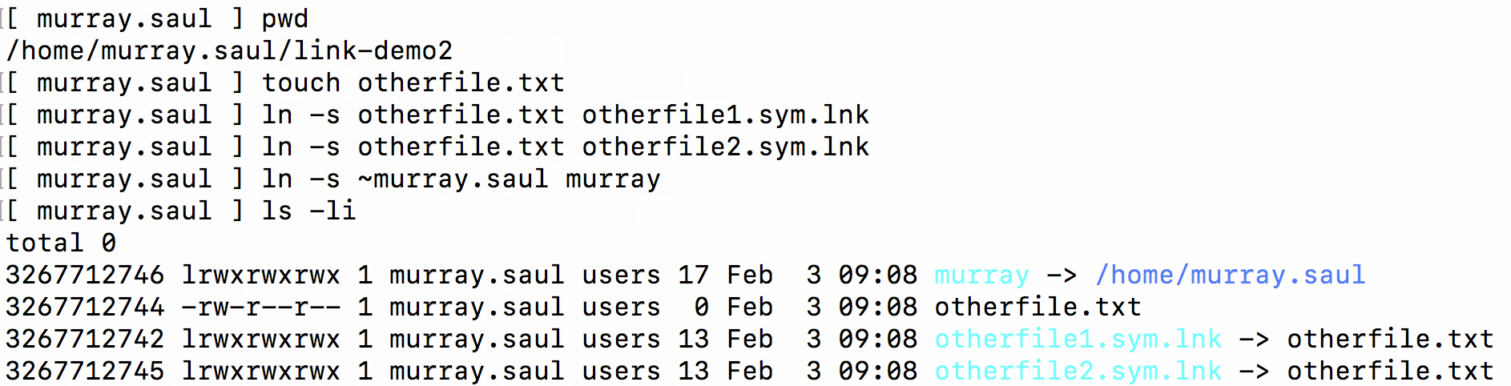
Linking files
Symbolic Links
Examples:
touch otherfile.txt ln -s otherfile.txt otherfile1.sym.lnk ln -s otherfile.txt otherfile2.sym.lnk ln -s otherfile.txt ~/backups/otherfile.sym.lnk ls –li otherfile*

Slide 9
Linking files
Instructor Demonstration
Your instructor will now demonstrate how to create Symbolic (Soft) links.

Slide 10
Linking files
Getting Practice
To get practice perform Week 8 Tutorial:
INVESTIGATION 1: LINKING FILES
LINUX PRACTICE QUESTIONS (Questions 1 – 2)

Slide 11
OSL640: INTRODUCTION TO OPEN SOURCE SYSTEMS Week 8: lesson 2 managing processes aliases and command history
Photos and icons used in this slide show are licensed under CC BY-SA

Slide 12
Lesson 2 topics
Processes
Process Definition / Foreground vs Background Processes
Running Processes in the Background
Managing Processes
Demonstration
Aliases & Command History
Purpose / Usage / Demonstration
Perform Week 8 Tutorial
Investigations 2 and 3
Review Questions (Questions 3 – 8)

Slide 13

Managing Processes
Processes Definition
All programs (tasks) that are running on a Unix/Linux computer system are referred to as processes.
Characteristics of Processes:
Each process has an owner
Each process has a unique ID (PID)
Processes keep their PID for their entire life.
Usually a parent sleeps (i.e. suspended) when a child is running (the exception is when the child process is running in the background)
UNIX / Linux processes are hierarchical. The process structure can have children processes, great grandchild processes, etc.

Slide 14
Managing Processes
Viewing Process Information You can issue Linux commands to provide information regarding running processes. The ps (process status) command displays a snapshot of process information. The top command provides real-time status of all running processes (press ctrl-c to exit top command)
Linux Command | Purpose
ps | Basic listing of processes in current user’s terminal, for example: PID, process names.
ps -l | Detailed listing in current user’s terminal for example: PID, parent PID (PPID), status, etc.
ps -ef | Detailed listing ALL processes running on entire system.
ps aux | Detailed listing of processes for ALL users and background running services (i.e. DAEMONS – background running services).
ps –U username | Basic listing of processes running for a particular user.

Slide 15
Managing Processes
Instructor Demonstration
Your instructor will now demonstrate how to view processes.

Slide 16

Managing Processes
Foreground vs. Background Processes
Processes in UNIX can run in the foreground or background
Commands issued from the shell normally run in the foreground.
Programs / Commands can be run in the background by placing an ampersand & after the command. For example: command &

Slide 17
Managing Processes
Managing Foreground Processes
Users can manage processes to become more productive while working in the Unix / Linux Command-line environment.
Below are keyboard shortcuts to manage foreground processes.
Linux Command | Purpose
ctrl-c | Terminates a process running in the foreground
ctrl-z | Sends a process running in the foreground into the background. Process is stopped (suspended) in background and requires bg command to run in background.

Slide 18
Managing Processes
Managing Background Processes
Below are common Linux commands / keyboard shortcuts to manage background processes.
Linux Command | Purpose
fg | The fg (foreground) command moves a background job into the foreground. The fg command issued without arguments will place the most recent process in the background to the foreground. Example: fg %job-number
bg | The bg utility resumes suspended jobs from the current environment. The bg command issued without arguments will run the most recent process that was placed into the background. Example: bg %job-number
jobs | The jobs utility displays the status of jobs that were started in the current shell environment

Slide 19
Managing Processes
Instructor Demonstration
Your instructor will now demonstrate how to manage foreground and background processes.

Slide 20

Managing Processes
Terminating Processes
You can use the kill command to terminate processes. You need to be the owner of the process to perform this operation.
The kill command sends the specified signal to the specified processes or process groups. If no signal is specified, the SIGTERM signal (#15) is sent. The default action for this signal is to terminate the process.
If the TERM signal does NOT work, you can issue the kill command with the option -9 (i.e. SIGKILL, signal #9).
Examples: kill %jobnumber kill -9 %jobnumber kill PID kill -9 PID

Slide 21
Managing Processes
Instructor Demonstration
Your instructor will now demonstrate how to terminate processes.

Slide 22
aliases / Command History
Using Aliases
Using the alias command assigns a nickname to an existing command or a series of commands. The unalias command is used to remove existent aliases.
Examples:
alias (alias command without an argument will display all the aliases currently set) alias dir=ls alias lal='ls -al' alias clearfile='cat /dev/null >'
unalias clearfile (removes alias clearfile from memory)

Slide 23
aliases / Command History
Command History:
The ~/.bash_history file stores recently executed command lines. There are several techniques using the ~/.bash_history file to run previously-issued commands..
Examples:
<up> or <down> move to previous or next command in Bash shell prompt
fc –l display last 16 commands
history | more display all stored commands
!# re-executes command by command number (obtained from history command)
!abc re-executes last command beginning with string ”abc”

Slide 24
Managing Processes
Instructor Demonstration
Your instructor will now demonstrate how to use aliases and command history.

Slide 25
Managing Processes / aliases / Command History
Getting Practice
To get practice to help perform assignment #2, perform Week 8 Tutorial:
INVESTIGATION 2: MANAGING PROCESSES
INVESTIGATION 3: ALIASES / COMMAND HISTORY
LINUX PRACTICE QUESTIONS (Questions 3 – 8)

