Slide 1
OSL640: INTRODUCTION TO OPEN SOURCE SYSTEMS Week 9 lesson 1 REGULAR EXPRESSIONS VS FILENAME EXPANSION / Simple AND COMPLEX REGULAR EXPRESSIONS
Photos and icons used in this slide show are licensed under CC BY-SA

Slide 2
Lesson 1 topics
Regular Expressions
Definition / Purpose
Regular Expressions vs. Filename Expansion
Simple and Complex Regular Expressions
Simple (Literal) Regular expressions using grep
Complex Regular Expressions using grep
Demonstration
Perform Week 9 Tutorial
Investigation 1
Review Questions (Simple and Complex Regular Expressions Parts A and B)

Slide 3

Regular Expressions
Definition
A regular expression … is a sequence of characters that define a search pattern. Usually, such patterns are used by string searching algorithms for "find" or "find and replace" operations on strings, or for input validation.
Reference: https://en.wikipedia.org/wiki/Regular_expression

Slide 4

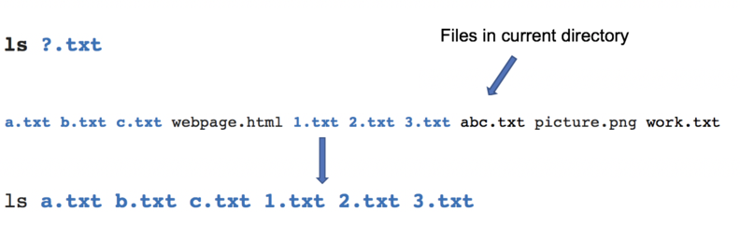
Regular Expressions
Regular Expressions vs Filename Expansion
In a previous lesson, you learned filename expansion symbols that allow the Linux shell to expand filenames as arguments (referred to as “globbing”).
This is used for command file management and file manipulation commands including: ls, rm, mv, cp, cat, less, more, head, tail, sort, uniq, grep, tr, cut and wc

Slide 5
Regular Expressions
Regular Expressions vs Filename Expansion
Regular expressions are used to search, edit and manipulate text. This can represent text contained in a file or within a pipeline command.
Regular expressions are used with commands that match patterns contained in text such as: grep , egrep, man, more, less, vi, sed and awk

Slide 6

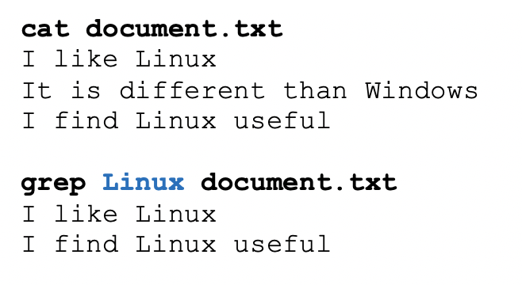
Regular Expressions
Simple (literal) Regular Expressions With Linux Commands
A simple regular expression is a collection of characters (for example words or phases).
Although we will later discuss several Linux commands that use regular expressions, the grep Linux command is useful to learn to display lines of text that match a regular expression.
Example: grep Linux document.txt

Slide 7
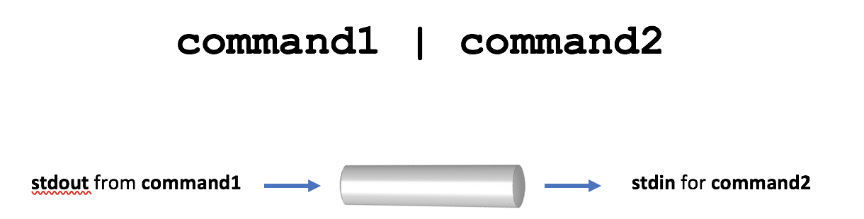
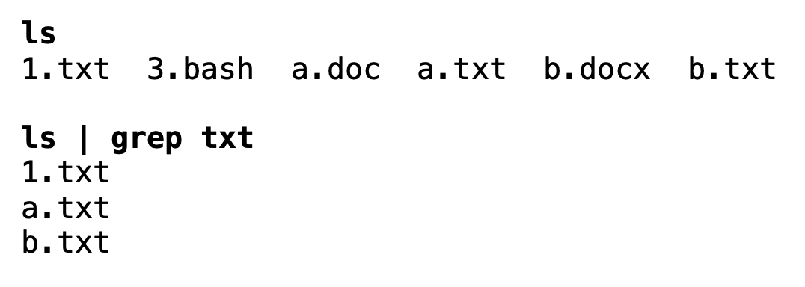
Regular Expressions
Regular Expressions With Linux Pipeline Commands
Regular expressions can also be used to manipulate text within Linux Pipeline Commands.
The grep command can act as a filter to match text patterns. In turn, the stdout from that filter can be further processed by other filters throughout the Linux pipeline command.
Examples: ls | grep txt who | grep khan | head -20

Slide 8

Regular Expressions
Instructor Demonstration
Your instructor will demonstrate examples of using simple regular expressions with the grep command.

Slide 9

Regular Expressions
More Precise Pattern Matching
The problem with using simple (literal) regular expressions is that only simple or general patterns are matched.
For example, the pattern: the would match larger words such as there, they, either, them, their, in addition to the word the.
There are also other types of patterns you may want to search such as location of pattern at the beginning or ending of a string, number of characters (or character classes) or the number of occurrences of a character or pattern.
We can use complex and extended regular expressions for more precise matches. We will discuss complex regular expressions in this lesson.

Slide 10
Regular Expressions
Complex Regular Expressions Symbols
Complex Regular Expressions use symbols to help match text for more precise or complex patterns.
The most common complex regular expression symbols are displayed below:
Anchors ^ , $
Characters .
Character Class [ ] , [^ ]
Zero or More Occurrence *

Slide 11
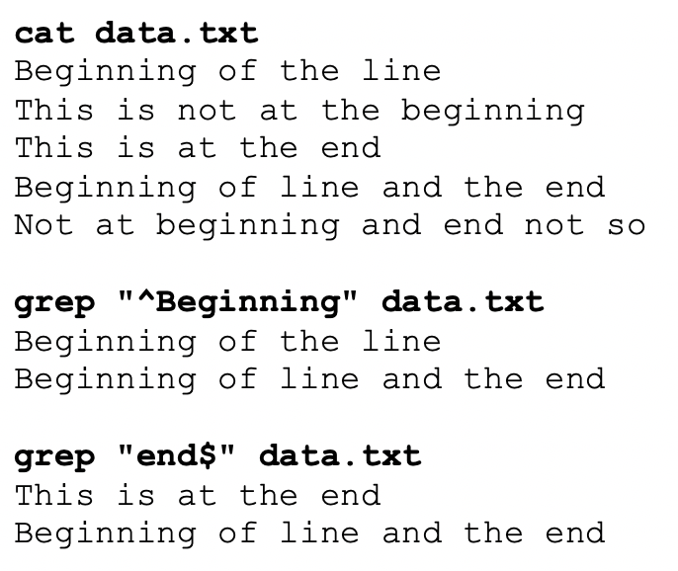
Regular Expressions
Complex Regular Expressions Symbols
Anchors: ^ , $ Anchors are used to “anchor” the match at a specific position (at beginning or ending of a string of text).
The ^ symbol anchors the pattern at the beginning of the string. The $ symbol anchors the pattern at the end of the string.
Examples: grep “^Beginning” data.txt grep “end$” data.txt

Slide 12
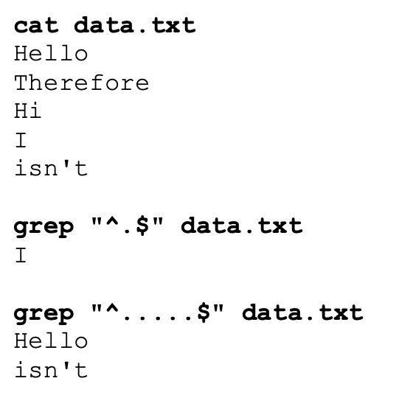
Regular Expressions
Complex Regular Expressions Symbols
Single Character: .
The period symbol “.” is used to represent a single character which could represent any character.
This symbol (or sequence of period symbols) are effective when used with anchors.
Examples: grep “^.$” data.txt grep “^.....$” data.txt

Slide 13
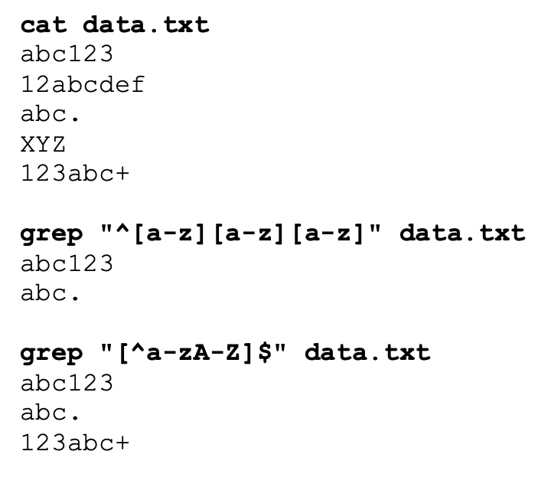
Regular Expressions
Complex Regular Expressions Symbols
Character Class: [ ] , [^ ]
Works like the Single Character symbol, but with restrictions.
The ^ symbol with the character class means opposite of the contents within the character class.
This symbol (or sequence of these symbols) are effective when used with anchors.
Examples: grep “^[a-z][a-z][a-z]” data.txt grep “[^a-zA-Z]$” data.txt

Slide 14
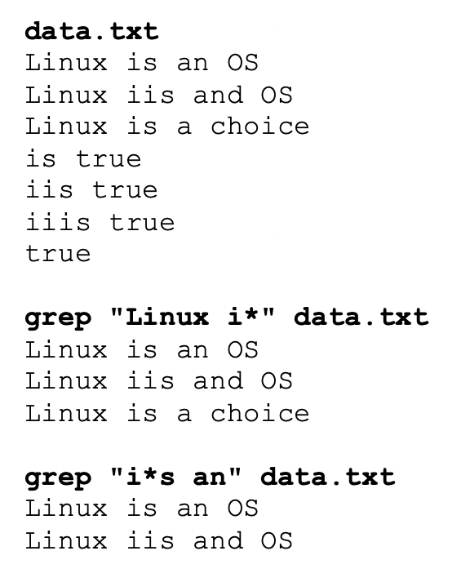
Regular Expressions
Complex Regular Expressions Symbols
Zero or More Occurrence(s) *
This symbol means zero of more occurrences of the previous character.
People learning about regular expressions get confused with this symbol thinking that it means zero or any character, but that would require the use of two symbols: .*
Examples:
grep “Linux i*” data.txt grep “I*s an” data.txt grep “^[0-9].*[0-9]$” myfile.txt

Slide 15
Regular Expressions
Instructor Demonstration
Your instructor will demonstrate examples of using complex regular expressions with the grep command.

Slide 16
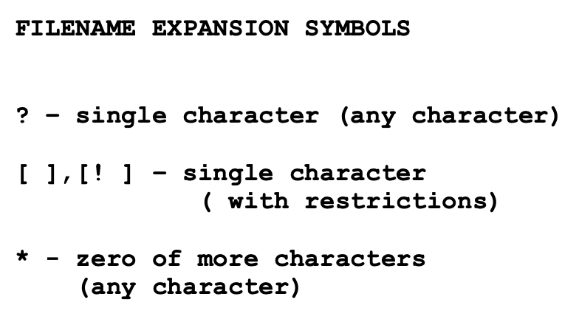
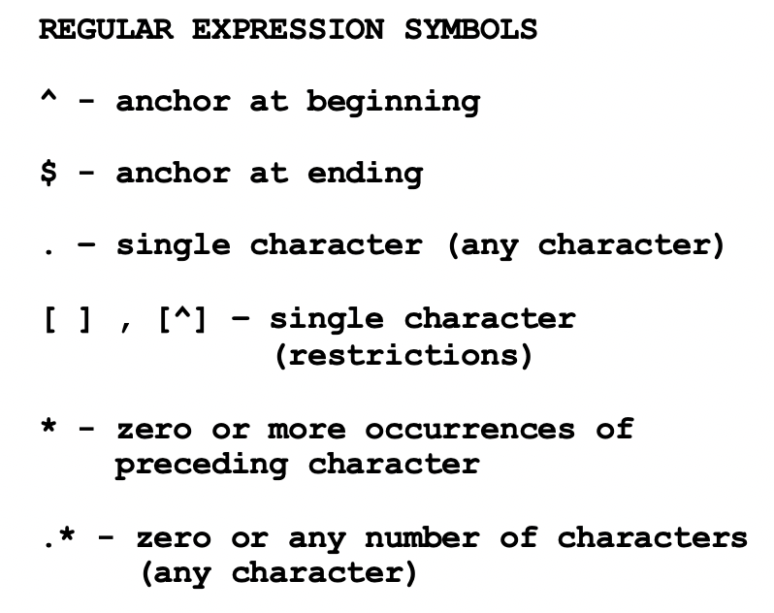
Regular Expressions
Tip: Creating a Reference Sheet
It is a good idea to keep symbols for Filename Expansion and Regular Expressions separate since there is some overlapping similar symbols that have different purposes.
It is recommended to write-out these separate set of symbols on a sheet of paper for reference.

Slide 17
Regular expressions
Getting Practice
To get practice perform Week 9 Tutorial:
INVESTIGATION 1: SIMPLE & COMPLEX REGULAR EXPRESSIONS
LINUX PRACTICE QUESTIONS

Slide 18
OSL640: INTRODUCTION TO OPEN SOURCE SYSTEMS Week 9: lesson 2 extended regular expressions Linux commands that use regular expressions
Photos and icons used in this slide show are licensed under CC BY-SA

Slide 19
Lesson 2 topics
Extended Regular Expressions
Definition / Purpose
Extended Regular Expressions Symbols
Instructor Demonstration
Other Linux Commands That Use Regular Expressions
man , more , less , vi , sed , awk
Perform Week 9 Tutorial
Investigation 2
Review Questions (Extended Regular Expressions, Parts A and B)
Complete Assignment #2 (Due Friday at midnight) Work on Assignment #3 (Section 1: Regular Expressions Using grep)

Slide 20
Extended Regular expressions
Extended Regular Expressions
Extended Regular Expressions consist of additional special characters that “extend” the capability of regular expressions.
We will discuss three types of extended regular expressions:
Repetition: {min, max} , ? , +
Grouping: ( )
Or Condition: |

Slide 21
Extended Regular expressions
AAAA
Repetition
The extended regular expression symbol consists of the minimum and/or maximum number of repetitions contained within braces { }
Usage:
{min,max}
Examples: a{2,5} 2 to 5 occurrences of the character a [0-9]{1,} 1 or more occurrences of a number [0-9]+ (shortcut method) [a-z]{0,1} zero or 1 occurrence of a lowercase letter [a-z]? (shortcut method)

Slide 22
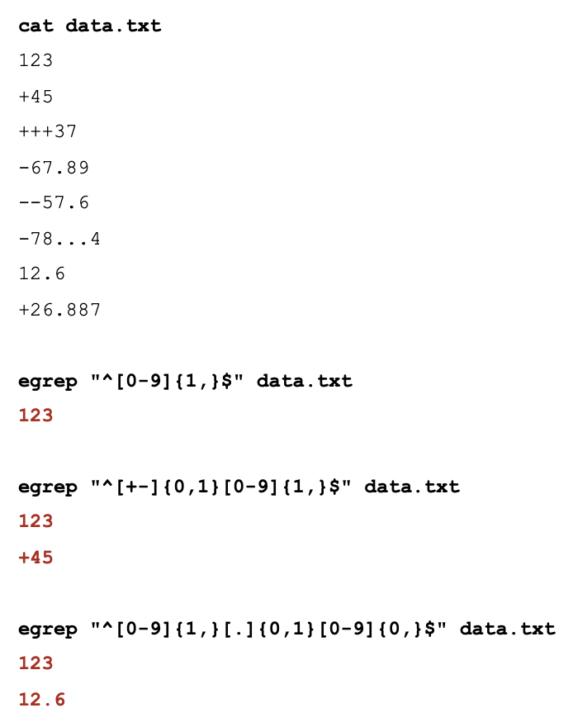
Extended Regular expressions
AAAA
Repetition Extended Regular Expression Example
If you issue the grep command without options with extended regular expressions, the command will NOT work.
When using the grep command with extended regular expressions you need to use egrep or grep –E
Examples: egrep “^[0-9]{1,}$” data.txt egrep “^[+-]{0,1}[0-9]{1,}$” data.txt egrep “^[0-9]{1,}[.]{0,1}[0-9]{0,}$” data.txt
grep –E “^[0-9]{1,}$” data.txt grep –E “^[+-]{0,1}[0-9]{1,}$” data.txt grep –E “^[0-9]{1,}[.]{0,1}[0-9]{0,}$” data.txt

Slide 23
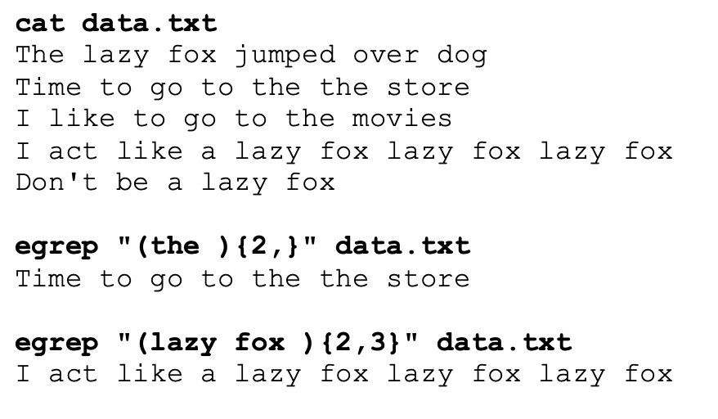
Extended Regular expressions
(pattern)
Grouping
If you want to search for repetition for a group of characters, a word, or a phase, you can enclose them within brackets ( )
Examples: egrep “(the ){2,}” data.txt egrep “(lazy fox ){2,3}” data.txt

Slide 24
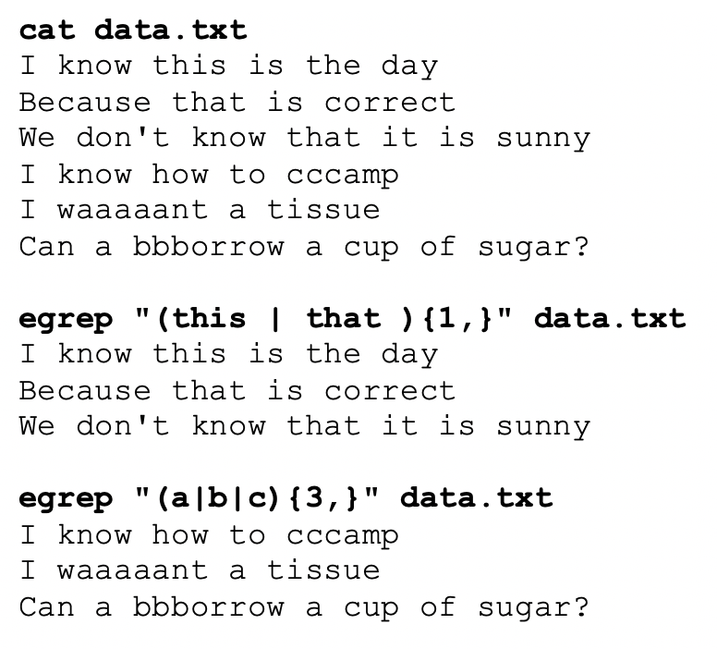
Regular Expressions
(this |that )
Or Condition
The | symbol is used as the “or” symbol to provide alternatives within a group.
Examples: egrep “(this | that ){1,}” data.txt egrep “(a|b|c){3,}” data.txt

Slide 25
Regular Expressions
Instructor Demonstration
Your instructor will demonstrate examples of using Extended Regular expressions with the egrep command.

Slide 26
Regular Expressions
Other Linux Commands that Use Extended Regular Expressions
There are other Linux commands / utilities in addition to grep or egrep that use regular expressions.
You have already used a few of these commands like: man, more, less, and vi.
Other commands like sed and awk will be taught in a future lesson.

Slide 27
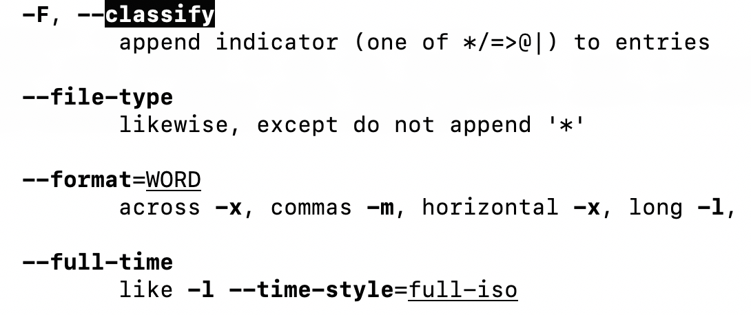
Regular Expressions
Other Linux Commands that Use Extended Regular Expressions
man , more , less
When searching for patterns using the man, more, or less commands, you specify a regular expression with a forward slash /
Example with man ls command: /classify

Slide 28
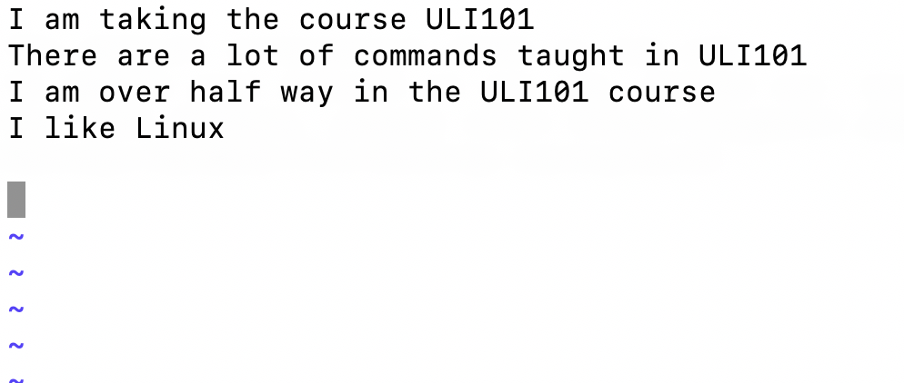
Regular Expressions
Other Linux Commands that Use Extended Regular Expressions
vi
The vi text editor use regular expressions to search and manipulate (edit) text within a text document.
Examples: /pattern – search for pattern in text file :%s/osl640/OSL640/g – search and replace text globally (all lines)

Slide 29
Regular Expressions
Using Regular Expressions with Linux Commands other than grep
awk , sed
The awk and sed Linux utilities are used to manipulate text, from files or via Linux pipeline commands.
You will learn how to use these commands in a later lesson.

Slide 30
Regular Expressions
Instructor Demonstration
Your instructor will demonstrate examples of using Extended Regular Expressions with the man, more, less and vi utilities.

Slide 31
Regular expressions
Getting Practice
To get practice perform Week 9 Tutorial:
INVESTIGATION 2: EXTENDED REGULAR EXPRESSIONS
INVESTIGATION 3: OTHER COMMANDS THAT USE REGULAR EXPRESSIONS
LINUX PRACTICE QUESTIONS

