Slide 1
AI Assisted Knowledge Integration
Making the digital thread actionable — with a live demo to follow

Slide 2
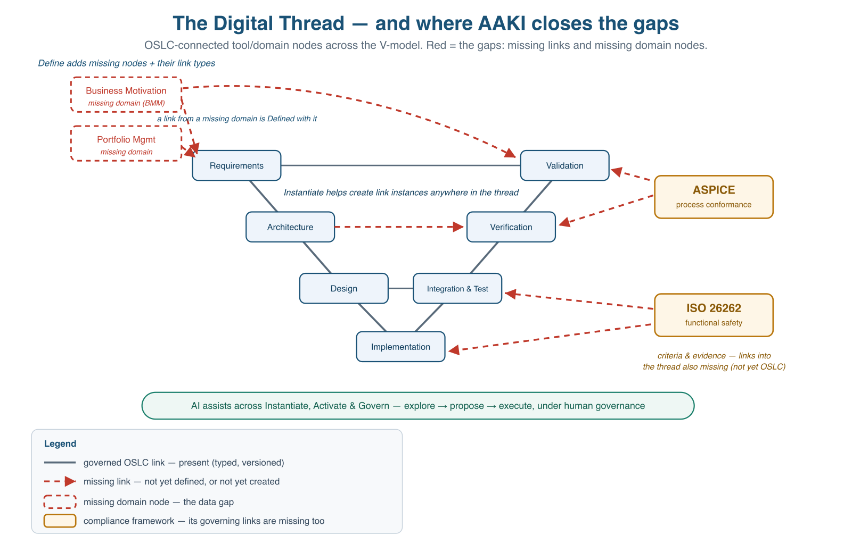
The Digital Thread – a navigable, governed graph
Tool and domain nodes across the V-model, connected by links — the connected, traceable, queryable definition of the product across its lifecycle

Slide 3
Challenges — a Digital Thread graph with holes
Seen as nodes and links, four gaps stand in the way of realizing the Digital Thread value:
Missing links between nodes — the connectivity/traceability gap. Tools are islands; linking them is manual, slow, error-prone, and decays over time. You can’t reliably exchange or trace data across the thread.
Missing domain nodes — the data gap. Some information has no node at all. Business motivation and portfolio — Doing the Right Things Right — are often absent entirely.
Ungoverned evolution — the governance & continuous-improvement gap. A connected, populated thread only pays off if it’s governed as it evolves — otherwise it stays hard to reach (no federation → lossy data marts), inert, and its conformance lives in episodic audits with no feedback loop. This is where the thread’s value is ultimately realized.
Configuration Management – managing versions and configurations of all the contributions to the digital thread

Slide 4
AAKI closes the gaps — AI assistants + OSLC
What if an AI assistant could add the missing nodes (harvest a domain into a governed OSLC server in days, not months) …
What if it could add the missing data and links — populating resources and the typed cross-tool links between them, without the author hand-crafting each one …
What if you could then ask the whole connected thread questions and act on version aware, governed, trustworthy answers …
What if conformance to your governance regime were a continuously-held state over that live thread — not a report rebuilt at audit time — and the same thread showed you where to improve?
The promise: AI assistants helping close the gaps in your digital thread and make it actionable — to “Do the Right Things Right.”

Slide 5
The four “what ifs” are the four AAKI stages
The “what if” | AAKI stage
Add a missing node — harvest a domain into a governed OSLC server fast | Define — AI configures over existing shared vocabularies (SysML, PLM, OSLC RM/QM/CM/AM, BMM), or drafts a new one for a genuine gap
Add the missing data and links — populate resources and links without hand-crafting | Instantiate — AI translates SME content and intent into shape-conformant resources and typed links via MCP
Ask the connected thread and decide | Activate — natural-language Q&A, what-if, gap/impact analysis, compliance reporting
Hold conformance to your governance regime as a continuously-held state, and see where to improve | Govern — a regime’s criteria governed as OSLC data linked to their evidence; continuous conformance assessment reusing Activate’s queries; AI drafts findings/ratings, humans own the rating, reducing compliance drift

Slide 6
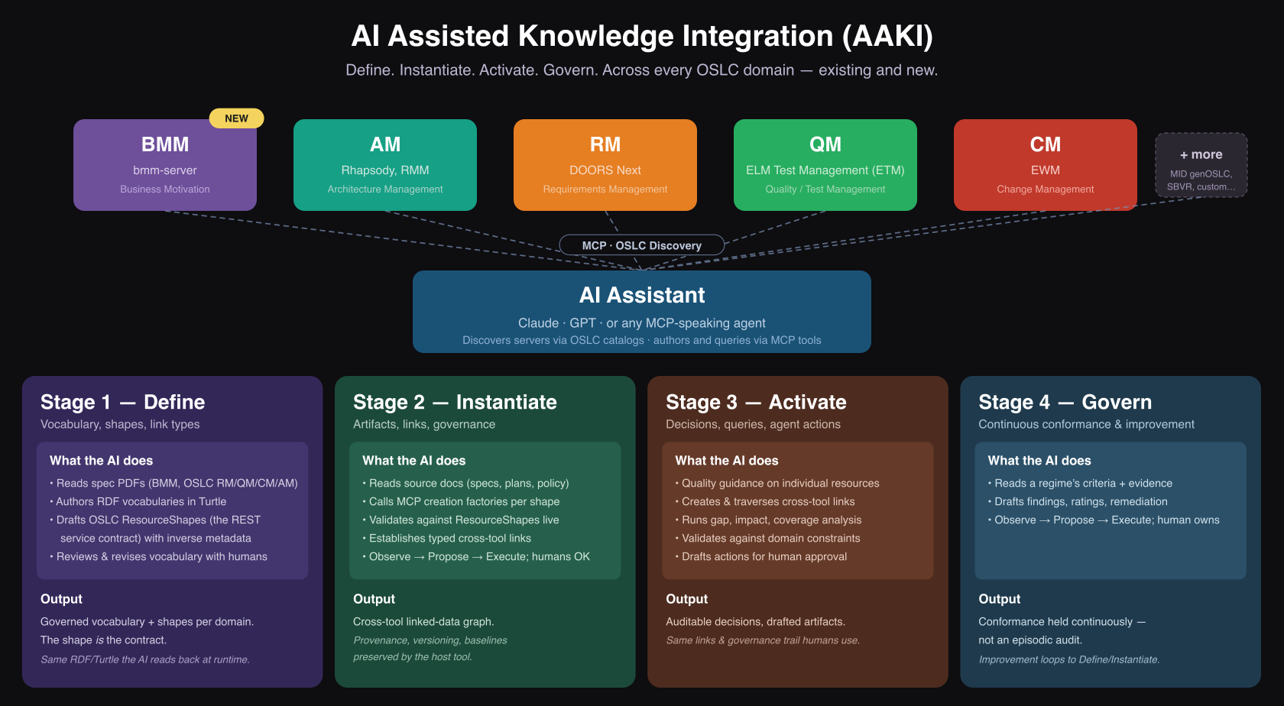
AAKI at a glance
AAKI = AI Assisted Knowledge Integration. Define, Instantiate, Activate, Govern over an OSLC linked-data thread.

Slide 7
The connectivity substrate — OSLC
Closing the connectivity gap needs a standard way for tools to link:
OSLC connectors expose otherwise-unintegrated tools through a discoverable interface: catalog → service providers → creation factories, query capabilities, vocabularies, shapes — and discoverable by AI via MCP.
Link ownership gives every link a home and a queryable reverse direction.
Link validity marks a link suspect when an endpoint changes — staleness made visible.
Configuration Management answers “which baseline?” — traceability with version context.
Without this substrate the AI has only text similarity — unsafe for engineering decisions. With it, the AI reasons over typed, governed, versioned links.

Slide 8
Stage 1 — Define (add the missing node)
The meaning layer. What kinds of things exist, what properties they have, how they relate.
Input: spec / policy / method documents; SME knowledge
AI’s role — two paths, one tool:
Draft where needed, create a new open RDF vocabulary + OSLC ResourceShapes for a genuine conceptual gap.
Configure a supporting OSLC server over shared vocabularies
Your role: review, refine, govern the contract downstream consumers rely on
Output: a real, governed OSLC server node in the thread
Days or weeks, not months or years — and most of those days are configuration, not authoring. Reuse whenever a shared concept space exists; create only for genuine gaps.

Slide 9
A note on the “ontology”
Define produces an application vocabulary + an API/validation contract — in the lineage of W3C SHACL (OSLC’s ResourceShape is one of its ancestors).
It validates, it does not infer — like schema.org and most production knowledge graphs.
OWL-compatible, not OWL-required: the vocabulary is plain RDF; layer OWL over it if you wish, but reasoning is never a precondition for interoperability.
Where an authoritative formal ontology exists (SysML v2, ISO 15926, IOF/BFO, FIBO), Define reuses it as the vocabulary layer.
AAKI’s contribution is closing connectivity and data gaps — which formal ontologies do not themselves address.

Slide 10
Stage 2 — Instantiate (add instance data)
The content layer. Populate nodes with resources and the links between them.
Input: an example document (a business plan, an ISO procedure, a requirements set) + SME conversations
AI’s role: translates intent into shape-conformant resources, posts via MCP, creates the cross-domain links, reports progress
Your role: govern context (configuration, change set, approval state), review proposals, own the outcome
Output: a populated, linked, queryable thread
The linking cost moves off the author. The AI never delivers without approval. The incentive problem that kept the thread sparse dissolves

Slide 11
Stage 3 — Activate (make the thread actionable)
The value layer. Use the connected thread to drive decisions
Natural-language questions. Cross-domain queries. “What-if” analyses. Gap and coverage detection
Impact analysis, Compliance reports, Traceability views: All over the same governed graph — same provenance, configuration context, and approval state
Stage 3 justifies Stages 1 and 2. Without Activate you have a beautifully governed thread nobody uses. With it, you have the system of record everyone wants to ask

Slide 12
Activate has three facets
Three lenses on the same governed graph — each for a different question. Same MCP protocol, same RDF substrate, different cost and scope per facet
Facet | The AI’s scope | Example question
Tool / Resource Optimization | One tool, one domain | “Is this requirement well-written? Any duplicate test cases?”
Integration | Live OSLC link graph across tools | “Which requirements lack test cases? Impact of changing this interface?”
Analytics | Materialized view (LQE-style) | “Test coverage by hazard category? What changed since the last milestone?”

Slide 13
Stage 4 — Govern (conformance & improvement)
The evolution layer. Govern how the thread evolves against external criteria, reusing Activate’s queries. A governance regime is first-class OSLC data, part of the thread — not documents on a shared drive:
Criteria governed as OSLC data — an ASPICE process outcome, an ISO 26262 safety requirement, an internal quality gate is itself a governed, versioned resource. Regimes are optional and plural — the model is regime-agnostic (IEC 61508, DO-178C, ISO 9001, …).
Linked to their evidence — each criterion points at the requirements, designs, and tests that evidence it.
Versioned → metrics over time — because criteria and evidence are versioned, conformance is assessed over the live thread (not an episodic audit), yielding process metrics over time.
Compliance becomes a continuously-held state — and the thread surfaces improvement signals feeding back into Define and Instantiate.

Slide 14
Governance discipline: Observe / Propose / Execute
This is the cross-cutting governance discipline — RACI, Observe-Propose-Execute, provenance — that runs across all four stages, not a stage itself (distinct from the Govern stage above).
The AI does not appear on the RACI chart. Three patterns let it assist without taking the wheel:
Observe — read-only analyses; no approval needed. “Show me requirements without test cases.”
Propose — drafts artifacts and links into a proposed state; human reviews, edits, promotes. “Draft a test case for this requirement.”
Execute — mechanical operations under pre-authorized policy captured in a change set for approval and delivery. “Link every test case to the requirement it names.”
Humans remain Responsible and Accountable. The governance trail (provenance, versioning, attribution, configuration context) proves it

Slide 15
Why now
RDF was built for this. Turtle expresses meaning, not just structure — AI assistants are unusually fluent in it.
OSLC was built for this. Typed, governed, linked artifacts across tools is the substrate AI needs to reason reliably.
AI is the missing component. A 6-month manual integration becomes a 6-week guided collaboration; a thread nobody queried becomes one everyone queries.
Stages 1 and 2 used to be too expensive to justify Stage 3. Stage 4 was often out of scope. AI changes that economics.

Slide 16
The proof: genoslc-bmm-server
One node of a digital thread — the business-motivation domain, a real data-gap fill.
Define done. The AI read the OMG Business Motivation Model 1.3 spec → BMM.ttl + BMM-Shapes.ttl (25 classes, 49 properties, 14 ResourceShapes). create-oslc-server assembled a fully operational, AI-ready OSLC server.
Instantiate runs live. The AI populates EU-Rent — Vision, Goals, Strategies, Tactics, Influencers, Assessments, Policies — with cross-resource links, in minutes.
Activate runs live. “Which goals lack supporting tactics?” “Impact of revising Mission X?” — the AI traverses the OSLC graph and answers.
Real shapes. Real OSLC server. Real MCP endpoints. Not slide-ware.

Slide 17
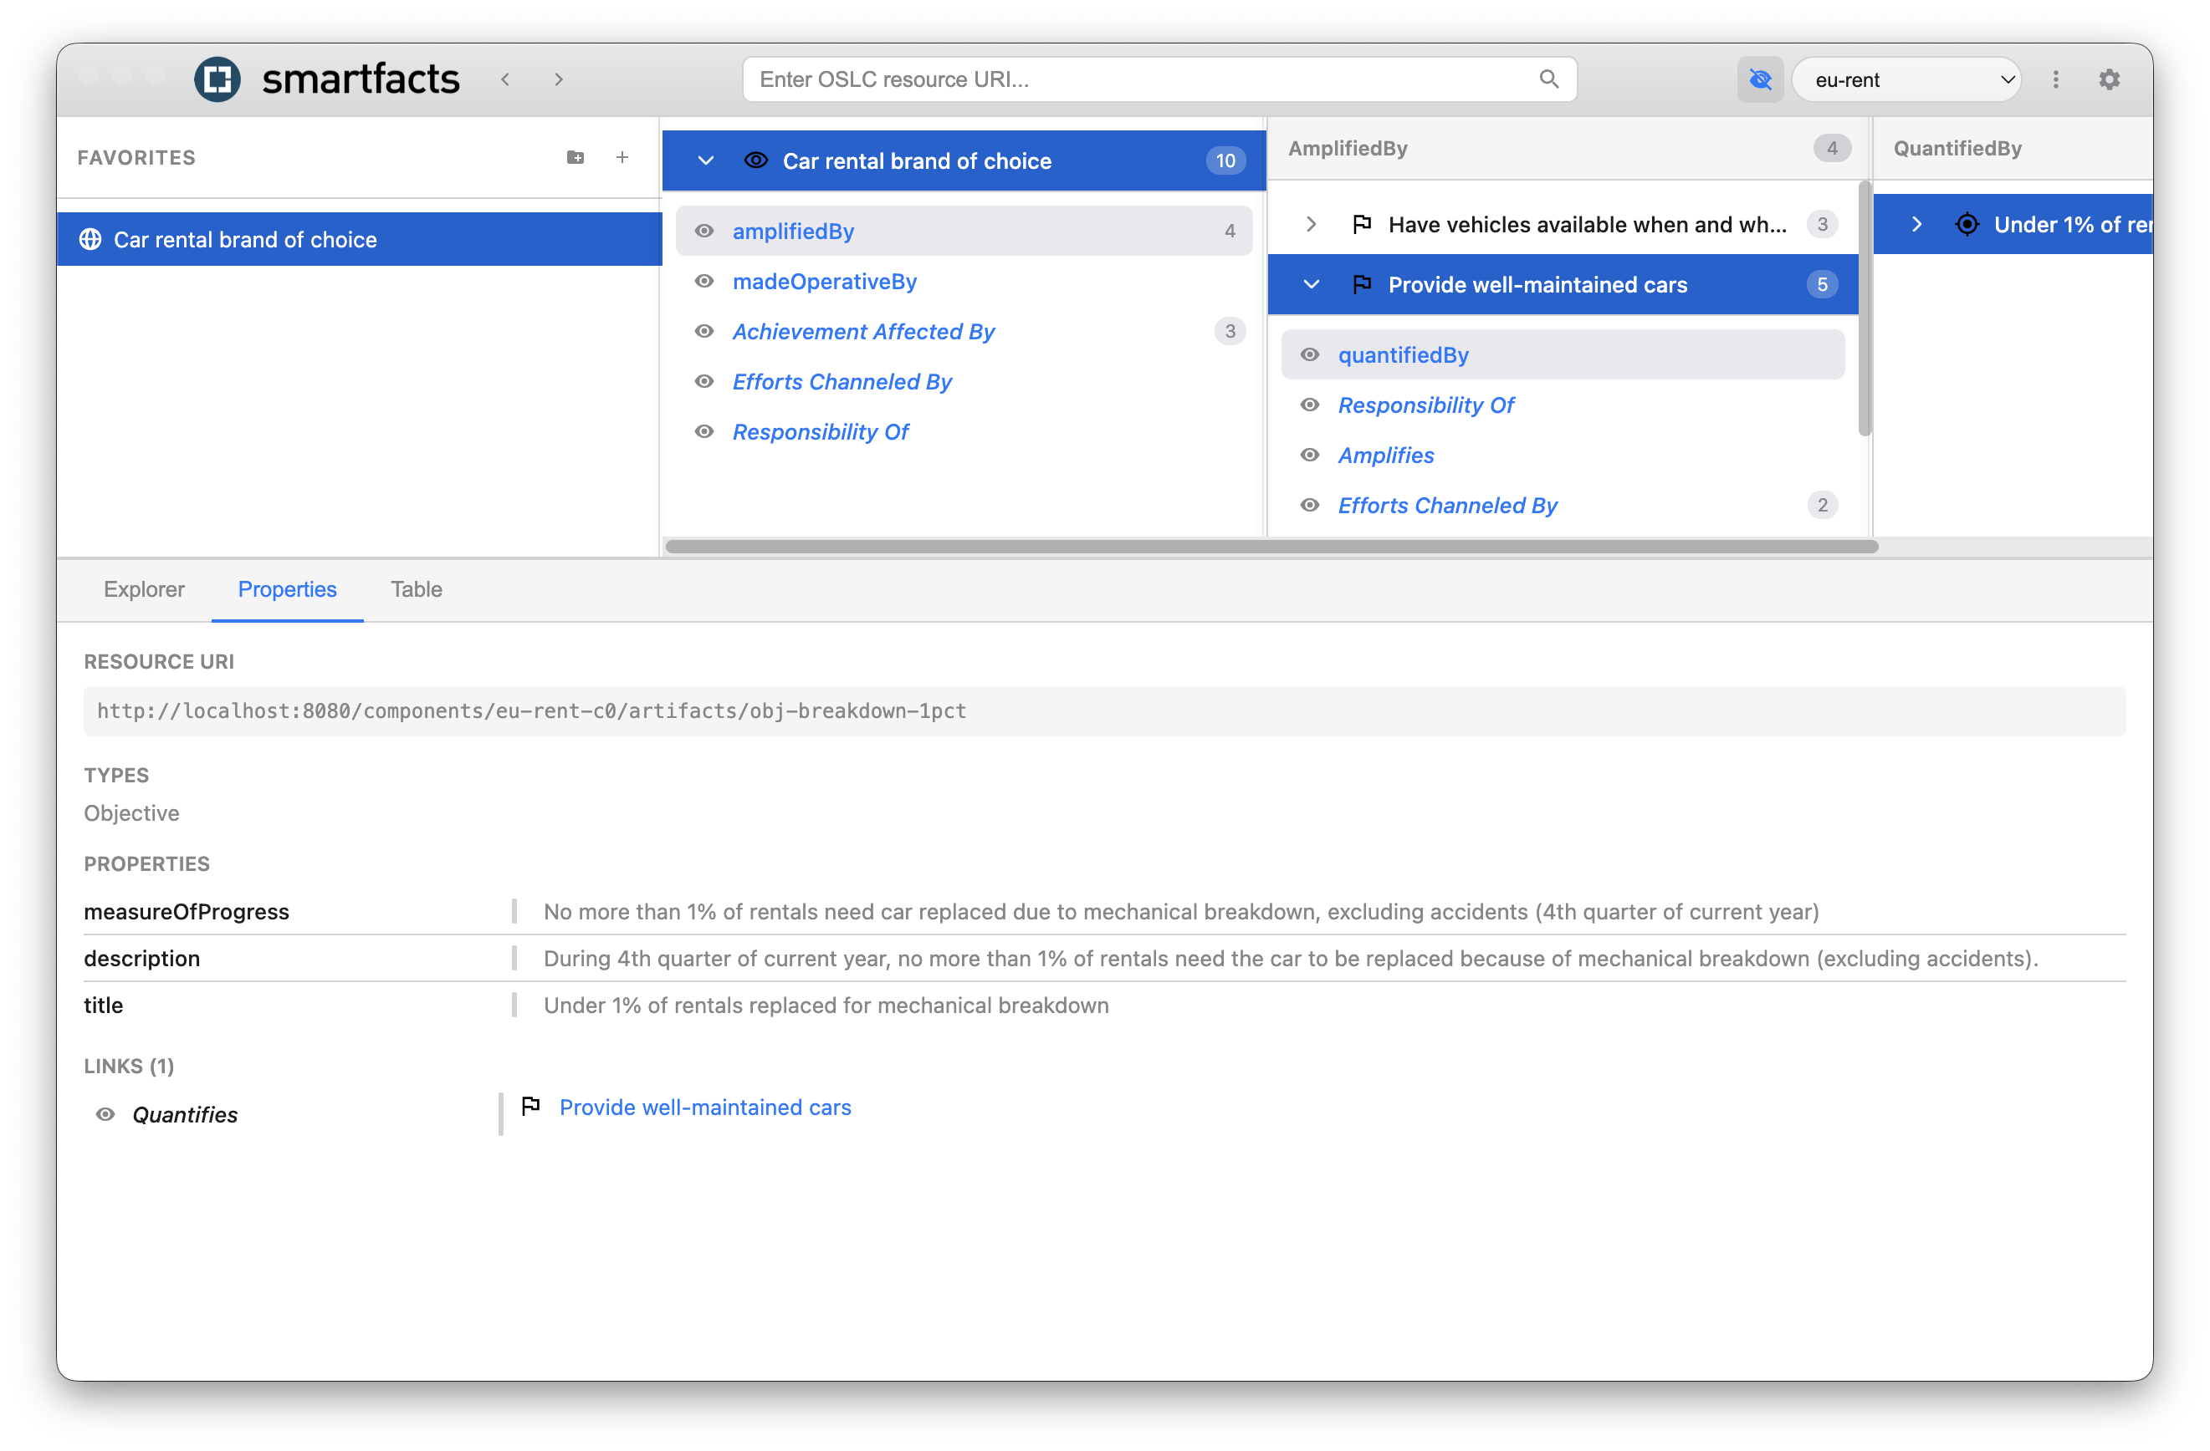
EU-Rent’s Business Motivation

Slide 18
Prompt: Identify Goals on the EU-Rent ServiceProvider that have no realizing Tactic chain
Result:
Traced Goal ← channelsEffortsToward — Strategy ← implements — Tactic across the 4 EU-Rent Goals. One is fully realized; three have broken chains:
Fully covered: Provide well-maintained cars (…/goal-well-maintained-cars) — two Strategies, both implemented by Tactics.
Gap, no Means at all: Provide industry-leading customer service (…/goal-customer-service) — no Strategy channels toward it; only an Objective (85% CSAT) exists. Needs a new Strategy plus Tactics (staff training/service standards, complaint resolution, self-service).
Gap, Tactic layer missing: Be a premium brand car rental company (…/goal-premium-brand) — strat-onairport channels toward it but no Tactic implements it. Needs airport-presence execution tactics.
Gap, Tactic layer missing: Have vehicles available when and where expected (…/goal-vehicle-availability) — strat-vehicle-stock channels toward it but no Tactic implements it (and no Objective quantifies it). Needs stock/fleet-balancing tactics.
Root cause: three Strategies (strat-onairport, strat-vehicle-stock, strat-rewards-scheme) have zero implementing Tactics. Also one orphan: tactic-encourage-extensions implements no Strategy. All read-only — nothing changed.

Slide 19
Thank you
Questions before the demo?
The digital thread’s promise was traceability; its unmet need was action. AAKI closes the missing links and missing nodes with AI + OSLC — so the thread becomes something you act on, prove continuously, and improve.

