Slide 1
Jenkins jobs analysis and visualization
https://github.com/OSLL/jenkins_job_builder_visualization rebovykin@gmail.com mark.zaslavskiy@gmail.com

Slide 2
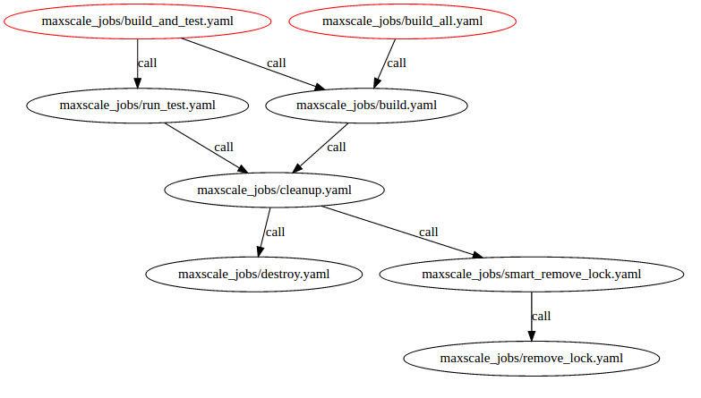
Call graph
Jenkins jobs call each other.
Do you call all the jobs correctly?
Do you have cyclic dependencies?

Slide 3
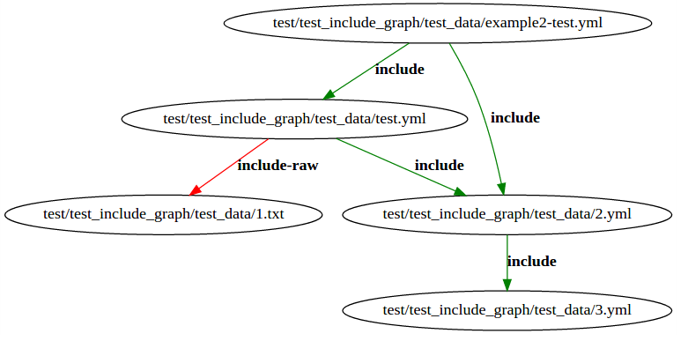
Include graph
One .yaml config includes another .yaml config, that itself includes .yaml configs and so on.
If you change one file, what configs will you possibly break?

