Slide 1
Full Automated Continuous Integration and Testing Infrastructure for Maxscale and MariaDB
Mark Zaslavskiy^{1,3}, Alexander Kaluzhniy^{1,2}, Tatyana Berlenko^{1,2}, Ilfat Kinyaev^{1,2}, Kirill Krinkin^{1,2}
Timofey Turenko
MariaDB Corporation Ab
¹FRUCT LLC
²Saint-Petersburg State Electrotechnical University «LETI»
³ITMO University Saint-Petersburg, Russia

Slide 2
Motivation
Quality assurance procedure for distributed database management systems is time and resource consuming because growing variety of:
Supported product versions,
Use cases,
Environment options (OS and software dependencies versions),
RDBMS configuration options,
Network configurations.
Notes:
Nowadays testing of complex distributed db management systems become more difficult due to constantly growing number of possible test environment options and test scenarios. Moreover the procedure itself is usualy time consuming because of big variety of possible checked use cases.

Slide 3
Maxscale
Intelligent DB proxy for the MariaDB;
Provides increased level of availability, scalability and security for MariaDB/MySQL cluster.
The work aims to provide solution for automating integration tests and environment management for Maxscale and backend database.
Notes:
Maxscale is an Intelligent DB proxy for the MariaDB. This software allows to manage MariaDB or MySQL cluster in order to improve its most important characteristics.
This facts make MAxscale Testing very complex because it should at least provide corevage for all versions of backend dbs, supported OS and network configurations. Existing testing infrastructure solved this task with several limitations and it was hardly extendable.
Our goal was to create transparent test automation for Maxscale. Lets review the existing system.

Slide 4
Testing tasks
Build and publish Maxscale binary packages (rpm and deb).
Run and test. Install Maxscale packages on a clean virtual environment and execute integration tests.
Upgrade test. Install new Maxscale version on a virtual machine with old one and validate update.
Notes:
The Maxscale quality assurance process contains of three basic tasks. All this tasks use a virtual machines as a test environment.
The first one, build, performs check of building procedures for RPM or DEB packages and publish binaries at devel repositories.
Run and test task performs integration tests on a set of virtual machines with maxscale and a database backend installed .
Upgrade test task is aimed to check maxscale update procedure from one version to another.

Slide 5
Previous solution
A set of Bash scripts with hardcoded parameters (IPs, VM number).
Virtualization providers: Libvirt/QEMU and Amazon Web Services
Limited error processing.
Limited results processing.
Single ssh key for all test runs.
Notes:
Previous test automation solution for maxscale was implemented as a set of bash scripts. These scripts perform launch of a several Vms (I will call it VM configuration) using predefined VM templates. The most valuable parameters of each template as IPs, number of VM, OS type were hardcoded inside scripts.
Also, there were a several other limitations. For example, error processing and cleanup actions were implemented very briefly and all complex actions were delegated to the end user. The solution supported only Libvirt and AWS virtualization providers. Test results processing was implemented only by determining status of particular test run. Below I will briefly describe limitation for each provider.

Slide 6
Previous infrastructure - libvirt/QEMU
Sequence of procedures for preparing machines:
preconfigure image;
copy image;
bring up machines one by one;
config each machine network.
Disadvantages:
VM preparation is slow.
Network configuration is done by script.
Notes:
libvirt scripts performed sequental launch of each machine using direct call of QUEMU. After all machines were launched the network configuration were performed by the same scripts.
// Such solution made testing procedure slower in addition to limitations described above.

Slide 7
Previous infrastructure - AWS
Algorithm
Bring up 9 AWS instances.
Gather AWS machines data.
Disadvantages:
Manual cleanup after tests.
Notes:
Aws solution used pretty much the same algorithm but due to some AWS limitations a sequental configuration launche sometimes ended with several not responding machines. This fact made cleanup procedures more difficult.

Slide 8
Solution requirements
Provide reliable and easy extendable test automation instrument.
Support variety of:
  virtualization providers,
  OS,
  products.
VM management:
  reliability,
  automatic network configuration,
  smart cleanup (collect artifacts and destroy VMs).
Notes:
In order to overcome all limitations stated below we aimed to implement transparent automation tool for MAxscale/MAriaDb product stack. This tool should support existing variety of different environment options and be extendable to new option types and existing options new values. Also the solution should allow to manage VMs: collect and export network settings, determine dead VMs and restart them, perform smart cleanup which will destroy only those VMs and artifacts which are not needed for debug.

Slide 9
Proposed solution - MDBCI
MDBCI (MariaDB Continuous Interface) -
a set of tools for testing MariaDb and Maxscale,
domain-specific Ruby wrapper around Vagrant.
The main features of MDBCI:
Support of Docker, Libvirt, VirtualBox, AWS and PPC.
Automatic and robust creation of VM set by configuration template.
Automatic deploy MariaDb/Galera/Maxscale to VM nodes, running configuration procedures.
Products repository management on all available platforms.
Notes:
Our solution was imeplented as a set of Ruby scripts which transparantely wraps vagrant. The key feature of MDBCI is a mapping of complex general purpoise Varant domain dictionary to much simple Maxscale/MAriaDb domain. Besides, MDBCI supports the most popular virtualization providers (docker, libvirt, virtual box, aws and ppc). The tool allows to define VM configuration in a declarative way and perform launch without any additional settings (such as particular IP). MDBCI also provides additional interfaces for deploying MariaDB products and managing their repositories.

Slide 10
MDBCI additional features
Parsing and storing of performance (sysbench) and regression (CTest) testing results.
Deep integration with Jenkins testing jobs;
All test runs are processed and stored into special database, which allows to compare different product commits/settings.
Snapshots and cloning interfaces for Docker and Libvirt configurations.
Notes:
In addition, MDBCI also has functionality for parsing of performance and regression test results. Each test run is analyzed and all tests results (including status of particular test) is extractd from log and stored to DB. For better performance MDBCI offers snapshot and clone functionality for VM configuration allowing to instantly restore previous state or create full working copy of VMs.

Slide 11
Configuration launch usecase
Create a config file.
Download needed Vagrant boxes.
Generate Vagrant config file by MDBCI config.
Run configuration using MDBCI.
After successful launch of configuration all VM network information is exported to file.
Further VM control can be done with MDBCI or Vagrant.
(Optional) Create clone of currently running VMs.
(Optional) Create snapshot of currently running VMs.
Notes:
Typical MDBCI use case includes

Slide 12
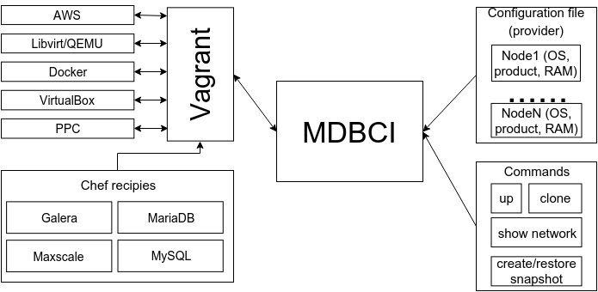
Architecture

Slide 13
Evaluation
Goal - measure VM launch fails ratio on AWS configuration.
Experiments steps
Test configuration using MDBCI command generate.
10 sequential launches of the generated configuration using “vagrant up” command.
10 sequential launches of the generated configuration using “mdbci up” command.
Calculation of failed launches percentage for each instrument.
Notes:
For comparing previous solution and MDBCI we performed following experiment. For a ten times we tried to launch the same configuration using AWS (1 maxscale, 8 mariadb machines) and measure launch time and a number of fully launched machines in order to determine performance and relaibility. As a almost complete replacement for previous solution we used Vagrant because it was used in the past.

Slide 14
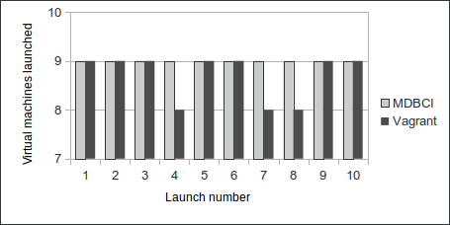
Evaluation
Number of successfully running machines after per test configuration launch
Notes:
Experiments shown that in during three launches Vagrant can not manage to run three machines. At the same time MDBCI succefuly launched all machines.

Slide 15
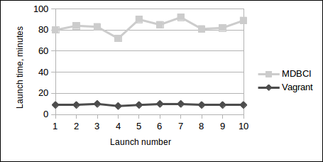
Evaluation
Time of test configuration launches
Notes:
However such robustness improvements lead to almost ten time increase of launch time due to sequental launch of AWS machines. But despite this fact mdbci results are still acceptable because usually integration test which require such configurations can lasts about several hours.

Slide 16
Conclusion
MDBCI allowed to overcome limitations of the previous test automation: nontransparent debug interfaces, limited support of virtualization providers.
MDBCI fully integrated to Maxscale development process.
Future development of MDBCI includes
embedding new virtualization providers,
different performance benchmarks support,
interfaces for multi provider configurations are planned.
Notes:
As a conclusion we want to say that our solution fully solved stated task and now it is an important instrument for maxscale development process.
In future we plan to add support of multiprovider configurations, add support of different performance benchmarks and new virtualixtion providetrs.

Slide 17
Links
Questions: mark.zaslavskiy@fruct.org
Source
https://github.com/OSLL/mdbci
Maxscale
https://github.com/mariadb-corporation/maxscale
https://mariadb.com/products/mariadb-maxscale

Slide 18
Configuration examples
{
"galera1" :
{
"hostname" : "galera1",
"box" : "ubuntu_trusty_libvirt",
"product" : {
"name": "galera",
"version": "5.5",
"cnf_template" : "server1.cnf",
"cnf_template_path": "/home/vagrant/cnf"
}
},
"maxscale" :
{
"hostname" : "maxscale",
"box" : "ubuntu_trusty_libvirt",
"product" : {
"name" : "maxscale"
},
"memory_size" : "1024"
}
}

