Slide 1
Part I: scenario template
SCENARIO DESCRIPTION
F_ID | FIELD_NAME |  | Value |  |  | Notes
1.1 | Short name |  | E_LAB_1 |  |  | Insert an acronym to be used as a reference in other templates (Max 8 Chars)
1.2 | Title |  | RFID Based User Localization |  |  | A title for the scenario
1.3 | Short narrative description |  | A user, carrying on a nomadic device equipped with an RFID reader, moves within two environments. At the entrance of each environment it is placed an RFID tag. By reading a TAG, the user notifies the system in which environment she is. The scenario includes the following entities: 2 environments 2 persons a nomadic device equipped with an RFID reader a monitoring station (PC) |  |  | Use cases are short stories of envisioned real life situations that describe a specific user group in a specific contextual setting interacting with specific devices to fulfill specific tasks and intentions.
1.4 | Reference person |  | Luca Roffia (lroffia@arces.unibo.it) |  |  | Insert name and contact of the team leader and team_ID.
1.5 | Date |  | 14/05/2010 |  |  | Insert date of scenario creation
USERS
F_ID | USER_ID | Type |  |  | Role
2.1 | U1 | General user |  |  | People moving around
2.2 | U2 | Monitoring operator |  |  | People monitoring the environment
ARTIFACTS
F_ID | A_ID | USER_ID |  | Type | Description
3.1 | A1 | U1 |  | Nomadic device | Smartphone with RFID reader
3.2 | A2 | U2 |  | Monitoring system | Centralized monitoring system with room level granularity

Slide 2


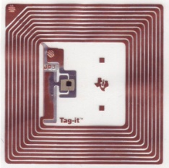



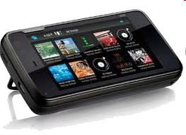

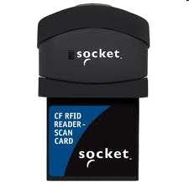
Part II: project presentation template
Application layout
Room 1
(A2)
RFID Tags (one in each environment)
TCP/IP
Room 2
Smart-M3
Nomadic device
+
RFID Reader
(A1)
GENERAL USER (U1)
MONITORING OPERATOR (U2)

Slide 3
Part II: project presentation template
Software architecture
E1_RFID Adapter
E4_Instances Creator
KP
KP
E2_User
Location Detector
Sensor Data
User Device
Environments
User Location
Smart-M3
KP
Sensor Data
User Location
KP type
SSAP type
GUI
Producer
Update
KP
E3_User Location Monitor
Consumer
Subscribe
Aggregator
Query

Slide 4

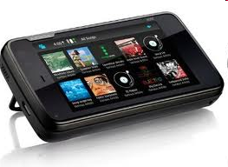






Part II: project presentation template
Hardware-Software infrastructure
Hardware
Software, i.e. KPs
O.S.
(Windows)
KP
E1_RFID Adapter
(Ubuntu)
(A1)
(Maemo)
(Android)
GUI
...
(...)
KP
E3_User Location Monitor
(A2)
KP
E2_User Location Detector
KPI library
KP
E4_Instances creator
(C#)
Smart-M3
(Java)
SIB-C version 0.9.2 beta
(Python)

Slide 5
Part II: project presentation template
Run-time data flow
KP
Sensor Data
KP
User Location
KP
GUI
E1_RFID Adapter
E2_User Location Detector
E3_User Location Monitor

Slide 6
Part II: project presentation template
Ontology class tree
owl:Thing
Environment
Person
Device
Data
Identification Type
Measurand
SensorData
IdentificationData

Slide 7
Part II: project presentation template
Instances
Environment
“Room 1”
Measurand
HasFriendlyName
Environment_1URI
IdentificationData
HasIdentificationData
IdentificationData_1URI
Person
ContainsEntity
HasValue
34H
Person_1URI
HasIdentificationType
RFID
HasDevice
Device
SensorData
Identification Type
Device_1URI
CLASS
rdf:type
HasSensorData
SensorData_1URI
Class Instance
Property
“Luca”
HasValue
34H
HasName
Literal
HasMeasurand
RFID

Slide 8
Part II: project presentation template
KP Ontology Awareness
“Room 1”
HasFriendlyName
Environment_1URI
HasIdentificationData
IdentificationData_1URI
ContainsEntity
HasValue
34H
Person_1URI
HasIdentificationType
RFID
HasDevice
Changes
Device_1URI
Semantic connection
HasSensorData
SensorData_1URI
Class Instance
“Luca”
HasValue
34H
Property
HasName
HasMeasurand
RFID
Literal

Slide 9
Part II: project presentation template
KP template
 |  |  |  |  | KP name
Executive summary
F_ID | Field Name | Value
1.1 | Author | Author
1.2 | Description | Brief description
1.3 | Type | Producer/consumer/aggregator/ legacy adapter
Information Level and Semantic Interoperability
2.1 | Ontology Awareness Required |  |  | Class_1 - properties_a - properties_b - ... ... Class_n - properties_x - properties_y - ...
2.2 | Information published on the Smart Space |  |  | List of RDF triples (subject, object, predicate)
2.3 | Information consumed from the Smart Space |  |  | List of RDF triples (subject, object, predicate)
System Level and Portability
3.1 | Programming language and KP API |  | Python/Java/C#/C
3.2 | Run time GUI |  | Yes/No
3.3 | SIB version |  | SIB-C version 0.9.2 beta

