Slide 1
Architecture Constraints
Software Architecture

Slide 2

Architecture Constraints
Constraints | Background and/or motivation
Scalability Constraint | Background : struggle to handle increased user load and data volume Motivation : Scalability limitations can hinder performance and future expansion
Technology Dependency | Background : Monolithic of rely on specific technologies that become outdated Motivation : Adapting tools can be challenging and costly with ,maintenance issues
Limited Module Independence | Background : Monolithic systems have tightly integrated modules Motivation : Changes or updates in one module may inadvertently affect others
Deployment Complexity | Background : Deploying updates are complicated and time-consuming process. Motivation : Frequent updates and maintenance can disrupt university operations and lead to user dissatisfaction
Vendor Lock-In | Background : Monolithic systems are tied to a specific vendor for support and updates Motivation : Lack of flexibility in choosing vendors can lead to higher costs

Slide 3
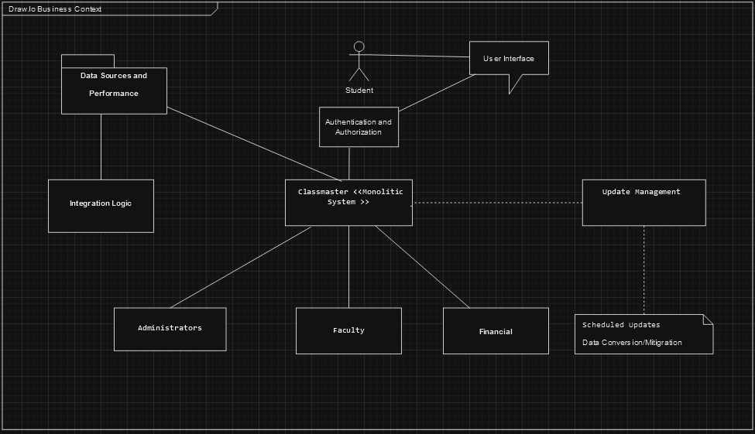
Business Context
.
Sources: https://docs.arc42.org & https://biking.michael-simons.eu/docs/index.html#section-system-scope-and-context

