Slide 1

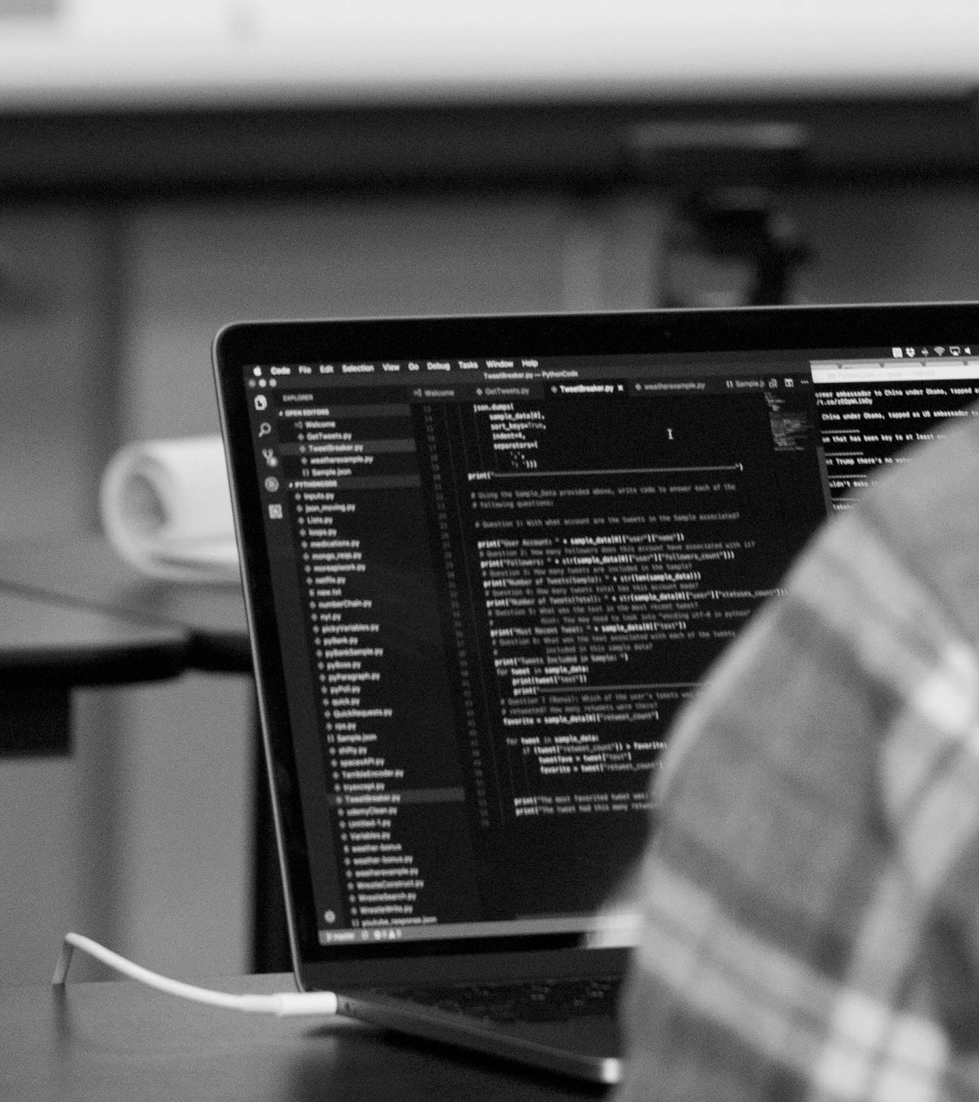
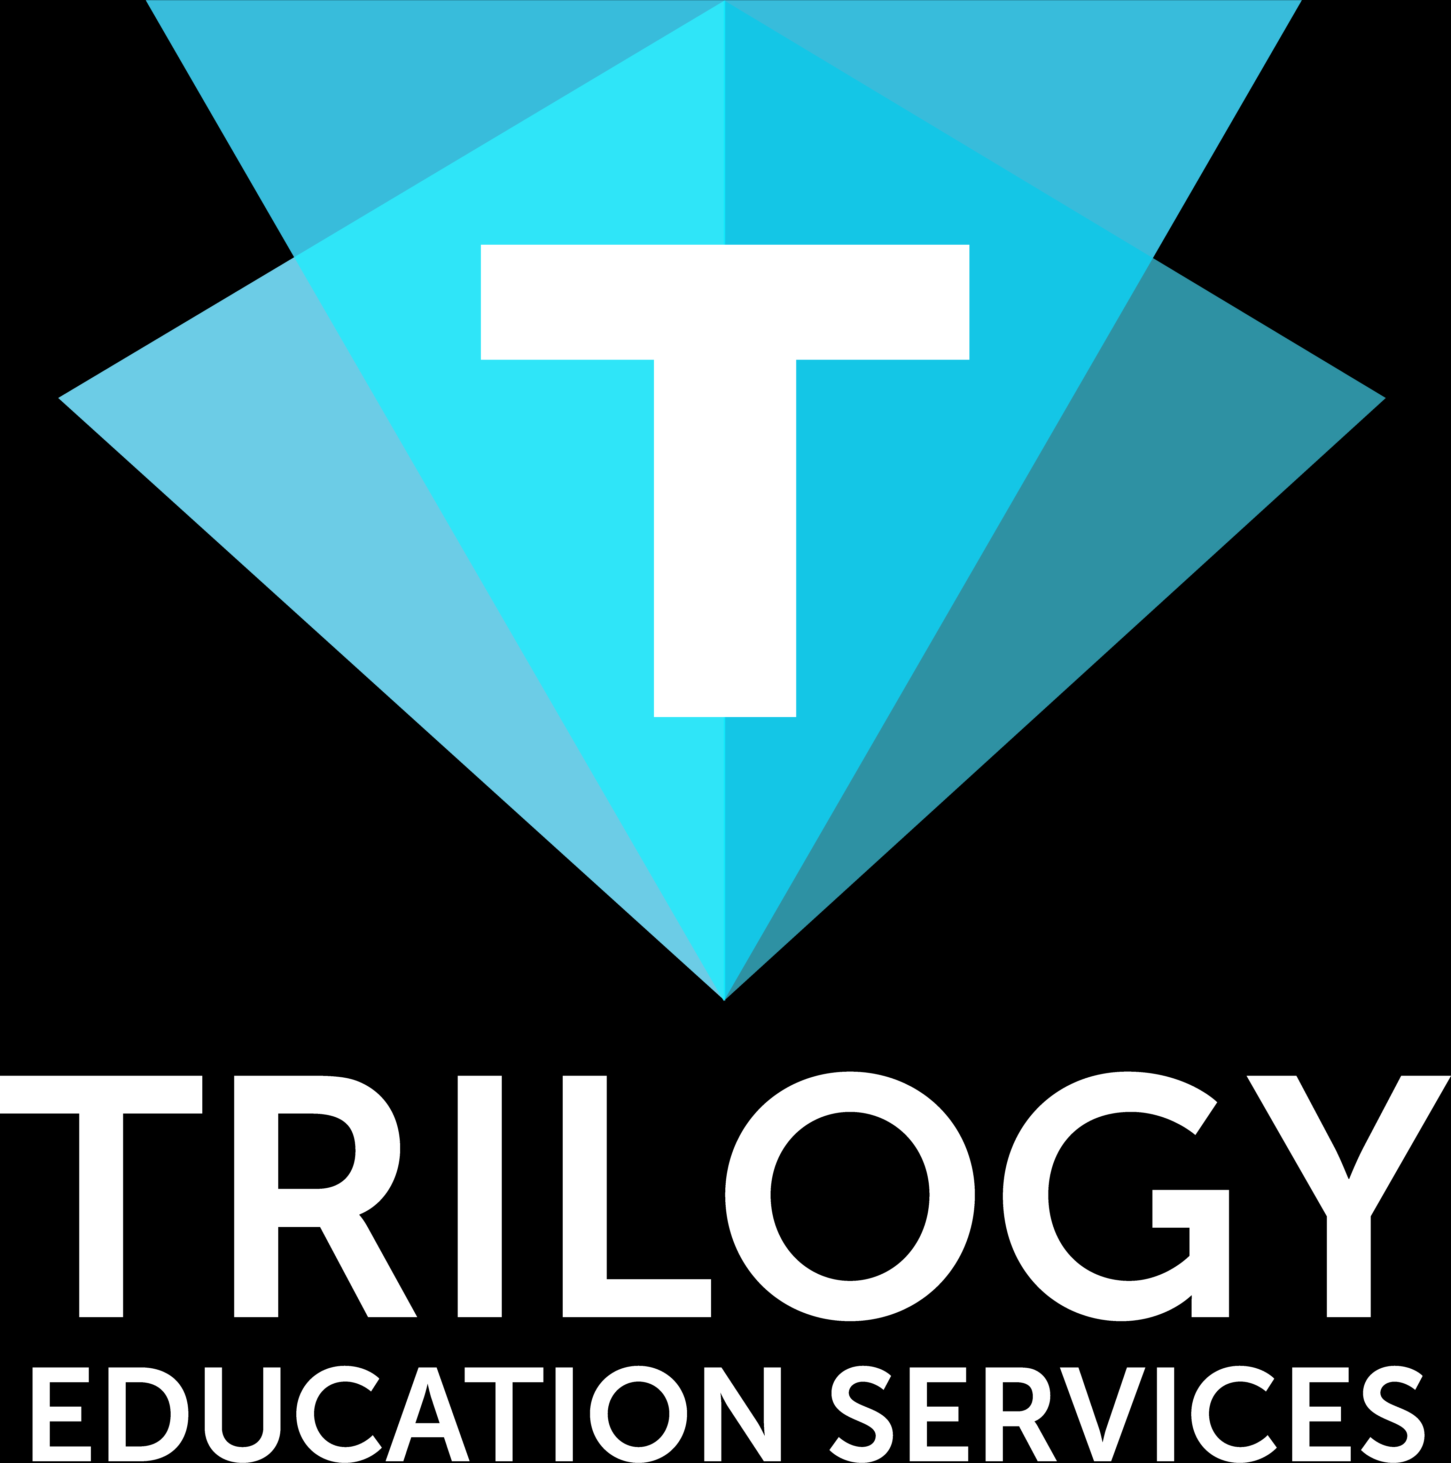
Creating a basic MVC Python application using Django
Presented by Omar Patel
Confidential & Proprietary Information of Trilogy Education Services, Inc. © Trilogy Education Services, Inc.

Slide 2

Confidential & Proprietary Information of Trilogy Education Services, Inc.
Who AM I and What is this?
I’m Omar Patel, lead instructor at UCLA Extension Coding Bootcamp and Curriculum Engineer at Trilogy.
This is a tech talk, a part of the alumni tech series we are doing. Please send us any suggestions for topics via chat.
© Trilogy Education Services, Inc.

Slide 3

Confidential & Proprietary Information of Trilogy Education Services, Inc.
Why Django?
First, I looked for something that could benefit both Data Visualization and Coding Bootcamp students.
I realized that Data Visualization and Coding Bootcamp students learn development, but coding students learn MVC with Node/Express while data visualization students learn full stack development through Flask.
Combining the issues together, a common solution arises with utilizing Python with Django. Data visualization students can learn a larger MVC framework and Coding Bootcamp students can become familiarized with another MVC framework outside of their current skill set.
© Trilogy Education Services, Inc.

Slide 4
Confidential & Proprietary Information of Trilogy Education Services, Inc.
What is Django?
According to djangoproject, “Django is a high-level Python Web framework that encourages rapid development and clean, pragmatic design. Built by experienced developers, it takes care of much of the hassle of Web development, so you can focus on writing your app without needing to reinvent the wheel. It’s free and open source.”
Basically, it’s a full stack framework that works similarly to the full stack frameworks you’ve used in class.
© Trilogy Education Services, Inc.
Notes:
Light Template

Slide 5
Confidential & Proprietary Information of Trilogy Education Services, Inc.
What are we Doing?
We’re going to be deconstructing a very simple MVC application utilizing Django. Th application will only have create and read capacities. This is stripped directly from the Coding Bootcamp curriculum since all the work has already been done for me (many thanks to Peleke Sengstacke!).
We won’t be going too much into the details, but rather using the end result to understand how Django works on a high level.
The reasoning behind using existing curriculum:
I can hand out the activities to you once the lecture is done
You can see the progression of the application via the in-class activities
There is a homework assignment that has you adding on to the created application at the end.
SO MANY BENEFITS
© Trilogy Education Services, Inc.

Slide 6
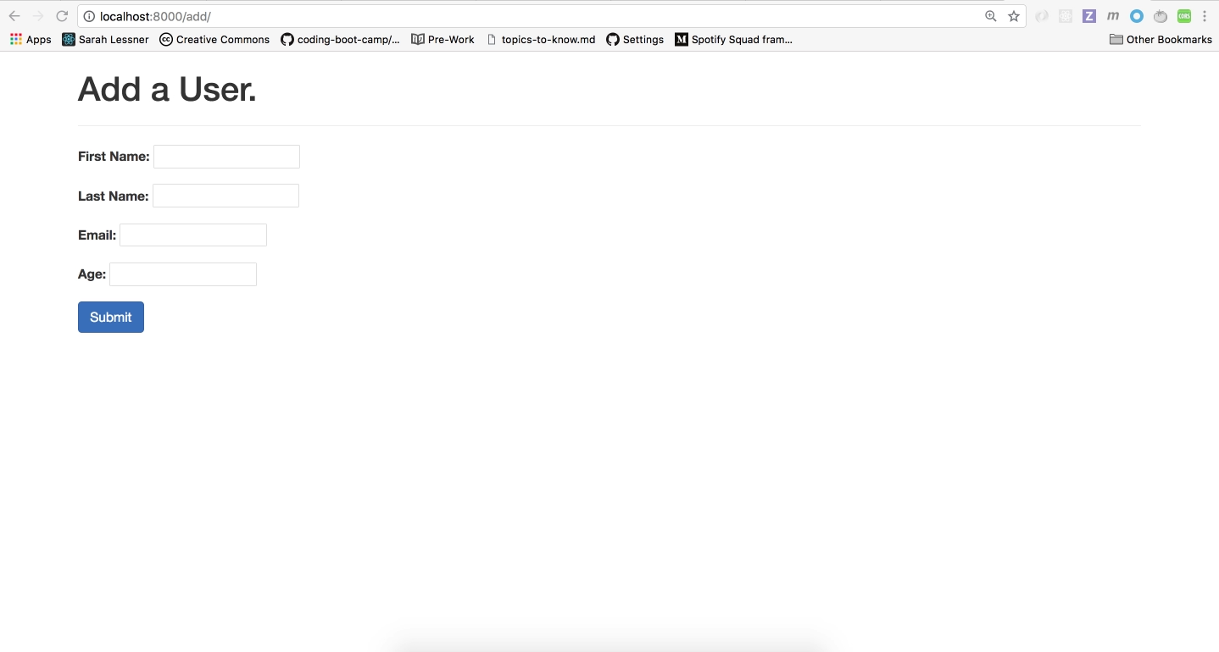
Confidential & Proprietary Information of Trilogy Education Services, Inc.
End Result
Note that this application is not deployed. The purpose of this application is to show how to develop something small and local. For instructions on deploying to Heroku from the start, check out https://devcenter.heroku.com/articles/getting-started-with-python
© Trilogy Education Services, Inc.
Notes:
Light Template

Slide 7
Confidential & Proprietary Information of Trilogy Education Services, Inc.
Setup
Before we begin building any application, there’s always the setup process. Let’s quickly go through what it takes to set up the basics for creating a Django application.
Instructions can be found here: https://github.com/OSP123/basic-django/blob/master/installation.md
© Trilogy Education Services, Inc.

Slide 8
Confidential & Proprietary Information of Trilogy Education Services, Inc.
Creating the Project/Apps
Now let’s get to generating a project. If you’ve followed the instructions, then it’s pretty simple: “django-admin startproject NAME_OF_APP”
Let’s go through the structure of this generated application.
The manage.py file is for the utility toolchain
The apps are a set of related features
We can create new apps using “python manage.py startapp users”
When generating a new app, you must add it to the settings.py file. In this case, we add “users.apps.UsersConfig” to “INSTALLED_APPS”
© Trilogy Education Services, Inc.
Notes:
Light Template

Slide 9
Confidential & Proprietary Information of Trilogy Education Services, Inc.
MVC in DJANGO is MTC or MTV
I am building the application based on my previous understanding of MVC, so the concept of the controller is usually what directs the action. In the case of Django, the controller is named ”views.py” and the display components are under “templates”. It gets a bit confusing, so just keep that in mind.
© Trilogy Education Services, Inc.

Slide 10
Confidential & Proprietary Information of Trilogy Education Services, Inc.
Controlling and Routing
When going to a web application, one of the first things that happens with the request is the routing. That is, matching the request with the appropriate action.
In Django, we use the “urls.py” file, along with some fancy regex, to create the routing.
Let’s import the controller (”views.py” in Python) to match the route to the appropriate controller.
Notice that the application that was generated has 3 routes built into the users. Once we set up the routes, we must also set up the urls to be included in the ”app” app within the ”urls.py” file.
The “app” app is our entry point into the application, so the urls from other apps must be included in the ”urls.py” of this file
© Trilogy Education Services, Inc.
Notes:
Light Template

Slide 11
Confidential & Proprietary Information of Trilogy Education Services, Inc.
Running Our Server and Controlling
Now that we have our routes set up, let’s set up our controller. Remember, our understanding of controllers are Django’s “views.py” file in each app.
Let’s create a basic controller to handle a path for “test” and have the controller return HTML.
We’ll go to our “views.py” file within “users” and add the appropriate action. Notice that the action still takes in a request object, similar to Express. We can then create a response and then pass that into an imported HTTPresponse module for us to return an actual response object, along with the data we need.
© Trilogy Education Services, Inc.

Slide 12
Confidential & Proprietary Information of Trilogy Education Services, Inc.
Templating
Since all or most of you have completed the program, you know that sending back strings doesn’t scale very well. In the coding program, we used Handlebars. Django comes with something very similar, but built in.
In order to use the templates in your app, be sure to create a templates folder with the name of the directory for the template views. For example, we have “templates/users”. Notice that the files have the ”.html” extension. Django understands how to render the data passed into the template files, so no need to change the extension names.
We will first create a base template. This is similar to the layout templates in Handlebars. Ie, other templates get passed into the layout. Once we have the layout template, let’s set up the child templates.
© Trilogy Education Services, Inc.
Notes:
Light Template

Slide 13
Confidential & Proprietary Information of Trilogy Education Services, Inc.
Templating Continued
Once we have our templates files, let’s add blocks of code where we want the data to be passed in. Again, this is going to be very similar to what we did with Handlebars. That is, passing data to the template via an object.
Once we pass the data in, you can see it being displayed based on the conditionals we use.
© Trilogy Education Services, Inc.
Notes:
Light Template

Slide 14
Confidential & Proprietary Information of Trilogy Education Services, Inc.
Models
Models in Python are fairly straightforward and very similar to what we’ve covered with Sequelize and Mongoose. Django comes with an ORM, so you can switch between databases fairly easily. In my case, I’m using SQLlite3.
Notice that I have several fields for the User model, along with a few methods. I have overridden an existing method, save, in order to add some custom code.
If we go back to the “views.py” file, you’ll notice that we also have an action for add. Add allows you to save users and has some validations in there as well.
Note that you will have to use makeMigrations and migrate commands to have the changes incorporated from your models into the application.
© Trilogy Education Services, Inc.

Slide 15
Confidential & Proprietary Information of Trilogy Education Services, Inc.
Follow up
Obviously, there is a lot more to cover for Django, but hopefully that was enough to get a high level overview of how Django works and where things are located.
I’m going to be sending out the resources to learn the basics of Python, along with the activities for the class. Be sure to not share this with anyone outside of the program alumni ☺. I recommend completing the activities and going through the lessons to recreate the application I showed you. After completing the activities, be sure to attempt the homework (making it a full CRUD application)
If you’d like to delve even deeper, I recommend going through the official Django tutorial: https://docs.djangoproject.com/en/2.1/intro/tutorial01/.
As always, keep learning
© Trilogy Education Services, Inc.
Notes:
Light Template

Slide 16

Confidential & Proprietary Information of Trilogy Education Services, Inc.
© Trilogy Education Services, Inc.

