Slide 1

MySES App
An app to help you and your unit manage members and availability.

Slide 2
What is MySES
Manage your information
Manage your notifications and qualifications
Manage availability
Monitor team status (availability)

Slide 3
Geo-location goals
To understand where available unit members are.
Respect member privacy.
Visually indicate the readiness of available members.

Slide 4
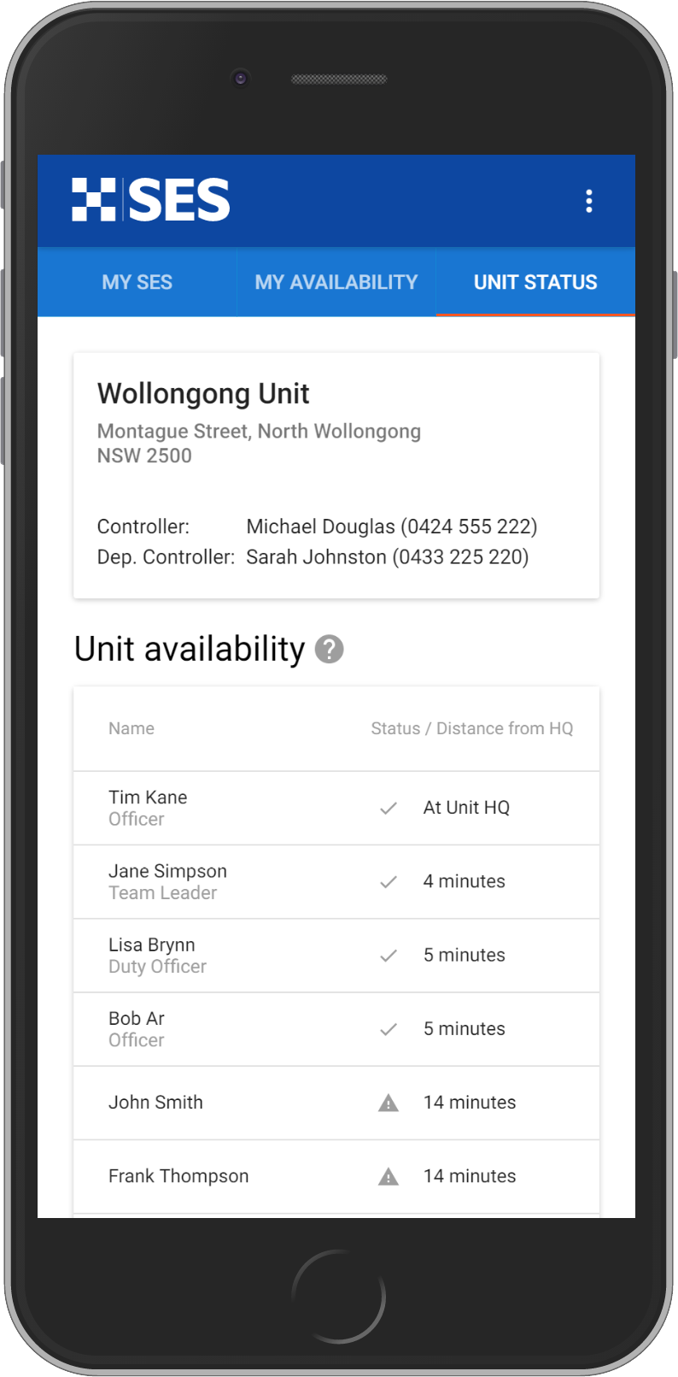
Demonstration
Demonstration in Chrome.
Currently tested and working on iOS and Android devices.

