Slide 1
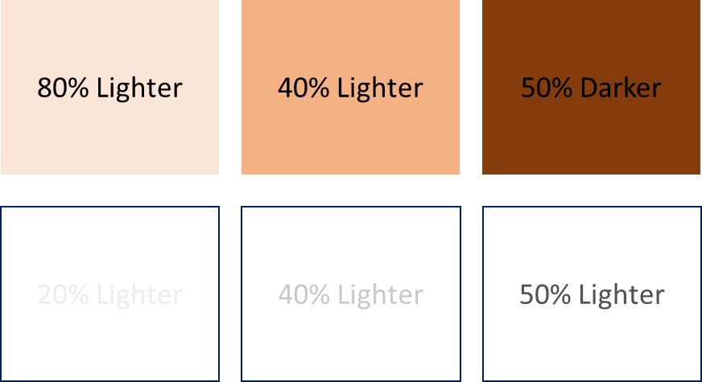
80% Lighter
40% Lighter
50% Darker
20% Lighter
40% Lighter
50% Lighter

