Slide 1
Zephyr Behavior Tree
Gerson Fernando Budke
nandojve@gmail.com

Slide 2
Who am I
Zephyr maintainer of:
Atmel Microcontrollers
Introduced SAM4E/L SoC devices and drivers
Introduced SAMV71 SoC devices
GigaDevice platform
Introduced the manufacturer
Introduced the many GD32 SoCs and drivers
Bouffalo Lab platform
Introducing the manufacturer https://github.com/zephyrproject-rtos/zephyr/pull/78795
UpdateHub https://updatehub.io
Many drivers sent to upstream
USB, I2C, SPI ...
Many drivers fixed
Ethernet, USB, I2C, SPI ...
Notes:
Hook: Celular example
Question: The Application that ran on those phones are the same?

Slide 3
Agenda
From Baremetal to ZephyrBT
What is Behavior Trees? A brief idea!
ZephyrBT in practice

Slide 4

From Baremetal to ZephyrBT

Slide 5
From Baremetal to ZephyrBT
Goals:
Move from Baremetal to some RTOS
Flexible platform
Modular
Easy to test
Easy to develop

Slide 6
From Baremetal to ZephyrBT
Solution:
Use Zephyr RTOS (very flexible and modular)
Use Z-Bus (alleviate lot’s of complexity)
Use RENODE (Make tests easy with a virtual board)
Keep C language (Developers already know it)
Keep eyes on Rust in Zephyr (it is the future … )
Still complex!!

Slide 7
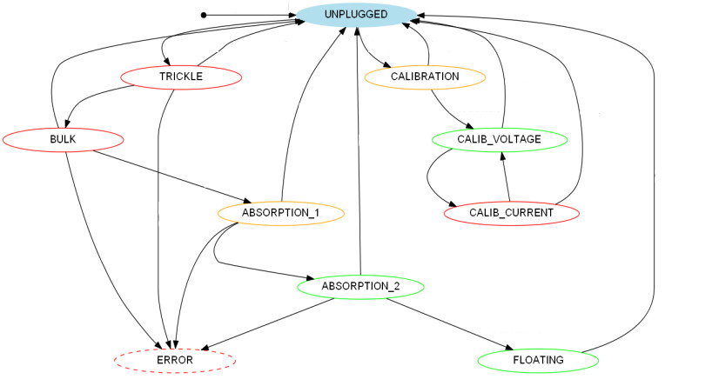
From Baremetal to ZephyrBT

Slide 8
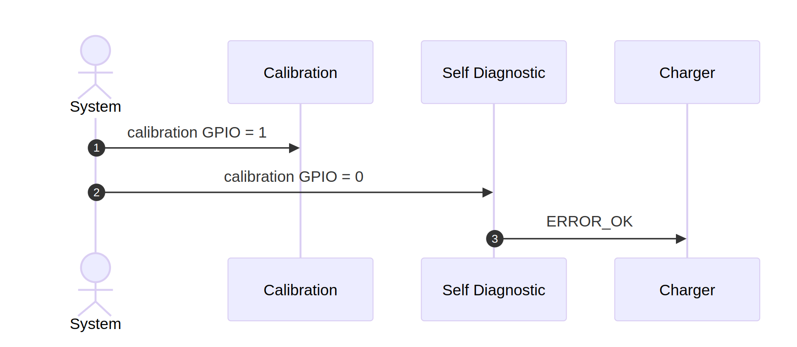
From Baremetal to ZephyrBT
Organize and split in groups
Z-Bus is lightweight and flexible to manage multiple threads allowing many-to-many communication.

Slide 9
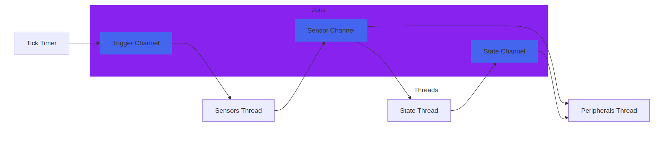
From Baremetal to ZephyrBT
The Z-Bus expects a sequential flow (no loops allowed)
Easy to implement like an “PLC”
Problem is that you fall into FSM:
Each new change require at least one new state
Complexity grows fast
Difficult to read the logic behind

Slide 10
From Baremetal to ZephyrBT
So, let’s try something different like behavior trees:
Sensors can be read only when it is necessary
It can be easy to share data between nodes
Fine control of the program execution path
Program flow is designed graphically
Easy to extend
Code is like a Lego !?

Slide 11
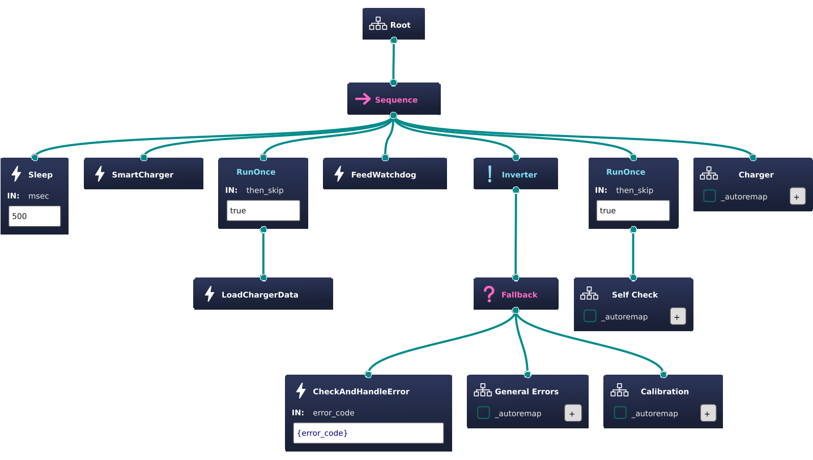
What is Behavior Tree?
A behavior tree is a mathematical model of plan execution used in computer science, robotics, control systems and video games.
Source: Wikipedia

Slide 12
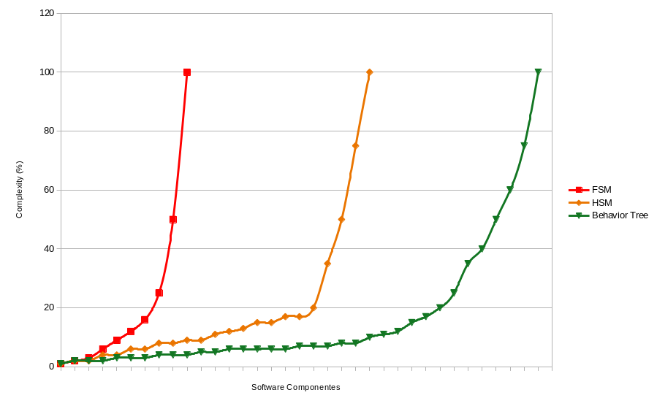
What is Behavior Tree?
A "good" software architecture should have the following characteristics:
Modularity
Reusability of components
Composability
Good separation of concerns
Source: BehaviorTree.CPP

Slide 13
What is Behavior Tree?
Each node (structure) can return one of for status:
Success (My job is done with Success status)
Running (I still have work to do)
Failed (My job is done with Failed status)
Skip (I don’t have anything to do)

Slide 14
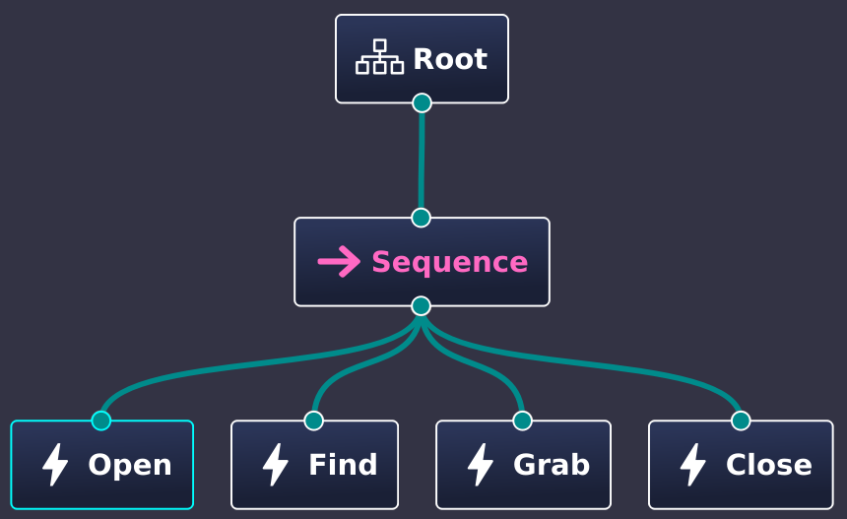
What is Behavior Tree?
Action node status:
Could system execute the “Open” action ?
Yes: return Success
No: return Fail
Is the Fridge already “Open” ?
Yes: return Skip, but it could be Success too
Is this operation take a lot of time ?
Yes: return Running and check again on the next round

Slide 15
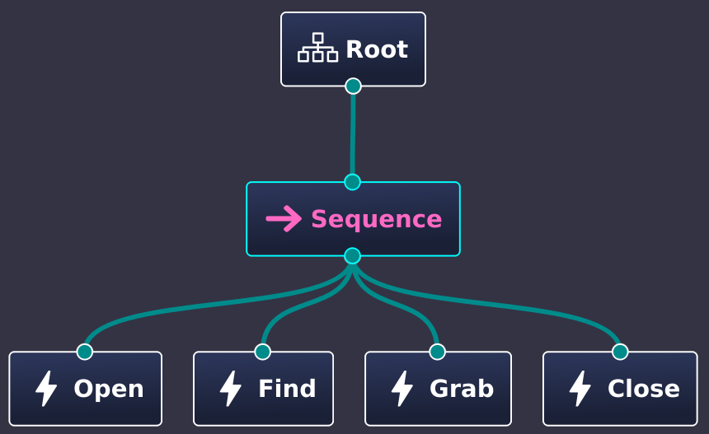
What is Behavior Tree?
Sequence Control node status:
For each S in Siblings:
R = Eval(S)
Is the sibling returned Success or Skip?
continue
Return R
Return Success

Slide 16
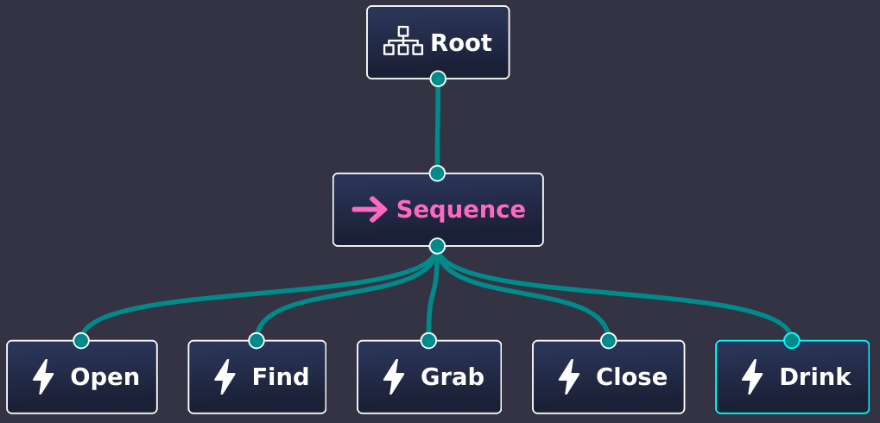
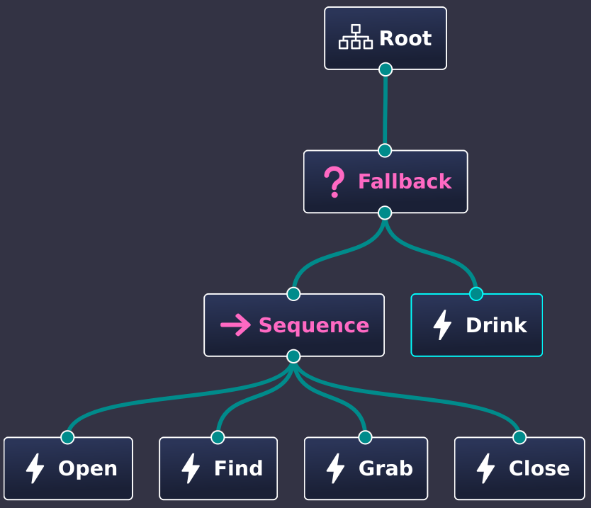
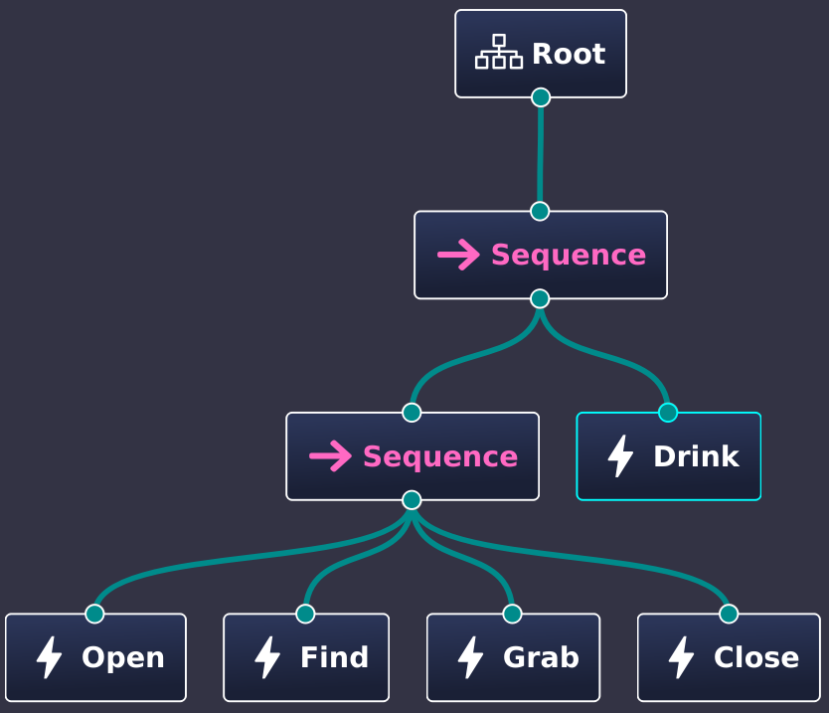
What is Behavior Tree?

Slide 17
ZephyrBT in practice
The ZephyrBT implementation can be access at
https://github.com/OSSystems/ZephyrBT
The Groot2 IDE can be download at
https://www.behaviortree.dev/groot

Slide 18
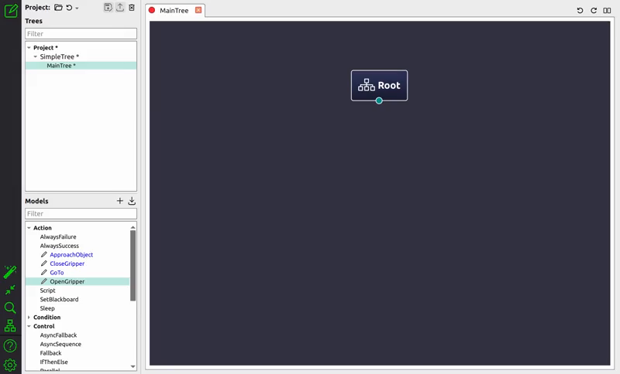
ZephyrBT in practice

Slide 19
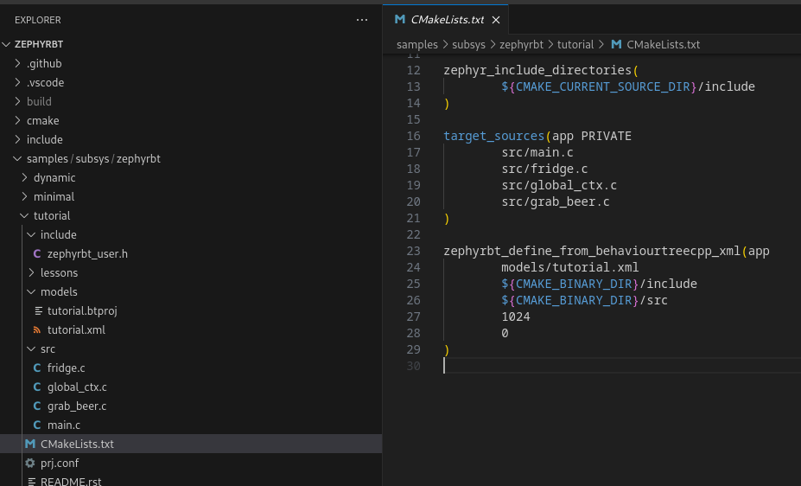

Slide 20
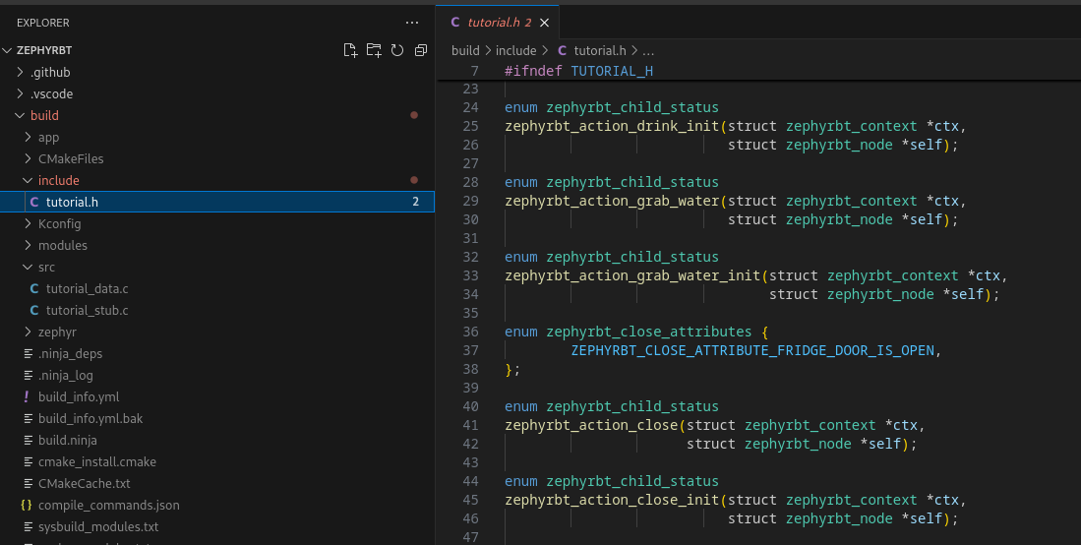

Slide 21
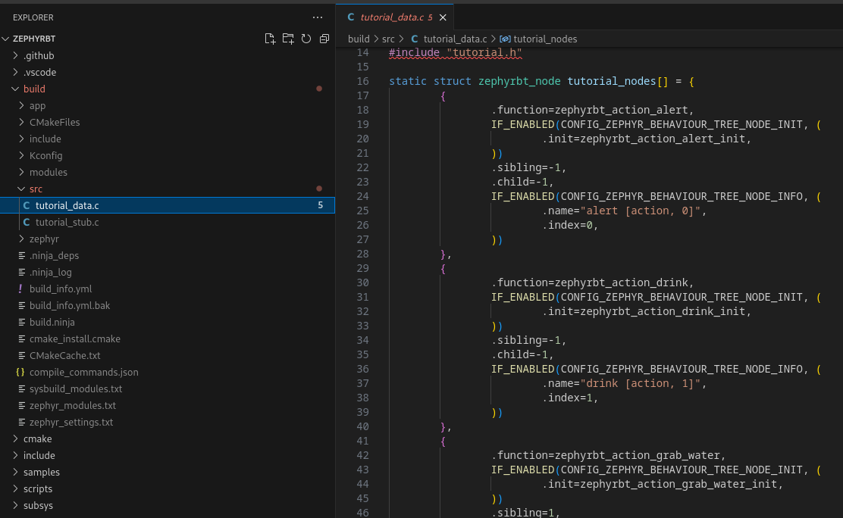

Slide 22
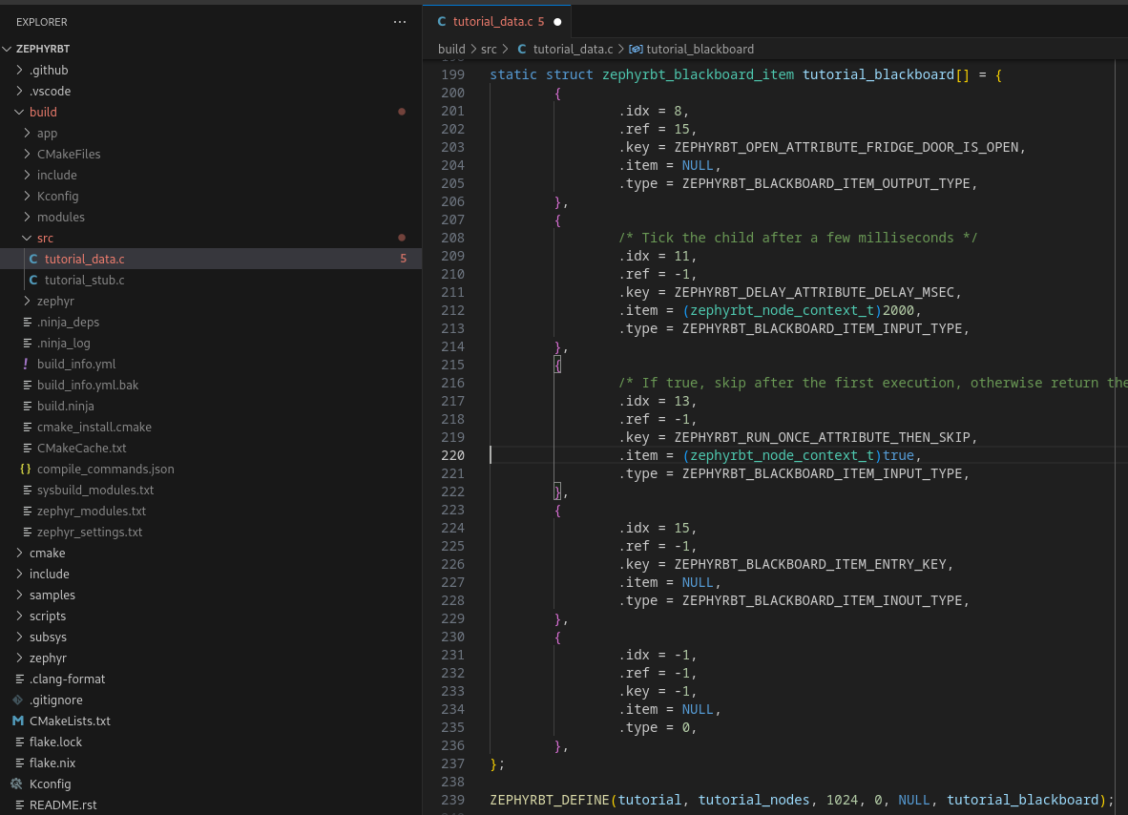

Slide 23
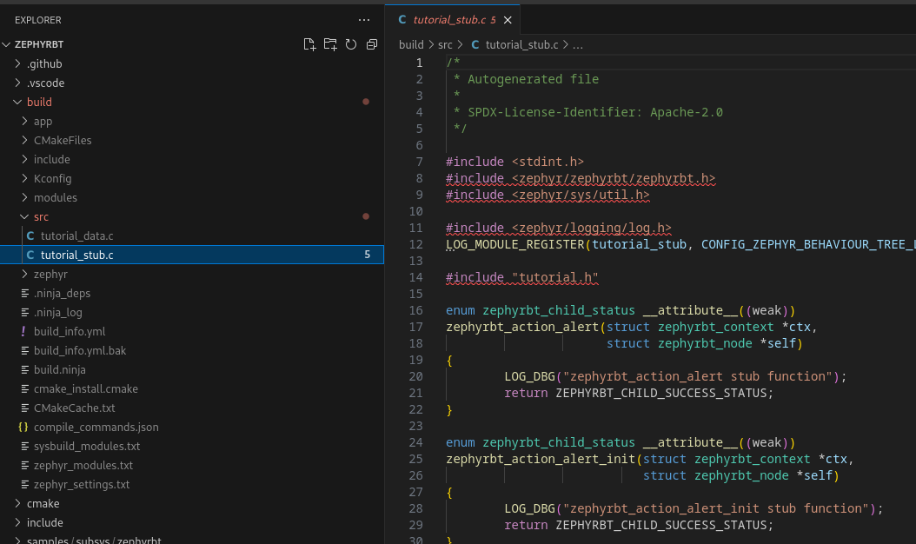

Slide 24
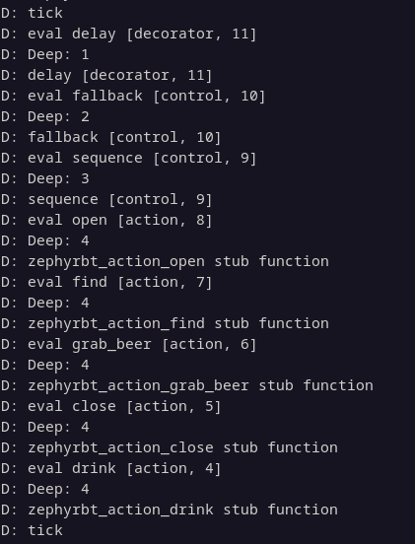
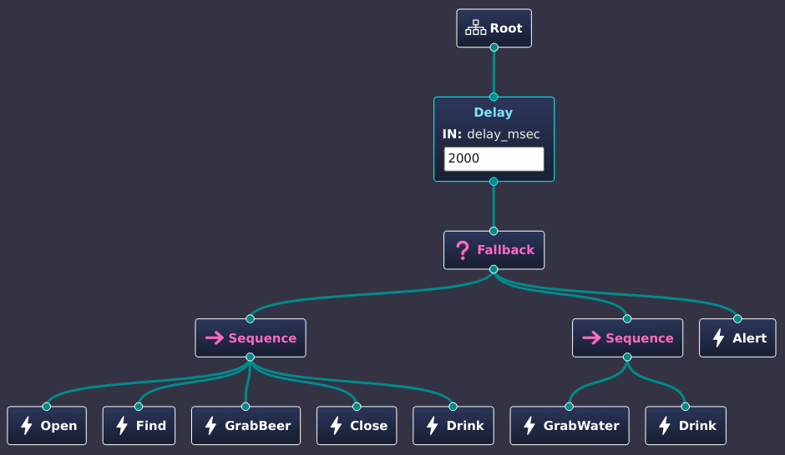

Slide 25
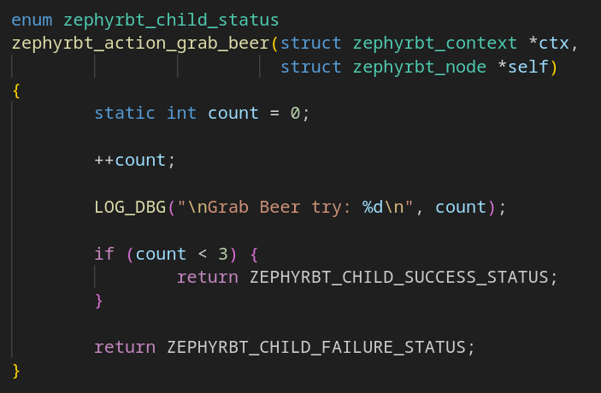
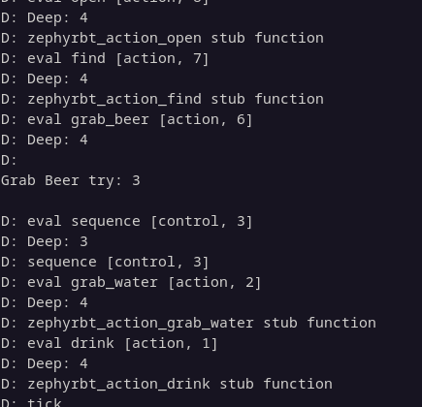

Slide 26
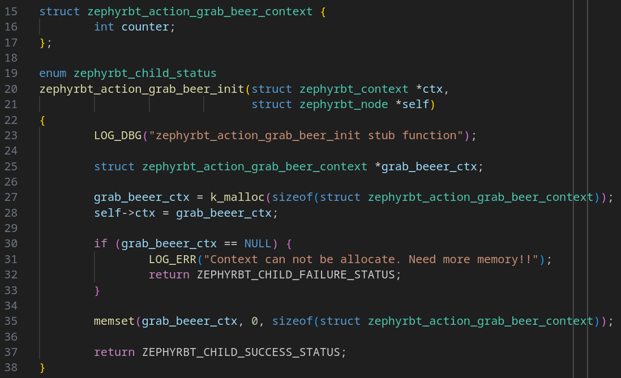

Slide 27
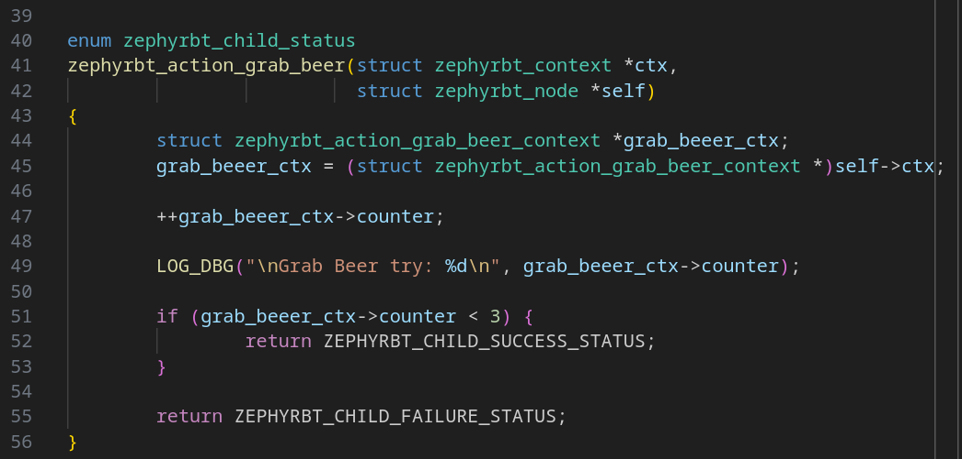

Slide 28
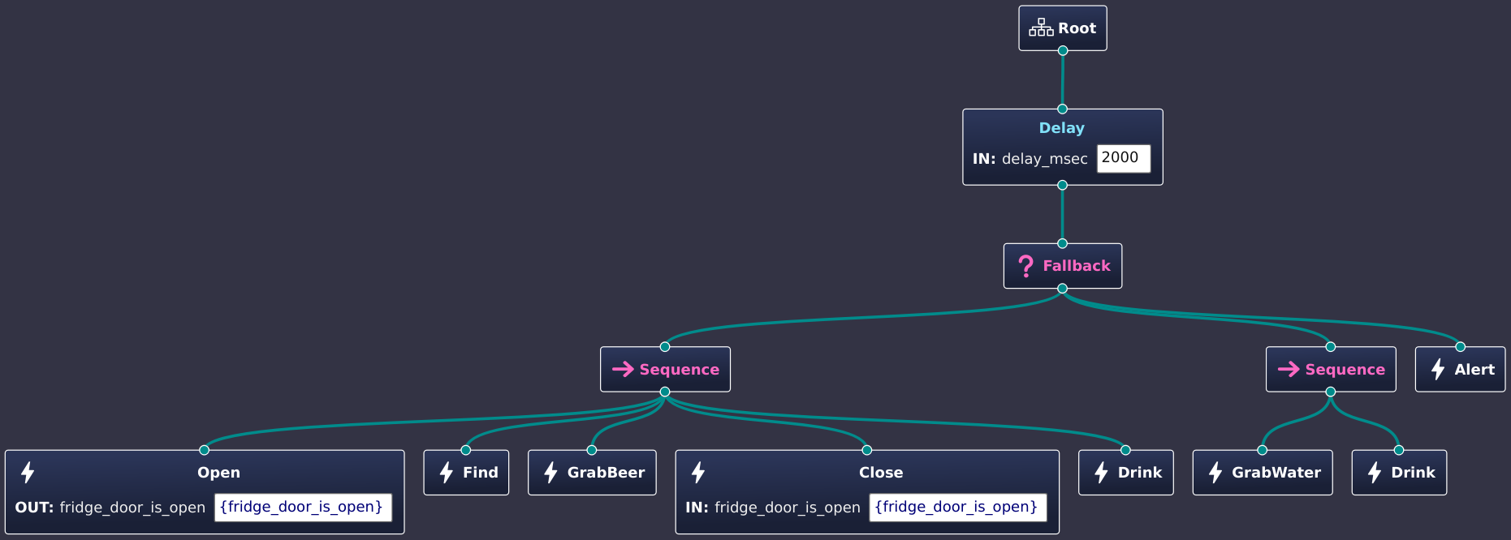

Slide 29
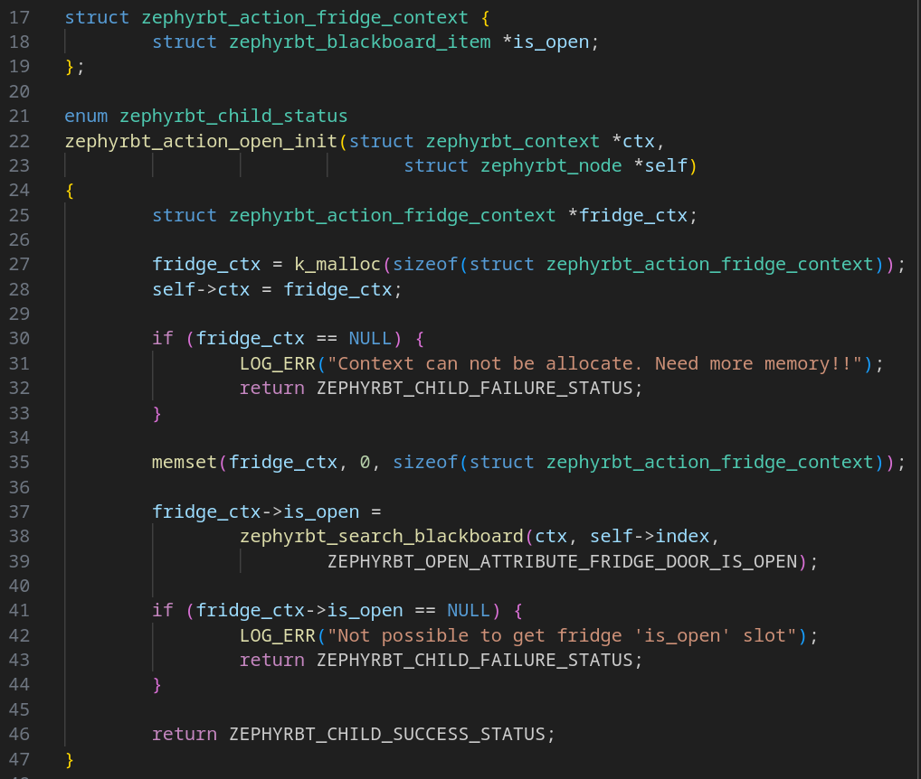

Slide 30
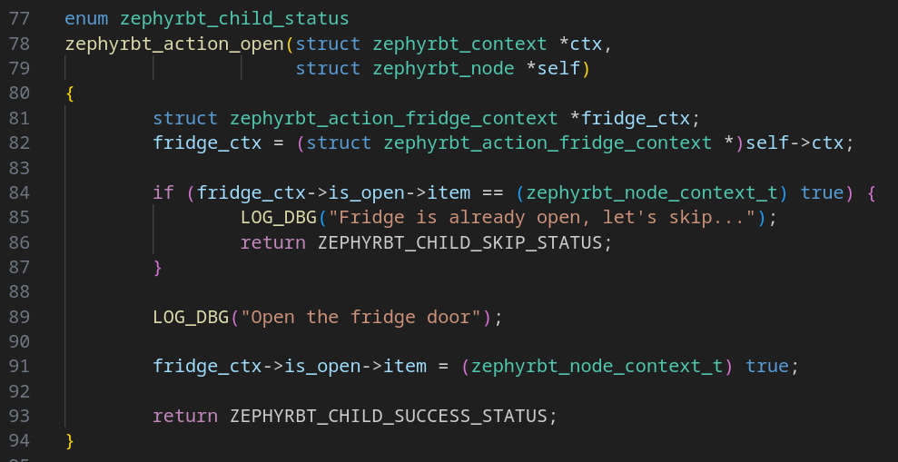

Slide 31
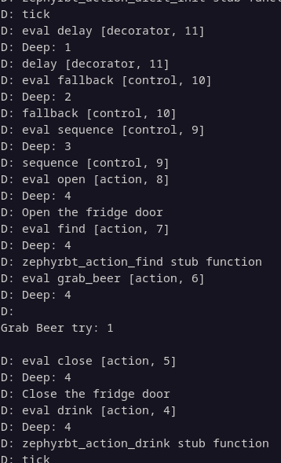
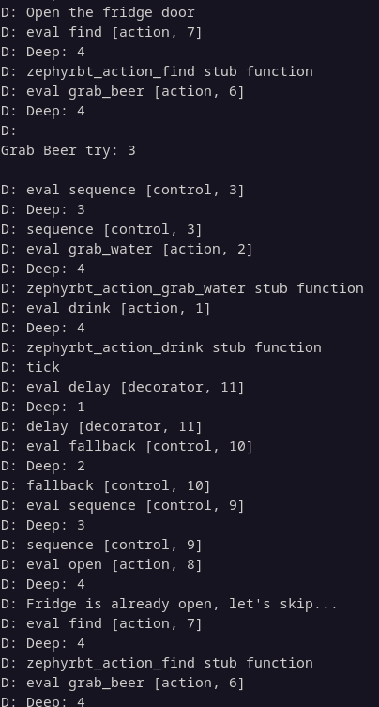

Slide 32
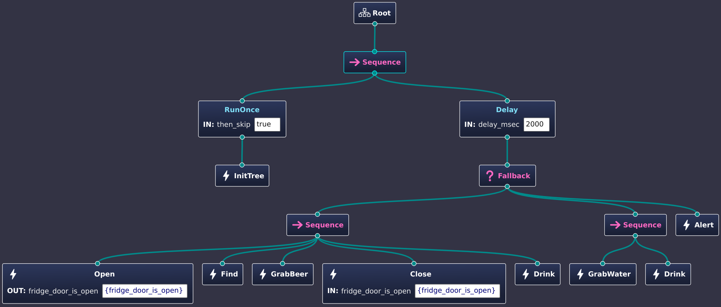

Slide 33
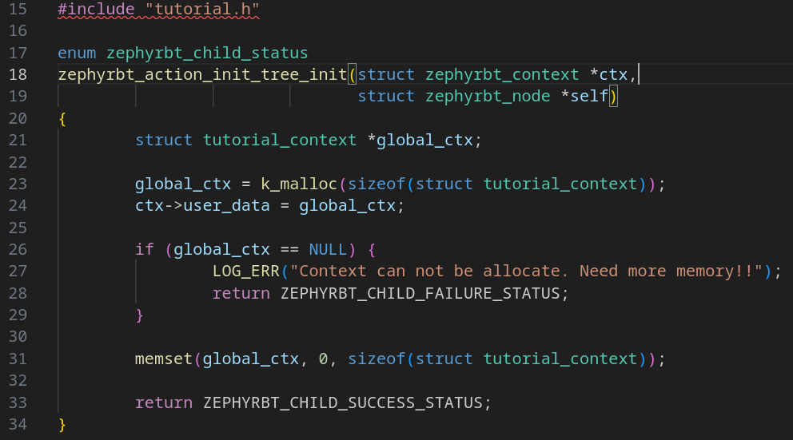

Slide 34
Pros
Allow a subset of functions/sub-tree ready on a product
User can customize their own functions
User can extend the behavior
Vendor can hide their IP on a sub-tree
Easy to visualize the data flow

Slide 35
Cons
Easy to fall in the trap that use too much the blackboard
Blackboard can be evil when used to synchronize between subsystems
Shared data requires synchronization

Slide 36
Available
Groot2 IDE can be used to develop
ZephyrBT is Apache 2.0
Nodes:
Actions: Always-Success, Always-Failure, Sleep, Set-Blackboard
Control: Sequence and Fallback
Decorators: Inverter, Delay, Repeat, Run-Once, Timeout

Slide 37
Summary
Behavior Tree is a different development paradigm
ZephyrBT currently is an early stage and implement the minimal
ZephyrBT can be used without an IDE
ZephyrBT is easy to use and cover all the general use cases
ZephyrBT can be easily extended with Custom Actions
ZephyrBT can be extended with other code generators
ZephyrBT is not integrated with ROS
ZephyrBT is not a replacement for BehaviorTree.CPP

Slide 38


Contact
Gerson Fernando Budke
nandojve@gmail.com

Slide 39
References
https://www.behaviortree.dev/
BehaviorTree.CPP: Task Planning for Robots and Virtual Agents - Davide Faconti - CppCon 2023
https://github.com/OSSystems/ZephyrBT

Slide 40
Backup

Slide 41
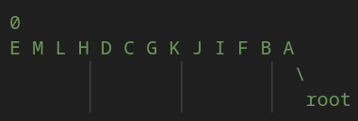
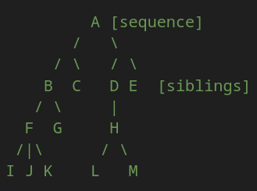
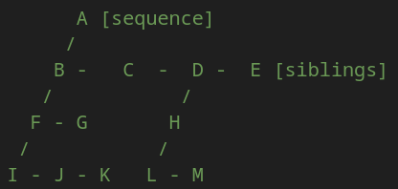
ZephyrBT in practice

