Slide 1



x
0m
1m
2m
x = 0.5 m
1m
2m
x
x = 0
$$y$$
$$0$$
$$x$$

Slide 2

Position (m)
Position (m)
Time (s)
Time (s)

Slide 4
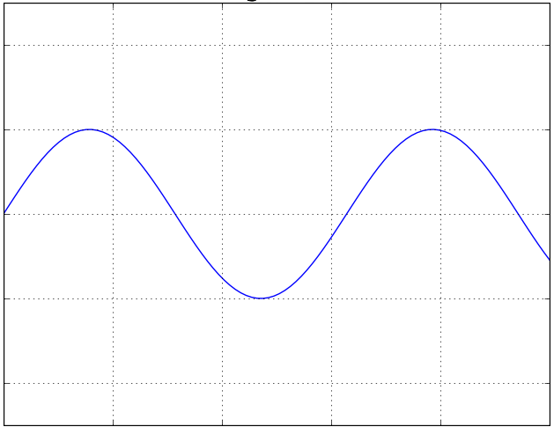
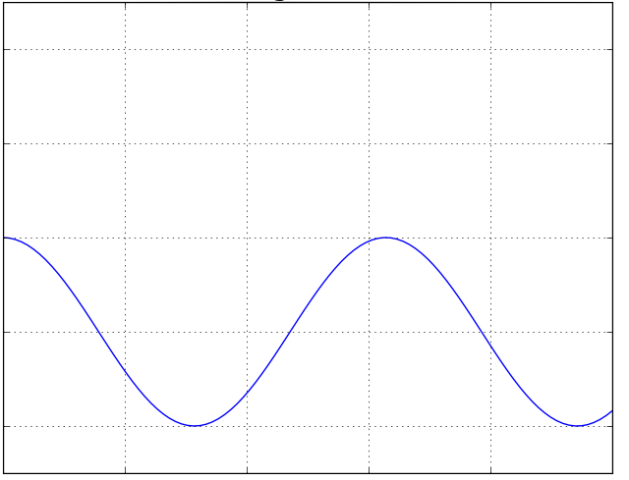
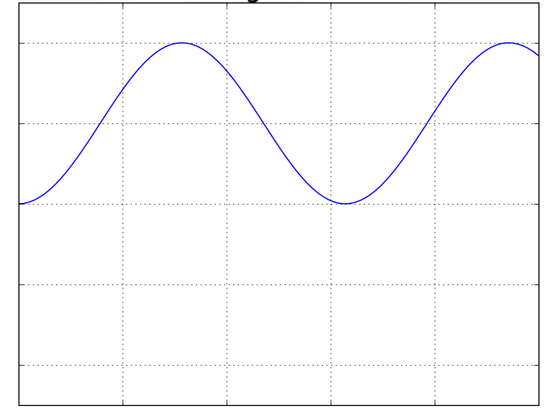






Figure A
Figure B
Position
Position
$$0$$
$$0$$
$$0$$
Time
$$0$$
Time
Figure C
Position
$$0$$
$$0$$
Time

Slide 5






$$a(t)$$
$$v(t)$$
$$0$$
$$t$$
$$0$$
$$t$$
$$x(t)$$
$$0$$
$$t$$

Slide 6
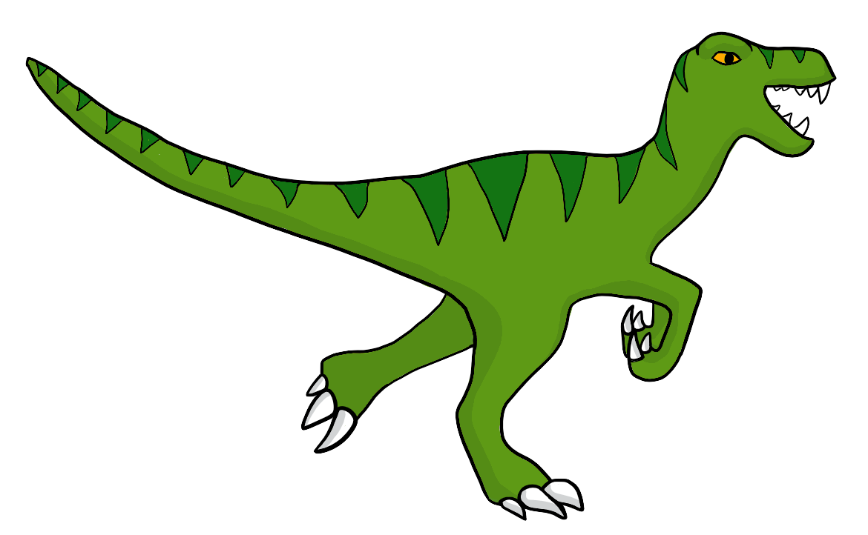
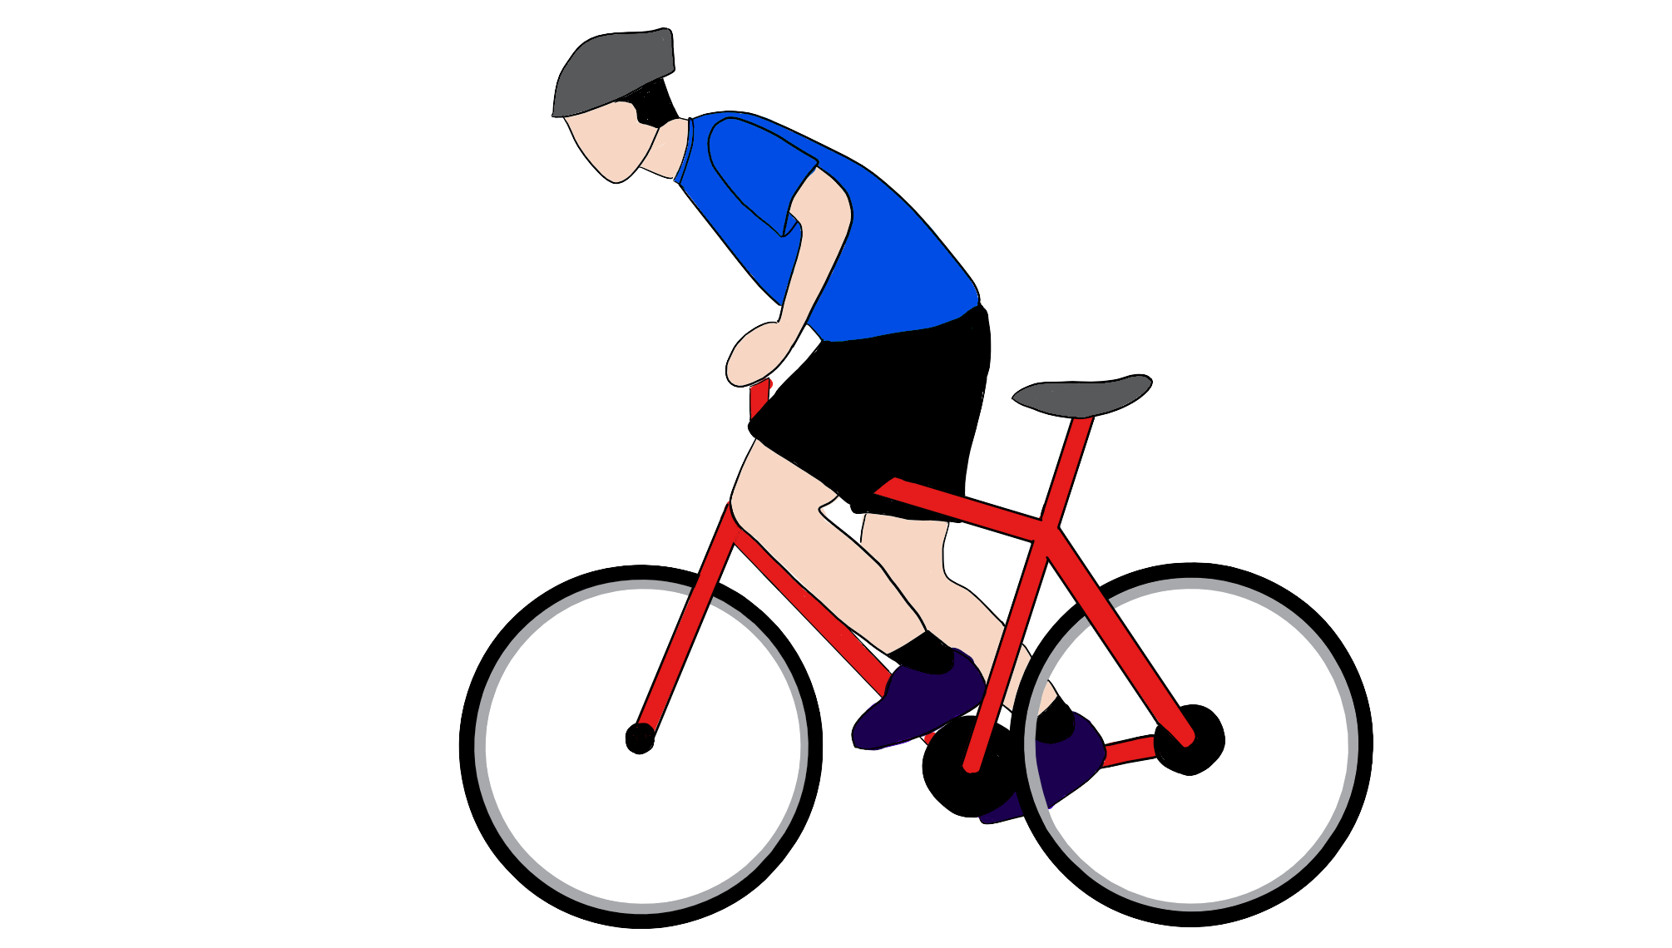







$$v_{V}$$
$$v_{R}$$
$$0$$
$$x_{0V}$$
$$x_{V}$$
$$x_{0R}$$
$$x_{R}$$
70 m

Slide 7
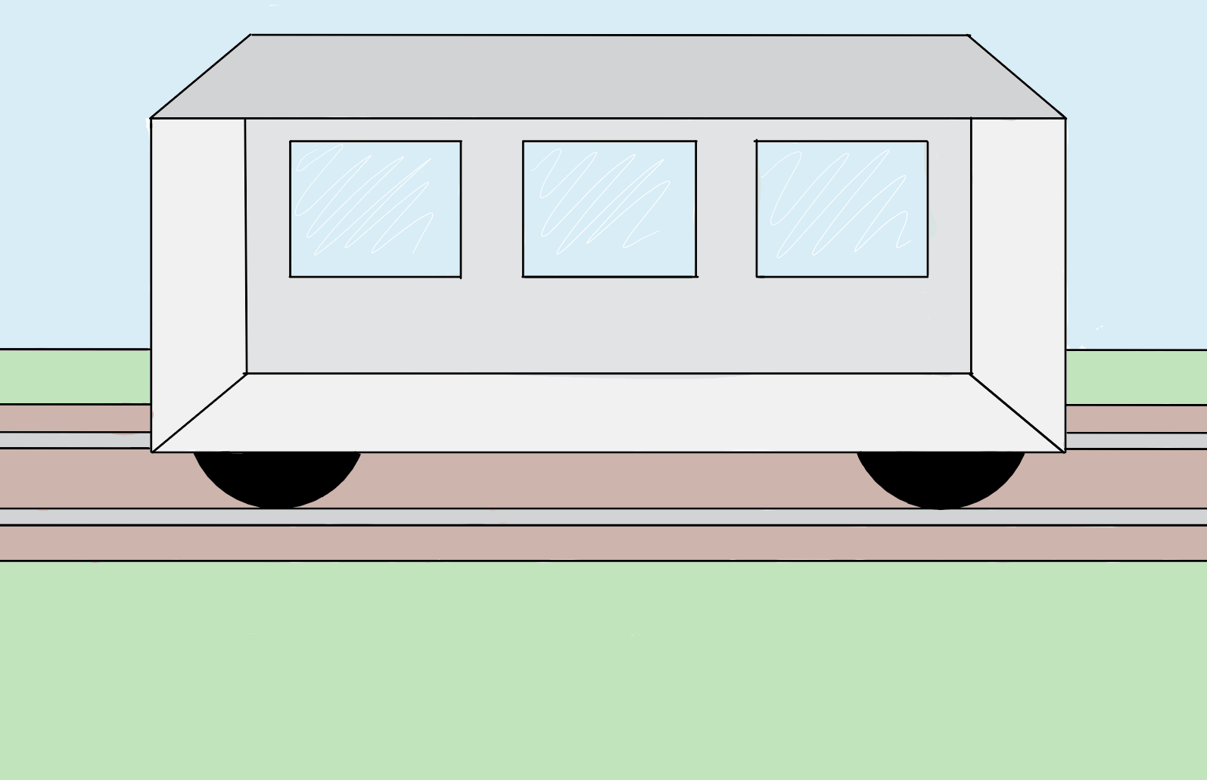
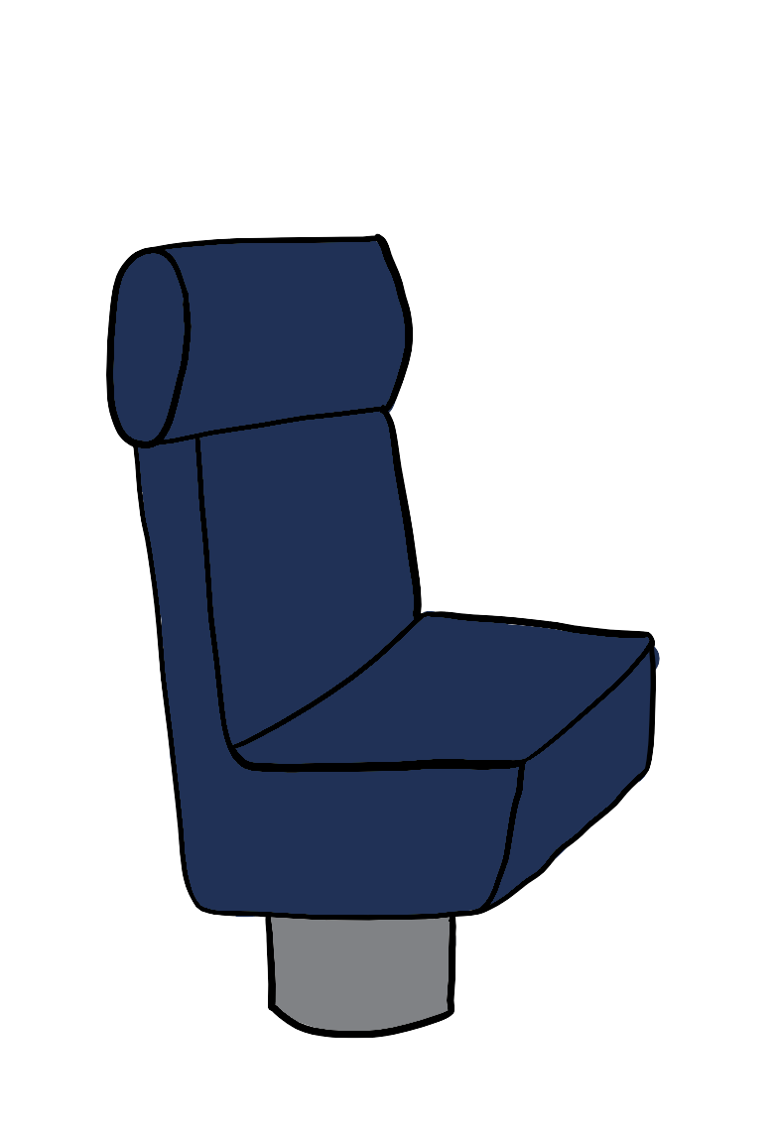
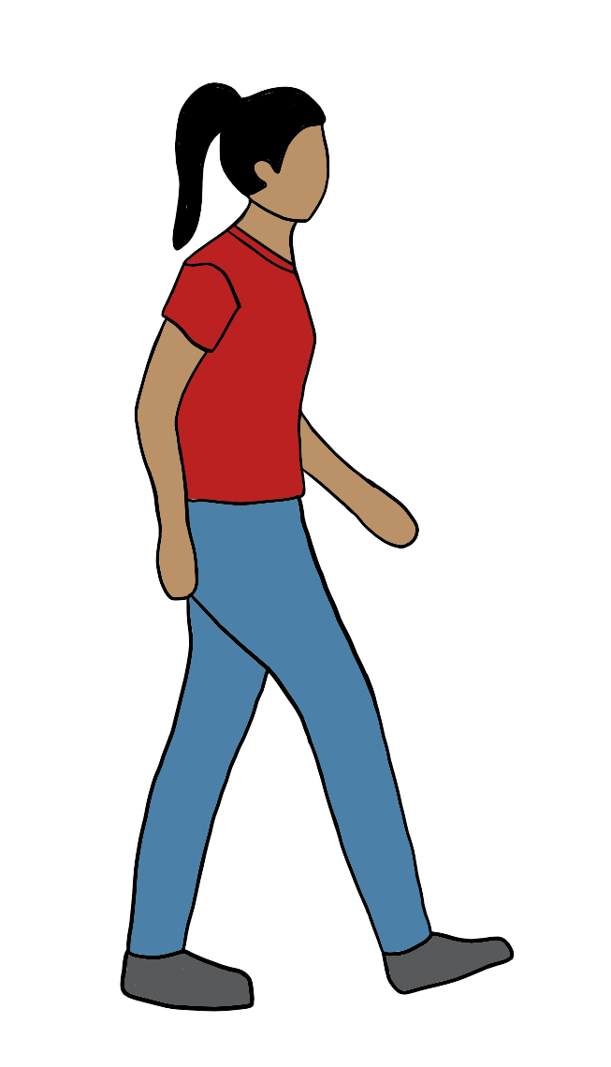
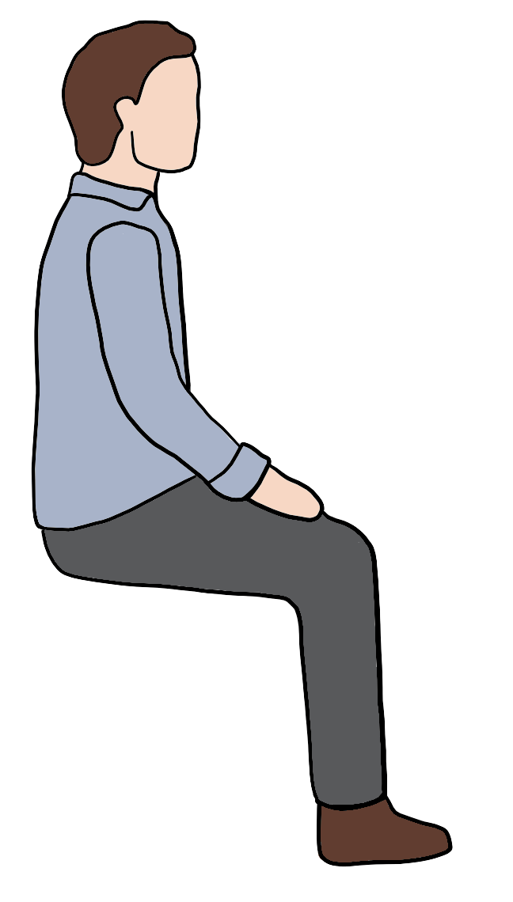
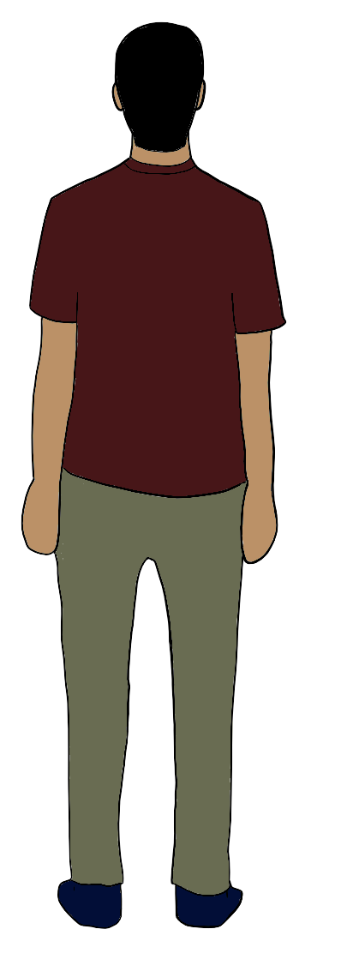

$$v^{′B}$$
$$v^{A}$$
$$0$$
$$x^{A}(t)$$
$$x$$
$$0$$
$$x^{′B}(t)$$
$$x^{′A}(t)$$
$$x′$$

