Slide 1


Slide 2
3

Slide 4



Slide 5
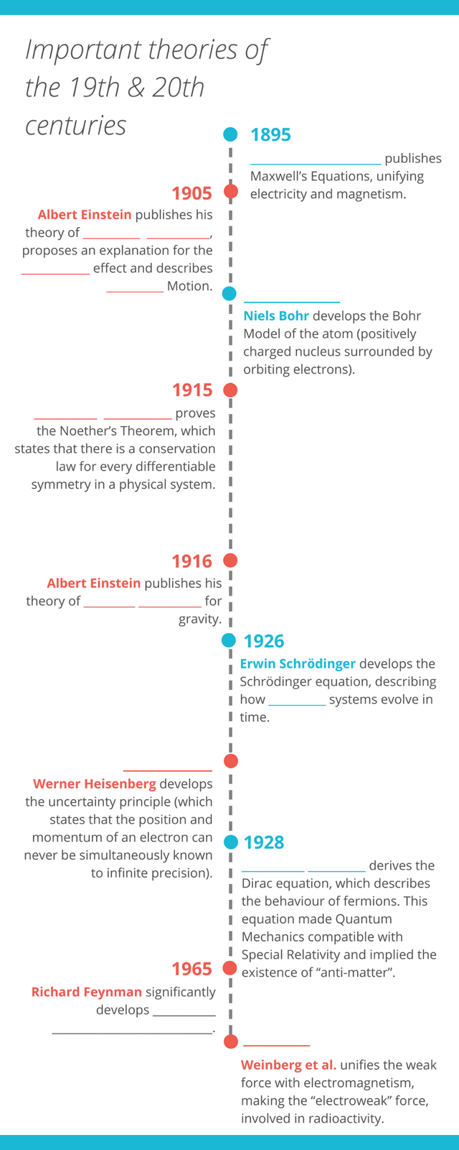
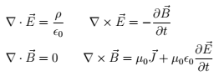
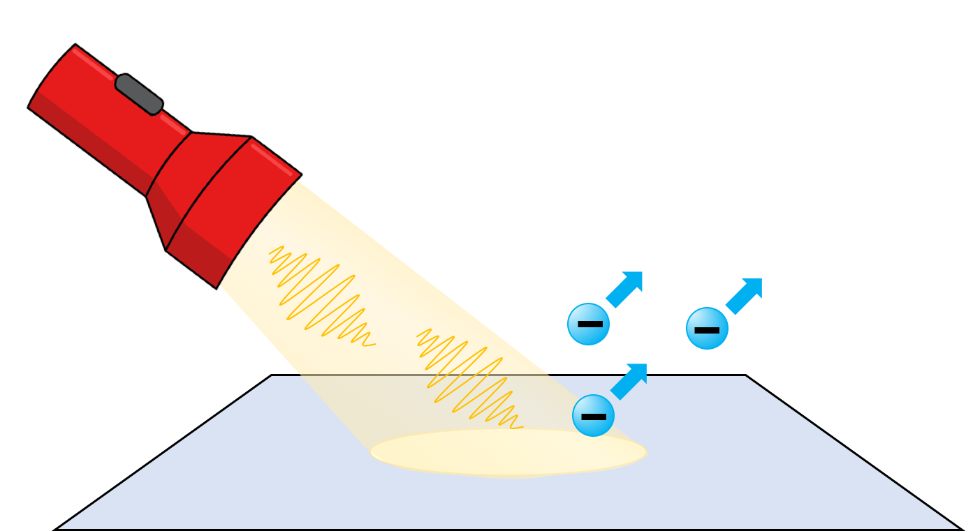
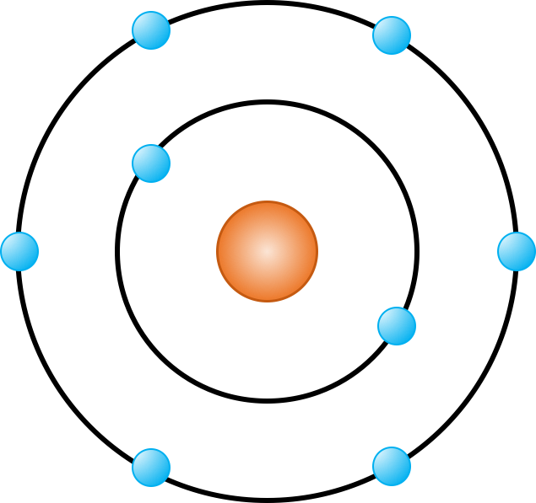


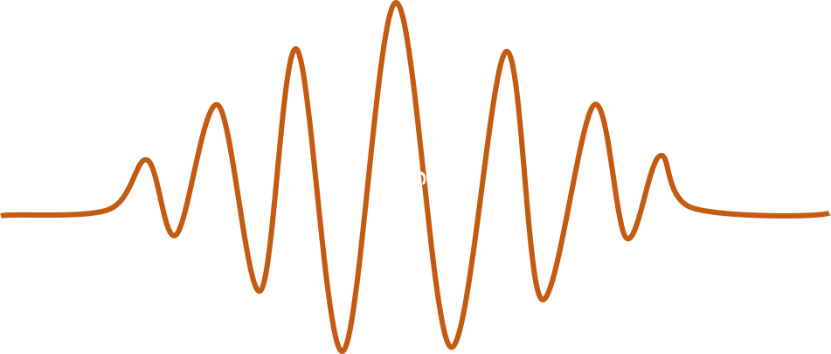
James Clerk Maxwell
Special Relativity
photoelectric
Brownian
1913
Emmy Noether
General Relativity
quantum
1927
Erwin Schrodinger
Quantum electrodynamics
1978

