Slide 1










Useful components
$$z$$
$$y$$
$$y$$
$$0$$
$$x$$
$$y$$
$$0$$
$$x$$
$$0$$
$$x$$
$$x$$
$$0$$

Slide 2












$${\vec{v}}_{d}$$
$$conventional current$$
$$A$$
$$e^{−}$$
$$e^{−}$$
$$motion of electrons$$
$$l=v_{d}Δt$$
$$A$$
$$\vec{E}$$
$$ACME battery$$
$$A$$
$$L, ΔV$$

Slide 3


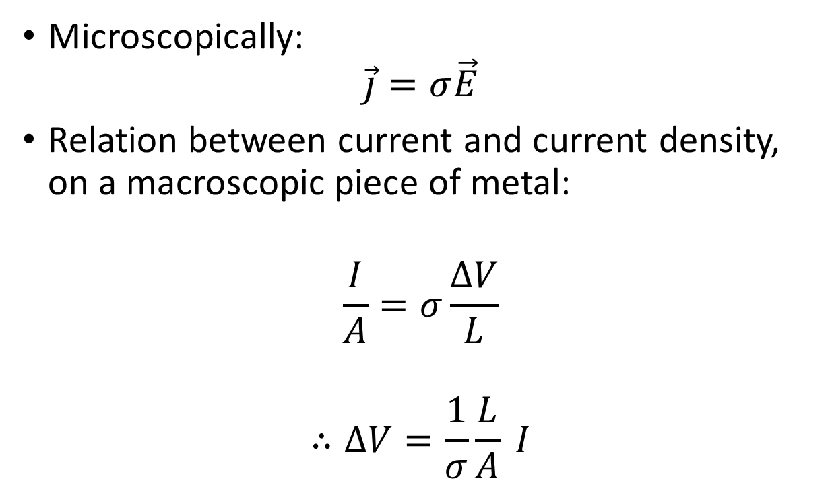


ρ
$$ρ\left(T\right)=ρ_{0}\left[1+α\left(T−T_{0}\right)\right]$$
$$ρ_{0}$$
$$ρ_{0}−ρ_{0}{αT}_{0}$$
$$T_{0}$$
$$T$$

