Slide 1



x
0m
1m
2m
x = 0.5 m
1m
2m
x
x = 0
$$y$$
$$0$$
$$x$$

Slide 2
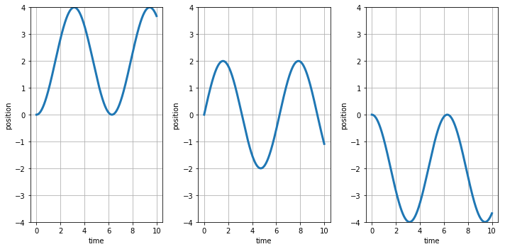



$$A$$
$$B$$
$$C$$

