Slide 1
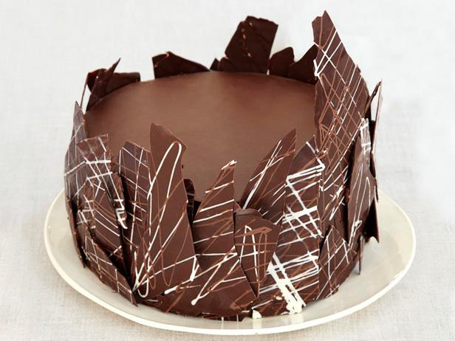
Cake Catalog
Home About Add Cake Cart
Supreme Chocolate Cake
Prep Time: 1hr 0 min Cook Time: 1 hr 30 min Servings: 8
Dietary Information: Vegan Dairy Free
Ingredients:
1
2
3
4
Directions:
A
B
C
D
Add to Cake Cart

Slide 2
Cake Catalog
Home About Add Cake Cart
Supreme Chocolate Cake
Add to Cart
X
Cake Type: Chocolate
Dietary Tags: Vegan
Dairy Free
Servings per Cake: 8
Prep Time: 1 hr 0 min
Cook Time: 1 hr 30 min
See Full recipe

