Slide 1
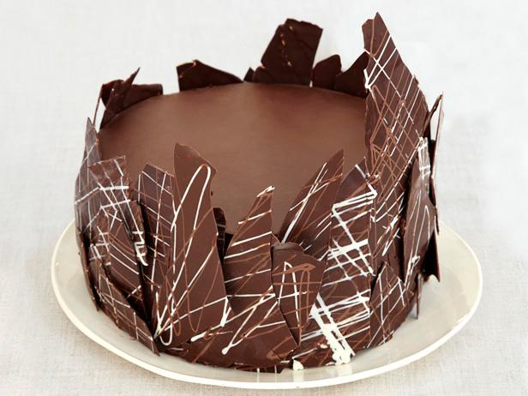
Cake Catalog
Home About Add Cake Cart
Supreme Chocolate Cake
Add to Cart
Cake Type: Chocolate
Dietary Tags: Vegan
Dairy Free
Servings per Cake: 8
Prep Time: 1 hr 0 min
Cook Time: 1 hr 30 min
See Full recipe

