Slide 1
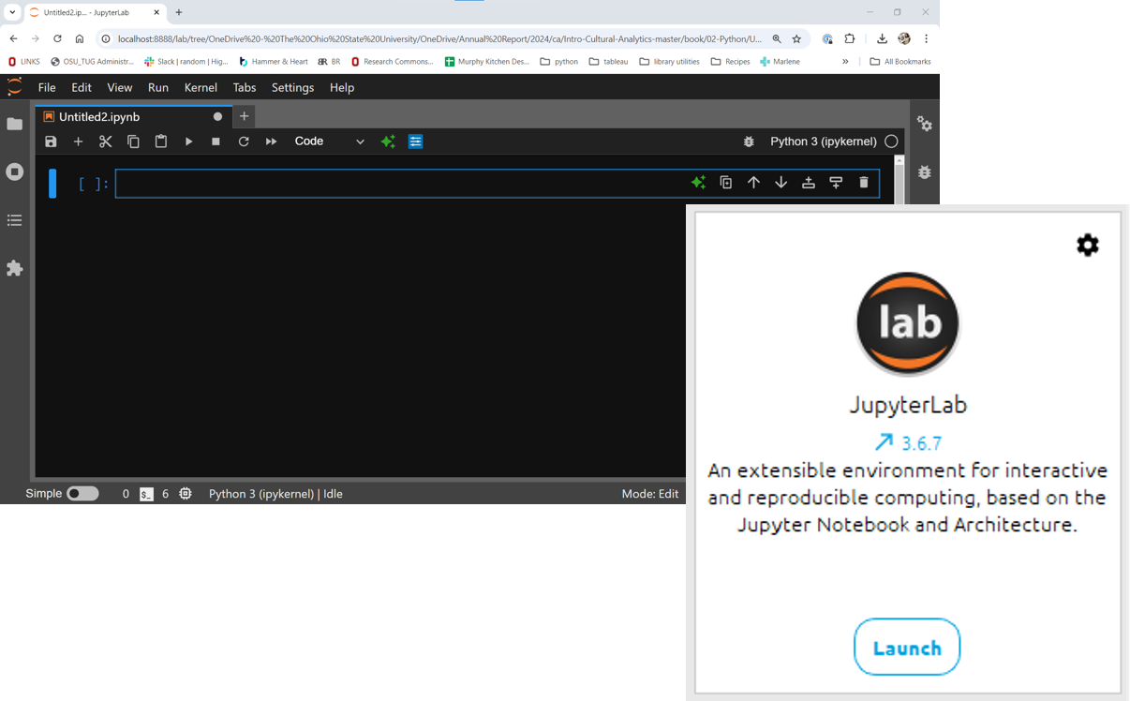
Python Learning Community
September 17, 2024

Slide 2



Do you consider yourself ...
ABSOLUTE BEGINNER
BEGINNER
ADVANCED BEGINNER
Never tried Python
Ready to get started!!!
Taken a few workshops
Still getting sea legs
Python dabbler
Need review
Working towards confidently applying skills

Slide 3
IMPOSTER

Slide 4
Variable Names
Upper and lower case letters
Digits 0-9
Underscores(_)
i.e. no_spaces

Slide 5
Variable Names Cannot ...
Include other punctuation (- . ! ? @)
Contain spaces
Start with a number
Use a reserved Python word

Slide 6
Reserved Python words
False | await | continue | import | pass
True | def | except | in | raise
None | del | finally | is | return
and | elif | for | lambda | try
as | else | from | nonlocal | while
assert | break | global | not | with
async | class | if | or | yield

Slide 7
Built-in Data Types
Data Type:
Text Type | str
Numeric Types: | int, float, complex
Sequence Types | list, tuple, range
Mapping Type | dict
Set Types | set, frozenset
Boolean Type | bool
Binary Types | bytes, bytearray, memoryview
None Type | NoneType

Slide 8
Python Math
Operation | Result
x + y | sum of x and y | +x | x unchanged
x - y | difference of x and y | abs(x) | absolute value or magnitude of x
x * y | product of x and y | int(x) | x converted to integer
x / y | quotient of x and y | float(x) | x converted to floating point
x // y | floored quotient of x and y | pow(x, y) | x to the power y
x % y | remainder of x / y | x**y | x to the power y
-x | x negated
https://docs.python.org/3/library/stdtypes.html#numeric-types-int-float-complex

