Slide 1
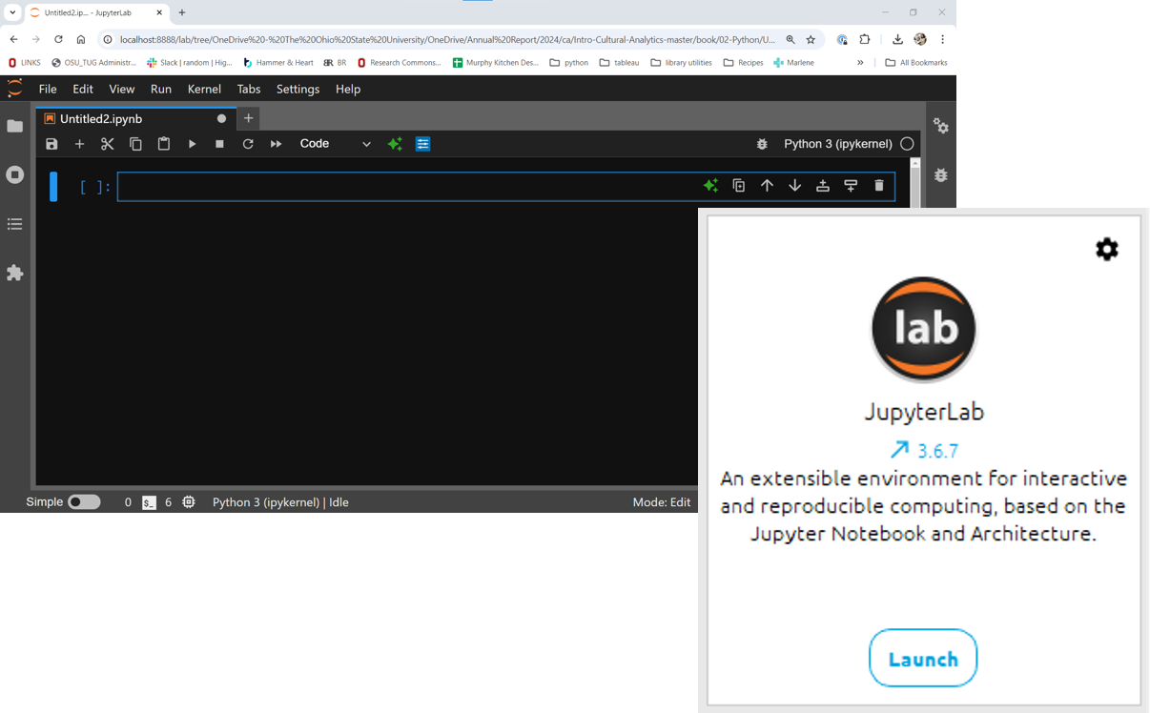
Python Learning Community
October 8, 2024
https://github.com/OSU-Libraries-Research-Services/PLC

Slide 2
https://github.com/OSU-Libraries-Research-Services/PLC
Download updated Week 3 file

Slide 3
Variable Names
Upper and lower case letters
Digits 0-9
Underscores(_)
i.e. no_spaces

Slide 4
Variable Names Cannot ...
Include other punctuation (- . ! ? @)
Contain spaces
Start with a number
Use a reserved Python word

Slide 5
Reserved Python words
False | await | continue | import | pass
True | def | except | in | raise
None | del | finally | is | return
and | elif | for | lambda | try
as | else | from | nonlocal | while
assert | break | global | not | with
async | class | if | or | yield

Slide 6
Built-in Data Types
Data Type:
Text Type | str
Numeric Types: | int, float, complex
Sequence Types | list, tuple, range
Mapping Type | dict
Set Types | set, frozenset
Boolean Type | bool
Binary Types | bytes, bytearray, memoryview
None Type | NoneType

Slide 7
Python Math
Operation | Result
x + y | sum of x and y | +x | x unchanged
x - y | difference of x and y | abs(x) | absolute value or magnitude of x
x * y | product of x and y | int(x) | x converted to integer
x / y | quotient of x and y | float(x) | x converted to floating point
x // y | floored quotient of x and y | pow(x, y) | x to the power y
x % y | remainder of x / y | x**y | x to the power y
-x | x negated
https://docs.python.org/3/library/stdtypes.html#numeric-types-int-float-complex

