Slide 1
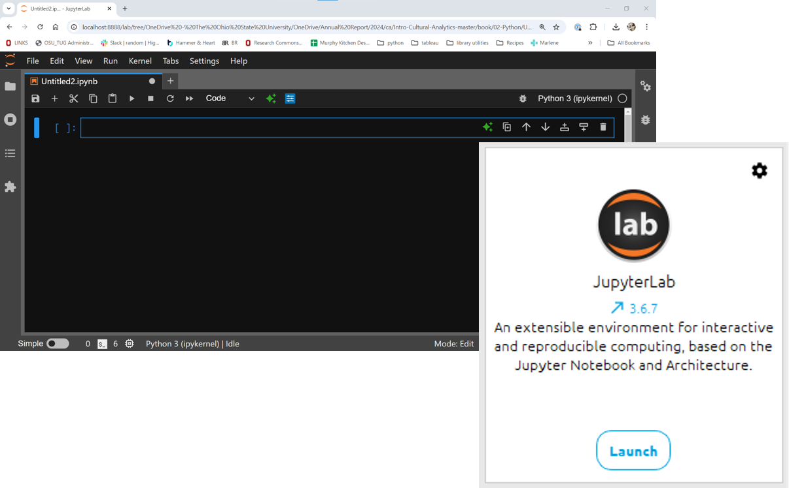
Python Learning Community
January 14, 2025

Slide 2



Do you consider yourself ...
ABSOLUTE BEGINNER
BEGINNER
ADVANCED BEGINNER
Never tried Python
Ready to get started!!!
Taken a few workshops
Still getting sea legs
Python dabbler
Need review
Working towards confidently applying skills

Slide 3
IMPOSTER

