Slide 1

P
step | goal
1 | canva
2 | share
3 | ppt
4 | end
ELEGANT
PITCH
DECK
Company name |
Presentation 2024
D

Slide 2



How to Use This Presentation
CANVA
POWERPOINT
GOOGLE SLIDES
Click on the "Canva" button under this presentation preview. Start editing your presentation. You need to sign in to your Canva account.
Export this design from Canva as a PowerPoint template. Open the design in Canva. This will provide you with all the fonts used and elements used in this presentation as listed on page 21. Learn more on slide 3.
Export this design from Canva as a GoogleSlide template. This will provide you with all the fonts used and elements used in this presentation as listed on page 21. Learn more on slide 4.

Slide 3
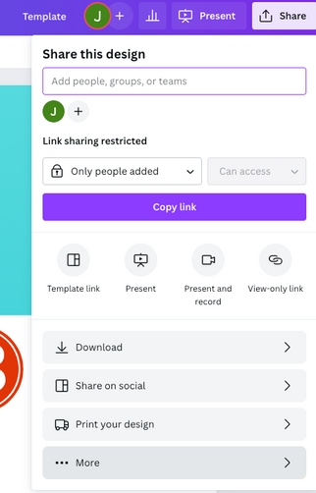
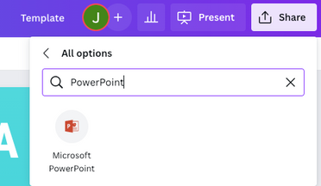
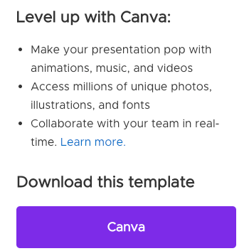
Download this presentation as a Powerpoint template in 3 steps
1
2
3
Click on the "Canva" button next to this presentation. Start editing your presentation. You may need to sign in to your Canva account.
Click on the "Share" button on the top right corner in Canva and click on "More" at the bottom of the menu.
Enter "PowerPoint" in the search bar and click on the PowerPoint icon to download.

