Slide 1



YOUR MARKETING PRESENTATION
Cute Interface Marketing Plan

Slide 2
How to Use This Presentation
Google Slides
PowerPoint
Canva
Click on the "Google Slides" button
below this presentation preview.
Click on "Make a copy."
Start editing your presentation.
You need to sign in to your
Google account.
Click on the "PowerPoint" button
below this presentation preview.
Start editing your presentation.
Download and install the fonts
used in this presentation as
listed on the next page.
Click on the "Canva" button under
this presentation preview.
Start editing your presentation.
You need to sign in to your
Canva account.

Slide 3


Add an Agenda Page
Write an agenda here.
Write an agenda here.
Write an agenda here.
Write an agenda here.
Write an agenda here.

Slide 4


Hello there!
I'm Rain, and I'll be sharing
with you our business plan
Follow us at @reallygreatsite to learn more.

Slide 5



SOLUTION
Solution 1
Solution 2
Solution 3
Write the proposed
business solution
here and elaborate on it.
Write the proposed
business solution
here and elaborate on it.
Write the proposed
business solution
here and elaborate on it.

Slide 6

Write the company's unique value proposition.
Turn an unaware visitor into an interested customer by expounding on your company’s compelling, unique value proposition here.

Slide 7
STRENGTHS
WEAKNESSES
What are you doing well?
What sets you apart?
What are your good qualities?
Where do you need to improve?
Are resources adequate?
What do others do better than you?
OPPORTUNITIES
THREATS
What are your goals?
Are demands shifting?
How can it be improved?
What are the blockers you're facing?
What are factors outside of your control?

Slide 8




UNFAIR ADVANTAGE
Cheap
Quality
Effective
Explain what sets
you apart from
your competitors.
Explain what sets
you apart from
your competitors.
Explain what sets
you apart from
your competitors.

Slide 9



CHANNELS
Marketing Channel 2
How will you reach your target consumers?
Marketing Channel 1
Marketing Channel 3
How will you reach your target consumers?
How will you reach your target consumers?

Slide 10

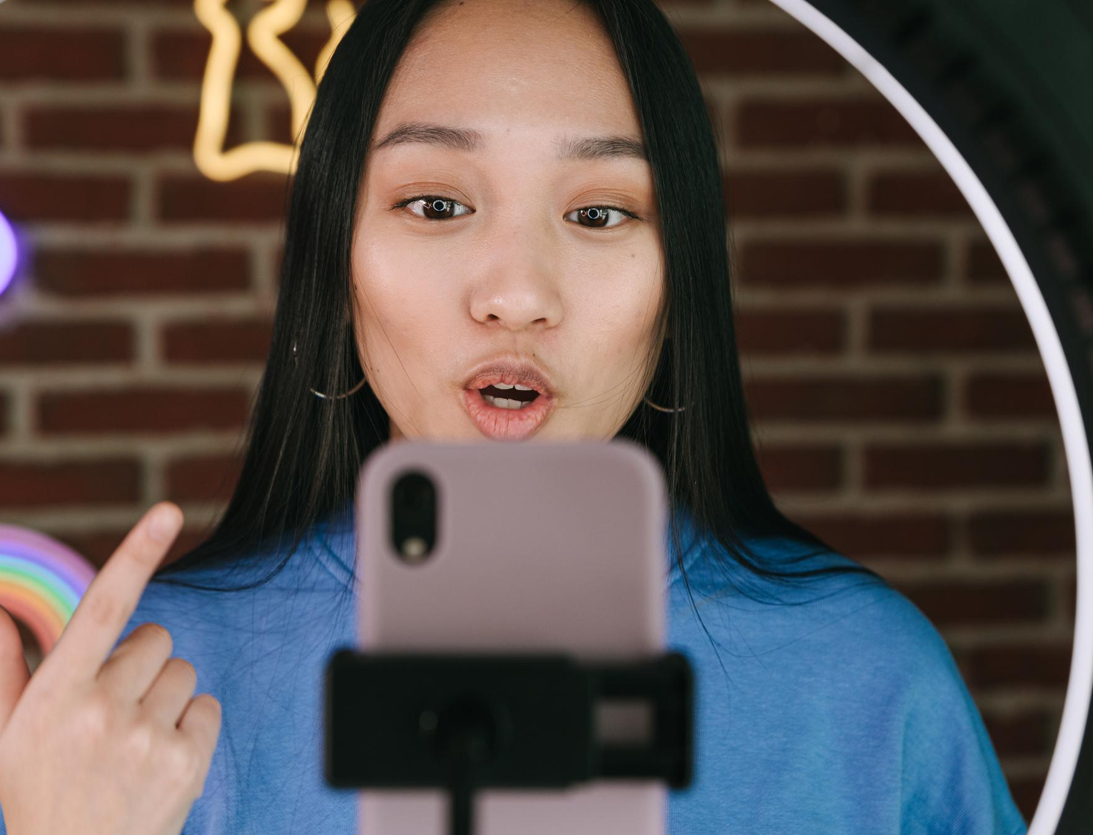
01
Add a
Section Header

Slide 11

CONSUMER SEGMENTS
Persona 1
Persona 2
Persona 3
Visualize the ideal customer for which your solutions are intended.
Visualize the ideal customer for which your solutions are intended.
Visualize the ideal customer for which your solutions are intended.

Slide 12
COST STRUCTURE & REVENUE STREAM
 | 1st Quarter | 2nd Quarter | 3rd Quarter | 4th Quarter
Income Statement
Revenue Add the product of your average sales price and the number of units sold with your other sources of revenue | $ 000 | $ 000 | $ 000 | $ 000
Fixed Costs Add your fixed costs, such as salaries, insurance, and rent, among others | $ 000 | $ 000 | $ 000 | $ 000
Variable Costs Add your variable costs, such as materials, labor, and insurance, among others | $ 000 | $ 000 | $ 000 | $ 000
Total Costs Add your fixed and variable costs | $ 000 | $ 000 | $ 000 | $ 000
Profit Deduct the total costs from your total revenue | $ 000 | $ 000 | $ 000 | $ 000

