Slide 1
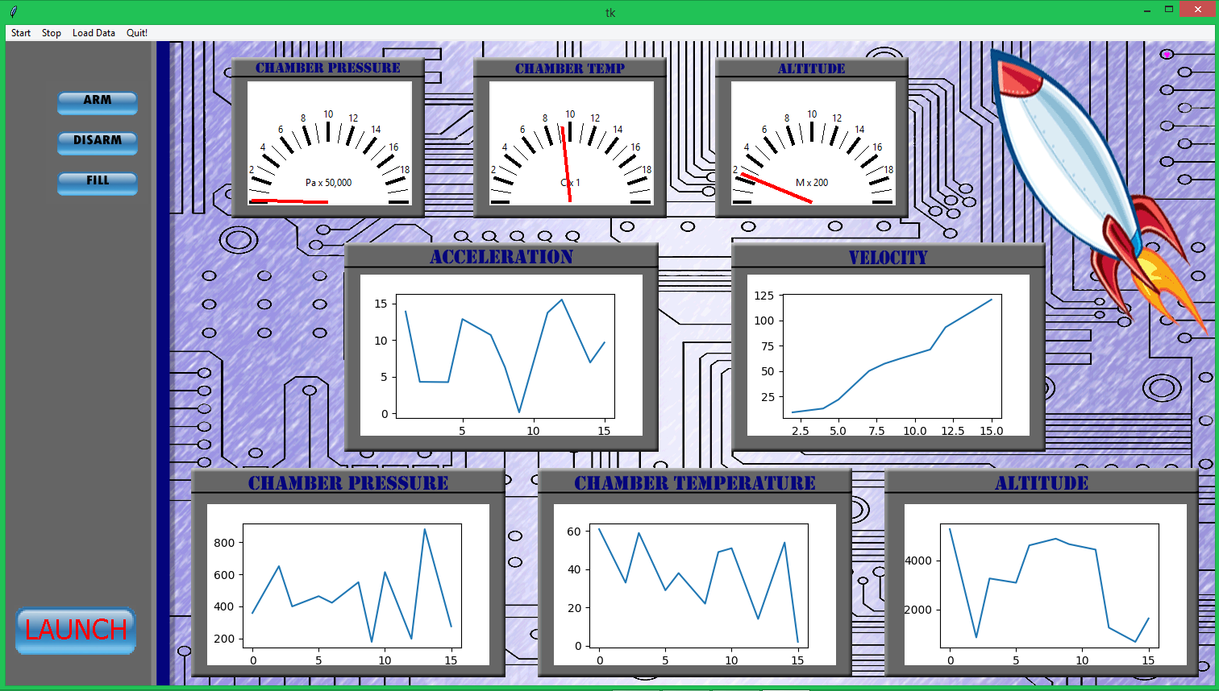

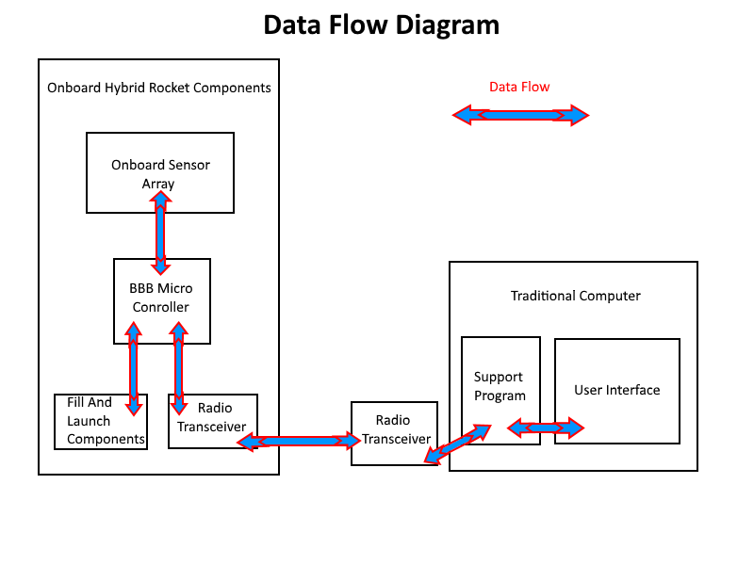
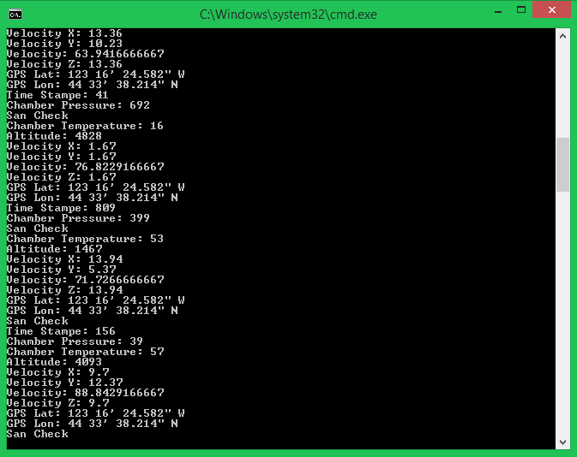



DATA VISUALIZATION ON a ROCKET
What is a hybrid rocket and why does it need software?
Major System Components
How do we watch data from a rocket live?
Technical Details
Data gathered on board the rocket is a beagle bone black micro computer.
Sensors to collect data regarding pressure, temperature, altitude, and acceleration are installed on the rocket.
Velocity is numerically derived from the aceleration data.
Xbee radio transceivers are used for radio communication between the rocket and the ground.
A Python based program on the rocket manages sensor data and radio transmission. This component was developed by the ECE team.
A Python based graphical user interface is the primary focus in order to Provide the capability to communicate with the Xbee and the user.
The program is divided into two threads; One that controls the Xbee and one that collects as well as visualizes data.
Tkinter is used as the graphical user interface library.
Matplotlib provides a graphing API which is utilized to make our graphs.
Data is received, converted, and passed to drawing functions displayed on the interface.
When a user clicks a command button, the command is sent to the radio communication thread which transmits the information to the rocket.
Screen shot of the user interface.
OSU Hybrid Team Logo
What to do with rocket data…
Over the last couple years, teams at Oregon State University have been developing and testing a feasible hybrid rocket. Last year, Oregon State’s team was successfully able to launch a hybrid rocket up to 5,000 ft. On board their rocket was an array of sensors collecting data on a micro computer housed in the avionics bay. They were successful in collecting a large amount of data, but did not have a quick and easy way to view this data. This is where we come in.
The objective of the project is to establish a live communication line with this years rocket where we will effectively issue commands as well as receive sensor data. Following the data being collected, it will be visualized on a graphical interface. The underlying mechanism of this project requires communication between two remote computers controlled by software.
A micro computer in the avionics bay of the rocket is attached to a sensor array. It gathers data and communicates with a radio transceiver to relay information. Software on the ground is connected to another radio transceiver. Data and commands are communicated through these transceivers.
HYRO Rocket Interface
In order to visualize sensor data which is transmitted to the interface, data is collected from these sensors, then packaged and sent to the radio transceiver.
Upon reception, data is visualized on the interface. This is achieved through the use of python and its graphical libraries. Data is visualized on time verse unit graphs and classic gauges. During live flight, data is updated on the interface continuously.
Hybrid Rocket System Overview
A hybrid rocket has two types of fuel, liquid and solid. A normal rocket has one or the other.
The rocket has a set of sensors that monitor its behavior in flight.
Information from these sensors is sent to a computer on the ground.
The job of our software on the ground computer is to turn this information into something that humans can understand.
Our software will receive information from the rocket while it is in fight.
We graph this information in a way that is easy to under stand.
Previous flights can be loaded at a later time to review old data.
Goal for this year is to fly the rocket over 10,000 feet!
A user initiates start and stop transmissions. Following a new transmission, data collected is logged in time stamped folders, providing a loading option which allows previously recorded data to be viewed at a later time.
Controls are provided which allow users to issue pre-launch commands to the rocket In which the on board system preforms the requested action.
Goals and Metrics
• Data received must be accurately logged to disk and visualized in a graph.
• Data needs to be transferred in under a second in order to ensure accurate representation of current rocket status.
• Provide an intuitive, functional interface for the user.
• Successfully remote filling capabilities to the rocket team. .
Josh Asher
Jason Klindtworth
Layne Nolli
Screen capture of live data on the console.
Notes:
If tri-fold mounting at SMS – make sure no text or image is in-between the two vertical guide lines; this space will be cut away. To view the vertical guide lines: Select “View” from the main menu, select “Guides” from the pull down menu, and lastly select “Static Guides”.

