Slide 1

Hyro Team 28
Josh Asher
Jason Klindtworth
Layne nolli

Slide 2
Avionics System on hybrid rocket
We have been requested to design remote operation and data visualization software for a hybrid rocket.
The system has two components one onboard the rocket and one a traditional computer on the ground.
Important goals include remote filling, arming, and launch. Along with visualizing data that is collected from onboard sensors.

Slide 3
What is a hybrid rocket?
A rocket with a motor that has both solid and liquid fuel.
The liquid fuel is called the oxidizer and is housed in a tank that is filled right before launch of the rocket.
The solid fuel is held in the combustion chamber.
The oxidizer is injected through the center of the solid fuel
Hybrid rockets have the unique capability of being throttled.

Slide 4
Last years success
Team did not include CS students, but were able to build a system to collect data.
Last year was the second year for the hybrid and they finally got it off the ground. It was a major success.
We have a little to go off of from last year including data.
This year they want that data visualized, along with easier to use remote filling and launching capabilities.

Slide 5

Link to video of last year rocket

Slide 6
The first couple weeks 1-4
Meetings were setup and guided by last years team.
We had to understand what the system did and what they wanted.
This lead us to understand the problem and being our problem statement.
Things changes as we learned more about the system.

Slide 7
Initial stumbling blocks
Our client teaches a class during our meetings times and it was hard to initially understand what she wanted.
It took a while to get the information from last year.
We had no idea what an avionics system did.
Much of what was being discussed in the meetings were geared towards the mechanical engineers coming into the project winter term.
We had to initiate a friendship with the electrical engineering capstone students.
Learning to use LaTeX

Slide 8
Problem Statement
Data needs to be collected from onboard sensors in the rocket
The data needs to be passed through a radio transceiver to a ground Computer
Commands need to be sent from the ground to the rocket
Data needs to be visualized in a human readable way

Slide 9
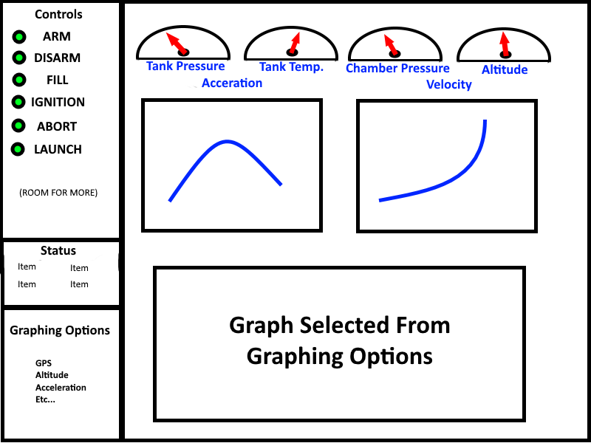
Problem Statement – UI Mockup

Slide 10
Problem Statement – Metrics
Data Process Time – Have to be able to communicate data in under a second or else the data will not be reliable
Command sequence reliability – Safety features need to be included to limit the possibility of human error
Accuracy of Data/Visualization – We need to check for consistency between the data we are getting and the visualization of that data on the UI

Slide 11
Weeks 4-6
Finished Problem Statement
Started working on Requirements Documents
Continued to learn about the Rocket System from weekly meetings

Slide 12
Week 4-6 – Stumbling blocks
Exact Componentry that will be on the rocket
Objectives were clear, but the details were vague
Had trouble applying the IEEE document requirements
Had trouble getting in touch with the client to get the document signed

Slide 13
Requirements Document - Introduction
Purpose and overview
Onboard computer software requirements
Ground computer software requirements

Slide 14
Requirements Document - Interfaces
System Interfaces (Graphical User Interface)
Hardware Interfaces (Sensors, Servos, Transceiver)
Software Interfaces (Operating systems)
Data Flow Diagram

Slide 15
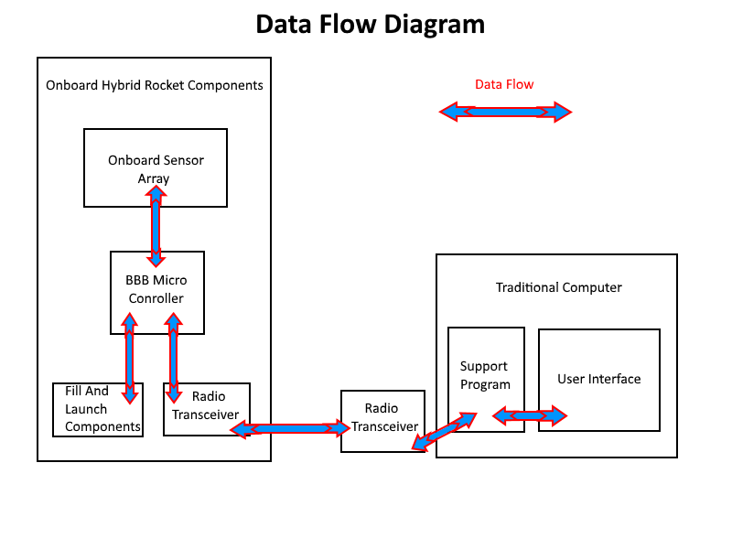
Requirements Document – Data Flow

Slide 16
Weeks 6-8
Finished requirements document
Completed Tech Review
Researched possible technologies to use to complete our goals for the project
Finalized that we will be using a Data Driven UI for output

Slide 17
Weeks 6-8 stumbling blocks
Challenging to get detailed requirements for the project
Many ways to satisfy requirements, difficult to finalize options
Hard to divide project into 9 tech components to be further investigated
Began work on design doc, IEEE 1016 document was difficult to understand

Slide 18
Week 8-10
Finished tech review
Worked on design document
Mechanical Engineers started to come on board
Through the design document we achieved a better understanding of the project as a whole

Slide 19
Week 8-10 stumbling blocks
Submission deadlines came up quick
Design document took a lot of planning and subsequently, time
Meetings with ECE students suggested potential future design adjustments
Client, other teams, mentors were all very busy so communication was impacted

Slide 20
Design document - Introduction
Introduction
Onboard rocket software
Traditional Computer Software

Slide 21
Design document Onboard Systems
Mutli-threaded python program – simple
Sensor data will be stored in a python dictionary
The dictionary will act as a global buffer
Time stamp will be recorded with the data to determine if the data is new.
Command will be stored in an array, and removed once processed.

Slide 22
Design document Onboard Systems
Sensor Polling thread responsible to filling data buffer.
Command processing thread, responsible for monitoring for commands and processing them.
Radio Transceiver thread, responsible for acquiring data from the radio transceiver and monitoring sensor buffer for new data to send to the ground computer.
Radio Transceiver send function, will send a message into the transceiver
We have chosen python as the language for this component

Slide 23
Design document Traditional Computer
Also multi-threaded python application.
We’ll be using Tkinter and Matplotlib for visualization.
There will be buffers for sensor data, and a buffer for data that has been received through the flight of the rocket.
Commands, responses, other messages need to be logged in a text files on the system

Slide 24
Design document Traditional Computer
Data Thread, responsible for getting data from transceiver and buffering data into sensor buffer.
Converter functions, data converters between data thread and buffer.
Redraw thread, responsible for call redraw functions on new data.
Drawing functions, responsible for visualizing specific data items.
All data will be logged to text file.

Slide 25
Design document User Interface
Command buttons on left hand side of screen.
Message window under this.
Graphing options under Message window
Right hand side of screen made up of the individual graphs and gauges.
One graph windows can be changed with the graphing options buttons.

Slide 26
Conclusion and Future objectives

