Slide 1
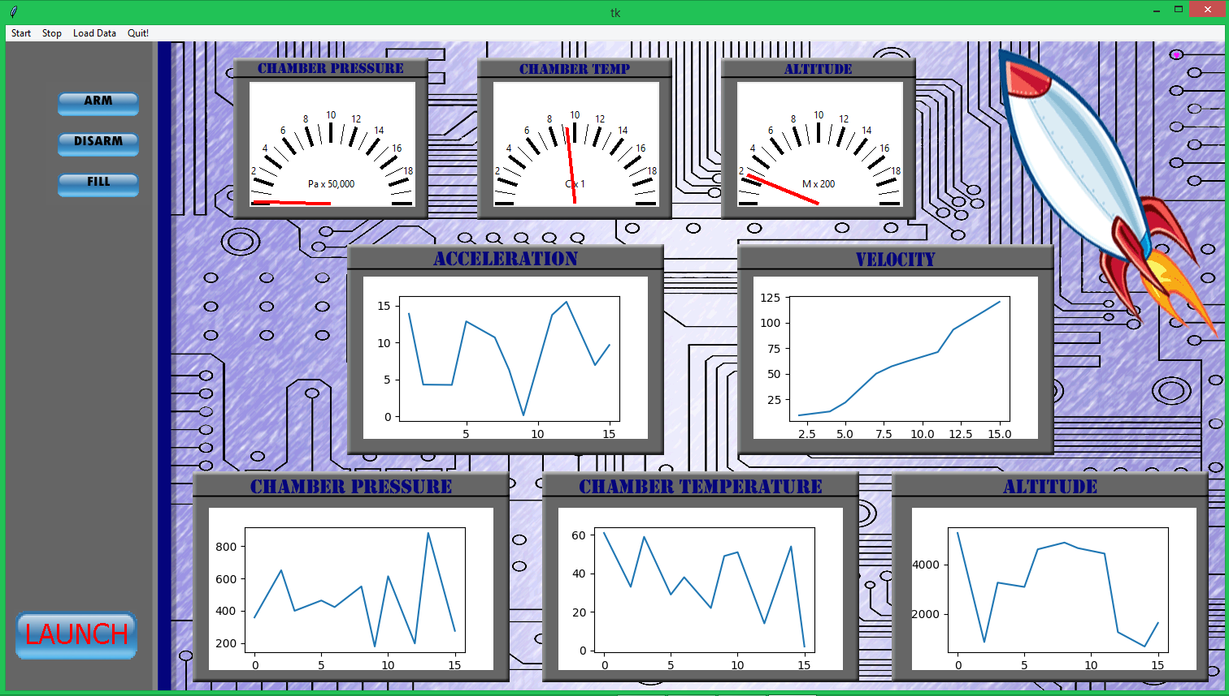

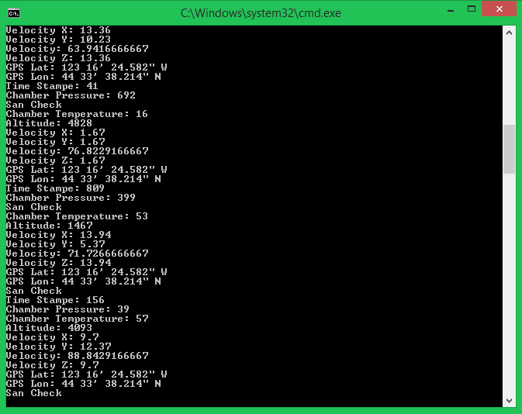
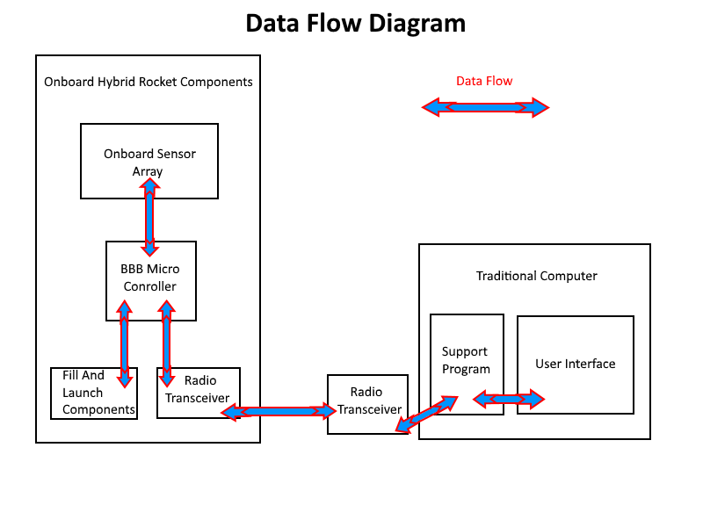
DATA VISUALIZATION ON a ROCKET
The major parts of our system.
What is a hybrid rocket and why does it need software?
How do we watch data from a rocket live?
Technical Details
On the rocket - Acting as the avionics system on board the rocket is a Beagle Bone Black micro computer. This computer is connected through GPIO lines to a set of sensors that measure different aspects of flight like, pressure, temperature, altitude, acceleration and GPS. It is also connected to an Xbee radio transceiver. A python program runs on the Beagle Bone Black that collects the sensor data, sends the data out through the Xbee, and listens for incoming data from another Xbee.
On the ground – The ground computer is Windows based laptop that is connected to a Xbee via a USB break out board. Our main software runs here. This software is a multi threaded python graphical application. On startup it creates a thread that starts communication with the Xbee. Another thread runs in parallel that generates the entire user interface. We use Tkinter and Matplotlib to implement our gauges and graphs. When data is received from the Xbee in a specified format it is placed into queues that the main thread can process. In the main thread when new data is detected it is converted into appropriate units, recorded to log files, and then passed to the drawing functions of the gauges and graphs. When a user clicks on a command button the main thread passes that information to the Xbee thread which sends it out the Xbee to the avionics board on the rocket.
What to do with rocket data…
Over the last couple years, teams at Oregon State University have been developing and testing a feasible hybrid rocket. Last year Oregon State’s team was successfully able to launch a hybrid rocket up to 5,000 ft. On board their rocket was an array of sensors collecting data on a micro computer housed in the avionics bay. They were successful in collecting a large amount of data, but they didn’t have a quick and easy way to view this data. That’s where we come in.
Our project’s goal is to establish a live communication line with this years rocket where we will be able to issue commands and receive sensor data. When this data is collected it is our job to visualize it on a graphical interface. The underlying mechanism of this project require communication between two remote computers. This communication is achieved through radio transceivers that can communicate with a modern computer.
There is a micro computer in the avionics bay of the rocket that is attached to an array of sensors. The computer can be programmed to read these sensors and communicate with one of the radio transceivers to relay information. Software on a laptop on the ground will be connected to another radio transceiver. This software will be able to talk to the computer on the rocket through these radio transceivers.
HYRO Rocket Interface
In order to solve this problem the Electrical Engineering team has carefully chosen sensors, servos, a radio transceiver, and a micro computer to fit these needs. Software running on this micro computer communicates with all these components. Data is collected from the sensors, then packaged up and sent out the radio transceiver.
The software also monitors for radio messages that might contain commands from the graphical user interface. On the ground our software monitors or sends radio messages from another radio transceiver. When sensor data is received from the rocket we graph this data on the user interface. This makes the rockets current state easy to visualize by the ground team while it is in flight. We then store this information for later visualization and records.
Goals and Metrics
• Communication must be kept between the rocket and ground team during flight to successfully transfer data.
• When data is received it must be accurately logged and visualized in a graph.
• Data needs to be transferred in under a second in order to have an accurate representation of current rocket status.
• Have an intuitive interface with ease of use.
• Successfully provide remote filling capabilities to the rocket team.
• Satisfy the data visualization criteria derived from our fellow engineering teammates.
Hybrid Rocket System Overview
• A hybrid rocket has two types of fuel, liquid and solid. A normal rocket has one or the other.
• The rocket has a set of sensors that monitor its behavior in flight.
• Information from these sensors is sent to a computer on the ground.
• The job of our software on the ground computer is to turn this information into something that humans can understand.
• Our software will receive information from the rocket while it is in fight in order for our team to watch its behavior.
The Oregon State hybrid team consists of many students from different colleges. We are made up o f Electrical Engineers, Mechanical Engineers, Computer Science Engineers, and Chemical engineers. The goal that we all face is to make a hybrid rocket fly it to 10,000 feet. While in flight we will monitor its progress in real time. We will be able to view sensor information from a section of the rocket called the avionics bay. This information will be presented in a human readable way in the form of graphs. We will also collect this information for later use and analysis.
Notes:
If tri-fold mounting at SMS – make sure no text or image is in-between the two vertical guide lines; this space will be cut away. To view the vertical guide lines: Select “View” from the main menu, select “Guides” from the pull down menu, and lastly select “Static Guides”.

