Slide 1
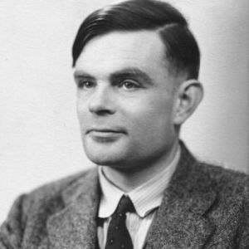
HEADER
Logic Gates. Boolean 1 = True, 0 = False
Alan Turing came up with the idea of the computer
About Binary
Eg
Binary is a system of representing numbers as powers of two. A number consists a sequence of ones and zeros with each one or zero corresponding to a different power of two. These are 1,2,4,8,16,32…(doubling every time)
010110 = 22
Citations/Challenge Questions (Numberphile, Standup Maths, Wikipedia Turing
What two gates is the half adder a made of? Why is one path long in the half adder?

