Slide 1
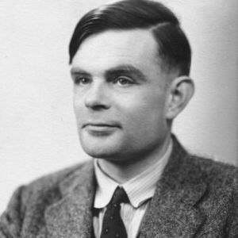
This “Title” appears to be stuck here.
Logic Gates. Boolean 1 = True, 0 = False
Alan Turing. First computer had no electronics. Go Allies beat Nazis.
About Binary
eg
010110 = 22
Citations/Challenge Questions (Numberphile, Standup Maths, Wikipedia Turing
What two gates is the half adder a made of? Why is one path long in the half adder?

