Slide 1
Filesystem (nativefs.c)
Buffer I/O (bio.c)
Device-specific (ide.c, loop_device.c)

Slide 2
/
/mnt/
/
/mnt/put_old
/mnt/abc
/put_old
/abc

Slide 3
struct proc
…
struct pid_entry pids[4]
int ns_pid = -1
…
struct pid_ns* pid_ns | pids[0]
int pid (=1)
struct pid_ns* pid_ns | pids[1]
int pid (=4)
struct pid_ns* pid_ns | pids[2]
int pid (=11)
struct pid_ns* pid_ns (=NULL) | pids[3] (unused)
int pid (=0)

Slide 4

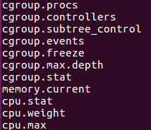
Root
Group 1
Group 2
Group 3
Group 4

Slide 5
/
.mutex/
cnts_gllk
…
dev/
tty0
…
images/
a
pconf/
ca
tty.c0
…
mnt/ca/
.mutex/
dev/
pconf/

Slide 6
/
.mutex/
cnts_gllk
…
dev/
tty0
…
pconf/
ca
tty.c0
…

Slide 7

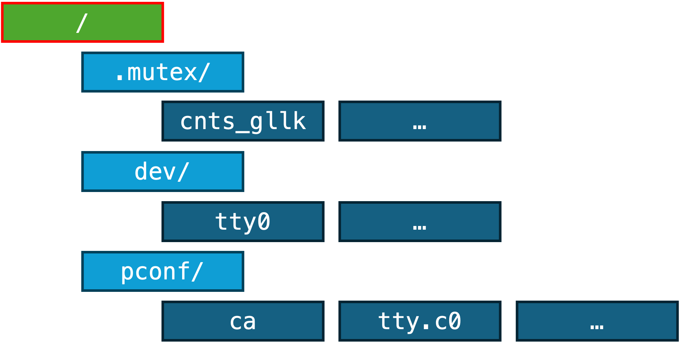
/pconf
PID NS
/pconf/ca
TTYNUM: 0 PPID: 6 NAME: ca
IMAGE: a
/pconf/tty.cX
ca
Parent
pouch
pid:1
MNT NS
Child sh
pid:2
stdin stdout
stderr
/dev/tty0
/cgroup/ca
…
…

Slide 8
mountnstable
root
active_mounts
mount
mount
mount
root
active_mounts
mount
mount
mount
…

