Slide 1



ND-SYNC: Detecting Synchronized Fraud Activities
Informatics Department
Aristotle University of Thessaloniki
School of Computer Science
Carnegie Mellon University
Maria Giatsoglou¹, Despoina Chatzakou¹, Neil Shah², Alex Beutel², Christos Faloutsos², Athena Vakali¹
¹ Informatics Department, Aristotle University of Thessaloniki, Greece
² School of Computer Science, Carnegie Mellon University, USA

Slide 2






Synchronization Fraud
###
$$$
&&&
###
###
### got
3K retweets
in 10 minutes
$$$
&&&
Alex
Alex
Alex
Alex
SUSPICIOUS?
not necessarily
10’
John
10’
John
10’
John
10’
###
$$$
&&&
###
Debbie
Debbie
Debbie
Debbie
###
$$$
&&&
###
###
$$$
&&&
###
###
$$$
&&&
… 3000 times
###
… 3000 times
… 3000 times
… 3000 times
Mary
Mary
Mary
Mary
Peter
Peter
Peter
Tim
Peter
Tim
Tim
Tim
SUSPICIOUS ?
Probably!
Group of unnaturally synchronized events/entities
Collective / group anomaly
e.g. retweets, Facebook likes, subgraphs, image subregions

Slide 3








Retweet Fraud
Complex problem with multiple dimensions
occasional retweet buyer
professional
content / user promoter
examples
###
%%%
###
%%%
###
###
paid
human
###
%%%
###
%%%
bots
honest humans
###
###
###
%%%
%%%
Accounts of varying automation level (bots, humans, semi-automated)
Mixed honest and fake retweets for the same post
Promiscuous vs. subtle fraudsters: based on the ratio of fraudulent to honest(-like) activity

Slide 4
Our goals
Given: N groups of entities; a representation for each entity in a p-dimensional space;
Identify groups of entities abnormally synchronized in some feature subspaces.
G1. Design a general, effective approach for collective anomalies detection
G2. Customize it for Retweet Fraud detection
G3. Find features that will assist distinguishing fraudsters from honest users

Slide 5
Outline
Background
Problem definition
Proposed approach
ND-SYNC pipeline
Features for retweet threads
Experiments
Dataset
Results
Conclusions

Slide 6
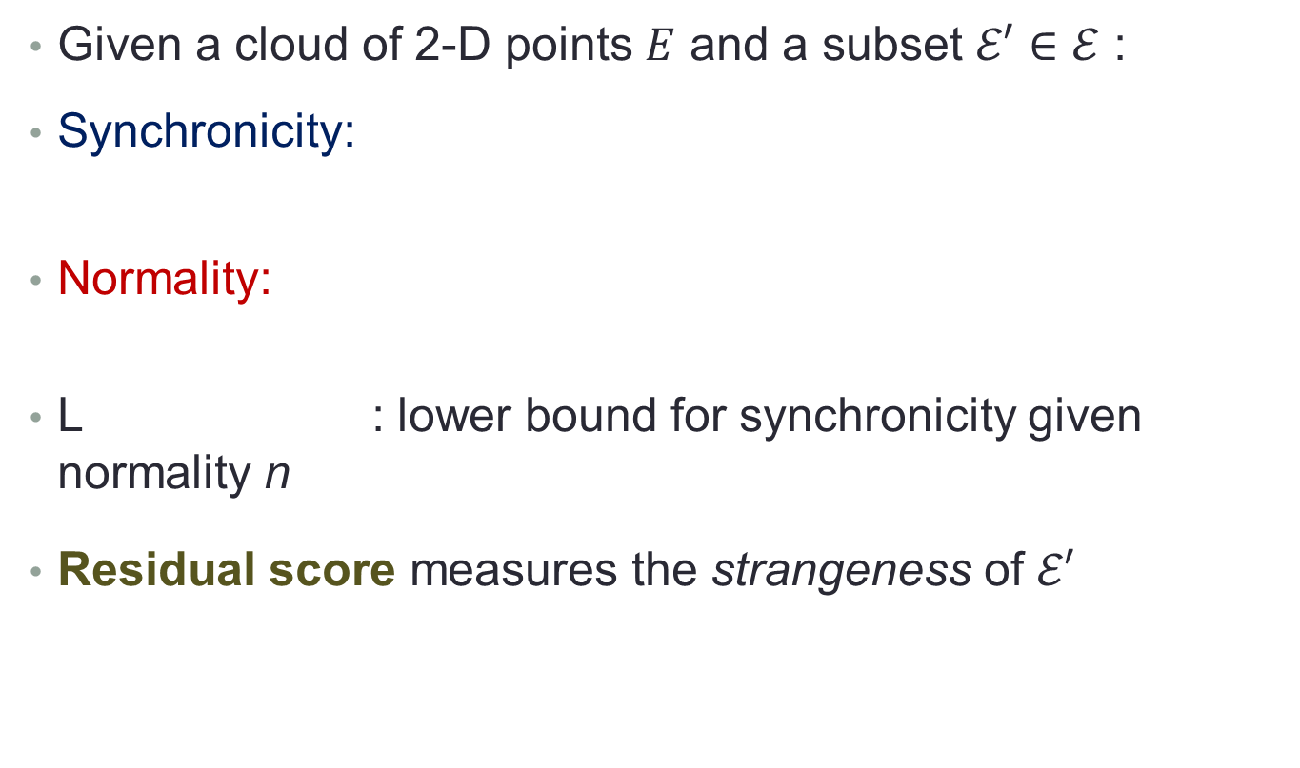



Measuring group strangeness
fd
coherence of subset $𝓔′$
average closeness
similarity between $𝓔′$ and “normal” $𝓔$
Meng Jiang, Peng Cui, Alex Beutel, Christos Faloutsos, Shiqiang Yang. CatchSync: Catching Synchronized Behavior in Large Directed Graphs. KDD 2014.

Slide 7
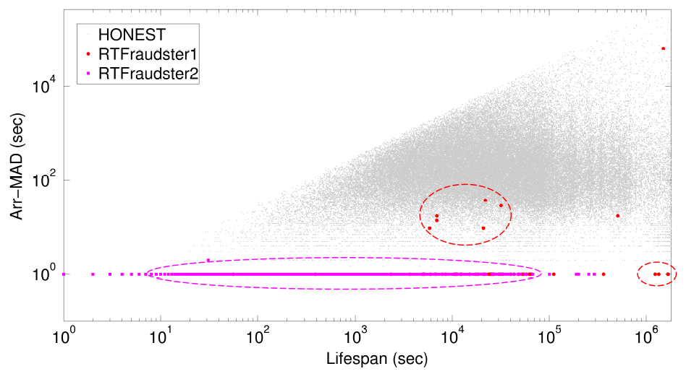


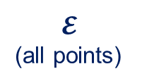

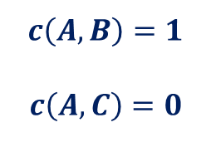
Measuring group strangeness
$$𝓔$$
(all points)
$$c\left(A,B\right)=1$$
$$c\left(A,C\right)=0$$
$$𝓔′$$
A
B
C

Slide 8
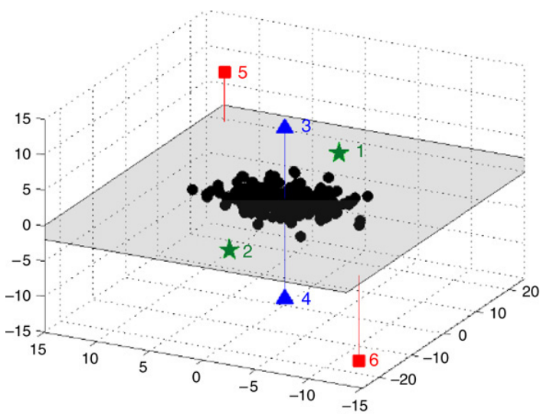
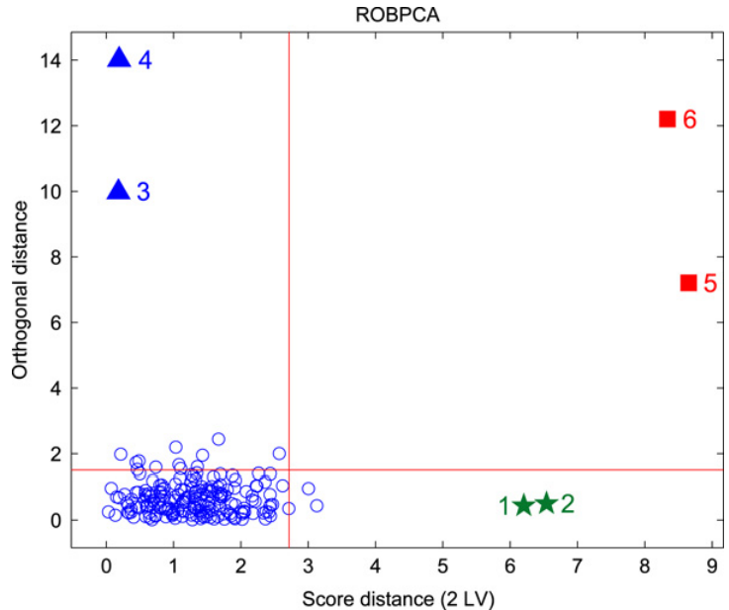
Robust outlier detection
Detail
ROBPCA-AO: robust dimensionality reduction approach; finds outlying points
Suitable for multivariate, high-dimensional data; Independent of features’ distribution; Non-deterministic
Finds the “best” k-D space to project data based on subset of points
Detects outliers based on two distance scores
orthogonal
distance
robust score
distance
M. Hubert, P.J. Rousseeuw, T. Verdonck. Robust PCA for skewed data and its outlier map. Comput. Stat. Dat. An., 53 (2009), 2264-2274.

Slide 9
Outline
Background
Problem definition
Proposed approach
ND-SYNC pipeline
Features for retweet threads
Experiments
Dataset
Results
Conclusions

Slide 10



Terminology
User u: a given Twitter account
Tweet tw_{u,i}: the i^{th} post of user u
Retweet thread: all re-posts of a tweet
###
%%%
***
$$$
tw_{u,1}
tw_{u,2}
tw_{u,3}
tw_{u,4}
u
t₁
t₂
t₃
t₄
time
###
###
###
###
###
###
Alex
Mary
Tim
Peter
Debbie
R_{u,1}
tw_{u,1}
t₁
t₂
t₃
t₄
t₄
time

Slide 11
Problem definition
SYNCFRAUD Problem.
Given: a set of groups of entities G with a variable number of entities e_{m,i} for each group g_{m}; p features for the entities’ representation,
Extract: a set of features at the group-level, and
Identify: suspicious groups S with highly synchronized characteristics.
RTFRAUD Problem.
groups of entities users
entities retweet threads
suspicious groups RTFraudsters

Slide 12
Outline
Background
Problem definition
Proposed approach
ND-SYNC pipeline
Features for retweet threads
Experiments
Dataset
Results
Conclusions

Slide 13
ND-SYNC pipeline
Given N groups of p -D entities and I iterations
Do
Feature subspace sweeping;
Group scoring;
Multivariate outlier detection;
Extract suspicious groups

Slide 14
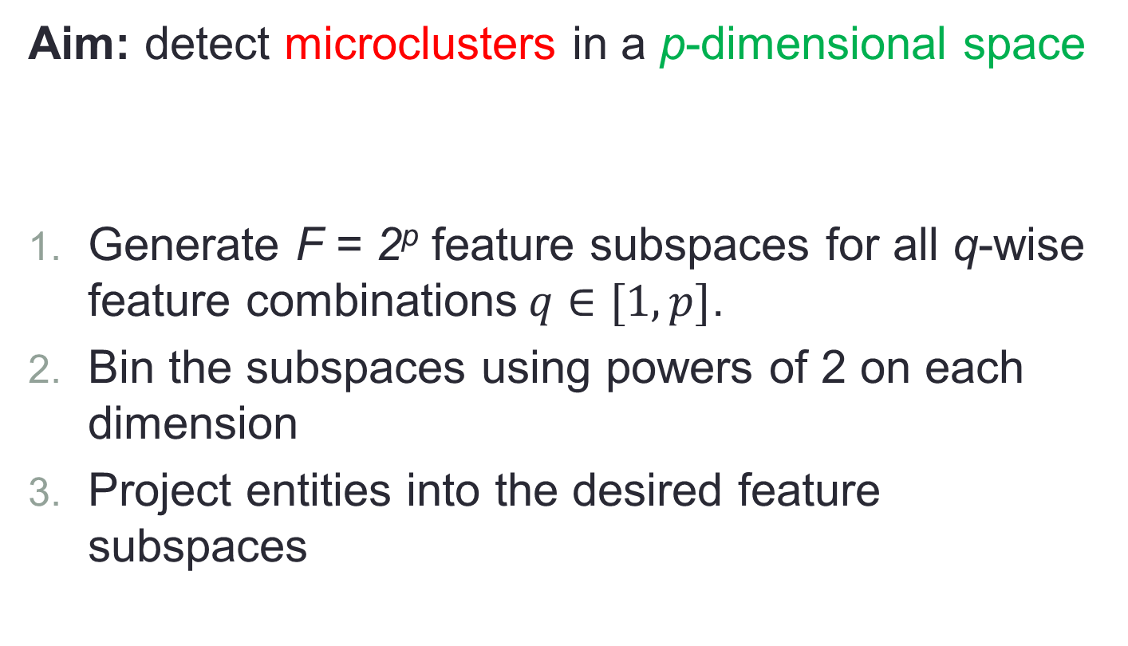
ND-SYNC: Feature subspace sweeping
Aim: detect microclusters in a p-dimensional space
Generate F = 2^{p} feature subspaces for all q-wise feature combinations$q∈[1,p]$.
Bin the subspaces using powers of 2 on each dimension
Project entities into the desired feature subspaces
sign of synchronicity
all, for simplicity

Slide 15
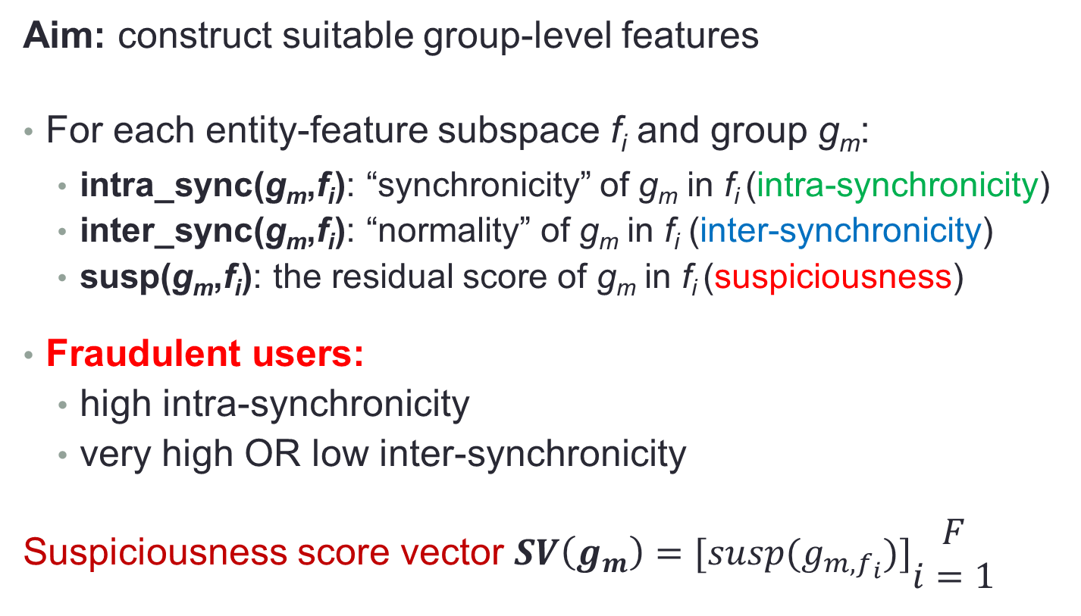
ND-SYNC: Group scoring
Aim: construct suitable group-level features
For each entity-feature subspace f_{i} and group g_{m}:
intra_sync(g_{m},f_{i}): “synchronicity” of g_{m} in f_{i} (intra-synchronicity)
inter_sync(g_{m},f_{i}): “normality” of g_{m} in f_{i} (inter-synchronicity)
susp(g_{m},f_{i}): the residual score of g_{m} in f_{i} (suspiciousness)
Fraudulent users:
high intra-synchronicity
very high OR low inter-synchronicity
Suspiciousness score vector $SV\left(g_{m}\right)=[susp(g_{m,f_{i}})]\begin{aligned}F \\ i=1\end{aligned}$

Slide 16
ND-SYNC: Multivariate outlier detection
Aim: given the suspiciousness score vectors identify the suspicious groups
Apply ROBPCA-AO for I iterations and find outliers
Flag a group as suspicious based on majority vote over all iterations.
To eliminate parameters
automatic selection of dimensionality k via 95% cumulative variance explained criterion heuristic
use of all entities for estimating the robust feature subspaces

Slide 17
Outline
Background
Problem definition
Proposed approach
ND-SYNC pipeline
Features for retweet threads
Experiments
Dataset
Results
Conclusions

Slide 18

Features for retweet threads
Retweets: # retweets
Response time: tweet’s posting first retweet
Lifespan: first last (observed) retweet constrained to 3 weeks
RT-Q3 response time: tweet’s posting first ¾ of retweets
RT-Q2 response time: tweet’s posting first ½ of retweets
Arr-MAD: mean absolute deviation of RTs inter-arrival times
Arr-IQR: inter-quartile range of RTs inter-arrival times

Slide 19
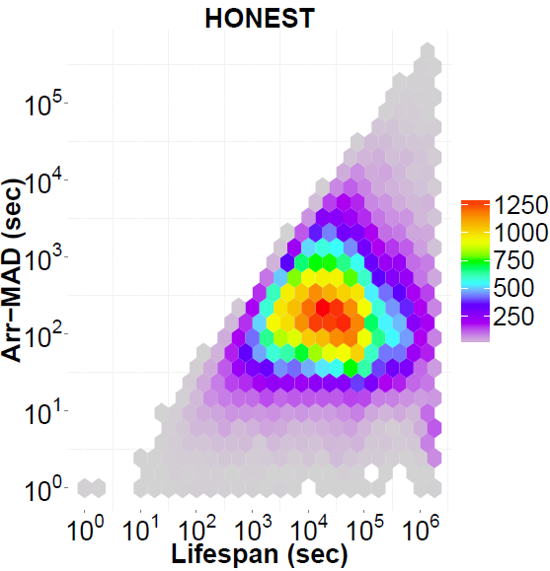
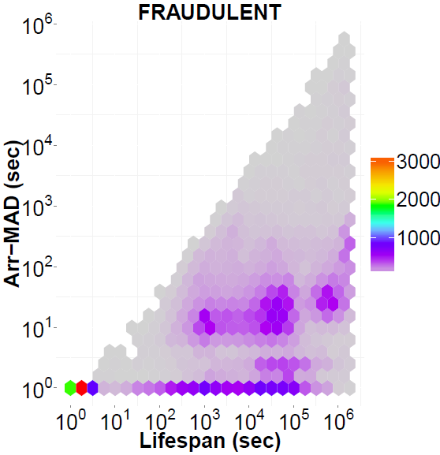
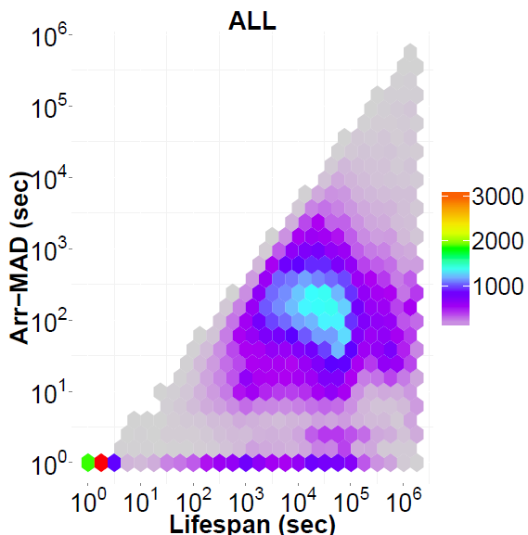
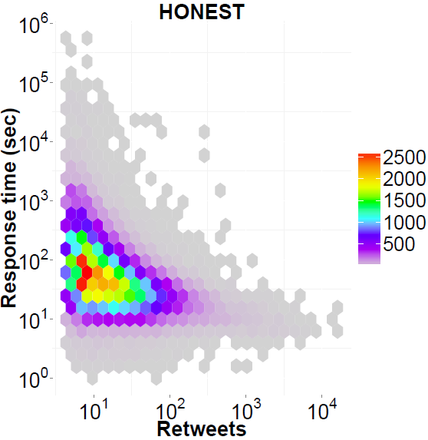
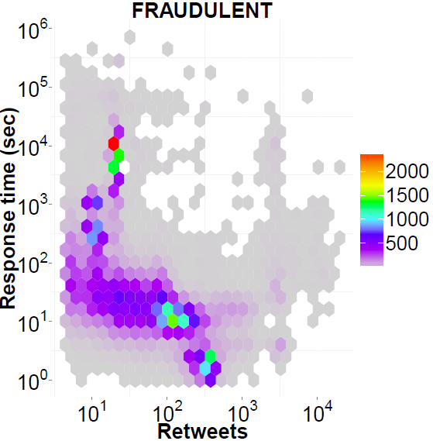
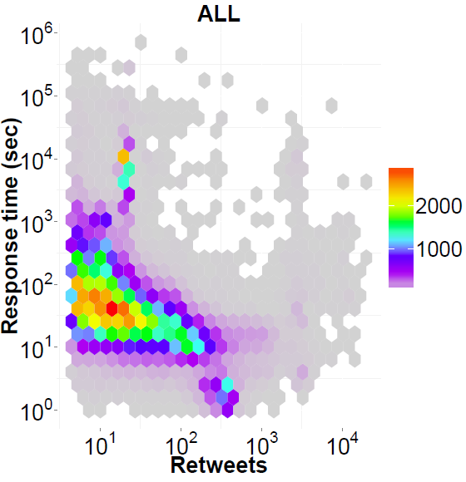
Microclusters of fraudulent retweet threads
2D feature subspaces
high synchronicity for RTFraudsters

Slide 20
Outline
Background
Problem definition
Proposed approach
ND-SYNC pipeline
Features for retweet threads
Experiments
Dataset
Results
Conclusions

Slide 21
Dataset generation
Selection of target users (both honest and fraudulent)
users with the most retweeted tweets and heavy use of spammy keywords (casino, buy, followback, etc) in a 2-day Twitter sample
active (frequent tweets) and popular (> 100 retweets) users (http://twittercounter.com/)
topic experts (European affairs and Automobile), based on Twitter lists
Target users tracked for 2-6 months (all tweets & their retweets)
Pruned “unpopular” users (all retweet threads < 50 retweet or fewer than 20)

Slide 22
Dataset overview
User categorization
28 fraudulent: tweets with spammy links and terms, repetitive promotions; fabricated profiles
278 honest
Type | #Retweet threads | #Retweets
honest | 83,587 | 2,939,455
fraudulent | 50,435 | 8,787,803
BOTH | 134,022 | 11,727,258
(Available at http://oswinds.csd.auth.gr/project/NDSYNC)

Slide 23
Outline
Background
Problem definition
Proposed approach
ND-SYNC pipeline
Features for retweet threads
Experiments
Dataset
Results
Conclusions

Slide 24
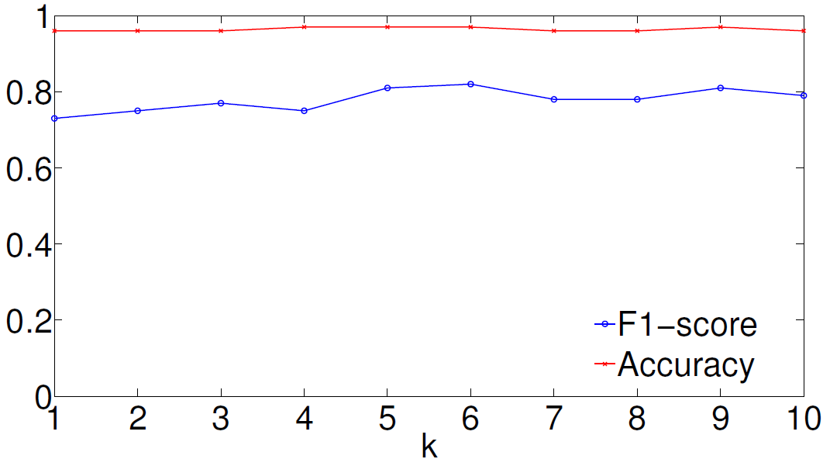
ND-SYNC effectiveness & robustness
97% accuracy
0.82 F1-score
Highly accurate and robust to the selection of k
Best performance at k = 6 (selected with the 95% cumulative variance explained criterion)
Only 1% decrease in F1-score using just 2D feature subspaces

Slide 25
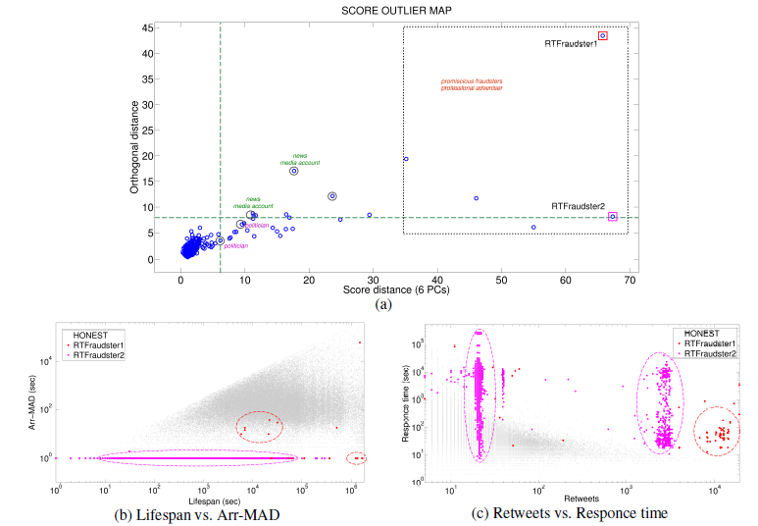
Detected outliers
professional promoters
promiscuous
65 retweet threads
in 4 months
80% > 1K retweets
60% > 10K retweets
news media
account
news media
account
politician

Slide 26
Outline
Background
Problem definition
Proposed approach
ND-SYNC pipeline
Features for retweet threads
Experiments
Dataset
Results
Conclusions

Slide 27
Conclusions
G1. Design a general, effective approach for collective anomalies detection
ND-SYNC is a general, effective pipeline, which automatically detects group anomalies
G2. Customize it for Retweet Fraud detection
Carefully designed set of features for the retweet fraud case
G3. Find features that will assist spotting fraudsters from honest users
ND-SYNC achieves 97% accuracy in distinguishing fraudulent from honest users on real Twitter data

Slide 28

Questions?
Download dataset at:
http://oswinds.csd.auth.gr/project/NDSYNC

